Slide 1
Improving food security and market price information systems in Myanmar
Presentation to the Information Management Network
August 4, 2013

Slide 2
Previous Food Security Information in Myanmar
Scattered food security information
Comparability concerns
Low understanding of seasonal fluctuations
Limited usage for programmatic purposes
Notes:
In Myanmar, WFP has for long been the main provider of information on food security, food prices and household purchasing power. This was done on a regular basis through several vulnerability and market assessments conducted by WFP.
WFP has been the most reliable and regular source of food security and vulnerability information. This helped informing the program work of WFP and other stakeholders but also provided the evidence base for policy formulations on how to best tackle the issue of food insecurity in Myanmar.
However, this was mainly restricted to WFP operational areas. When available, the information on the food security situation was geographically scattered. Multiple indicators were collected with little regard to seasonality. This resulted in issues of comparability but also hindered understanding of seasonal vulnerability fluctuations.
Overall this impacted the usefulness of such information for programmatic purposes.
Despite this central role as an information provider to partners and donors in the country, WFP also recognized the need, as a service provider, to build on its expertise to better serve stakeholders and beneficiaries in Myanmar.
This is why WFP decided to create a stronger, integrated and comprehensive information system that will provide the required large scale, evidence base, information to design the most appropriate responses to food insecurity in Myanmar.

Slide 3
The FSIN
Funded by the Livelihoods and Food Security Trust Fund (LIFT)
Created to facilitate information flow from field level actors to decision-makers in Yangon and Nay Pyi Taw
Provide evidence based information for better programming
Links well with other regional or global initiatives to improve information systems
Notes:
For this, WFP received funding from the Livelihoods and Food Security Trust Fund (LIFT) to initiate its project of improved food security and market prices information in Myanmar. This is a 3 years project that was initiated in February last year.
The project rapidly led to the creation of the Food Security Information Network, the FSIN. The FSIN is a network of key food security information managers from leading agencies in Food Security in the country. The network was made of 12 members in 2012 and is growing in 2013 with new members joining.
The FSIN was created to facilitate information flow from field level actors to decision-makers in Yangon and Nay Pyi Taw.
This is to ensure that food security programming and eventually policy making integrates quality and updated information from the field.
Overall the project links well with the objectives of the global FSIN initiative, recently launched by WFP, FAO and other partners, and that aims at connecting information systems and improving food security analysis and decision making.

Slide 4
Food Security Information Network
The FSIN is a network of technical experts and information managers from key food security stakeholders.
Objective:
Improve food security information systems to provide quality information for Action
Linking expertise between national, regional and local levels

Slide 5
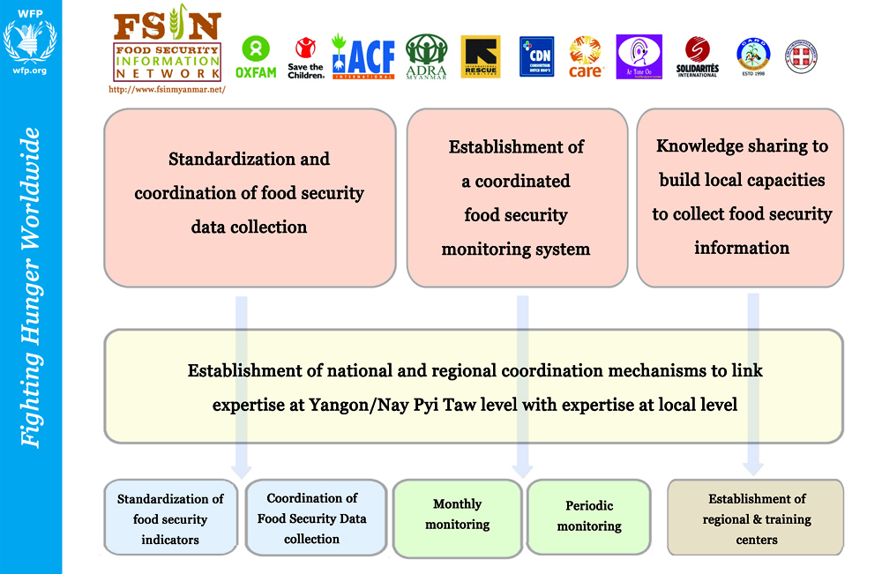
Notes:
To reach the overall objective of facilitating information flow, our project in Myanmar has three main objectives, :
to better standardize and coordinate assessment activities;
2) to manage a coordinated food security monitoring system and
3) to build capacities of actors in the food security sector (including Govt—most importantly) in order to maximize the quality of food security information available.

Slide 6
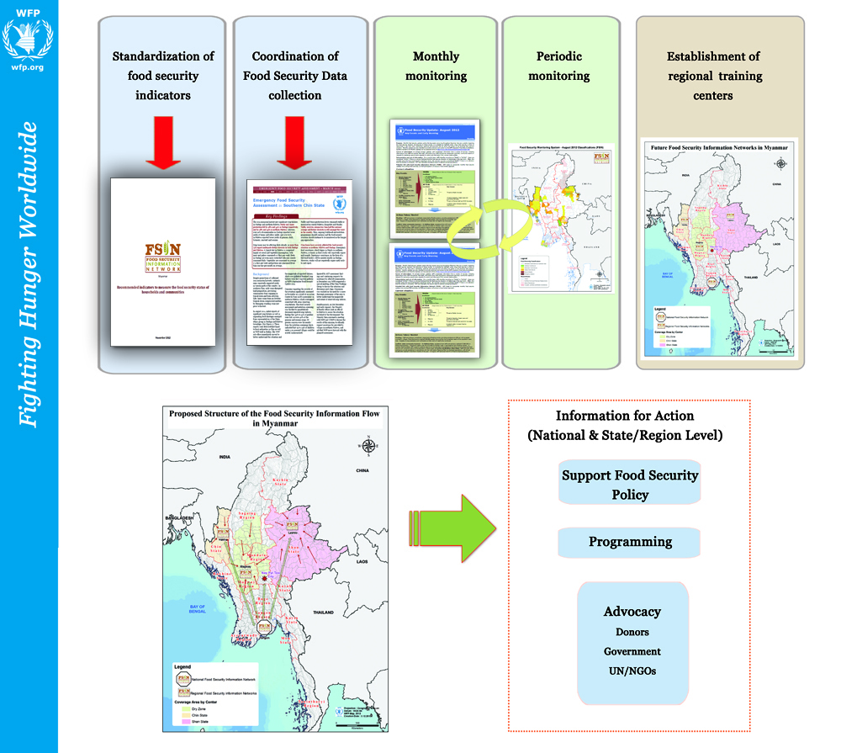
Notes:
The standardization and coordinating of food security data collection activities have several components:
The first component is about the development of an agreed upon set of indicators required to assess food insecurity. This intends to create a minimum package of food security indicators building on efforts in HQ to define food insecurity. As an example, we recently conducted workshops in the 3 different areas of the country, gathering in total close to 100 field staff, to define a Myanmar specific coping mechanisms index. This offers high potentialities to better assess vulnerabilities in the future and take regional specificities into account. We also developed a document with the recommended indicators to be used in the country to assess food security. This document will be regularly updated.
2) The second component relates to the creation of agreed-upon set of emergency assessment tools, focusing on rapid assessment activities.
3) Finally, the last component aims at maintaining rosters of trained partners willing to engage in assessment activities if needs arise.
This comes from learning from experiences in Pakistan where, with such rosters, WFP and partners were able to assess more than 11,000 villages in less than a week after the floods in 2010.

Slide 7
The FSIN is NOT ONLY about Food Security Monitoring

Slide 8
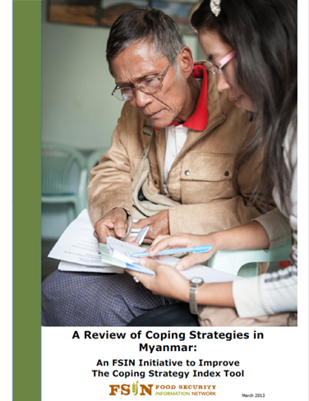
Standardization of indicators
Review indicators used in the country
Discuss and select key indicators to be used in surveys (workshop)
Develop methodology documents on the use of the indicators
Test the use of the indicators
Frequent review and update
Notes:
The food security monitoring system is a first-of-its kind system in Myanmar.
It includes a light monthly monitoring system and a more in-depth periodic monitoring, conducted 3 times a year.
The monitoring is conducted by WFP and the other members of the FSIN, in a synchronized and harmonized way.
It currently covers 50 townships in 2012 and should cover 80 in 2013 with new members joining for South Eastern part of the country.
Mobile technologies are currently being introduced to increase the efficiency of the monitoring. This should also support a rapid expansion of the coverage.
Eventually, the FSIN should be able to cover up to 55% of the rural townships of the country.
This monitoring offers obvious links with the IPC. We are linking with the IPC regional team to be ready to move towards a more IPC like process when the context and information base in Myanmar is more suitable.
Outputs of the monitoring include food security classifications, maps, bulletins and monthly updates.

Slide 9
Coordination of food security data collection
Emergency & rapid emergency assessment methods and tools
Emergency rosters:
Lists of available actors
Trained teams
Available assessment tools
Coordinate and exchange information
Notes:
The food security monitoring system is a first-of-its kind system in Myanmar.
It includes a light monthly monitoring system and a more in-depth periodic monitoring, conducted 3 times a year.
The monitoring is conducted by WFP and the other members of the FSIN, in a synchronized and harmonized way.
It currently covers 50 townships in 2012 and should cover 80 in 2013 with new members joining for South Eastern part of the country.
Mobile technologies are currently being introduced to increase the efficiency of the monitoring. This should also support a rapid expansion of the coverage.
Eventually, the FSIN should be able to cover up to 55% of the rural townships of the country.
This monitoring offers obvious links with the IPC. We are linking with the IPC regional team to be ready to move towards a more IPC like process when the context and information base in Myanmar is more suitable.
Outputs of the monitoring include food security classifications, maps, bulletins and monthly updates.

Slide 10
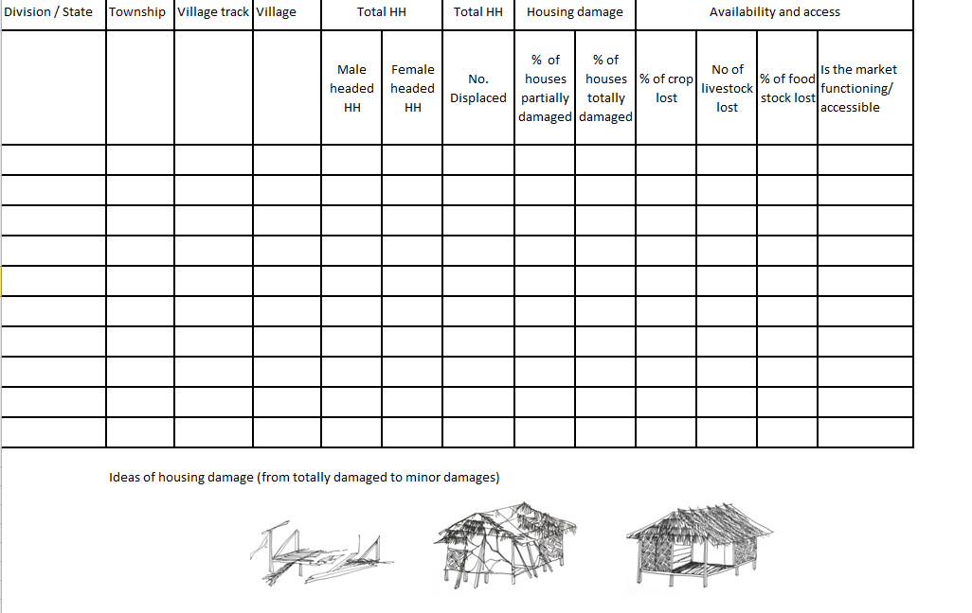

Slide 11
What is food security monitoring?
Food Security Monitoring System
Collection of food security data at set intervals, describing the severity and extent of food insecurity
Why food security monitoring?
Comprehensive food security assessments can be complicated, expensive, time-consuming…
Provide regular information to inform stakeholder programming/ resource allocation
Can function as an early warning system, through early detection of impending food security deteriorations
Can trigger and rationalize the need for additional more complete food security assessments

Slide 12
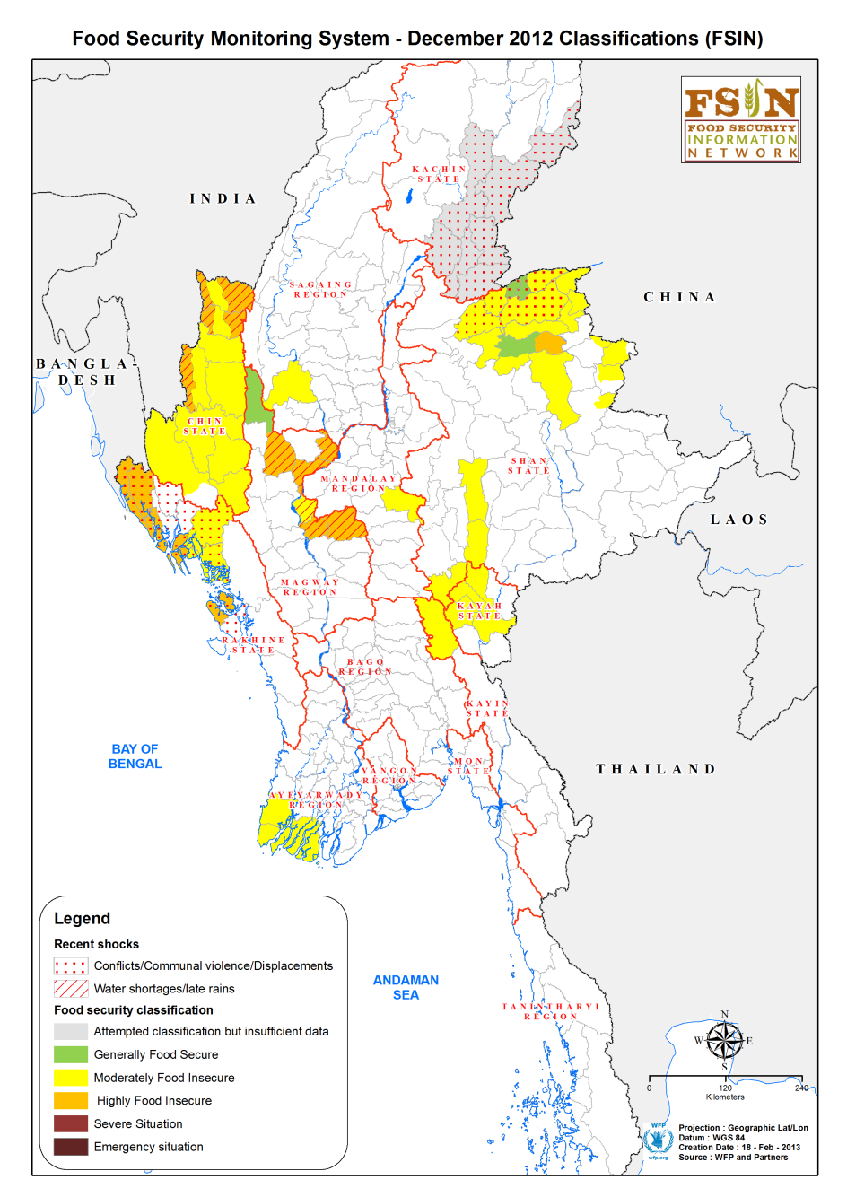
Food Security Monitoring System
The first of its kind in Myanmar
Monthly and periodic monitoring
Currently covers close to 70 townships
More than 30% of rural townships
19 agencies involved
Expanding
Introduction of mobile technologies
Market monitoring
Notes:
The food security monitoring system is a first-of-its kind system in Myanmar.
It includes a light monthly monitoring system and a more in-depth periodic monitoring, conducted 3 times a year.
The monitoring is conducted by WFP and the other members of the FSIN, in a synchronized and harmonized way.
It currently covers 50 townships in 2012 and should cover 80 in 2013 with new members joining for South Eastern part of the country.
Mobile technologies are currently being introduced to increase the efficiency of the monitoring. This should also support a rapid expansion of the coverage.
Eventually, the FSIN should be able to cover up to 55% of the rural townships of the country.
This monitoring offers obvious links with the IPC. We are linking with the IPC regional team to be ready to move towards a more IPC like process when the context and information base in Myanmar is more suitable.
Outputs of the monitoring include food security classifications, maps, bulletins and monthly updates.

Slide 13
2 main components of the food security monitoring
Periodic monitoring:
sentinel sites data collection
HH information
Village information
done in areas/townships where members are active
3 times a year (Pre-monsoon, monsoon, post-monsoon)
Limited number of indicators (key indicators)
Leads to food security classifications
Monthly monitoring: “light monitoring”
Local context review
Compilation of information from different sources
No classification but informs the periodic classifications

Slide 14
The periodic monitoring tools
Village questionnaire: 6 villages per Townships (sentinel sites)
Village demography
Productive assets ownership & housing
Drinking water and sanitation
Access to market
Household questionnaire: 7HH / village (random selection)
HH composition
Food Consumption (one week recall)
Staple food Stock
Household Hunger Scale
Coping mechanism (CSI)
Main income sources and last month income
Migration (seasonal)
Rice prices
Poverty score card (once a year)

Slide 15
The analytical framework
The key document framing the analysis of the data
Is based on key indicators
Helps review the information generated (primary & secondary)
Helps deciding on the food security status at township level

Slide 16
Reference Indicators |  | Phase 1 | Phase 2 | Phase 3 | Phase 4 | Phase 5
 |  | Generally food secure | Moderately food secure | Highly food insecure | Severe Situation | Emergency
Food Availability | Crop production | <10% loss | 10-40% loss | 40-70% loss | 70-90% loss | >90% loss
 | HH food stocks | >3 months stock | 2- 3 months of stock | 1-2 months of stock | <1 months of stock | Stocks depleted
 | Market stocks | Stocks are at normal level (reserve levels are good/ supply is sufficient to meet demand) | Stocks are reducing but still sufficient to meet demand | Low stock levels that are only partially able to meet demand | Stocks depleted but market is still functioning | Stocks depleted and markets not functioning
Food Access | Ability of HHs to purchase basic food basket | <40% of income required to purchase basic food basket | 40-60% of income required to purchase basic food basket | 61-75% of income required to purchase basic food basket | 76-100% of income required to purchase basic food basket | >100% of income required to purchase basic food basket
 | Diet adequacy | <20% of households report inadequate food consumption | 20-40% report inadequate food consumption | 40-60% report inadequate food consumption | 60-90% report inadequate food consumption | >90% report inadequate food consumption
 | Hunger | <5% report moderate or severe hunger | 5-20% report moderate or severe hunger | 20-40% report moderate or severe hunger | 40-70% report moderate or severe hunger | >70% report moderate or severe hunger
Food Utilization | Acute malnutrition | <5% | 5-10% | 10-15% | 15-25% | >25%
 | Disease | No significant outbreaks or only localized (<10% of villages impacted) | Generalized outbreaks (10-40% of villages impacted) | Widespread outbreaks (40-70% of villages impacted) | Severe outbreaks (>70% of villages impacted) but limited mortality | Severe outbreaks (>70% of villages impacted) with high mortality
Other indicators/ determinants of household food security | Natural disasters | No natural disaster or occurrence causing <10% asset loss | Occurrence of natural disaster causing 10-40% loss | Occurrence of natural disasters causing 40-70% loss | Occurrence of natural disaster causing 70-90% loss | Occurrence of natural disaster causing >90% loss
 | Migration | <10% increase in normal seasonal migration | 10-40% increase in traditional seasonal migration | 40-70% increase in traditional seasonal migration | 70-90% increase in traditional seasonal migration | >90% increase in traditional seasonal migration
 | Coping | <5% reporting more than daily usage of food-based coping mechanisms | 5-20% reporting more than daily usage of food-based coping mechanisms | 20-40% reporting more than daily usage of food-based coping mechanisms | 40-70% reporting more than daily usage of food-based coping mechanisms | >70% reporting more than daily usage of food-based coping mechanisms
The analytical framework

Slide 17
How is the analysis conducted?
Workshops/discussion around the results of data analysis
Integration of secondary sources of information:
Field staff knowledge/field observations
Projects information
Monthly monitoring information
Government information
Other surveys results…
Review of food security classifications
Outputs
Mapping
Reporting and sharing of data
Presentation of results and discussions

Slide 18
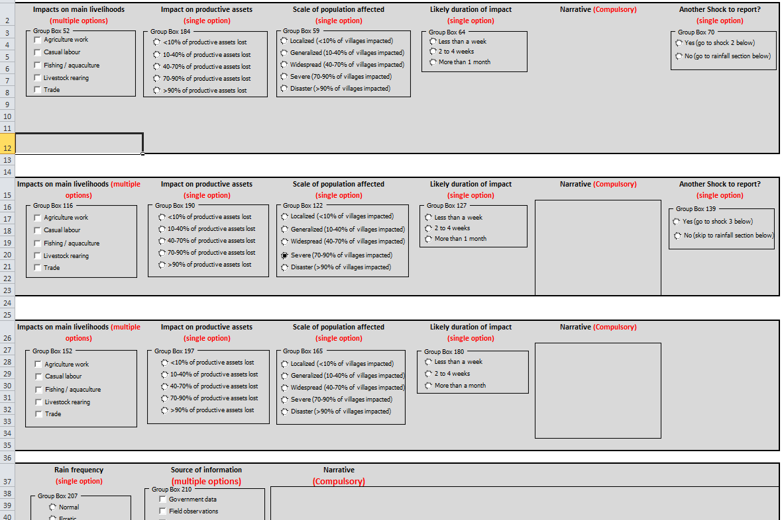
The monthly monitoring
“Light” exercise
Mainly qualitative: Observations, Secondary data & information mainly
Continuous monthly process
Includes market monitoring
Outputs:
FS Monthly updates
FS quarterly updates

Slide 19
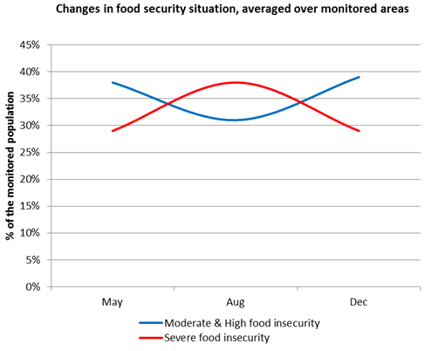
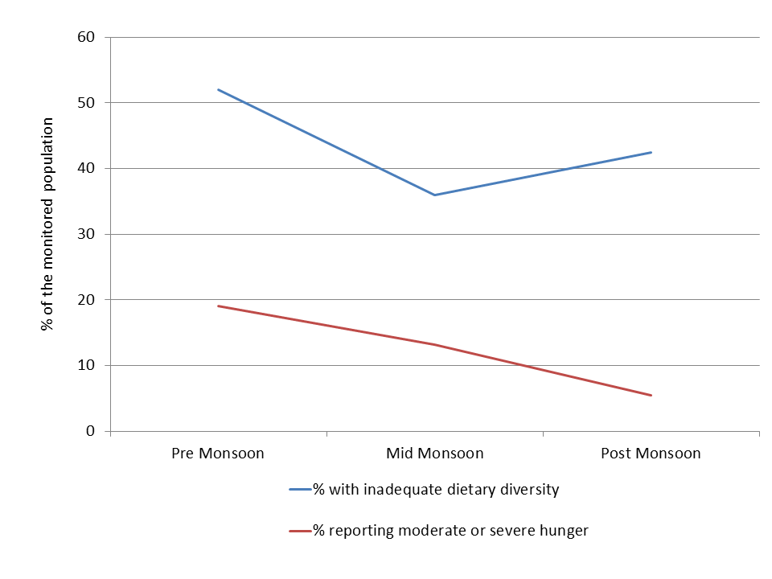
Outputs
Monthly updates
Periodic bulletins
Vulnerability maps
Trends

Slide 20
Transfer capacities
A critical component
Transfer of knowledge and technologies
To field staff (INGOs, NGOs and CBOs)
Government staff: local level, Nay Pi Taw
Settlement of regional resource centers
Provision of proper equipment
Trainings & workshops
Local programmatic coordination and engagement with Government
One center opened in Hakha
One center to be opened at Yezin University in Magway
Notes:
The capacity building component is the most critical part of our activities in the country.
Engagement and transfer of capacities to relevant local ministries have been extremely limited in the past.
However the current transition offers clear opportunity of productive engagement, with technical department staff, especially at local levels.
Through the FSIN, WFP is transferring knowledge and technologies from Yangon to WFP field staff, partners field staff and local government staff.
To do so, we are establishing regional resource centers.
These resources centers will be extensions of the current network, but located in the field, close to the operations.
The centres will be located in some of the most remote parts of the county to increase access to appropriate resources for local actors, often isolated from main coordination structures.
The centers will be equipped with computers (that include several open-sourced data analysis & GIS softwares), GPS devices and mobile technologies (tablets).
Our staff will be providing a set of trainings in these areas to ensure these equipment & technologies are used appropriately.
Being opened to all food security stakeholders, these resource centers will also provide an ideal platform to conduct trainings, workshops and improve local programmatic coordination.

Slide 21
Information sharing
Development of an interactive website
Dynamic mapping of monitoring information
Climate information
Market information
Download data
Real-time information sharing (audio podcasts)
Assessments and surveys reports
Newsletters
Support programming and decision making
Notes:
Finally, one key part of our work is to share the information among the FSIN members, other agencies, donors, Govt.
To do so we are currently building an attractive interactive website. The Website will have dynamic mapping, through which users will be able to visualize the information collected through the monitoring system.
On top of the traditional survey and assessment reports, the website will also provide climate information and an audio podcast functionality to enable real time information sharing.
Overall the users and FSIN members will be able to select the information they want to access.

Slide 22
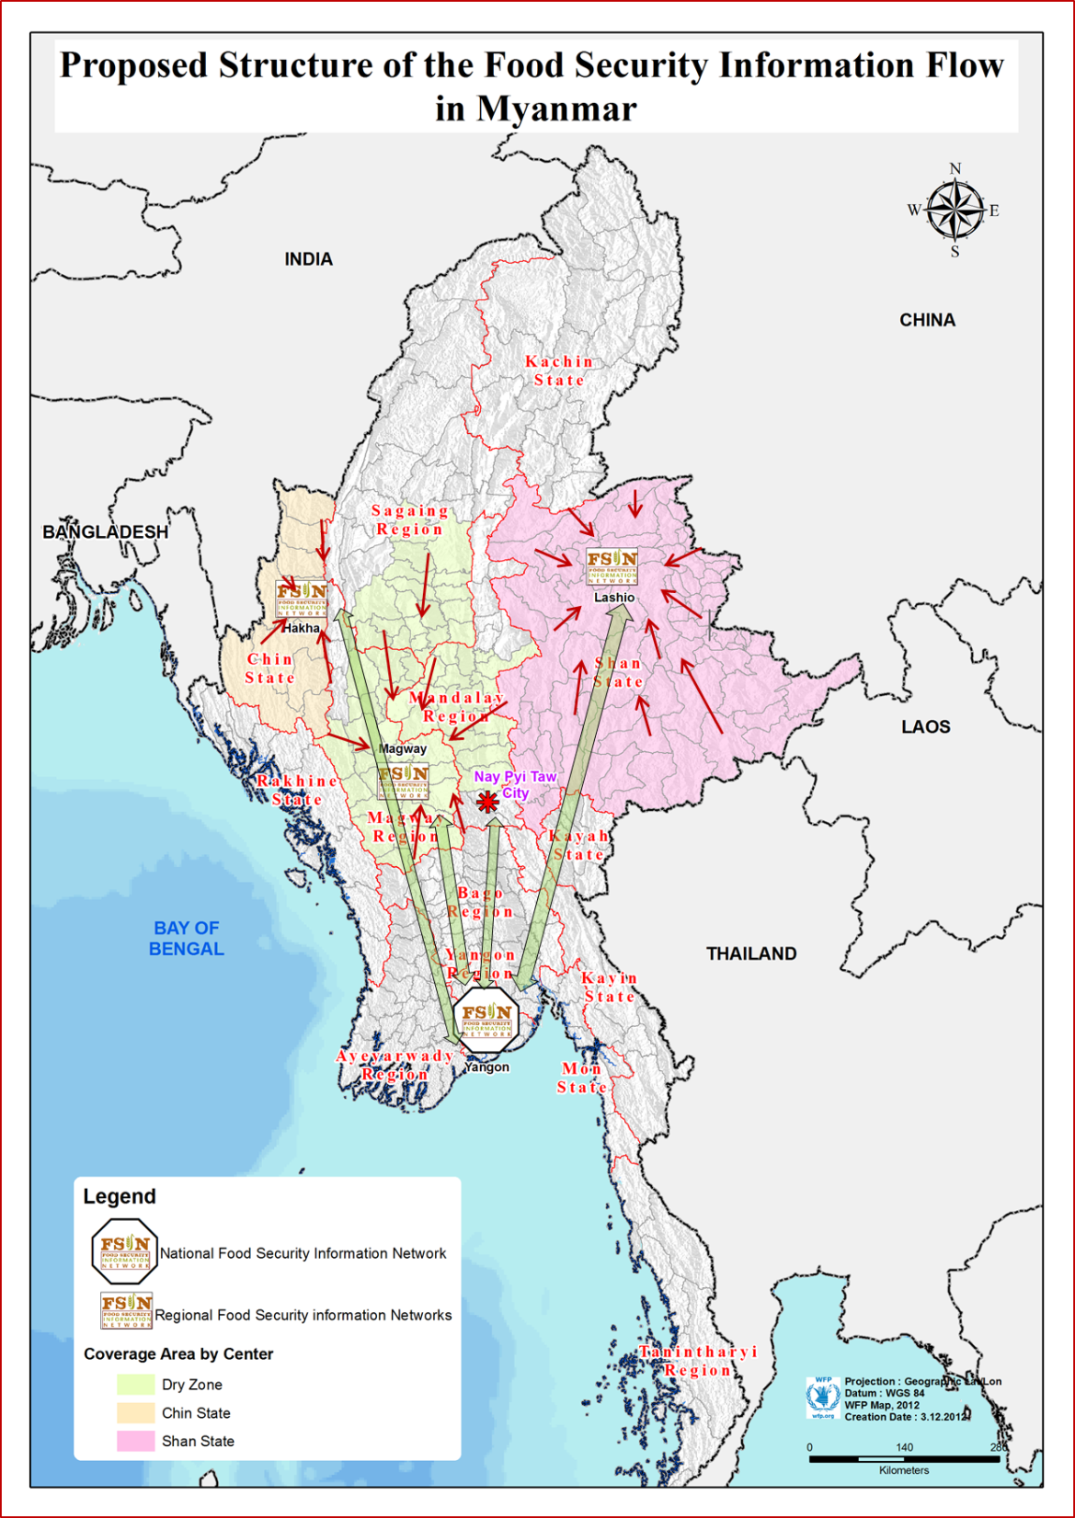

Slide 23
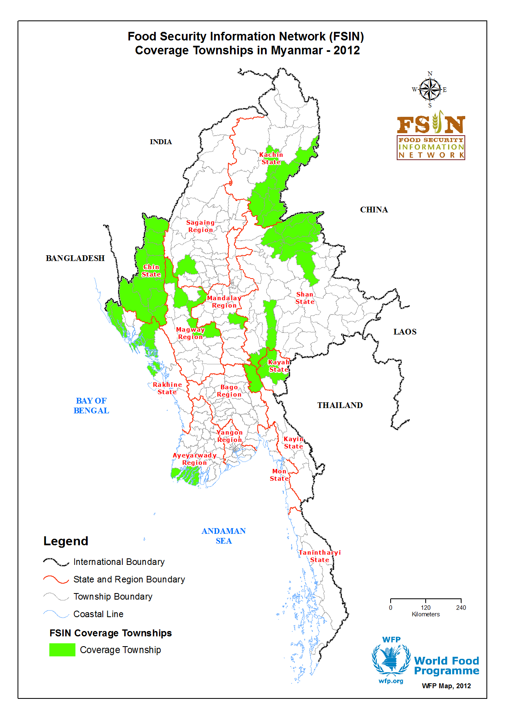
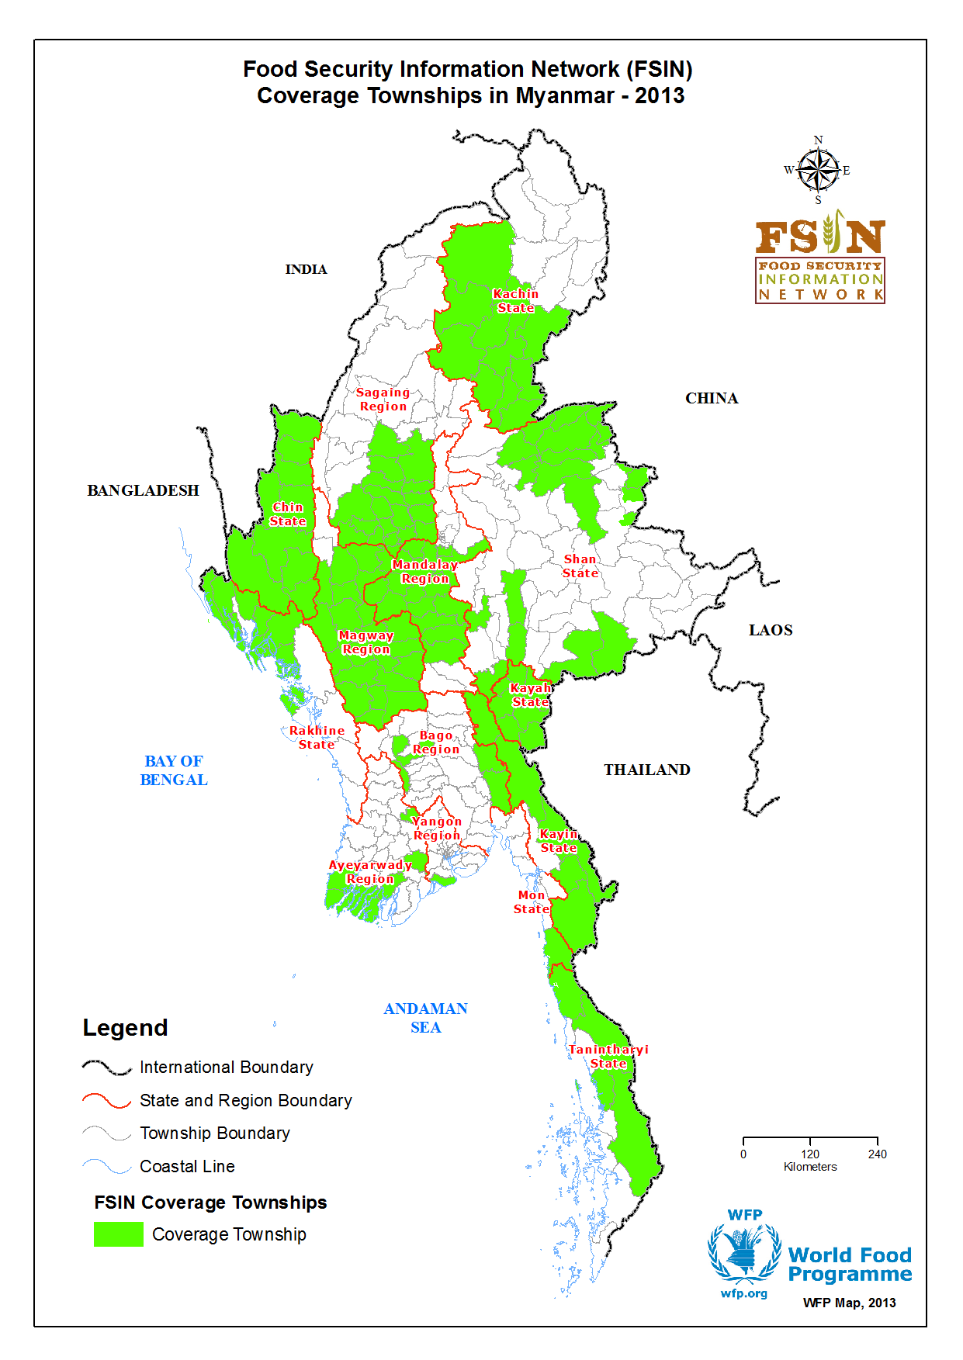

Slide 24
Some challenges
A lot to build
Engagement with the government
a long process
Requires changes in working habits
The continuity in the system will depend on its users
Notes:
After one year of implementation, the project shows good progress. The participation in the monitoring is high and effective, one resource center was opened, overall coordination starts to yield in term of standardization of activities.
However, as for any project, we are also facing some challenges.
There is a lot to build, there are a lot of gaps to fill in term of information and capacities.
The engagement of the government, a key factor of sustainability, will obviously be a long process and also requires changing somehow our working habits.
The coming 2 years will then be crucial to determine how best this transfer can happen.

Slide 25
Questions?
Thank you

