Slide 1
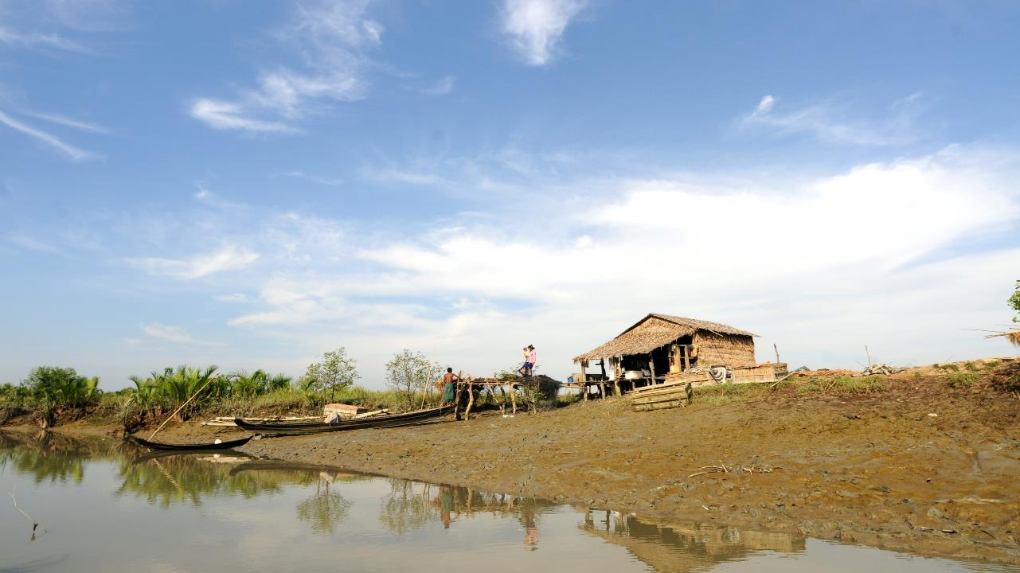
BRACED Myanmar Alliance:
‘DRRWG Hand over and De-Brief’
BRACED Myanmar Alliance
Rose Garden Hotel 23rd February

Slide 2
Outline of De-Brief
Review of BRACED Alliance Activities and programme
BRACED Results Evidence and Learning
Lessons and Recommendations
Future of Resilience discussion, Feedback & Questions

Slide 3
Resilience is a mixture of skills, capacities and resources to be able to anticipate and adapt to changing conditions and absorb shocks and stresses to be able to achieve development plans and objectives.
Notes:
BRACED Myanmar works through model of:
Community action activate community bodies to better understand and manage disaster climate and environmental risks, to support more sustainable, community-development. BRACED empowers communities and especially vulnerable groups to take ownership over resilience planning
Support institutional understanding and management of climate risk, to drive increased responsiveness local institutions mostly township government departments
Advocate for scale-up and replication of resilient practices through generation of evidence, lessons and learning of good practice on the ground to inform international, national and local policies and practices.

Slide 4
BRACED Resilience Activities
Community Resilience Assessment and action planning across different climatic and geographic zones (155 villages)
addressing a variety of different shocks and stresses

Slide 5
Outputs
WORK PACKAGES
OUTPUT 1, Communities skills, knowledge and capacities to uptake resilience activities and practices.
Community Resilience Assessments, action plans development
Financial services: SHGs/Microfinance/VSLAs
Inclusion: Women's empowerment + Child centered resilience
Communicating resilience and risk information
Output 2: Institutional support at Township level
Township planning for Resilience including TDMPs +TEMPS
Fostering networks and sharing between government, communities and projects
Access to scientific CC and weather information and transfer of Capacity and skills development
OUTPUT 3: Knowledge development, Governance and advocacy nationally
Research, learning and consolidating evidence
Advocacy and sharing events to encourage uptake of BRACED resilience approaches and activities into policy strategies and wider projects.

Slide 6
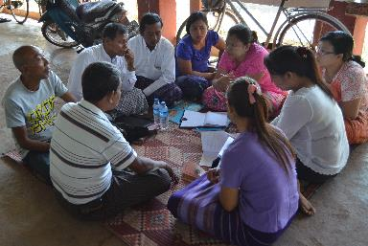
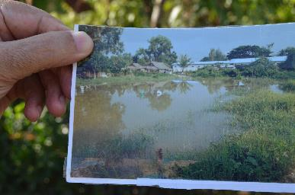
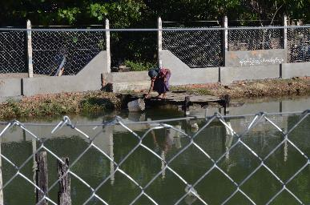
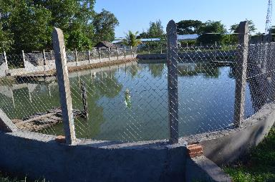
Total benefited: 548,373
155 CRAs
8 TEMPs
87 VSLAs & SHGs
1,198 MF clients
28 Resilience PSAs
24 Monsoon forums
8 TDMPs
182 CRA Grants
BRACED Key Outputs:

Slide 7
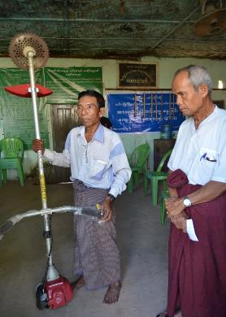
BRACED projects - Mawlamyine
Experienced Hazards: Annual flooding leading to disruption of community services (Water/food/health/education services), Increase in snake bite, Increase incidents of fire in the dry season and water scarcity/water pond pollution
Resilience Solutions: Water pond protection, Canoes, Grass cutter, Community services: VSLA’s, Microfinance, Establishment of CBOs, carpenters training, mobile fire fighting equipment
Notes:
The Zeyar Thiri Villagers reported that a single household in the village spends up to 9,000 Burmese Kyats per month (around USD 7) for clean drinking water during the 6 monsoon months every year. The renovation of the water pond is expected to significantly reduce expenditure for drinking water during the next flooding period.

Slide 8
Results Evidence and Learning

Slide 9
Levels of evidence – BRACED Myanmar
Blind randomized case
control trials
Evidence ++++++
Randomized case control trials
Evidence +++++
Climate Asia Survey
Randomized survey
Evidence +++
Baseline, midline and end line HH Surveys and township/institutional scorecards
Thematic research – women's empowerment, microfinance impact study, decentralised governance
Selected interviews
Evidence +
Qualitative mid and end line evaluations
Climate and weather information – Climate profiles,
Anecdotal case studies
Anecdote
Evidence –

Slide 10
Measurement & Evaluation Tools and Methods
Quasi experimental approach – baseline & end line
Institutional and community scorecards
Qualitative mid term review and final evaluation
Composite index of resilience
Most significant change case studies

Slide 11
BRACED Research and reports

Slide 12
Qualitative Evaluation Criteria | Unsatisfactory | Poor | Satisfactory | Good | Excellent | Explanation
Relevance |  |  |  | ✓ |  | BRACED was in line with organisational strategic plans and was well aligned to the priorities of the target groups
Effectiveness |  |  |  | ✓ |  | The project achieved all of its objectives at output level, but had mixed results at outcome level. composite resilience scores at household level showed increase in resilience scores in target communities (21% to 26%) verses non-target communities (17% to 20%). This equates to a 24% increase in overall resilience in target communities
Efficiency |  | ✓ |  |  |  | Cost efficiency the project did well, rationale for awarding a ‘poor’ score centers on the weaknesses in application of best practices in terms of systematic technical supervision of infrastructure. Significant challenges, both internal and external, which influenced the decisions made included slow start up, high staff turnover internally and within target institutions and huge demands in terms of monitoring and evaluation from the FM and donor
Sustainability |  |  | ✓ |  |  | Sustainability in a 3year project always a challenge. The CRA process was very good and has resulted in a significant number of proposals being submitted by communities on their own. The inclusion of proposal writing training was commended by evaluator. Institutionalisation: unlikely that these institutions will continue with interventions in which they see real benefit (such as the Monsoon Forums) without external support in the future
Impact |  |  |  | ✓ |  | The impact of the project has been good. There is much stronger coordination between township institutions and communities as evidenced by the funding of community priorities through state budgeting structures. The widespread uptake in accessing weather forecasting information and in the institutionalisation of the Early Warning System will continue to grow and impact on households and institutions at all levels of society. The effect on township level institutions has been good so far, but with the high levels of turnover in the public service it is not clear if this will be sustained into the future
Overall Score |  |  |  | ✓

Slide 13
Resilience Measurement: Composite Index of resilience

Slide 14
Overall Changes in Composite Index of Resilience
Treatment communities had higher average resilience scores at baseline across all of the KPI domains and within nearly all of the townships.
Headline findings - The overall KPI resilience measure increased significantly more (p<0.001) in treatment sites relative to control sites

Slide 15
Dimension of Resilience that have improved
Dimensions of Resilience | Explanations
Communication, Access and use of information | Reflecting the improvement of weather and risk information dissemination across the country with help of various agencies including BRACED and awareness raised among people on use of those information – more people are accessing and using weather and risk information
Decision making and planning | Reflecting greater involvement of women and children in community/community resilience planning – success of the community action planning model – but sustainable
Preparedness and coping mechanisms | Reflecting modest increases in treatment group access to plans, drill practice and being better prepared to cope with the last severe shock relative to a modest decline for the control group. Project community planning model has been able to secure increased engagement and action in this area from some Township administrations as well as modest increases in household preparedness – despite planning mandate & budget lying at higher levels.
Resilience system and livelihoods | Reflecting a decline for both treatment and control but a greater fall for control groups. Qualitative research indicates that when people were asked about access to basic services in the event of a future shock, they typically referred to massive shocks such as cyclone Nargis – beyond scope of BRACED

Slide 16
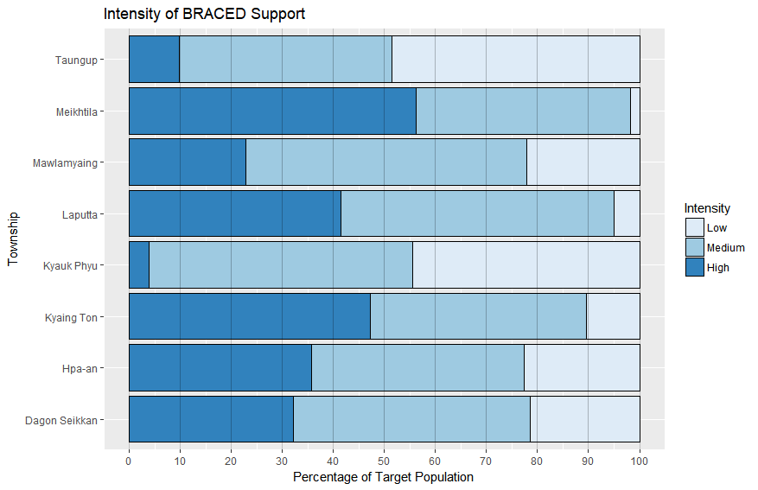
What types of Interventions have the Most Effect?
Need to investigate multi-collinearity before reporting impact by intervention type… at this stage we can say:
The more BRACED interventions received, the greater the increase in resilience (measured by KPI). KPI increase highest for 4+ interventions
Programme impact on KPI increases with the intensity of interventions received. But, – low intensity - those who are in the target area for the project but do not identify receiving any interventions, report declining resilience relative to the control group (p<0.05)

Slide 17
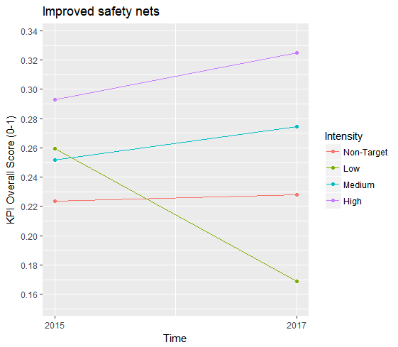
Why did Low Intensity Households do so Badly?
Decline relative to control is true for overall KPI, but mainly reflects the very poor relative performance of low intensity households in terms of improved safety nets:

Slide 18
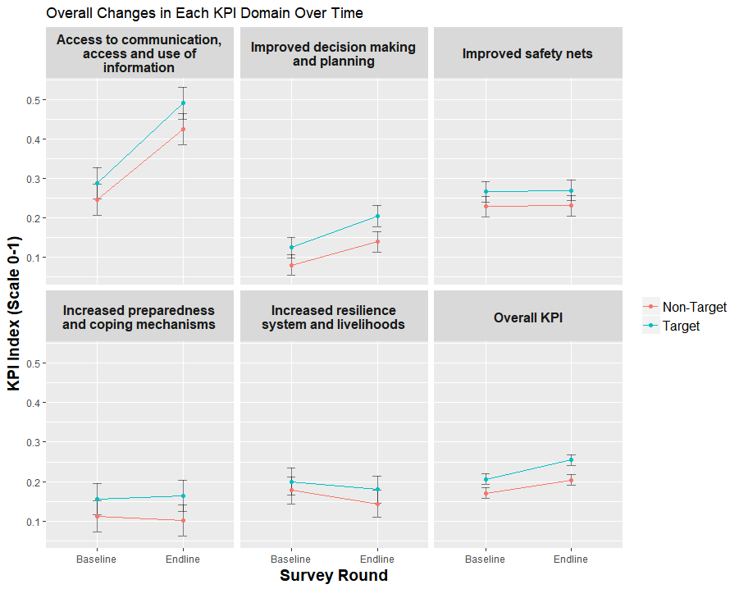
Overall Resilience Index Score
(%) | Target Areas |  | Non-Target Areas
 | Baseline | End line | Baseline | End line
Dagon Seikkan | 25 | 26 | 20 | 24
Hpa-an | 21 | 26 | 15 | 19
Kyaing Ton | 20 | 24 | 18 | 14
Kyauk Phyu | 18 | 26 | 15 | 23
Laputta | 23 | 27 | 18 | 20
Mawlamyaing | 23 | 23 | 18 | 22
Meikhtila | 15 | 25 | 15 | 20
Taungup | 23 | 27 | 19 | 21
Overall | 21 | 26 | 17 | 20
Dimension wise Progress on Compost Index of Resilience
% | Baseline | End line
Access to communication, access and use of information (20%) | 29 | 49
Improved decision making and planning (15%) | 12 | 20
Increased resilience system and livelihoods (30%) | 20 | 18
Increased preparedness and coping mechanisms (20%) | 16 | 17
Improved safety nets (15%) | 26 | 27

Slide 19
BRACED Lessons and Recommendations

Slide 20
Lessons: Building resilience
Community resilience needs to built over time and in phases. Community resilience begins with meeting immediate disaster resilience needs and only then do community members begin to identify and address issues that will take effect over a longer period.
Resilience can’t be built in one attempt, so sustained activities and interventions need to be implemented within communities building on new knowledge and information. This requires leadership and ownership by the community over their development activities and ongoing risk assessment.
The central issue of resilience is related to understanding uncertainty and being able to adapt to changing conditions. Many communities already have these skills but not always the information to understand risk and plan for future uncertainty. A good understanding of existing and anticipated shocks and stresses must be gathered early in a project

Slide 21
Lessons : Operationalising consortiums and working in partnerships
Collaboration and coordination are key to strengthening resilience. To address the multiple facets of resilience requires partnerships and collaboration between multi-disciplinary teams and agencies. A strong and effective working relationship takes time to build to ensure trust between all the partners and develop effective ways of working.
Whilst the consortium took considerable time to get operationalised, to start functioning as an Alliance, the results have shown significant value in working in partnership as opposed to individual agencies and over a longer period demonstrates better value for money.
High staff turnover both within implementing partners and government departments. We saw a 70% staff turnover within the Alliance members alone due to high demand for technical staff in the development sector and agencies and higher salary rates outside of NGO’s. This resulted in considerable resources targeted for training and retraining staff and partners which resulted in varied relationships with community members effecting buy in and ownership.

Slide 22
Lessons : Influencing Policies and strategies
BRACED had some success in engaging with decentralisation and the local planning process, but this has not been systematically integrated into longer term plans beyond the project. The top down nature of government means that even though the government is trying to decentralise decisions on resources are normaly made at the higher levels
Policy to practice: DRR and Climate Change policies and initiatives being developed but the knowledge and awareness of national policies on the ground is weak and – limited implementation of policies by the subnational level authorities.
Implementation of recommendations provided in research and through TDMP, TEMP and wider research under BRACED have been weak Government official showed interested in reports and expressed interest in integrating recommended activities into regional planning processes. lack of mandate and political will in local departments to implement such plans and a lack of capacity and resources
Significant transition of government staff was a serious challenge to institutionalization It is challenging to build lasting relationships and networks in some townships, to take ownership and longer term management of project activities.
Detailed technical information from local level project implementation doesn’t always feed up into national level national level consultation and engagement required to inform national decision makers however not just one off workshops needs strategic follow ups Strength in numbers to deliver advocacy messages and when representing in national forums and meeting eg National Joint Learning workshop with MCCA, MCCR and BRACED

Slide 23
Lessons :Climate and Disaster Coordination and communicating resilience
Need to foster better coordination between DRR and CC coordination mechanisms: multiple strategies and policies being developed in parallel related to DRR and climate change critical that platforms and mechanisms are designed to improve coordination between departments and implementation plans to avoid duplication of activities and plans and support streamlining of financing mechanisms for implementation.
Weather related information can be easily accessed through social media especially Facebook as was demonstrated during the 2015 floods, Government Departments disseminating through different channels such as TV/Radio broadcasts, but also, through social media and technical working groups. However, availability of climate information (longer term forecasts) is still limited especially at a local level.
To ensure the risk information is translated to action, the technical information need to be understood by the different stakeholders. different capacity needs for translating information at different level from national to subnational and at community level. Local language critical for application of risk information
Crucial to develop capacity of stakeholders who connect the different levels such as community leaders, regional officials, media personnel and private sector service providers who can help towards interpreting and disseminating the risk information to at risk communities.
Working with media is essential to multiply messages across the country and across audiences. Television, radio and written press all serve different purposes; Using mass media approach is effective to support the government policy and gives audiences important useful information so they can take action by themselves.

Slide 24
Recommendations
A single project or even consortium is unlikely to be able to address all the dimension and attributes of resilience. set parameters around resilience to highlight what can realistically be achieved within a single programme
Whilst standalone resilience projects allow a deep analysis and understanding of the contextual factors of resilience in each community, resilience and risk information also needs to be integrated into all regular development programming
key sectors such as health, education and rural development to ensure that all programming is risk informed and aware of likely risks and opportunities
Refining a resilience framework
Combined advocacy through DRRWG + other networks to government
Working with government and wider partners:
New projects should find clear entry points in formal government planning processes including the scheduling for annual budgeting exercises.
Government departments should be engaged and informed from the project inception
Increased dialogues and sharing between communities and local institutions both Government and private sector service providers
New projects should increasingly target state level institutions to ensure budget allocations reflected a greater focus on resilience.
Monitoring, reporting and financial management systems need to be in place from the start
Working in Consortia
A 3 year project time period is extremely short. Takes tome to be fully coherent and functioning as a unit. Min 4-5 yrs project period recommended to initiate any consortium
A clear vision and shared goals and objectives need to be established from the inception of a consortium project and activities and appropriate roles assigned
A comprehensive knowledge management systems and mechanism for capturing and integrating lessons into new programming is required to improve institutional memory of consortium projects.
Carefully planned start up phase should build internal capacity and scheduling between partners

Slide 25
Discussion and Q&A
What plans do you have for future Resilience planning?
How can we sustain and apply the knowledge and evidence generated through BRACED?
Who Else should we be working with to apply our recommendations?

Slide 26
Contacts and Resource persons
Agency | Contact
AA | Khin Win Kyi: Khinwin.Kyi@actionaid.org
BBC MA | Rachael Mcguimn: rachael.mcguin@mm.bbcmediaaction.org
UN Habitat | Shashank Misra: shashank.unhabitat@gmail.com
Plan International | Khual Tawna: Khual.Tawna@plan-international.org
MEI | Ngwe Moe: ngwemoe@enviromyanmar.net
World Vision | Doris Oo: doris_oo@wvi.org

Slide 27
Agency | Research/Documents/Reports | Links where to find
ACU | Decentralised Risk Informed planning In Myanmar Best Practice Manual Mid Term review results summary BRACED Community resilience assessment and action planning handbook Bassline study, Mid line survey and end line survey Mid term Review and end line evaluation LAYING THE FOUNDATIONS FOR MEASURING RESILIENCE RESILIENCE MEASUREMENT-MEL APPROACHES IN PRACTICE THE 3AS: TRACKING RESILIENCE ACROSS BRACED | ACU/Plan International – shared in DRRWG
BBCMA | Climate Asia Survey PSA’s – please liist
AA | Self Help Group formulations Gender empowerment study Community resilience assessments for Labutta, Meiktila and Hpa An
UNH | 8 Township Disaster Management Plans Climate Profiles for 8 townships Climate Information
WV | VSLA manual CRAs for Mawlamyine, Kengtun and Dagon Seikan Microfinance short term outcome assessment
Plan | CRAs for Taungup and Kyaukphyu Child centred resilience posters
MEI | Township Environmental Assessments and Environmental action plans for 8 townships

Slide 28
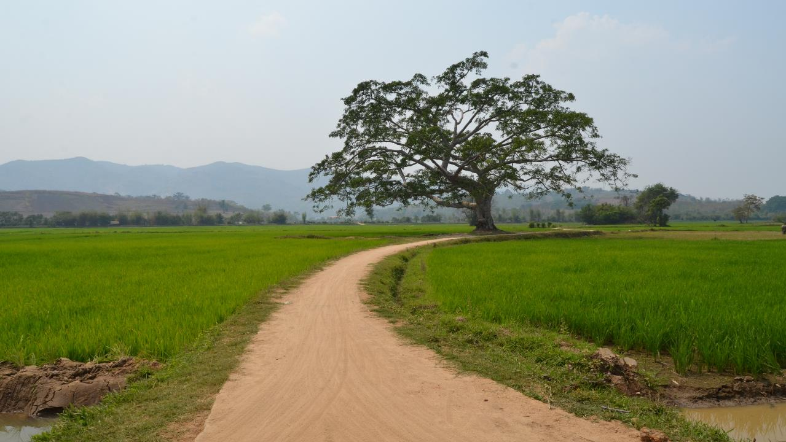
Thank you on Behalf of the BRACED Myanmar Alliance

