Slide 1
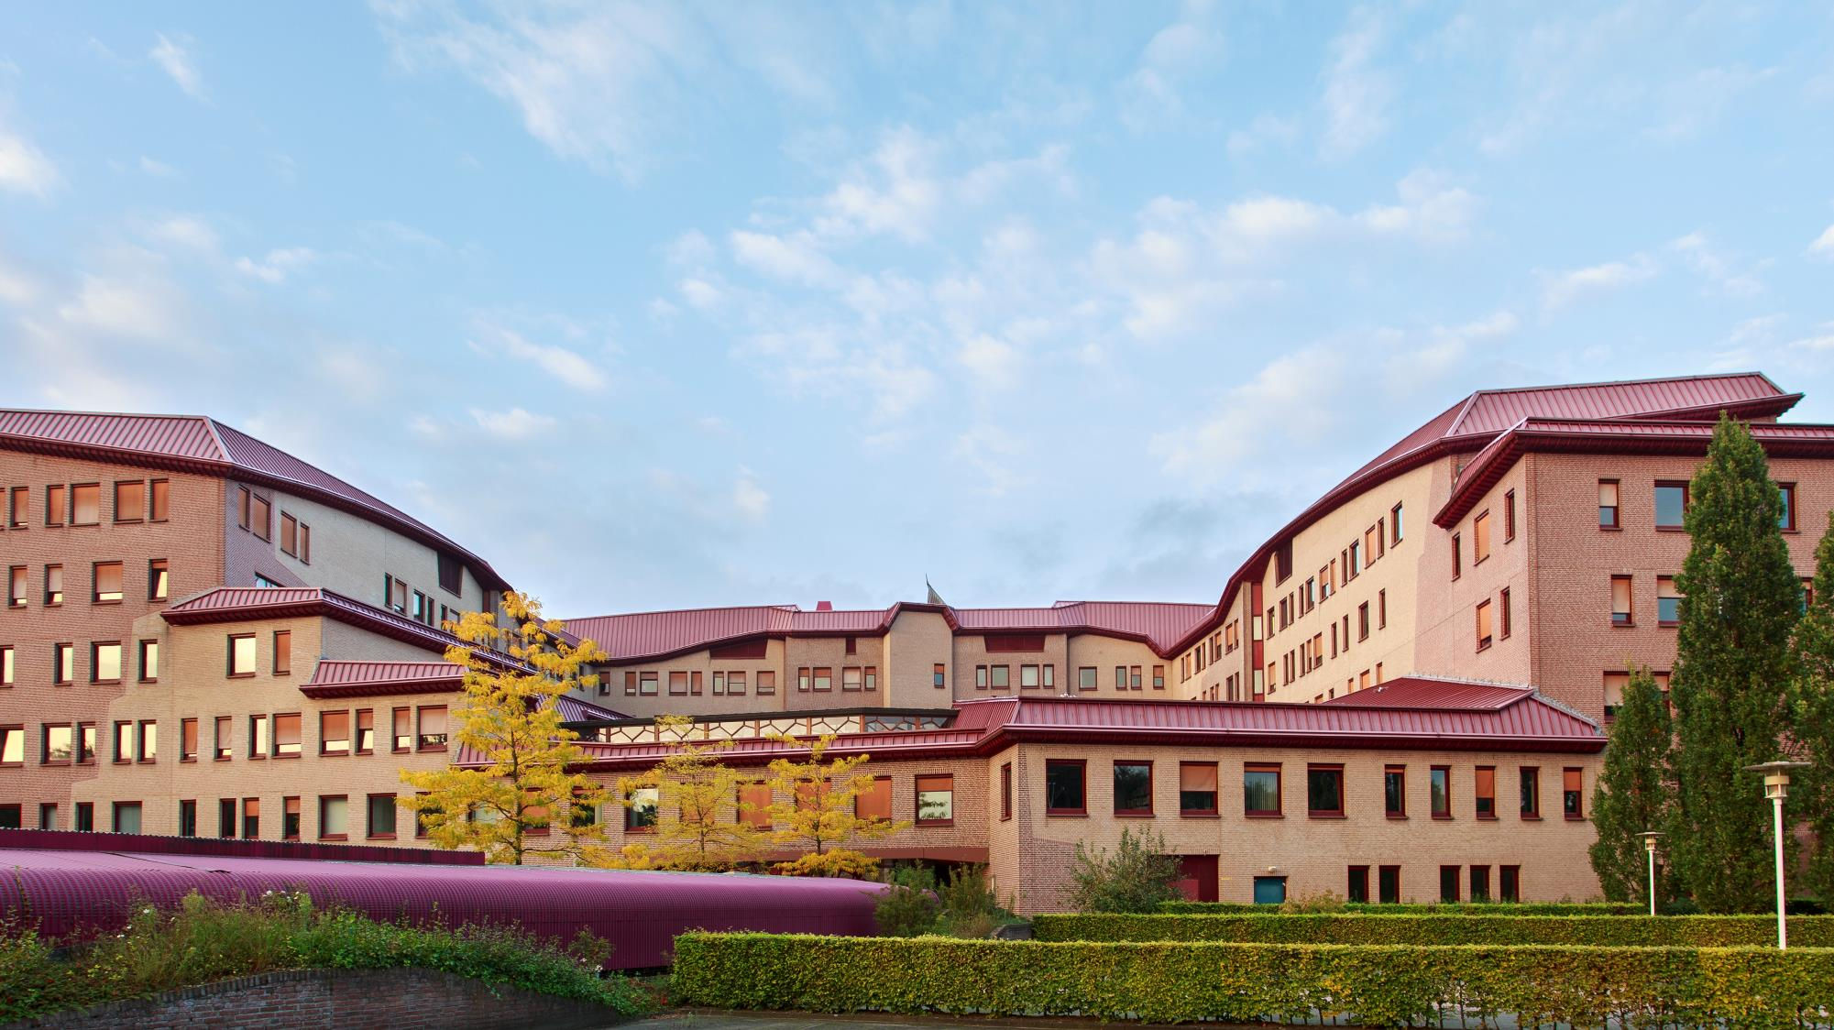

ITC FACULTY OF
GEO-INFORMATION SCIENCE AND EARTH OBSERVATION

Slide 2

Partnerships
Different types of partnerships, each with their own purpose
Partnerships in support of education
Partnerships in support of research
Partnerships for projects
Partnerships for internationalization
International Strategic partnerships

Slide 3
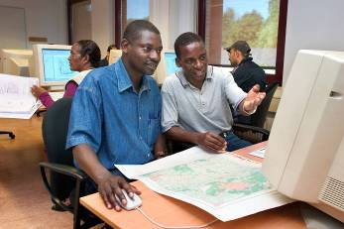
What is driving a partnership ?
Mission and Vision of the University
  Does a partnership fit in ? Does it serve a purpose ?
  What role does it have to play ?
What kind of strategies can be used ?
Example:
Mount Royal University,
Calgary, Canada
Photo: Gerard Kuster

Slide 4
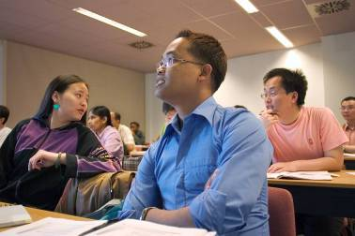
Institutional perspective on partnerships
Arguments for embarking on Internationalization
  Improving the quality of education
  Improving the quality of research
  Mutual understanding
  Capacity building – provide access to education and training
  Increasing the competences and capacity of students, staff and researchers
  Enhancement of reputation
  Financial advantages
Photo: Gerard Kuster

Slide 5
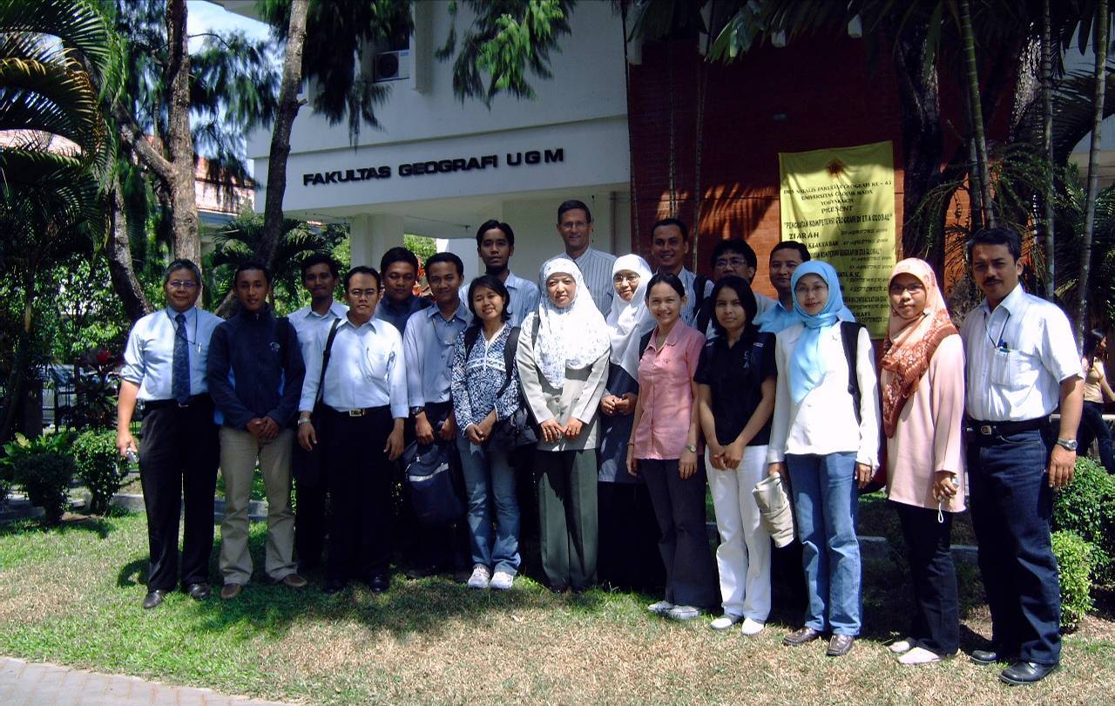
Institutional perspective on partnerships
What are you trying to achieve ?
What is in it for us, why would we do it ?

Slide 6
Partnerships in support of education and research
Partnerships in support of education can have different goals:
  Improve and enrich educational programs
  Change or adapt teaching methodology
  Exchange for curriculum development
  Exchange and internships
  Double and joint degrees
  Partnerships in support of research:
  Strengthen research profile
  Carry out joint research (EU, H2020, National Research Agenda)
  Joint PhD programs

Slide 7
Partnerships in support of projects
Cooperation in a consortium for projects
Calls for proposal (example: Orange Knowledge Program)
Public-Private partnerships
Projects can serve different purposes:
Outreach to society
Institutional collaboration
Profiling of expertise
Consultancy services

Slide 8
Mission, vision and strategy
Mission
To develop capacity, particularly in less developed countries, and to utilize geo-spatial solutions to deal with national and global problems
Vision
Spatial solutions will play an increasingly important role in meeting many of mankind’s complex challenges (often wicked problems), such as climate change, population growth and related claims for sufficient land, secure food, water, energy, health and housing provision
Goal
To enhance our standing as internationally recognized knowledge hub in the spatial domain, known for its collaborative educational and research activities, particularly in the global south

Slide 9

Example: Mount Royal university
Vision:
Creating exceptional learning experiences for a world of possibilities
From Mission Statement:
Mount Royal also serves a wider learner population provincially, nationally and internationally through face-to-face and distance delivery and through partnerships with other post-secondary institutions. Mount Royal serves its communities by creating and communicating knowledge and by meeting the needs of the labour market in fields related to its program areas.

Slide 10
Example: Mount royal university
The top five reasons for internationalizing are to:
prepare internationally knowledgeable graduates
build strategic alliances with institutions abroad
iii) promote innovation in curriculum and diversity of programs
ensure research and scholarship address international and national
issues and
v) respond to Canada’s labor market needs.

Slide 11
Example: Mount royal university
Key strategies in ongoing Internationalization:
  Strategy #1 - Institutional Partnerships
  Strategy #2 - International Experiences for Mount Royal Students
  Strategy #3 - Access for International Learners
  Strategy #4 - Internationalizing the Curriculum
  Strategy #5 - International Research Collaboration
  Strategy #6 - International Development and Technology Transfer
  Strategy #7- International Customized Training and Knowledge Export

Slide 12
partnerships
It is important to have a vision and strategies that drive the operational approach on internationalization, partnerships, etc
Motivation to enter into partnerships and (international) cooperation:
Incidental and opportunistic – project based
Structural and long-term – strategy based
Examples from ITC’s own experience:
Long-term partnerships with knowledge institutions such as ITB, Gadjah Mada University, IIRS

Slide 13
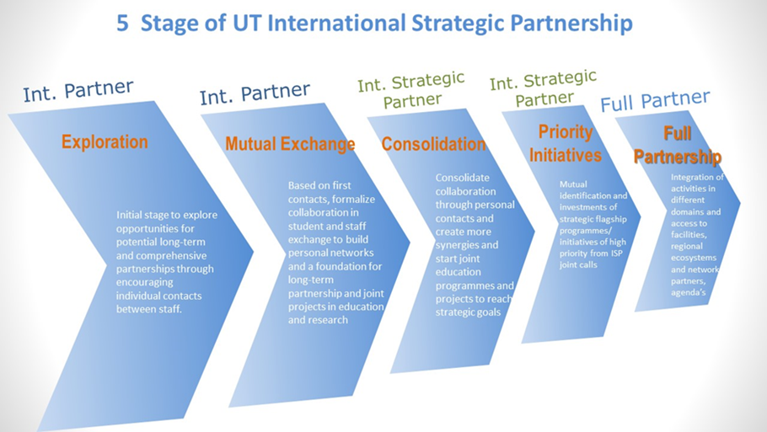
Institutional and legal framework
There are rules and regulations that govern cooperation and partnerships. As an institution you will be required to follow these:
Policy on International Strategic Partnerships
Rules and regulations for developing Double Degree programs
Rules and regulations for accreditation of educational programs
Research accreditation
etc

Slide 14
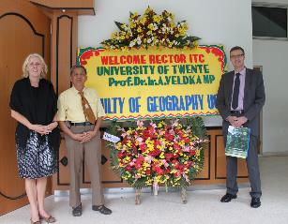
Impact of long-term partnership
Impact studies done in:
Indonesia – cooperation concentrated in 3 organizations (Ministry of Forestry, National Geo-spatial Agency (BIG), Faculty of Geography (UGM))
Cooperation going back to the 1970’s
Development of curriculum
Establishment of PUSPICS
Staff development (Master and PhD)
Double Degree program (Spatial Planning and Risk Management)
Structural partner in research and projects

Slide 15
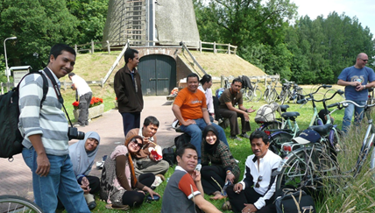
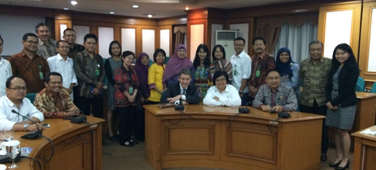
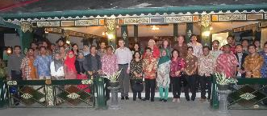
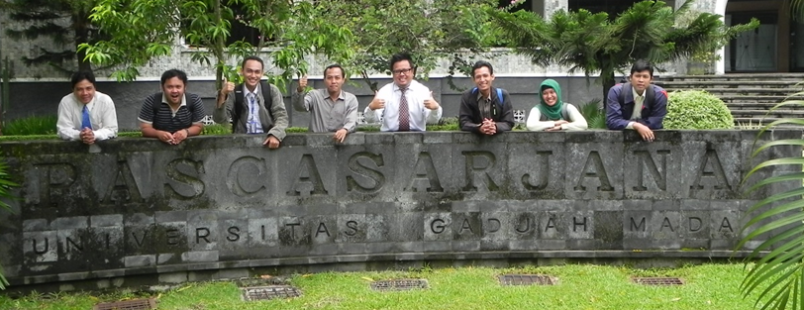
Impact of long-term partnership
Long-term cooperation with partner institutions
Sustainable Development Goals
  Resilience to climate change and climate-related hazards (13)
  Inclusive and sustainable urbanization (11)
  Sustainable management of marine and coastal ecosystems (14)
  Sustainable use of ecosystems, forest management (15)
  Equal rights to ownership and control over land (1)
  Partnerships for the Goals (17)
Professional Network and Alumni Network
Notes:
China (3), Ghana (1), India (1), Indonesia (2), Iran (1). 2 terminated over time (Bolivia, Nigeria).

Slide 16



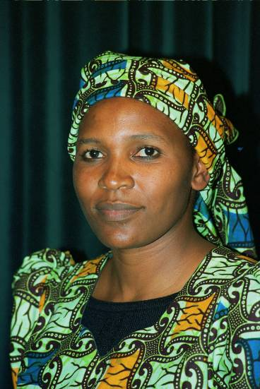
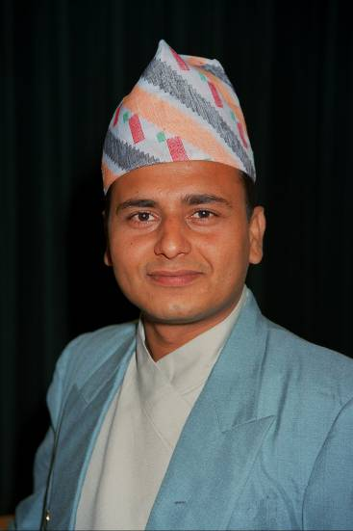
Thank you!

Slide 17
P
S

