Slide 1
Remote sensing and GIS Education in Vietnam Challenges and Opportunities
Fostering partnerships with universities involved
in Geospatial Sciences & Research
12-13 March 2019, Rose Garden Hotel, Yangon
Nguyen Quoc Dinh
Vietnam Institute for Geosciences and Mineral Resources
Nguyen Quoc Phi
Hanoi University of Mining and Geology
Quang-Thanh Bui, Pham Van Cu
VNU University of Science
Notes:
Maintain and expand your network:
what are the key conferences you attend ?
the key inter-governmental organisations you are members of (CCOP for exemple)
Other network for private sector?
Other network for universities?
Watching for call-for-proposals
What are the main website you look at for tenders? Calls-for-Proposals? (World Bank? ADB? European Union? Other?)

Slide 2
Agenda
Remote sensing and GIS application in Vietnam
Remote sensing and GIS education in Vietnam

Slide 3
Remote sensing and GIS application in Vietnam
Air pollution
Biodiversity
Urban and urbanizations
Natural resources (water & minerals)
Climate change and GHG emission
Food securities (Smart agriculture)
Ocean research and ocean technology
…………….

Slide 4
Remote sensing and GIS education in Vietnam
Loosely coupled with physical and social science - main emphasis on cartographic output products and visualization for research activities in geoscience
More or less research on using tools for specific applications and a classic map creation
Development of the new technology, approaches or methodology was restricted for different subjects individually (remote sensing, geoinformatics, cartography)
Needs for change

Slide 5
Motivations for change in curricula
Remote sensing and GIS education in Vietnam
Recognition the importance of geoinformatics/geospatial information science-technology
2006: National strategy on research and application of space technology:
- MOET: updating and re-constructing new curriculum, syllabus, education system...
National Programs on Science and Technology: Space, Regional Development
International donors: Erasmus+, Norpart (Norway), Society of Petroleum Engineering (SPE), Rosneft Vietnam BV, etc.

Slide 6
Motivations for change in curricula
Remote sensing and GIS education in Vietnam
Huge development in geoinformatics and remote sensing science
Change in perception of geoinformatics as a science which gives more possibilities in research and development of new applications
New requirements for the graduates
Regional and International integration
Annually updated courses

Slide 7
Goals in geoinformatics/geomatics/GISc education
Remote sensing and GIS education in Vietnam
Not only individually develop domains within geoinformatics but outline possible combinations and methods across all subjects to solve a given problem
Highlight an interdisciplinary character of geoinformatics science
No possibilities to cover all specialization within one department therefore cooperation with other departments physical (hydrology, geomorphology, etc.) and social/regional (urban studies, landuse/landcover, regionalization, etc.) geography – in applications the stress is on the geoinformation content (development of new tools, data quality, …)

Slide 8
Remote sensing and GIS education in Vietnam
Bachelor programs | Hanoi | Ho Chi Minh city
Natural resources and environment | 18 | 14
Mining and Geology | 4 | 3
Aquaculture-Forestry-Agriculture | 2 | 5
Water resources, Meteo | 3 | 1
Space technology | 3 | 3
IT | 20 | 20

Slide 9
Remote sensing and GIS education in Vietnam
Department / Inter-Department Faculty / Inter-Faculty | Course Title | Number of qualified internal staff for delivery | Number of external staff involved (if any) | Enrollment
Faculty of Geodesy, Faculty of Environment | Map analysis and advanced spatial analysis | 4 | 4 | Appox 100 students each year
 | Image processing | 5 | 4
 | GIS database and standardization | 3 | 2
 | Thermal, Radar Remote sensing | 5 | 4
 | Lidar, UAV | 5 | 4

Slide 10
Remote sensing and GIS education in Vietnam
Department / Inter-Department Faculty / Inter-Faculty | Course Title | Number of qualified internal staff for delivery | Number of external staff involved (if any) | Enrollment
Faculty of Geodesy, Faculty of Environment | Spatial statistics | 5 | 4 | Appox 100 students each year
 | Spatial data mining | 5 | 2
 | Hyperspectral and Laser Remote sensing | 3 | 2
 | Internet GIS and Mobile Mapping | 5 | 4
 | GPS | 5 | 4
45
34

Slide 11
Programs and enroll students (yearly)
Remote sensing and GIS education in Vietnam
Bachelor of Geospatial Information Science: 80-100
MSc in Cartography, Remote sensing and GIS: 20-30
PhD in Cartography, Remote sensing and GIS: 3-5
MSc in Natural Resources and Environment: 20-30
PhD in Natural Resources and Environment: 5

Slide 12
Remote sensing and GIS education in Vietnam - Summary
Government strategy
Inter-connected disciplines
Geospatial industry
Bringing the benefit of space technologies to the Educational Sector at very beginning stages – primary schools
Connecting space to villages – local communities

Slide 13
University governance - Game change
Remote sensing and GIS education in Vietnam
Autonomy of universities: New Law on Higher Education (pass 19/11/2018), will be applied from 1/7/2019
Before 2018: Government Resolution for public higher education institutions in the period of 2014-2017, only 23 universities were selected, most of them are economic or finance institutions
Up to now, there is no guidelines on autonomy for universities, especially on the management of financial and human resources

Slide 14
University governance - Game change
Remote sensing and GIS education in Vietnam
Number of leaner and staff
Enroll student: Starting to reduce from 2015 for most of universities. HUMG: 28.000 students (2011), 15.000 (2018)
Staff: Reduce the total number to 10%, a administrative decision from government

Slide 15
University governance - Game change
Remote sensing and GIS education in Vietnam
Number of enroll student - Faculty of Environment, HUMG
Change in policy for university admission (from 2015-2016): Most students choose top universities (10%), technical institutions are left out
Labor export (to Korea, Japan, Taiwan, etc.)
Professional training schools, job markets

Slide 16
Game change - Current resolutions
Remote sensing and GIS education in Vietnam
Curriculum development by open new education programs. Ex. Natural resources and environmental management program in HUMG
Change in teaching methods: Distant learning, reduce education time from 5 to 4 years (for engineer degree)
New funding streams have to be opened, especially from industry (mining and oil companies, mapping and environmental agencies)
Brain drain: Experienced teachers are running out to industry or private universities ➔ use external staff

Slide 17
Game change - Current resolutions
Remote sensing and GIS education in Vietnam
Develop partnerships with international universities for student exchange and internship, curriculum development and joint research and PhDs
Cooperation with the private sector (training, short courses for VINACOMIN, Vietsopetro) and institutional partnerships (research projects and training of trainers for VIGMR, Department of Survey, Mapping and Geographic Information, Ministry of Natural Resources and Environment, etc.)

Slide 18
International Universities - Types of partnerships
Remote sensing and GIS education in Vietnam
Exchange: An agreement with a partner institution that involves direct exchange of students to and from the partner institution and HUMG. Typically, HUMG will send one student to the partner institution in exchange for receiving one student from the partner institution to study at HUMG. Participants will enroll as exchange students at the partner university but will pay their tuition at HUMG for that term. This type of partnership is ideal as it creates a stronger relationship between the two institutions and promotes a deep cultural immersion for our students.
National University of Laos (Laos), Chulalongkorn, Khon Kaen, Prince of Songkla (Thailand), AGH UST (Poland), Paichai University (Korea), Kumamoto (Japan), etc.

Slide 19
International Universities - Types of partnerships
Remote sensing and GIS education in Vietnam
Faculty-Level: A faculty-level agreement is a partnership between a particular faculty of HUMG and an international institution. In this type of agreement, mobility of students is limited to the specified faculty or department at HUMG and at the partner institution.
NTNU (Norway), Geosciences University (China), Moscow State Mining University (Russia), etc.
Study: A study partnership is an agreement between two institutions that allows the direct study and enrollment of HUMG students at the partner institution. The program is similar to exchange programs in duration, independence, and academics, but does not bring international students to HUMG.
University of St. John, Chien Hsin Science and Technology University (Taiwan)

Slide 20
Private sector and institutional partnerships
Remote sensing and GIS education in Vietnam
Hands-on training courses: Design short courses/training courses for staffs of partner companies/groups. Send lecturers to develop research projects according to industrial activity requirements (mapping of mining operations, mineral exploitation and extraction activities, natural resource management).
Corporation Natural Resources and Environment of Vietnam, Vietnam National Coal - Mineral Industries Group (VINACOMIN), Vietnam Oil and Gas Group (PetroVietnam), etc.
Develop research projects: Partnerships with institutional bodies to develop common projects on survey of natural resources, mapping for land administration, hazard and risk assessment.
VIGMR; Department of Survey, Mapping and Geographic Information; Department of Geology and Minerals of Vietnam (DGMV) (Geological Survey of Vietnam), General Department of Land Administration, Ministry of Natural Resources and Environment

Slide 21
Source of funds for partnerships
Remote sensing and GIS education in Vietnam
State budget: Main source of budget for institutional partnership, develop common research projects.
Industrial donors: Training, lab. equipments. Bring industrial partners to HUMG’s Management Committee (VINACOMIN, PetroVietnam, etc.)
International donors: Erasmus+ Mineral, ESSENCE (energy); Norpart (Norway); Rosneft Vietnam B.V.; Training Course on Landslide Investigations and Hazards Mitigation attract funds from Integrated Research on Disaster Risk (IRDR)
Consortium: with industrial partners and other universities, ex. PSU (Thailand) and UUM (Malaysia) on disaster and environmental management (3 main tracks: Environmental Technology and Management, Disaster Prevention and Mitigation, ICT Utilization to Support Disaster and Environmental Management)

Slide 22
Partnerships - Lessons learned
Remote sensing and GIS education in Vietnam
Understand partners’ motivations and objectives (and their language also)
Create shared value
Build trust, personal relationship is important too
Develop clear agreements and be flexible
View partnerships as a mindset
Learn from partners
Share and learn from failures
Major funds: Goverment, local needs (provinces), and industrial donors
Open channels from international donors and inter-governmental organisations

Slide 23
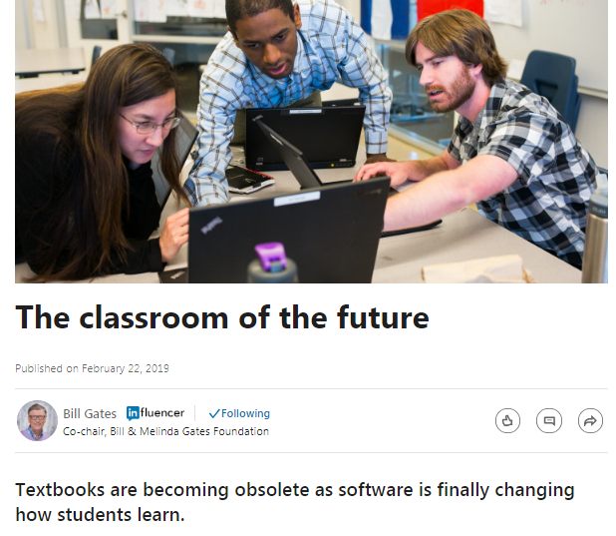
Many thanks ...

