Slide 1
ITC FACULTY OF GEO-INFORMATION SCIENCE AND EARTH OBSERVATION

Slide 2
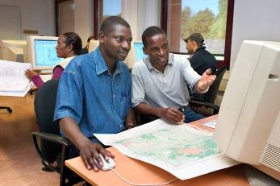
What is driving a partnership ?
Mission and Vision of the University
Does a partnership fit in ? Does it serve a purpose ?
What role does it have to play ?
What kind of strategies can be used ?
Example:
Mount Royal University,
Calgary, Canada
Photo: Gerard Kuster

Slide 3
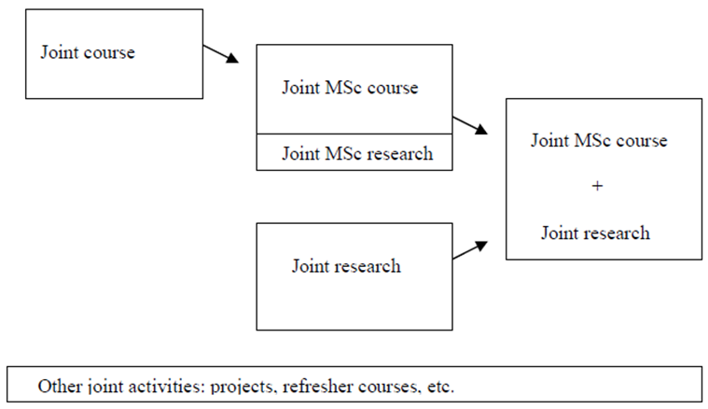
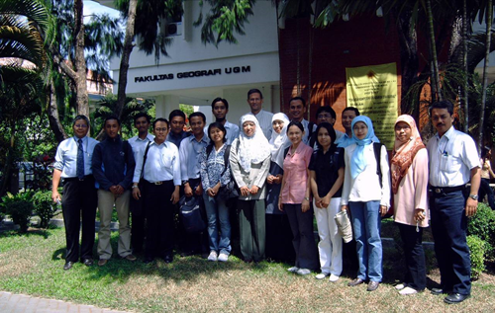
Partnerships over time
Changing focus of academic partnerships
Joint Education
Joint MSc degree courses
Joint MSc degree and joint research
Exchange and internships
Joint PhD

Slide 4
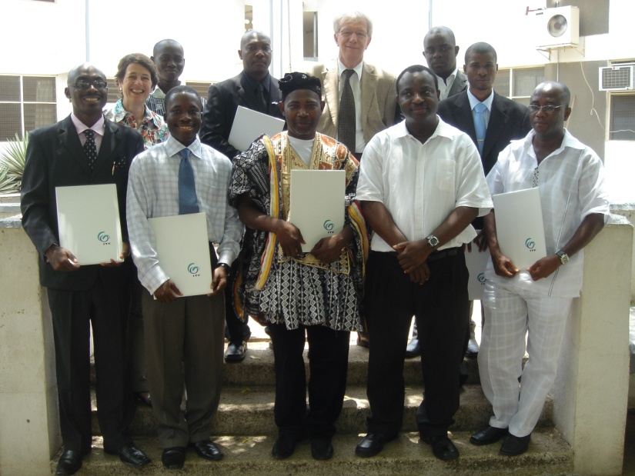
sustainable international partnerships
Key features
Know your partners well
Clear communication
Frequent meetings (especially in the beginning)
Long-term commitment
Clear objectives with benefit for all parties involved
Flexibility and understanding
Equality and trust between partners
End Scenario

Slide 5
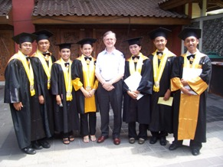
sustainable international partnerships
Good practices
Equal partnership without dominance of one party
Gradual development of academic partnership
Broader (Academic) partnership
Start small and get to know each other well
Work out technical and logistical support, clear tasks and responsibilities
Spread of funding sources
Alternative for joint or double degree
Bologna tools

Slide 6
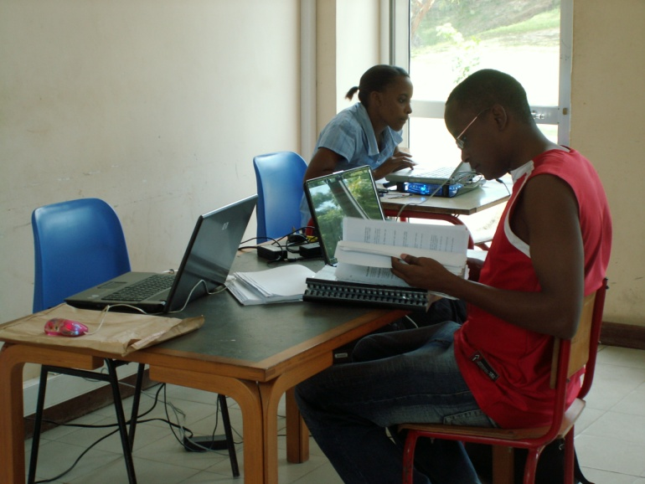
sustainable international partnerships
Good practices
Gradual development of academic partnership
Short courses Certificate Diploma Degree
Spread of funding sources
Fellowships, funding Dependency on single source
Alternative for joint or double degree
Parallel streams
Bologna tools

Slide 7
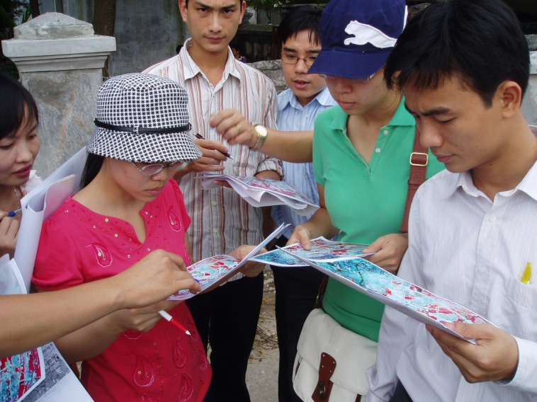
sustainable international partnerships
challenges
Different academic systems (legislation, credits, etc)
Recognition of foreign degrees
Problematic research environments
Access to scientific information, internet, library
Matching criteria of different accreditation bodies
Equivalence
Funding for staff and student mobility
Funding for development of facilities

Slide 8
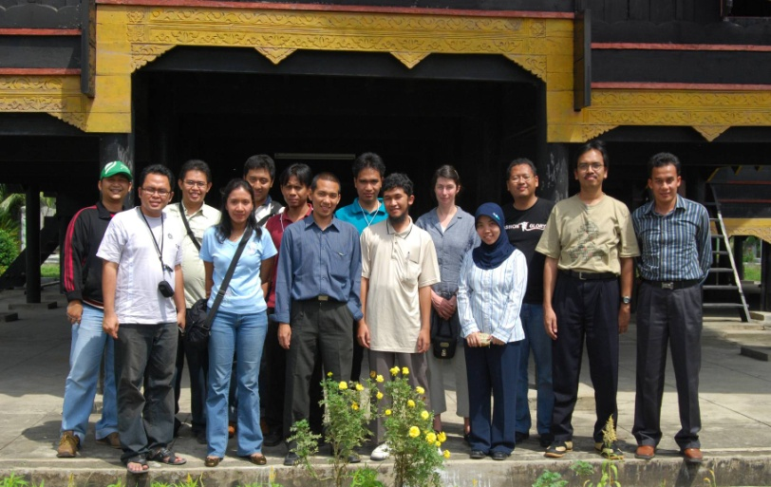
sustainable international partnerships
challenges
Different academic systems (legislation, credits, etc)
Credit transfer (ECTS), mutual recognition
Problematic research environments
Access to scientific information, internet, library
Joint MSc supervision, joint research
Equivalence
NVAO: > 60 %

Slide 9
Sustainable international partnerships
How can international partnerships be supported ?
Organizational structure to support initiatives
(International Office, Project Services Bureau)
Allocation of staff time and other resources (but what academic staff can do has its limits)
All parts of your institutions will be involved (Management, IO, admission, library, finance and administration)
Allocation of funds, staff time for acquisition

Slide 10
What if ….
Institutions enter into most partnerships with the assumption that everything will go well. But ….
Also think about what might be conditions to stop cooperation
Exit Strategy

Slide 11
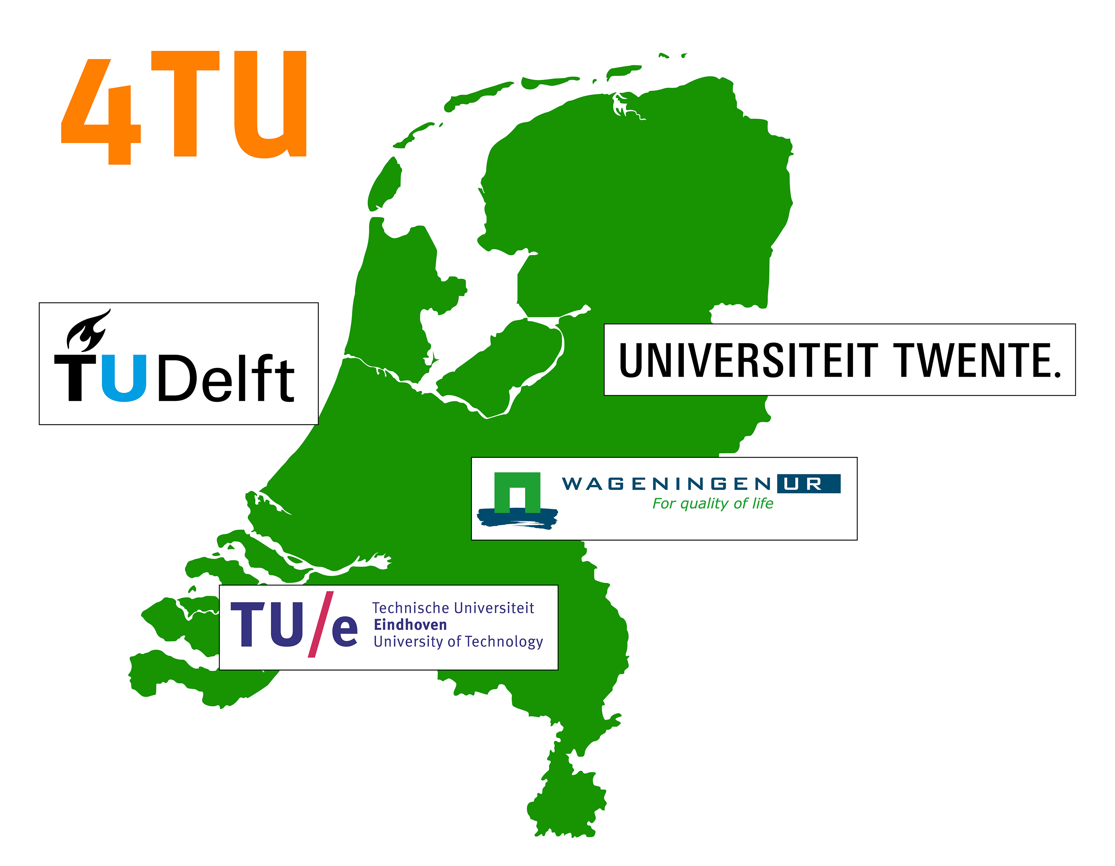
Examples of structural partnerships

Slide 12
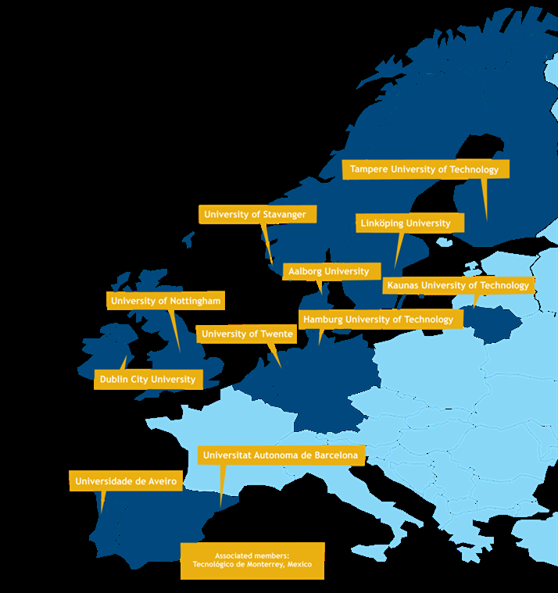
Examples of structural partnerships
European Consortium of Innovative Universities
Collective emphasis on innovation, creativity and societal impact, driving the development of a knowledge based economy
Innovation and entrepreneurship
Regional development
Excellence of research
Innovation in teaching and learning

Slide 13
Examples of structural partnerships

Slide 14
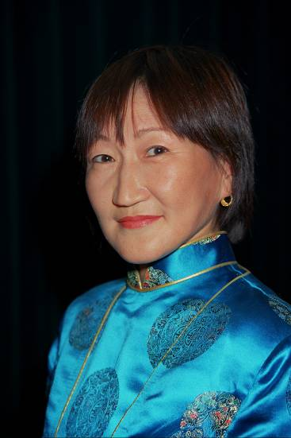
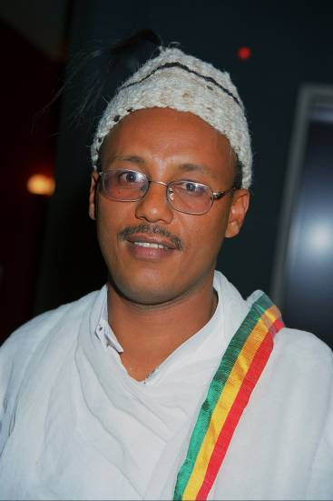
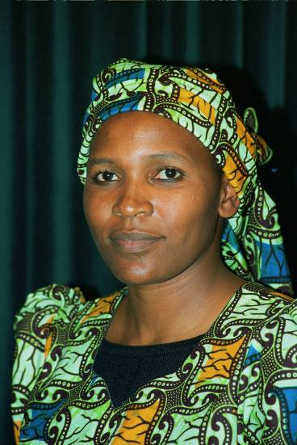
Thank you!

