Slide 1
UNOSAT’s Capacity Development in Geospatial Information Technology –
Partnerships & Lessons Learned
Fostering Partnerships with Universities Involved in
Geospatial Sciences and Research
Yangon, Myanmar
12 - 13 February 2020

Slide 2
Introduction to UNOSAT
UNITAR
Operational
Satellite
Programme (UNOSAT)
An operational programme of United Nations Institute for Training and Research (UNITAR)
Serving UN, international organizations, and national governments
Fully dedicated to satellite imagery analysis and applications of geospatial information technologies
Presence in Geneva, New York, Bangkok, and Nairobi

Slide 3
UNOSAT Activities
1. Analysis, Research and Innovation
Based on satellite imagery derived geospatial products,
using different tools
Decision support products for disaster risk reduction, climate change adaptation, sustainable development
Bringing in innovative and emerging technical tools for real-world application
Notes:
Rapid risk assessment
Alert & early warning
Simulated hazard scenario
Elements at risk mapping
Hazard extent mapping
Population/populated places
Land use/land cover
IDPs and camp mapping
Humanitarian access
Rapid damage estimation
Reconstruction monitoring
Structural damage to buildings
and critical facilities
Damage intensity
Transportation network
Secondary induced effects

Slide 4
2. Training and Capacity Development
Transferring knowledge and experience on utilizing satellite imagery and geospatial information technology
For member States, UN agencies, and other regional organizations

Slide 5
Geospatial Information Technology (GIS)
Big Data Analytics
Deep Learning
Decision
Support
System
Remote Sensing (RS)
Earth Observation (EO)
Augmented Reality (AR)
Virtual Reality (VR)
Sustainable
Development
Monitoring
Unmanned
Aerial
Vehicle (UAV)
Web
Mapping

Slide 6
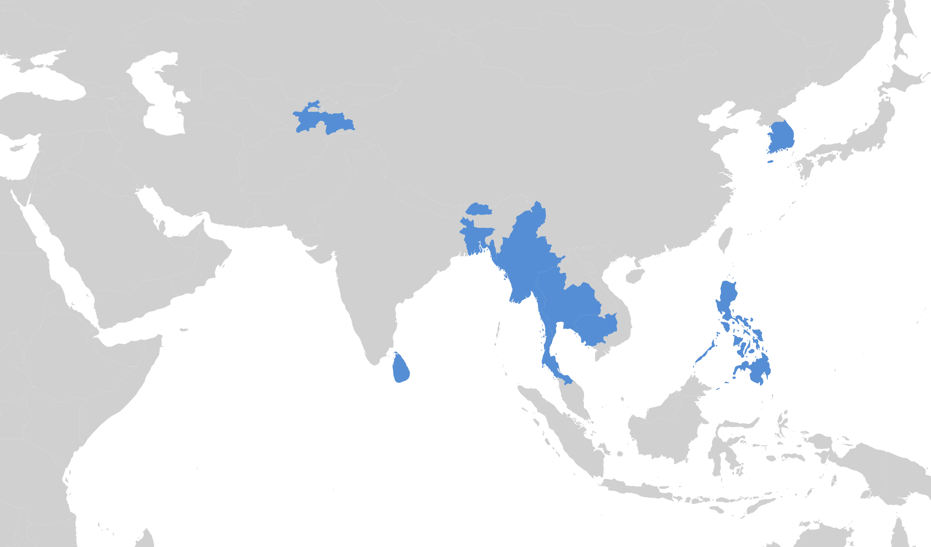
GIT for land management
UNOSAT In-Country Training in Asia-Pacific Region
(2012-2018)
Rapid response mapping
Intro to GIT for DRR
Advanced GIT for DRR decision support
GIT for disaster management
GIT for evidence-based decision making
GIT for DRM
Post-disaster impact analysis
UAV image processing
GIT for DRR
(intro and advanced)
GIT and geospatial data management for DRR
25
In-Country Trainings
390
Satellite application for urban DRR
Total Participants
GIT for DRR
GIT for drought risk management (intro and advanced)

Slide 7
UNOSAT Partnerships
“Through partnerships […] it makes it possible for UNITAR to consolidate and extend its capacity to provide a global platform for knowledge transfer”
- UNITAR Partnership
Notes:
partnerships constitute a master-piece in international, national and local efforts to initiate change.
A strategic partnership can improve synergies for both beneficiaries and contributes to an overall increase in institutional capacity. Investing in people is fundamental to deliver as one, excel in response to training needs, and innovate.

Slide 8
Governments
Academia
Inter-government organizations
Private Sector

Slide 9
Government
From government to UNITAR:
Opportunity to serve institutional mandate: Providing Member States and their representatives with relevant information, knowledge and skills
From UNITAR to government:
Supporting on training activities that could contribute to addressing global challenges
Complementing governments’ own research, training and capacity development activities
An opportunity to extend its network of contacts, visibility, and partnerships with the international organizations that constitute the UN system

Slide 10
Academia
From Academia to UNITAR
Engaging in partnerships with academia, training institutions and centers of excellence in developing and emerging countries
From UNITAR to Academia:
A structured offer to capacity-building and development needs
Supporting academia’s respective strengths to develop modern learning and training environments, platforms, tools, and methodologies
Opportunity to open up to new audiences, share knowledge in training and research, build up new collaborations with academic networks in other regions

Slide 11
Inter-government organizations
From Inter-governments to UNITAR:
Opportunity to develop synergies within UN system and with other international organizations
"Delivering as one"
From UNITAR to Inter-governments:
Offering in expertise on how to best deliver training, capture and retain knowledge, and best build upon it
Sharing capacities on research on learning methodologies and approaches

Slide 12
Private Sector
From Private Sector to UNITAR:
Promoting and enhancing the value of its social responsibility policy for sustainable development
From UNITAR to Private Sector:
Environment for contribution to sustainable development
Opportunity to show the applications of UN public-private partnerships

Slide 13
Data collection/sharing:
Satellite imagery, attribute data
Understanding data gap and for further analysis
Examples of Activity Type
From Data Sharing to Project Collaboration
Software licence:
For UNOSAT’s analytic and research work
For UNOSAT training participants
Procedural cooperation:
For smooth and efficient task implementation
Training and awareness raising event:
Co-development/co-organization of capacity development events
Research for innovation:
Co-development of emerging technical applications

Slide 14
And many more partners…

Slide 15
UNOSAT Partnership Example
Network for Training and Capacity Development
Challenges:
One-time training and its ineffective sustainability with partners
Objective:
To support sustainable capacity development and knowledge retention
Implemented Means:
Short-, mid- to Longer-term training modules
Community of practice and informal geospatial data working group meetings for sharing challenges and seeking potential solutions

Slide 16
2-week long training course
Research by participants for appropriate project ideas
Network for Training and Capacity Development
Short- to long-term training
Project selection and UNOSAT technical support
Thematic application/
operational course
2-week advanced course
Final week of training custom-tailored to support the project
1-week introductory course
Participant project work
Review of analysis
Final
presentation

Slide 17
Participant-to-participant professional communication
Network for Training and Capacity Development
Community of Practice
Online group discussion
Launch of community of practice forum
in a training country
Participant
meet & greet
once in two months

Slide 18
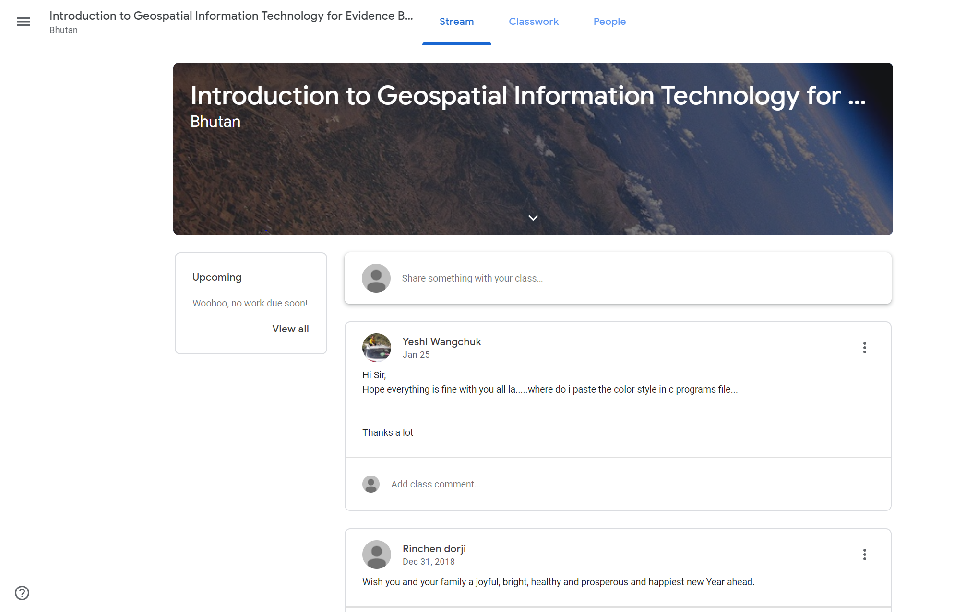
XXXXX
Network for Training and Capacity Development
Community of Practice
in Bhutan

Slide 19
Regional-Level Training Course
Network for Training and Capacity Development
Expansion of Community of Practice
New Regional-Level Community of Practice

Slide 20
Lessons Learned
Self-Assessment
Complimentary role
Trust Your Partner
Should be done before looking into potential partnership
To better understand what are your strengths and weaknesses
Complimentary roles among the partners works the best
Win-win modality
Building trust with your counterparts

Slide 21
Partnership-by-Partnership
Golden Time for Partnership
Duplication of Work
Different partnerships at different level of engagement
Different type of mutual benefits
Immediate response/communication
Always be transparent and clear
Similar mandates/Donor-driven
Lack of awareness on existing initiatives/projects/knowledge products
Lack of flexibility of the existing projects to collaborate

Slide 22
No Common Platform for Idea Exchange
High Turn-Over Rate
Data/
Information Sensitivity
Difficulty in sharing/exchanging current activities and possible collaboration
No such platform means difficulty in creating partnership organically
When person in charge is gone, partnership gets weak
How to strengthen the partnership at the institutional level?
Not every knowledge/data/information are sharable
Notes:
Good practice on idea sharing and exchange: UN Information Management Working Group → UNOSAT, OCHA, IOM, WFP, ICRC, PDC

Slide 23
UNITAR-UNOSAT
International Environment House
Chemin des Anémones 11-13
CH-1219 Châtelaine
Geneva - Switzerland
T : +41 22 767 4020
Email : unosat@unitar.org
www.unitar.org/unosat
UNOSAT Bangkok Liaison Office
The United Nations Building
Rajadamnern Nok Avenue
Bangkok 10200, Thailand
T : +66 (02) 288 1563
Email :khaled.mashfiq@unitar.org

Slide 24
How We Build Partnership
Potential Partnership Assessment
Networking Activities
What would be the benefits for both sides?
For how long?
For which activity?
Where?
How?
Notes:
Assessing potential partnership with strategic approach
Short-, mid-, and long-term
Research, training, others
At official workshops and conferences
Training and awareness raising events
Government official communication channel
In-person, email communications

Slide 25
Brainstorming with Potential Partner
Drafting Documents
Continuous communication and exchange of ideas
Positioning the role through Strength-Weakness-Opportunity-Threat (SWOT) analysis
Concept note/project proposal & document, including:
Goal/Objective
Theory of change and logical framework
Activities and tasks
Estimated budget
Communication strategy
Monitoring and Evaluation

Slide 26
Raising Fund
Signing Agreement
Within your organization?
With your potential partner?
From the other donors?
Overall commitment on partnership and mutual cooperation:
Letter of Intent (LoI)
Memorandum of Agreement (MoA)
Memorandum of Understanding (MoU)
For detailed and focused activities?

Slide 27
Evaluating Partnership
Continuing Partnership
What were the achievements and short-coming?
Conflict management?
Renewal of partnership
Brainstorming for new project ideas/concepts

