Slide 1
Tools to identify Partners and Develop Networking
Fostering partnerships with universities involved
in Geospatial Sciences & Research
12-13 March 2019, Rose Garden Hotel, Yangon
Nguyen Quoc Dinh
Vietnam Institute for Geosciences and Mineral Resources

Slide 2
MINISTRY OF NATURAL RESOURCES AND ENVIRONMENT
Vietnam Institute of Geosciences and Mineral Resources
(VIGMR)

Slide 3
8. Myanmar
VIGMR’s International cooperation
VIGMR has close scientific
relationships and cooperation
with international organizations
Scientists from universities & other
countries in geological cooperation
programs, exchanging experiences on
scientific researches and training activities
IGCP
Australia
Austria
UNESCO
Belgium
UNDP
Canada
CCOP
Cambodia
China
ESCAP
France
JAMSTEC
Germany
Italy
NGI
Japan
GEUS
Laos
Malaysia, Myanmar
CAS
Poland
VSEGEI
Russia
Thailand
BGS
USA, etc.

Slide 4
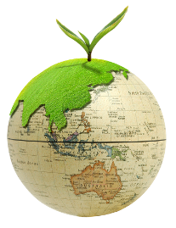
Economic Geology and Geomatics (EGG)
Researches related to natural environment, geo-environment, conservation, natural disasters, and mineral resources
Governments
Maintaining close connection
Academics
Industries

Slide 5
WHY networking?
…, If you want to go far, go together.
Geospatial Sciences, GIS applications involve interdisciplinary, muti-disciplinary research projects

Slide 6
Establishing, Maintaining and Expanding your network
Limitations of academics who works in developing countries
Access to funding (project, meeting, conferences)
Lack of information
Partnership with developed countries
Culture of cooperation
Establishing network
Conferences (rarely go, due to funding and too much information)
Workshops, training course and meeting (international and national, as many as possible)
Networks with developed countries (inter-governmental organizations CCOP, Geoparks, Sentinel Asia)
Private sector (Exhibition, workshop)
Networks with universities
Local embassies event
Notes:
I worked in europe for 13 years, know the limitation very well
Maintain and expand your network:
what are the key conferences you attend ? Not many, no need to go abroad to meet people, international workshop in your countries are affordable
the key inter-governmental organisations you are members of (CCOP for exemple)
Other network for private sector?
Other network for universities?
Watching for call-for-proposals
What are the main website you look at for tenders? Calls-for-Proposals? (World Bank? ADB? European Union? Other?)

Slide 7
How to build a strong network?
Conferences, workshop, training course
People know what you are doing.
You know what people are doing
Finding common interest
Always think about long-term relationships
Participate professional organizations
Take an active role (organizing workshop, training course, meeting…)
Truly participating allows you to get to know people and build strong, enduring relationships.
Publication
-Readers of your articles who share common interest will seek you out.
Find and approach via internet
- Find people who work in the same field though publication, webpage
Notes:
International workshops in your countries would be the best to go, people go to your countries are willing to cooperate to local partners. Big conferences (budget to go, no chance to talk with people).
A great way to build your network is to host an event (workshop, training course, meeting). This will provide a way to connect the members of your network with each other. Encouraging each member to bring a member of their network will also help to significantly expand yours.

Slide 8
How to maintain a strong network?
Mailing list
Keep Update
Change to your organization, your work status or your contact details
Add value to your network.
- share your knowledge and expertise, and offer to help when you see an opportunity
Social network (LinkedIn, Researchgate, and Facebook)
- Just updating your status on LinkedIn and Facebook keeps your contacts aware of what’s happening.
- Posting your project, members of your network you may join
Acknowledge
Express thanks, congratulations and wishes when needed. This is a great way to show the members of your network you care.
Notes:
make sure to share you knowledge and expertise and offer to help when you see an opportunity. Helping other people will often come back to you tenfold.

Slide 9
Selected projects of EGG
Selected Projects: (Role, Funding agency: Name of Project, Year)
Research Fund: GCRF (UK), Resilience to Coupled Human-Natural Multi-hazards Network, 2019-2021
Research Fund (AAS, USA): Field-Scale Application Of Vetiver Grass To Mitigate Dioxin Contaminated Soil At Bien Hoa Airbase, 2018-2020
Project-based (WB): Vietnam Irrigated Agriculture Improvement Project, 2018-2020
Research NASA (USA): Land Use Status, Change and Impacts in Vietnam, Cambodia and Laos, 2018-2021
Research grant: Ministry of Education and research- (Germany) – Min. of Sciences Technology (Vietnam): “Strengthening Vietnamese Capacity of Civil Protection and Disaster Management”, 2018-2021
Research grant: VVN (Vietnam), Natural based landslide reduction using Vetiver system in Laocai province, 2018-2019
Project-based UNDP: Vulnerability and risk assessment and mapping for water resource infrastructure in Vietnam, with specific detail for Mekong Delta, Jan 2018 – Dec 2018;
Project- based VLIR (Belgium): Mountainous Community Resilience to reduce the negative impacts of landslides on rural communities, 2018-2019
Notes:
Before 2012: Europe, after 2012, starting from zero (network, project)

Slide 10
EGG cooperation
Main collaborators (with ongoing project)
Francisco José Mora Más, Professor, Rector Universitat Politècnica de València, Spain
Lee Woo-Kyun, Professor, Environmental GIS-RS LAB, Korea University, Korean
Ko-Fei Liu, Professor, Department of Civil Engineering, National Taiwan University, Taiwan;
Matthieu KERVYN DE MEERENDRE, Professor, Department of Geography, VUB, Belgium
NGUYEN Phuong, Professor, Hanoi University of Mining and Geology (HUMG); Vietnam
PHAM Quang Ha, Professor, Institute for Agricultural Envronment (IAE/VAAS), Vietnam;
Nguyen Xuan Thinh, Professor, Department of Spatial Information Management and Modelling, TU Dortmund University , Germany;
TRAN Thanh Hai, Rector, Professor, Hanoi University of Mining and Geology (HUMG); Vietnam
Tohru Ohta, Ass. Professor, Department of Earth Sciences, Waseda University, Japan;
Son Van Nghiem, Ph.D. Science and Applications Development Lead, Radar Science and Engineering Section, NASA, USA
Zeng-Yei Hseu, Professor, Department of Agricultural Chemistry, National Taiwan University, Taipei, Taiwan
Jimmy Chou, Professor, GIS center, Fengchia University, Taiwan
Jonathan C-W Chan, Professor, Dept of Electronics & Informatics (ETRO), Vrije Universiteit Brussel (VUB), Belgium

Slide 11
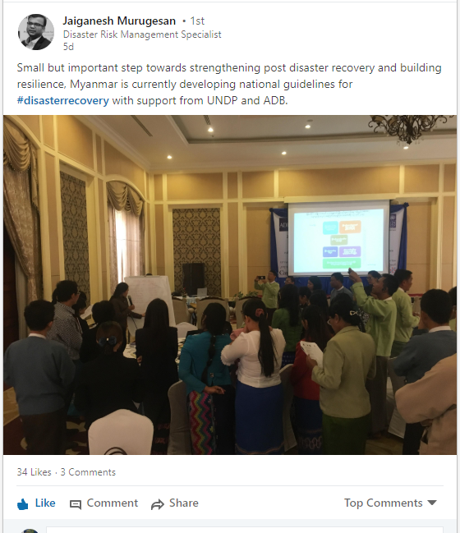
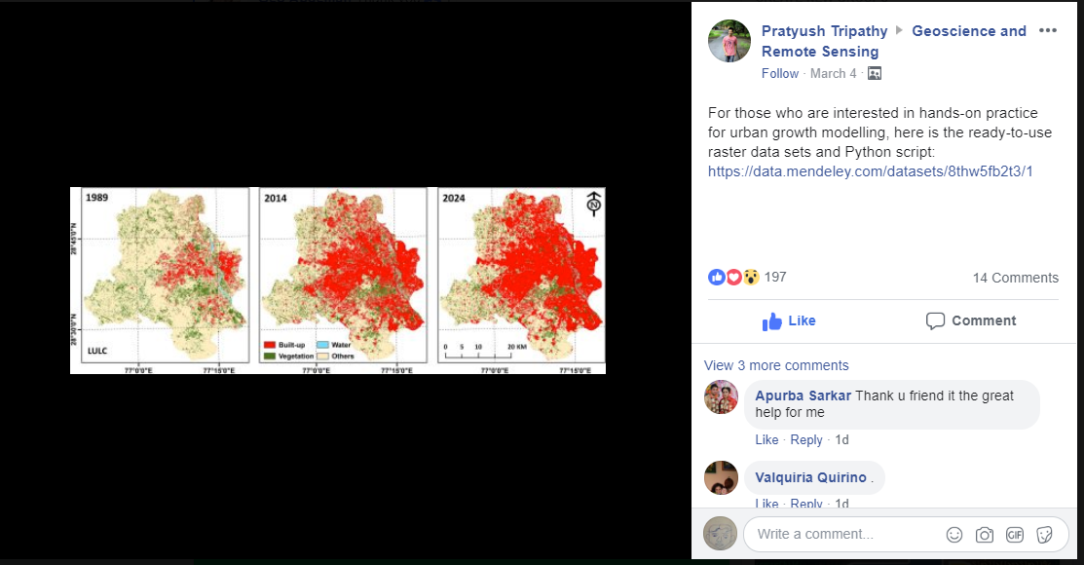
Establishing, Maintaining and Expanding your network
Maintaining and Expanding your network
Social network (Linkedin, Facebook, Researchgate …)
Providing your expertise to multidisciplinary projects
Mailing list, newsletter
Former students and colleagues
Contribution to RS/GIS communities: softwares to apps
Notes:
Social network helps you to connect with people without efforts

Slide 12
Watching for call-for-proposals
Sources of funding
National agencies (most important): network with the people in the agencies, well informed when new call comes. MoST, MoNRE,
International agencies and NGO: World Bank, ADB, European Union (newsletter)
Bilateral Development Agencies: Enabel, VLIR-UOS (Belgium), ADF (France), DAAD, BMBF (Germany), JSPS (Japan), UKRI (UK), MOST (Taiwan), ITEC (India)
Inter-governmental organisations (CCOP, Geoparks, Sentinel Asia): funding for workshop, training
Websites
WB http://projects.worldbank.org/procurement/procurementsearch?lang=en
ADB https://www.adb.org/projects/tenders/type/invitation-bids-1521
UNDP http://procurement-notices.undp.org/
NGO https://www.ngocentre.org.vn/jobs
UKRI https://www.ukri.org/
Enabel, VLIR-UOS https://www.vliruos.be/en/home/1
CCOP http://ccop.or.th/ (training course)
Notes:
You have projects, you would have resources for capacity building, cooperation, exchange expertise.

Slide 13
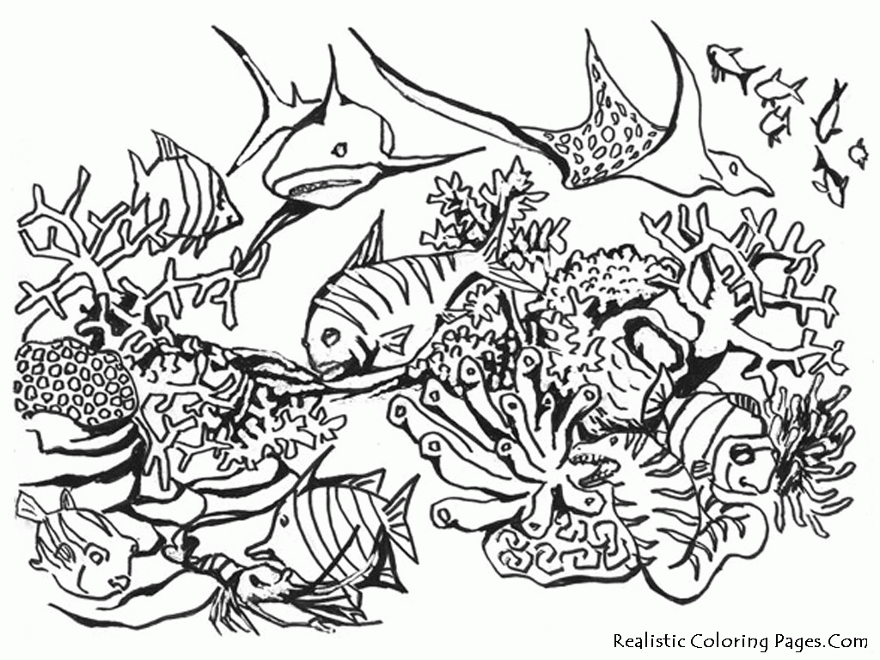
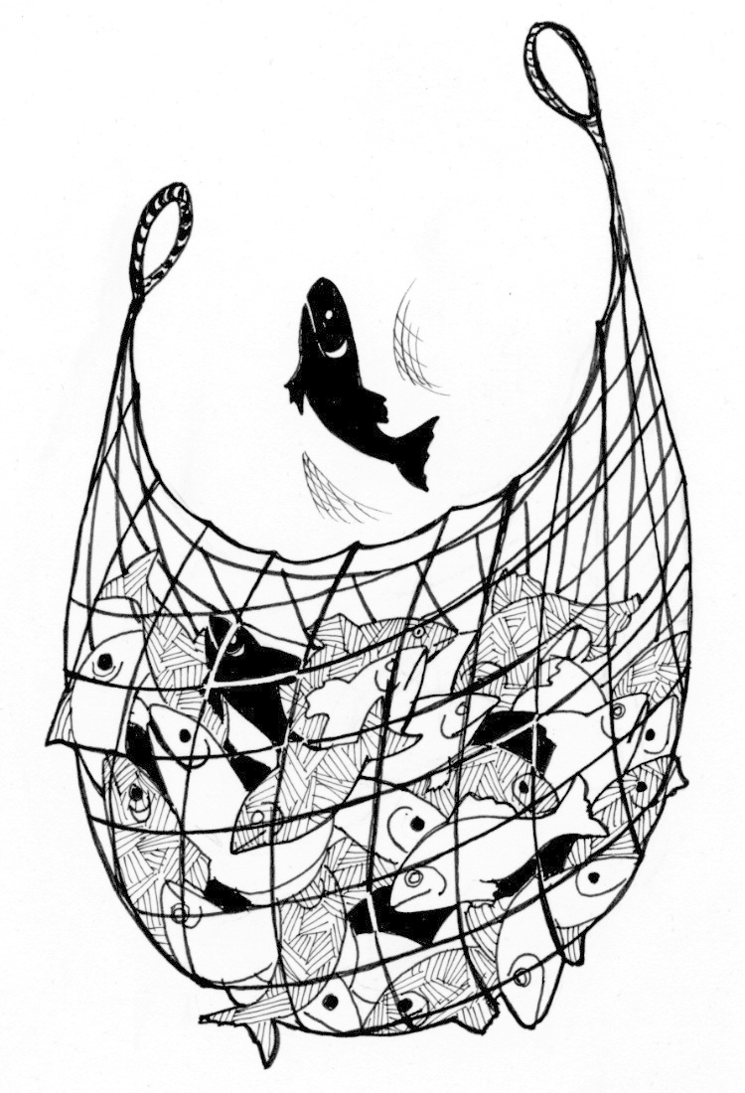
Watching for call-for-proposals
Net(works)
Notes:
You have projects, you would have resources for capacity building, cooperation, exchange expertise.

Slide 14
Many thanks for your attention
Meteorology and Hydrology
Public Health
Rural Development
Survey
Geosciences
Nguyen Quoc Dinh, Dr. rer. nat. Head of Economic Geology and Geomatics Department Vietnam Institute of Geosciences and Mineral Resources (VIGMR) Chien-Thang-Str , Thanh Xuan - Ha Noi - Viet Nam Mobil: 0917703233 URL: http://www.vigmr.vn Email: nqdinh@monre.gov.vn dinhnq@gmail.com orcid https://orcid.org/0000-0003-3844-091X

