Slide 1
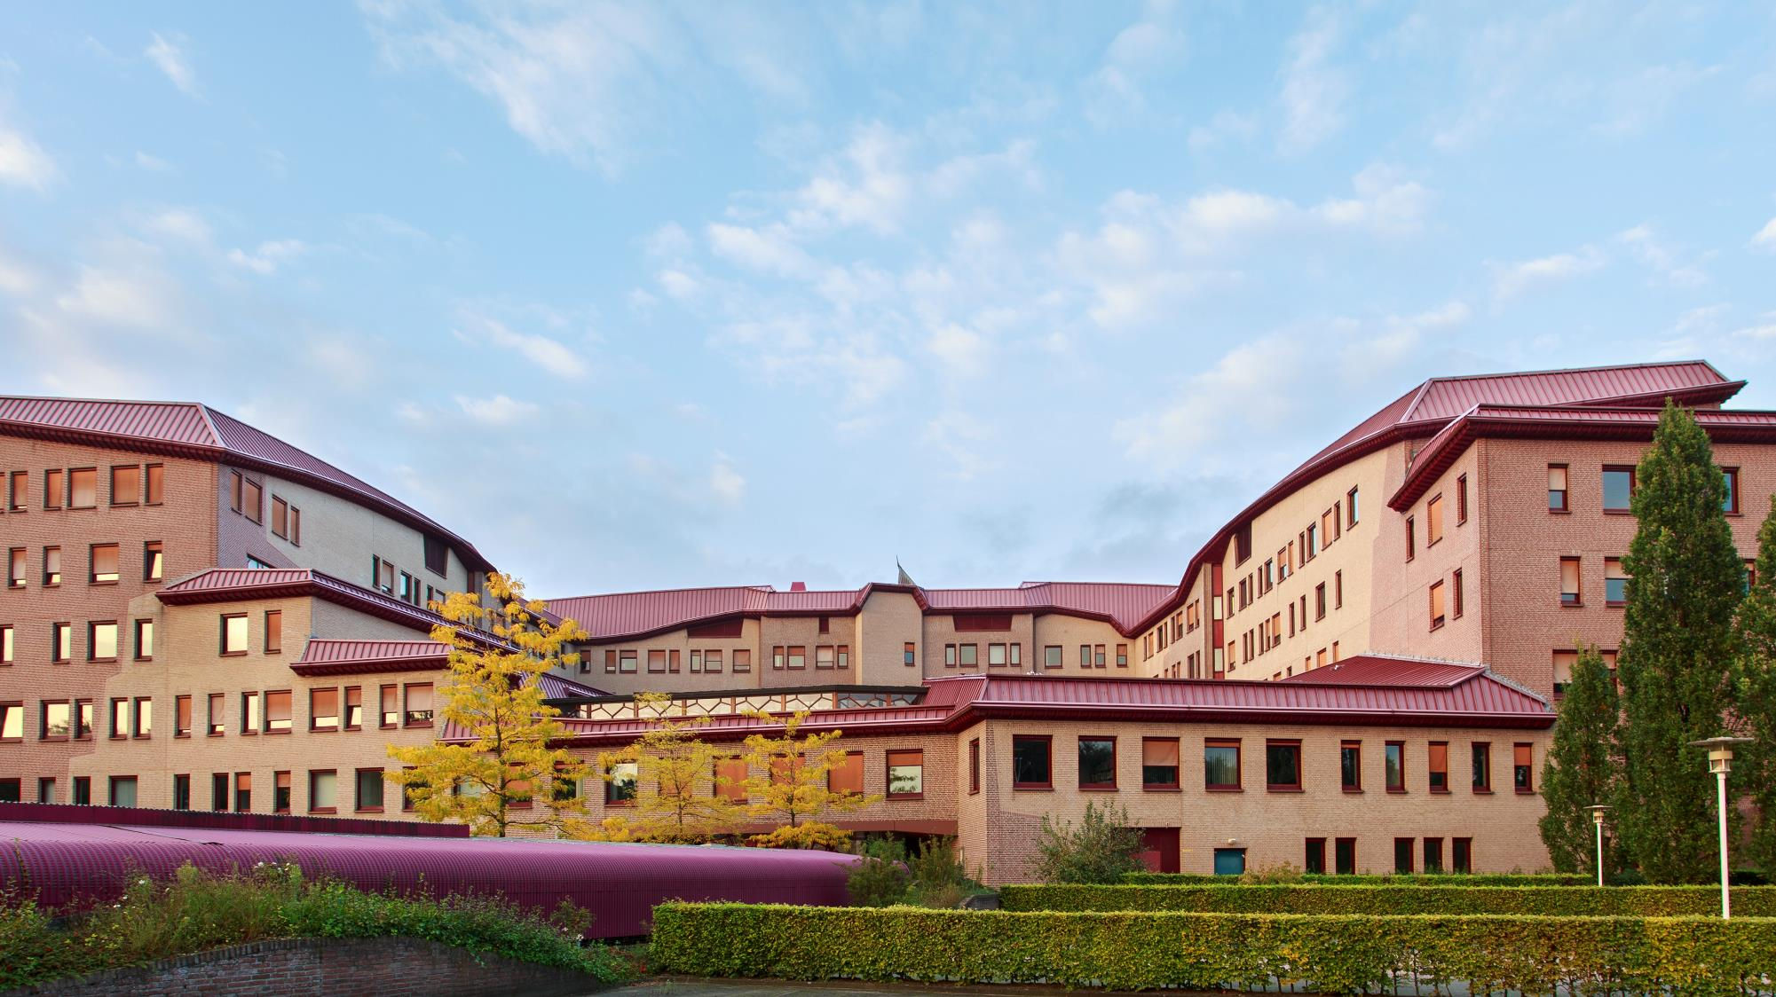

ITC FACULTY OF
GEO-INFORMATION SCIENCE AND EARTH OBSERVATION

Slide 2
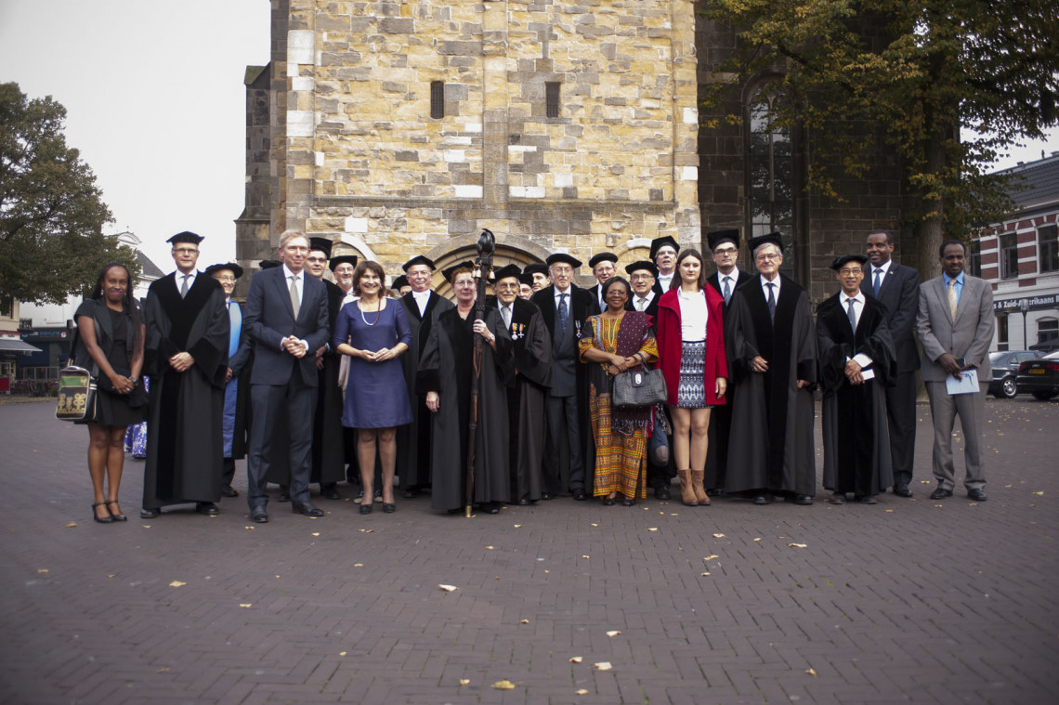

mission and mandate
Mission: to develop capacity, particularly in less developed countries, and to use geo-spatial solutions to deal with mankind’s challenges (wicked problems) such as climate change, population growth, sufficient and secure food, water, energy, health land and housing
ITC’s mandate lies in the combination of education, research and capacity development with a focus on people and institutions in the global South
This impacts on:
Geographic areas of interest
Partners and institutions for cooperation
Student population
Policy briefs Ministers Ploumen, Kaag

Slide 3
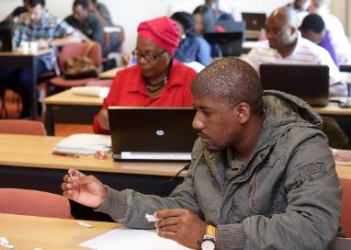
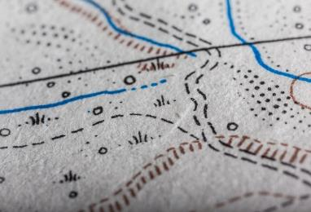
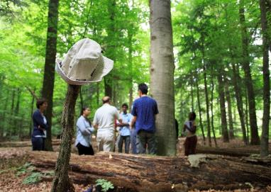
EDUCATION
RESEARCH
CAPACITY DEVELOPMENT
ITC’S CORE ACTIVITIES: Three Primary Processes

Slide 4

EDUCATION IN
A MULTICULTURAL ENVIRONMENT

Slide 5
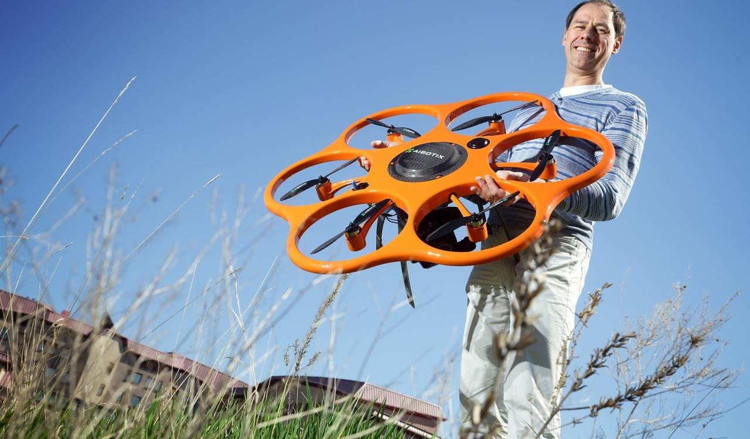

APPLICATION
food security
water management
urban planning
land administration
disaster management
strengthening civil society
earth sciences
environmental management and biodiversity
Tailor-made specialization

Slide 6
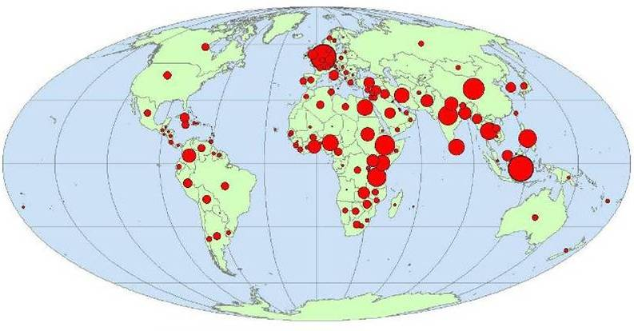
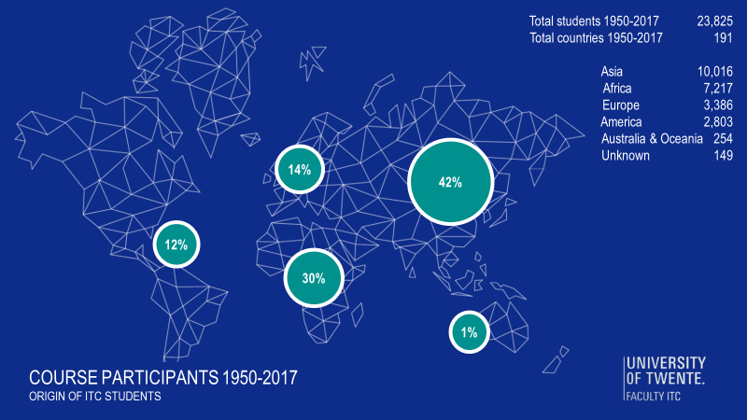
Alumni of ITC
Myanmar: 187
Communities of Practice:
Alumni Associations
Facebook groups

Slide 7
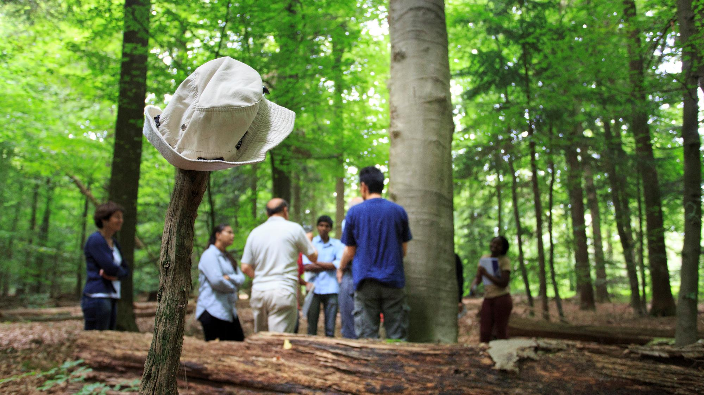
CAPACITY DEVELOPMENT
INTERNATIONAL PARTNERSHIPS INSTITUTIONAL COOPERATION

Slide 8
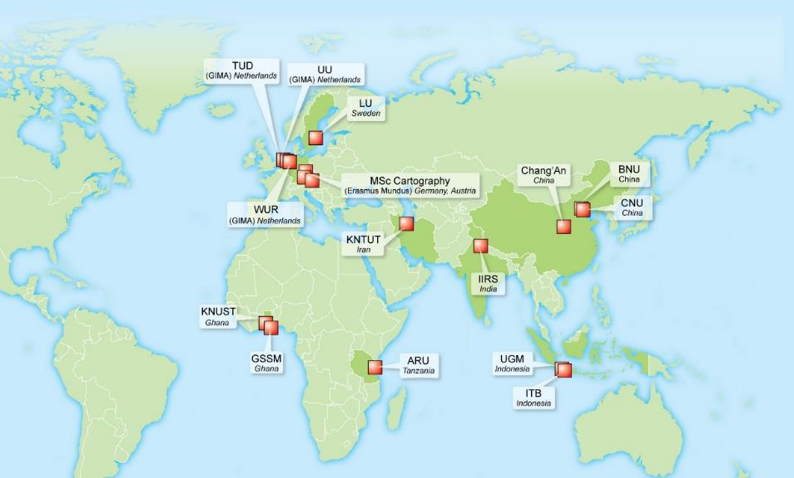
JOINT EDUCATION PROGRAMMES – JEPS (1)
M-GEO
programme
diploma
programme
GIMA – joint programme 4 NL universities
MSc Carto-
graphy
4

Slide 9
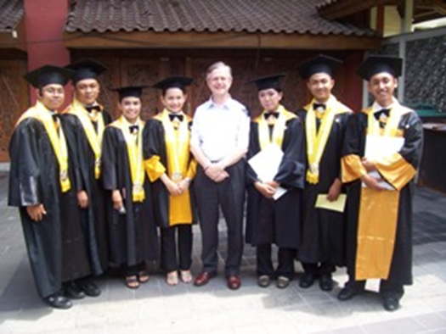
tools
Identification of opportunities
Through personal networks, contacts
Through commercial services
Memberships
Identification of partners
Theory of Change
Logical Framework

Slide 10
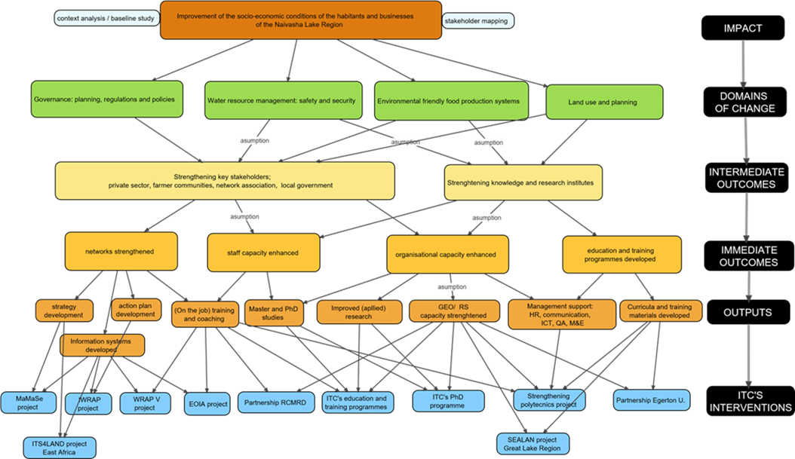
tools
Theory of Change – Logical Framework: defining goal and purpose

Slide 11
Workflow for projects and
partnerships
Flowchart with steps
Description of steps
Milestones
Building up a project file

Slide 12
Workflow for projects and partnerships
Milestones:
Approval by Management Team (MT)
Registration by Finance Department
Proposal development, budget
External checks (Legal, IPR)
Final approval by MT (financial coverage, FTE, other commitments)
  Proposal, budget forecast
  Reference of experiences
  Proof of previous milestones
Final check by Controller
  Complete project file
Documents signed (Dean or CVB)

Slide 13
Workflow for projects and partnerships
Support structure:
Development: Concepts and content, administrative, financial
Implementation:
Administrative, financial, logistics
Monitoring and Evaluation
ESA
PGM
GIP
NRM
EOS
DA
WB
WRS
LE
BB
WB
LE
TL
JT
BB
TH
MO
EH
CS
HM
Faculty Bureau
FEZ
PA
PA

Slide 14
Documents available
Erasmus Mundus: Joint Education from A to Z: a reference guide
Erasmus Mundus: ASEMUNDUS Good Pratice Report
Protocols for Double Degree programs, Joint PhD’s
Guidelines for selection of Strategic Partners
Protocol for Project Support (under development)
Guidelines
  Theory of Change
  Logical Framework

Slide 15
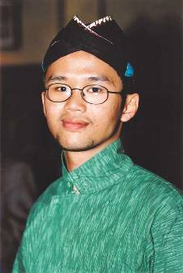
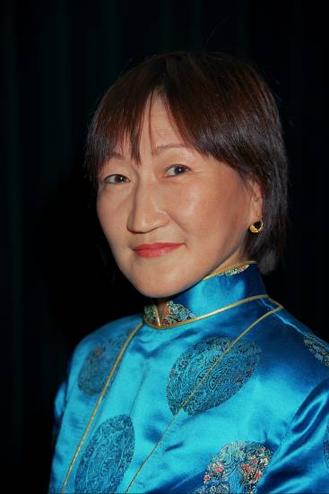
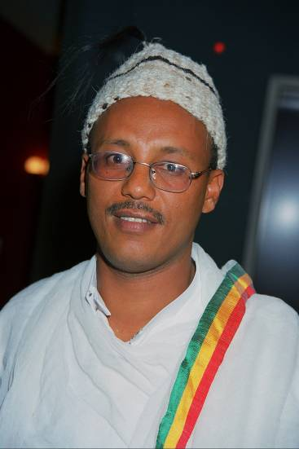
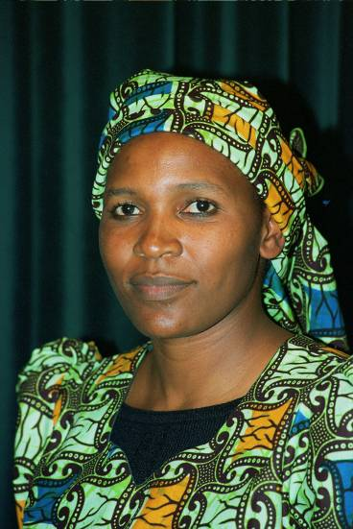
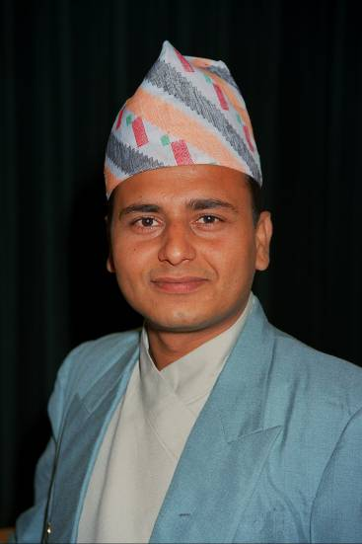
Thank you!
t.m.loran@utwente.nl

