Slide 1
Ministry of Agriculture, Livestock and Irrigation
Department of Rural Development
GIS for Rural Development
Projects of DRD
Ni Lar Soe
Deputy Director
M&E, MIS Division
Department of Rural Development
matoetoe@gmail.com
12nd March 2019

Slide 2
Content
About the Ministry
Projects
Partnerships
Benefits
Challenges
Future Plan

Slide 3
About the Ministry
Ministry of Agriculture, Livestock and Irrigation was established on April 1st , 2016 in line with the form of New Government.
The Ministry was reorganized by merging the former 3 Ministries namely Ministry of Agriculture and irrigation, Ministry of livestock, fisheries and rural development and Ministry of cooperative.
Under the Ministry, 11 departments, 4 universities in the fields of Agriculture, Veterinary and Cooperative.
Department of Rural Development (DRD) is one of the departments under the Ministry.

Slide 4
Focusing three sectors-
Goal
The goal of Our Department of Rural Development is to improve socio-economic life of rural people and to narrow down rural-urban divides.
Infrastructure development
Livelihood enhancement
Capacity development
To implement three sectors, developed the Rural Development Strategic Framework

Slide 5
The main of Rural Development Projects,
Water Supply Project - Government Budget, JICA, UNICEF
Rural Electrification Project - Government Budget, World Bank, GIZ
Ever Green Village Development Project - Government Budget
Village Development Planning Project ( VDP) –Government Budget, Lift Fund
National Community-Driven Development Project (NCDDP) –World Bank
Enhancing Rural Livelihoods and Incomes Project (ERLIP) – ADB

Slide 6
GIS is becoming essential
To plan
To avoid overlapping of project areas
To collect more data on the progress of our projects
To monitor and evaluate the outcomes of activities effectively.

Slide 7
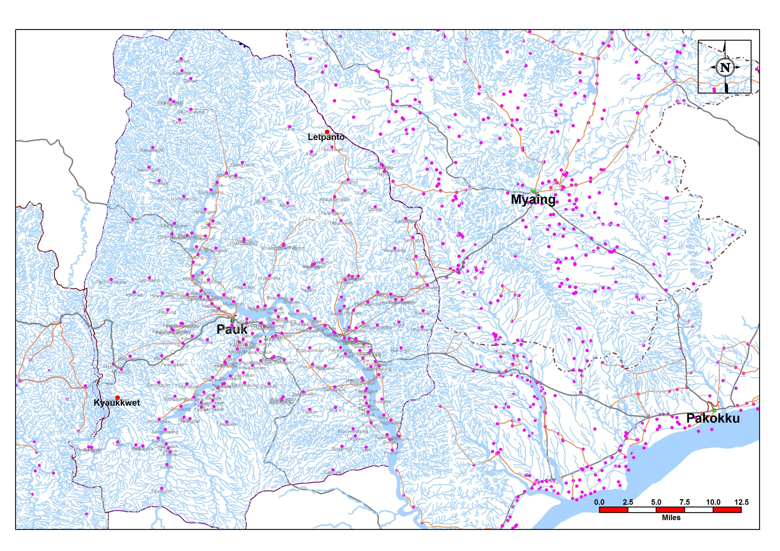
Since 2001, Department of Rural Development (DRD), the former name of Department of Development Affairs (DDA), has been using Geographic Information System in assessing of village data.

Slide 8
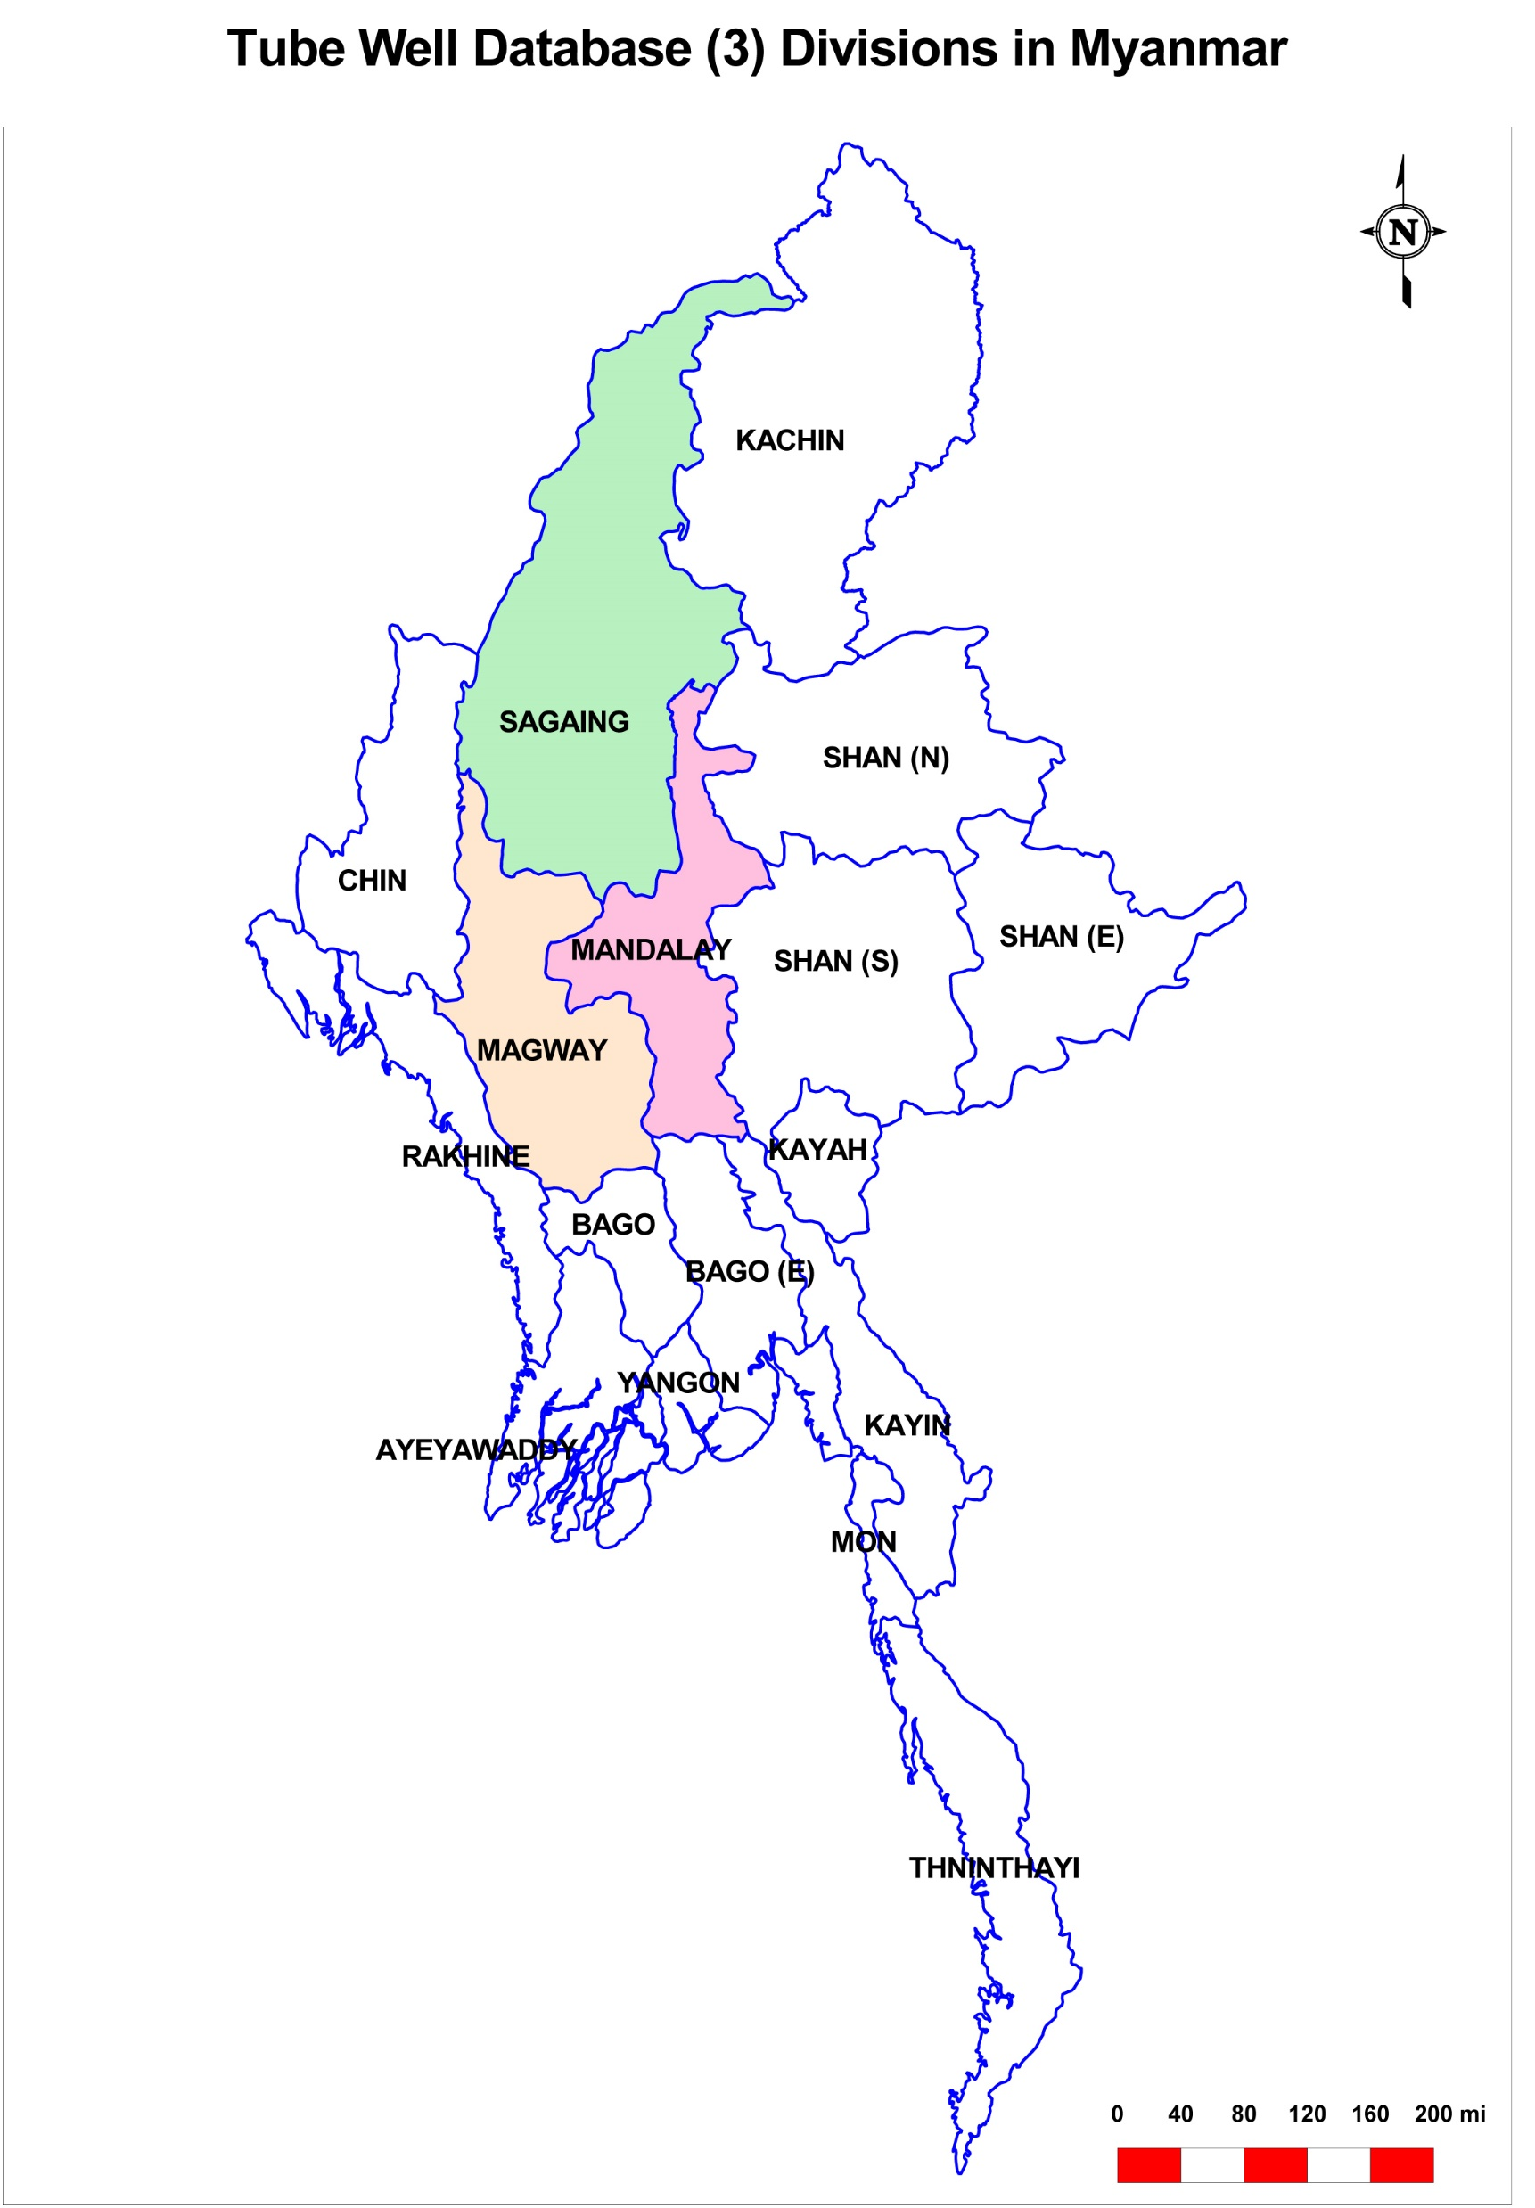
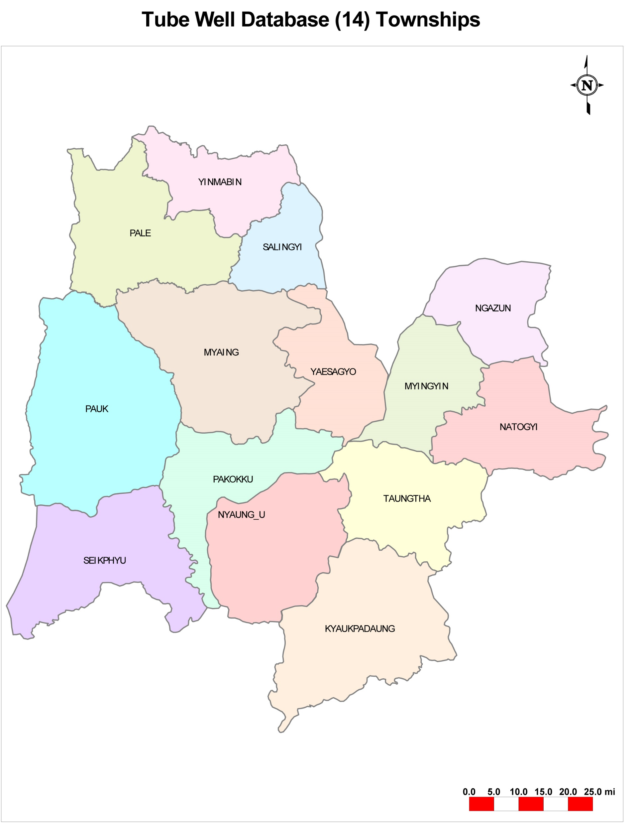
In 2008 and 2009, collected the WASH data supported by UNICEF.

Slide 9
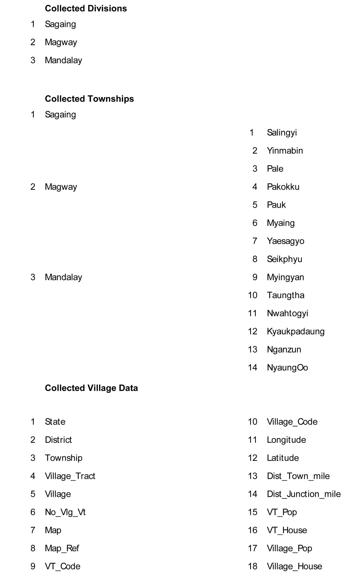
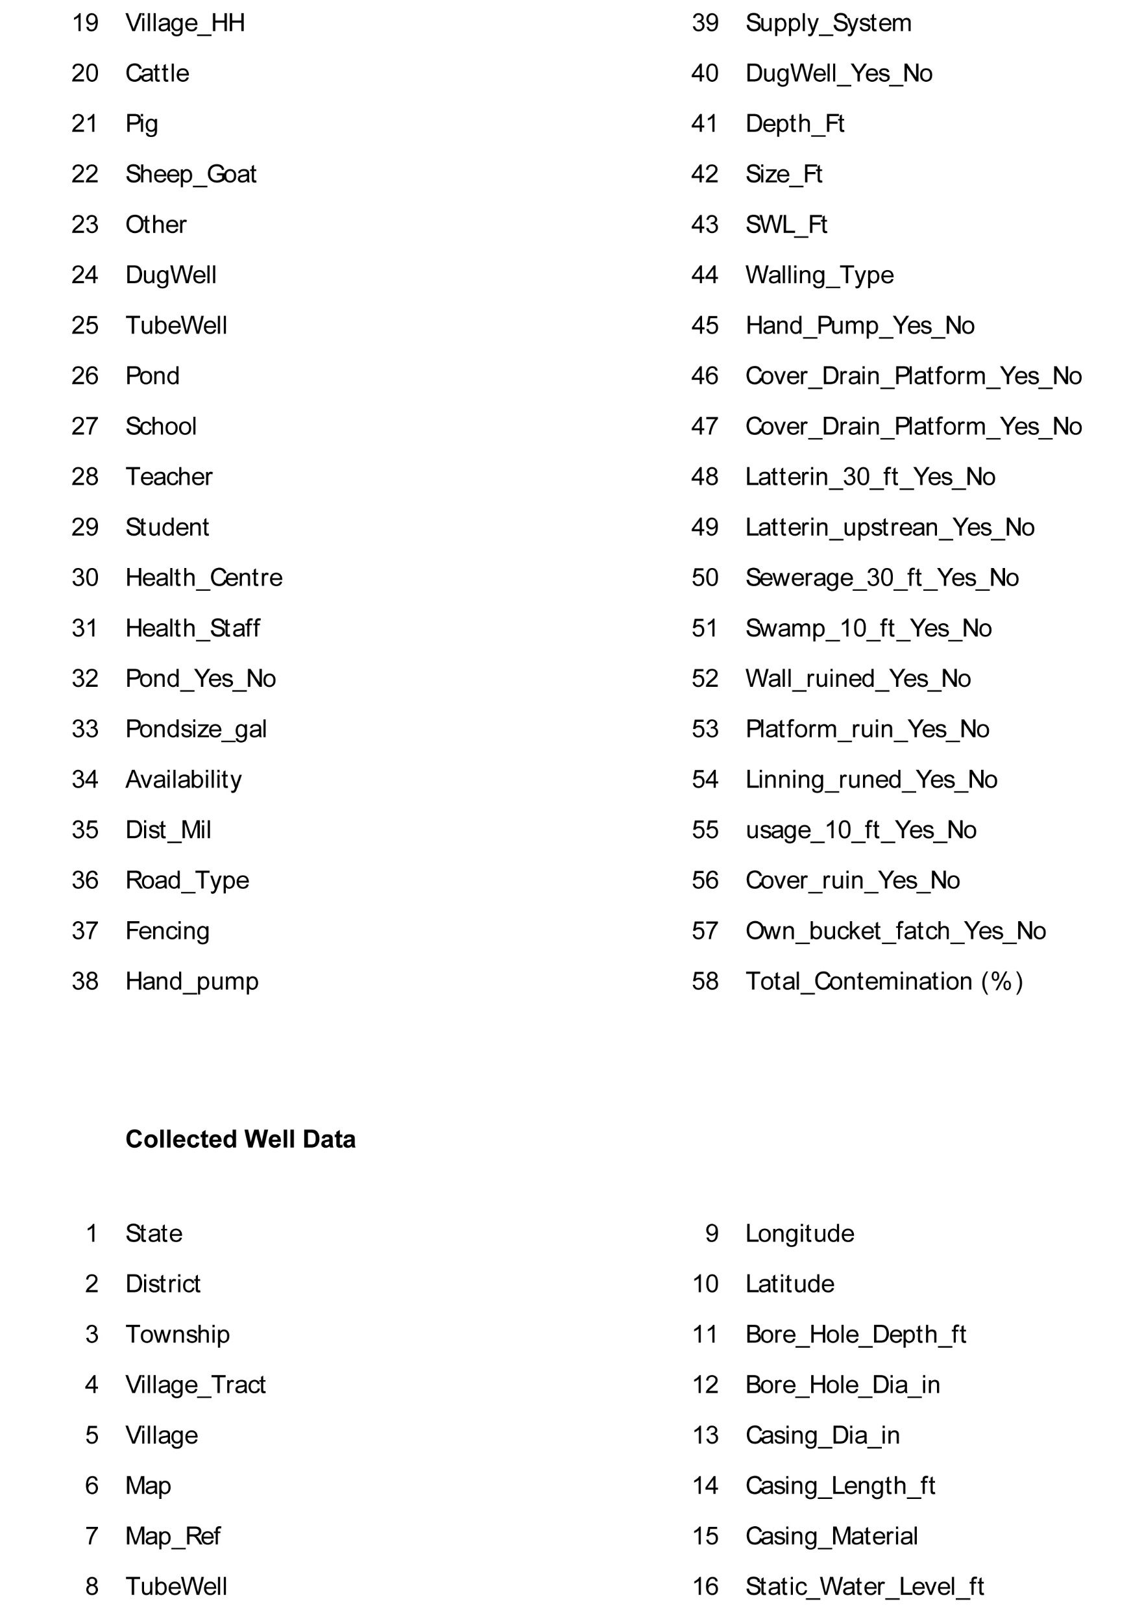
WASH database

Slide 10
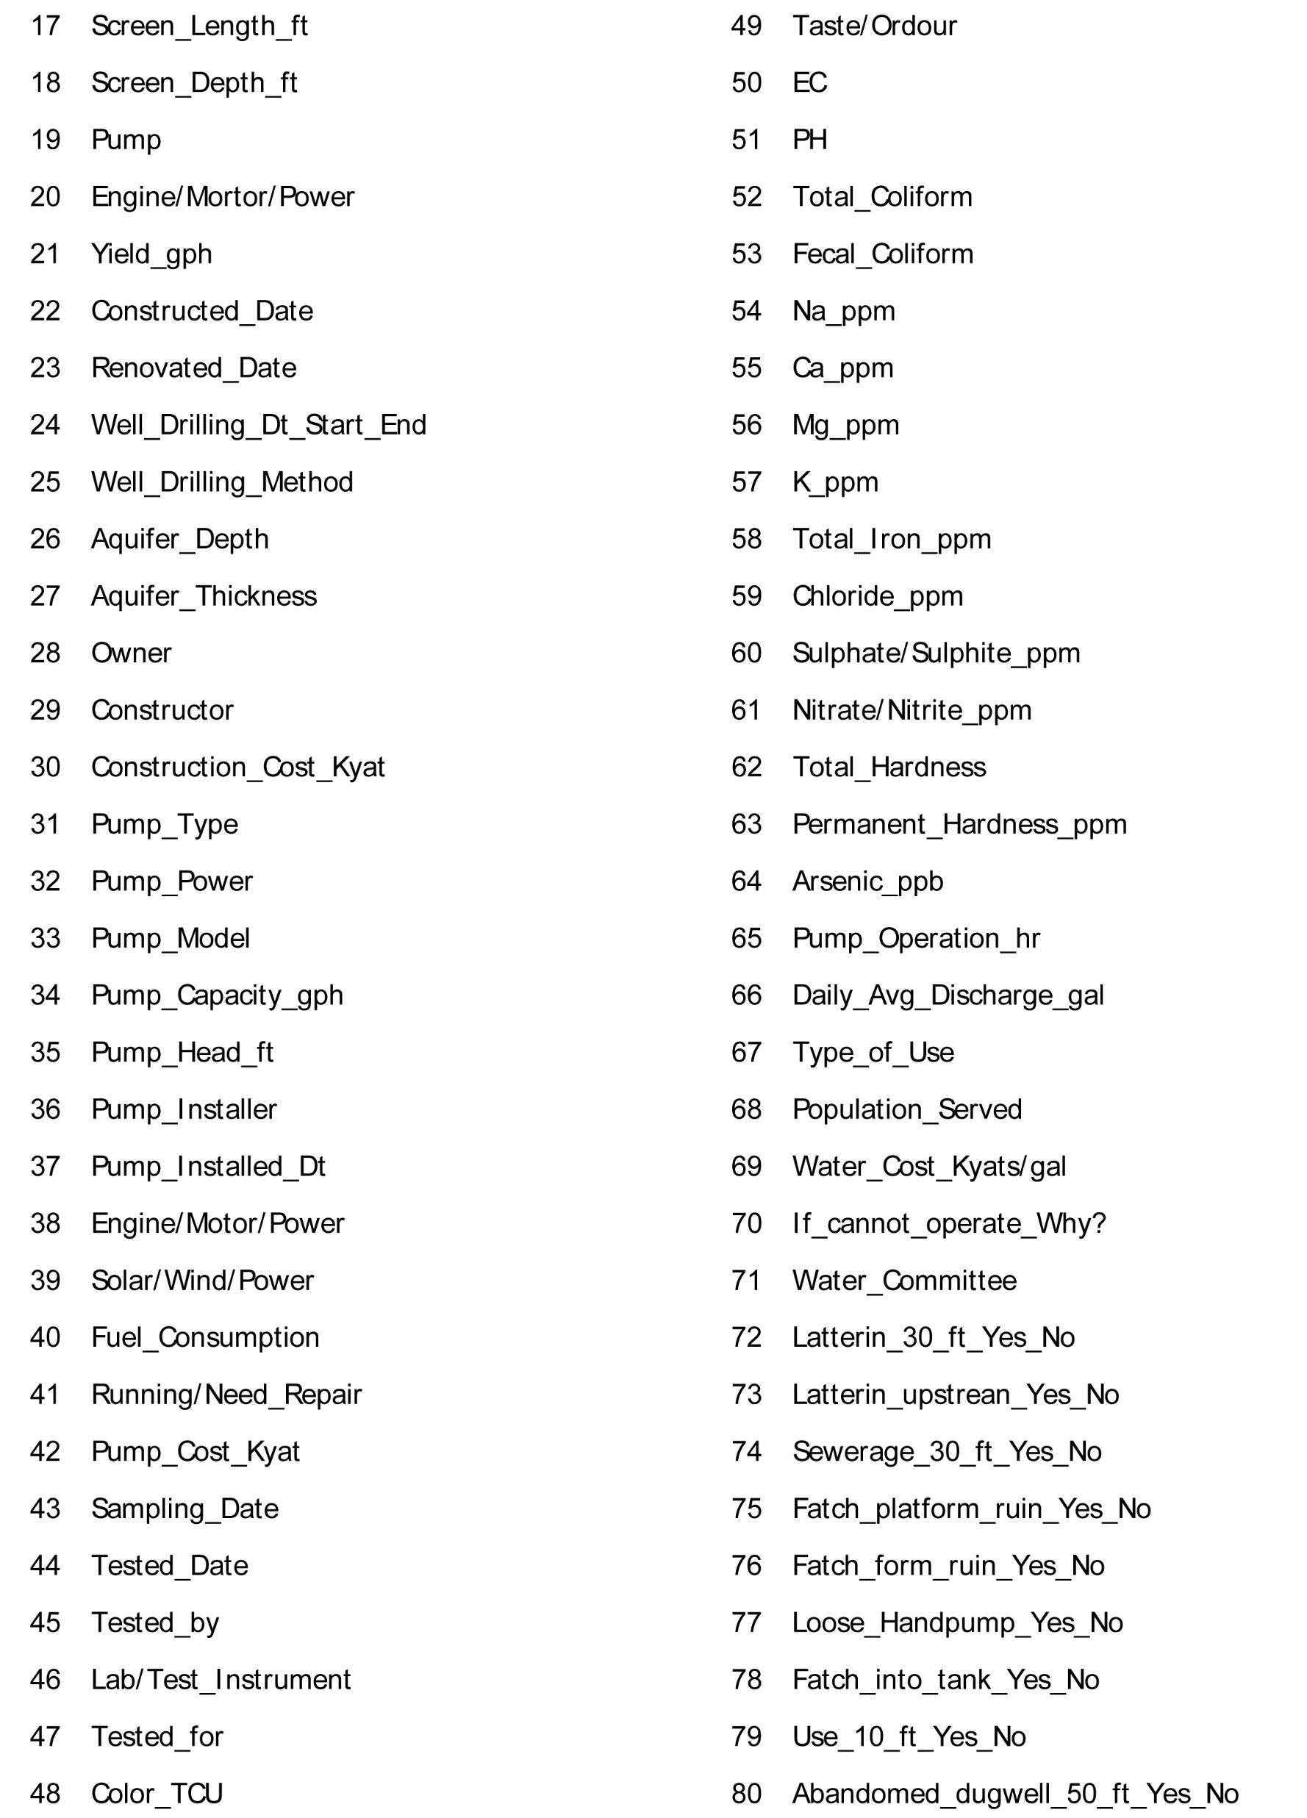
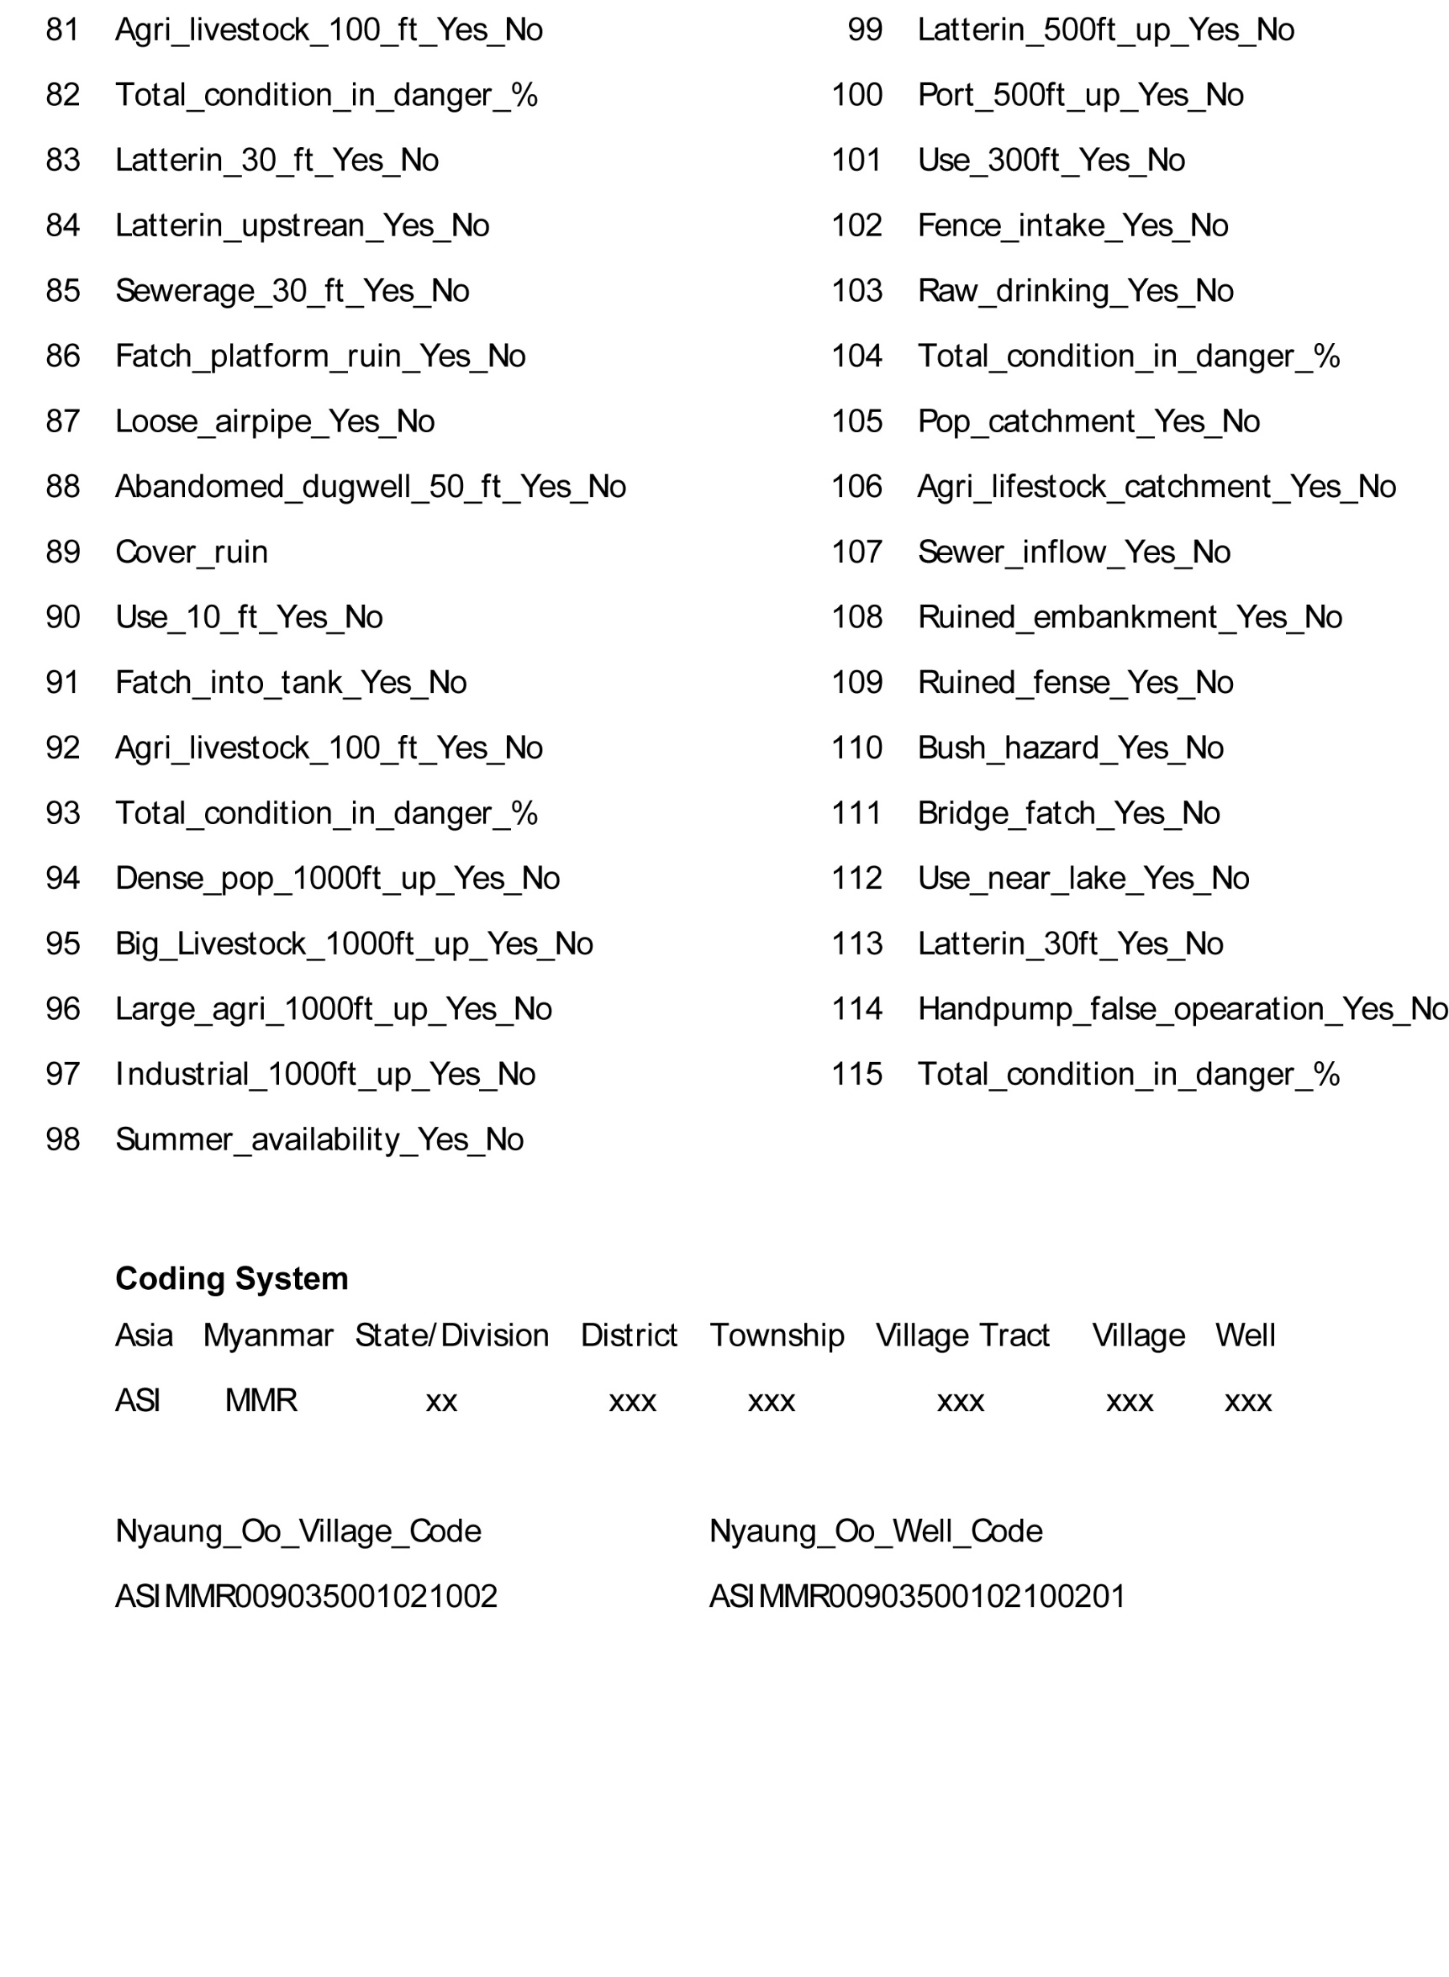
WASH database

Slide 11
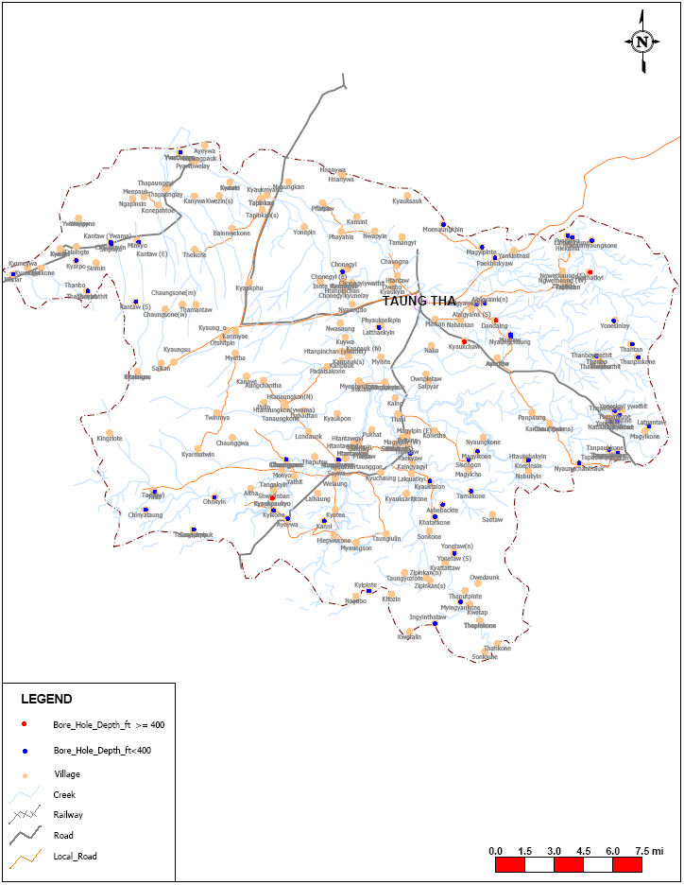
Village Tube-well Map
Tube Wells of AyardawTownship, Sagaing Region
Tube Wells of Taungtha Township, Mandalay Region

Slide 12
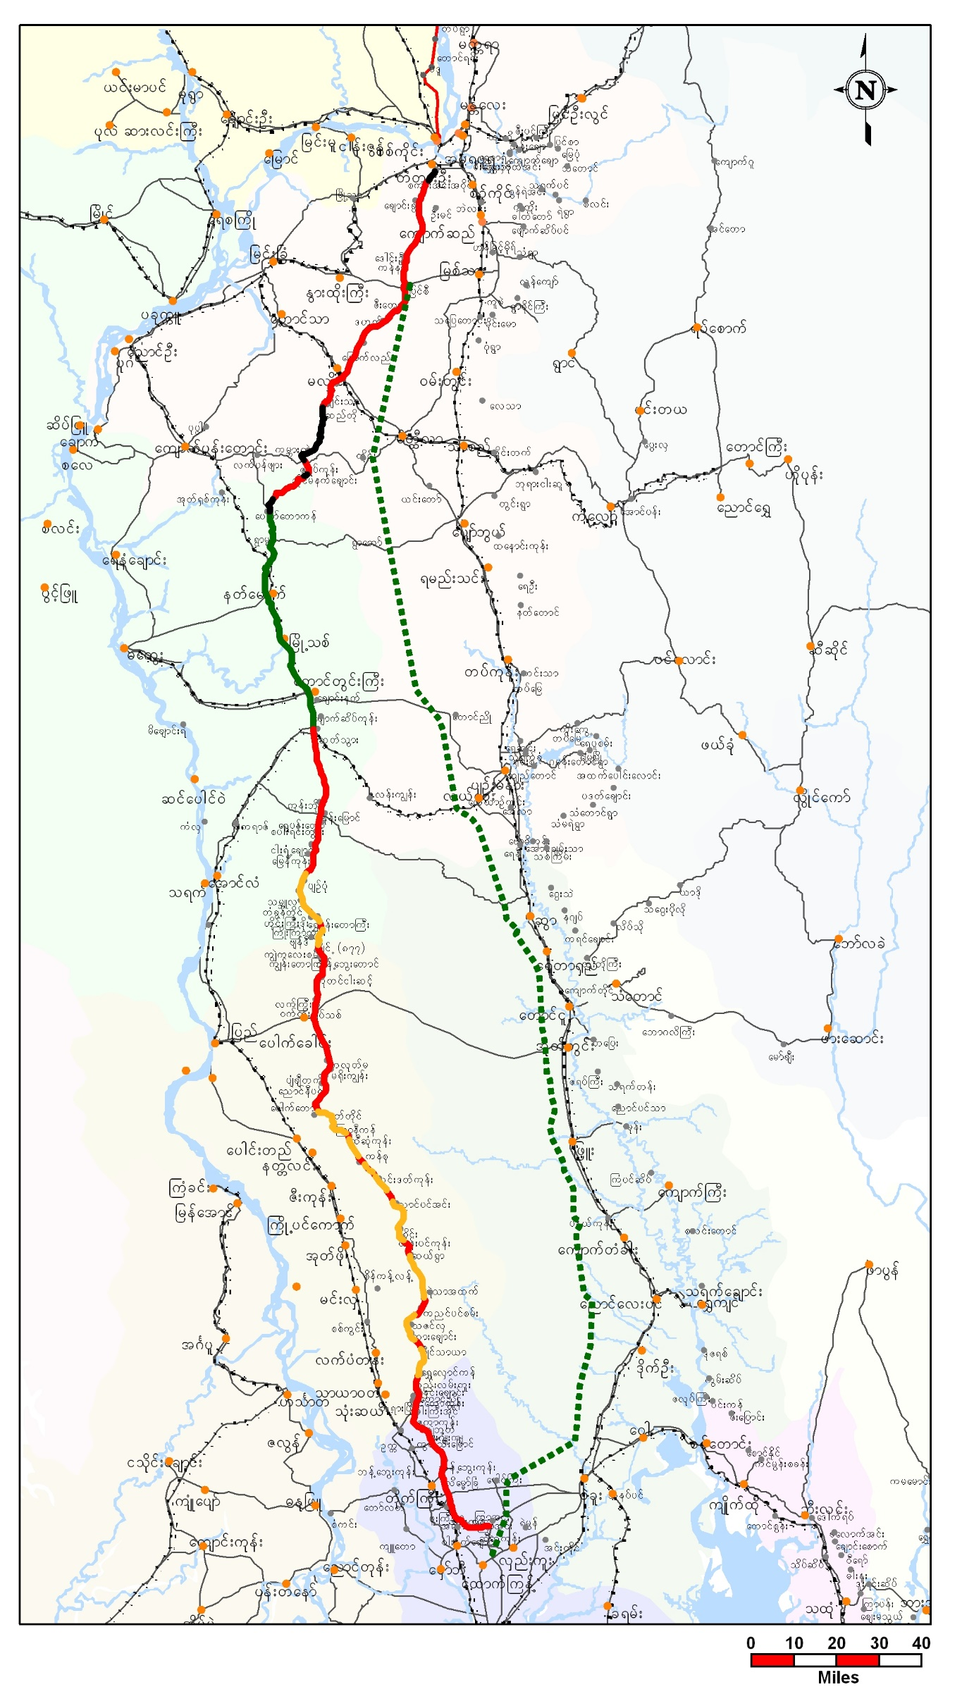
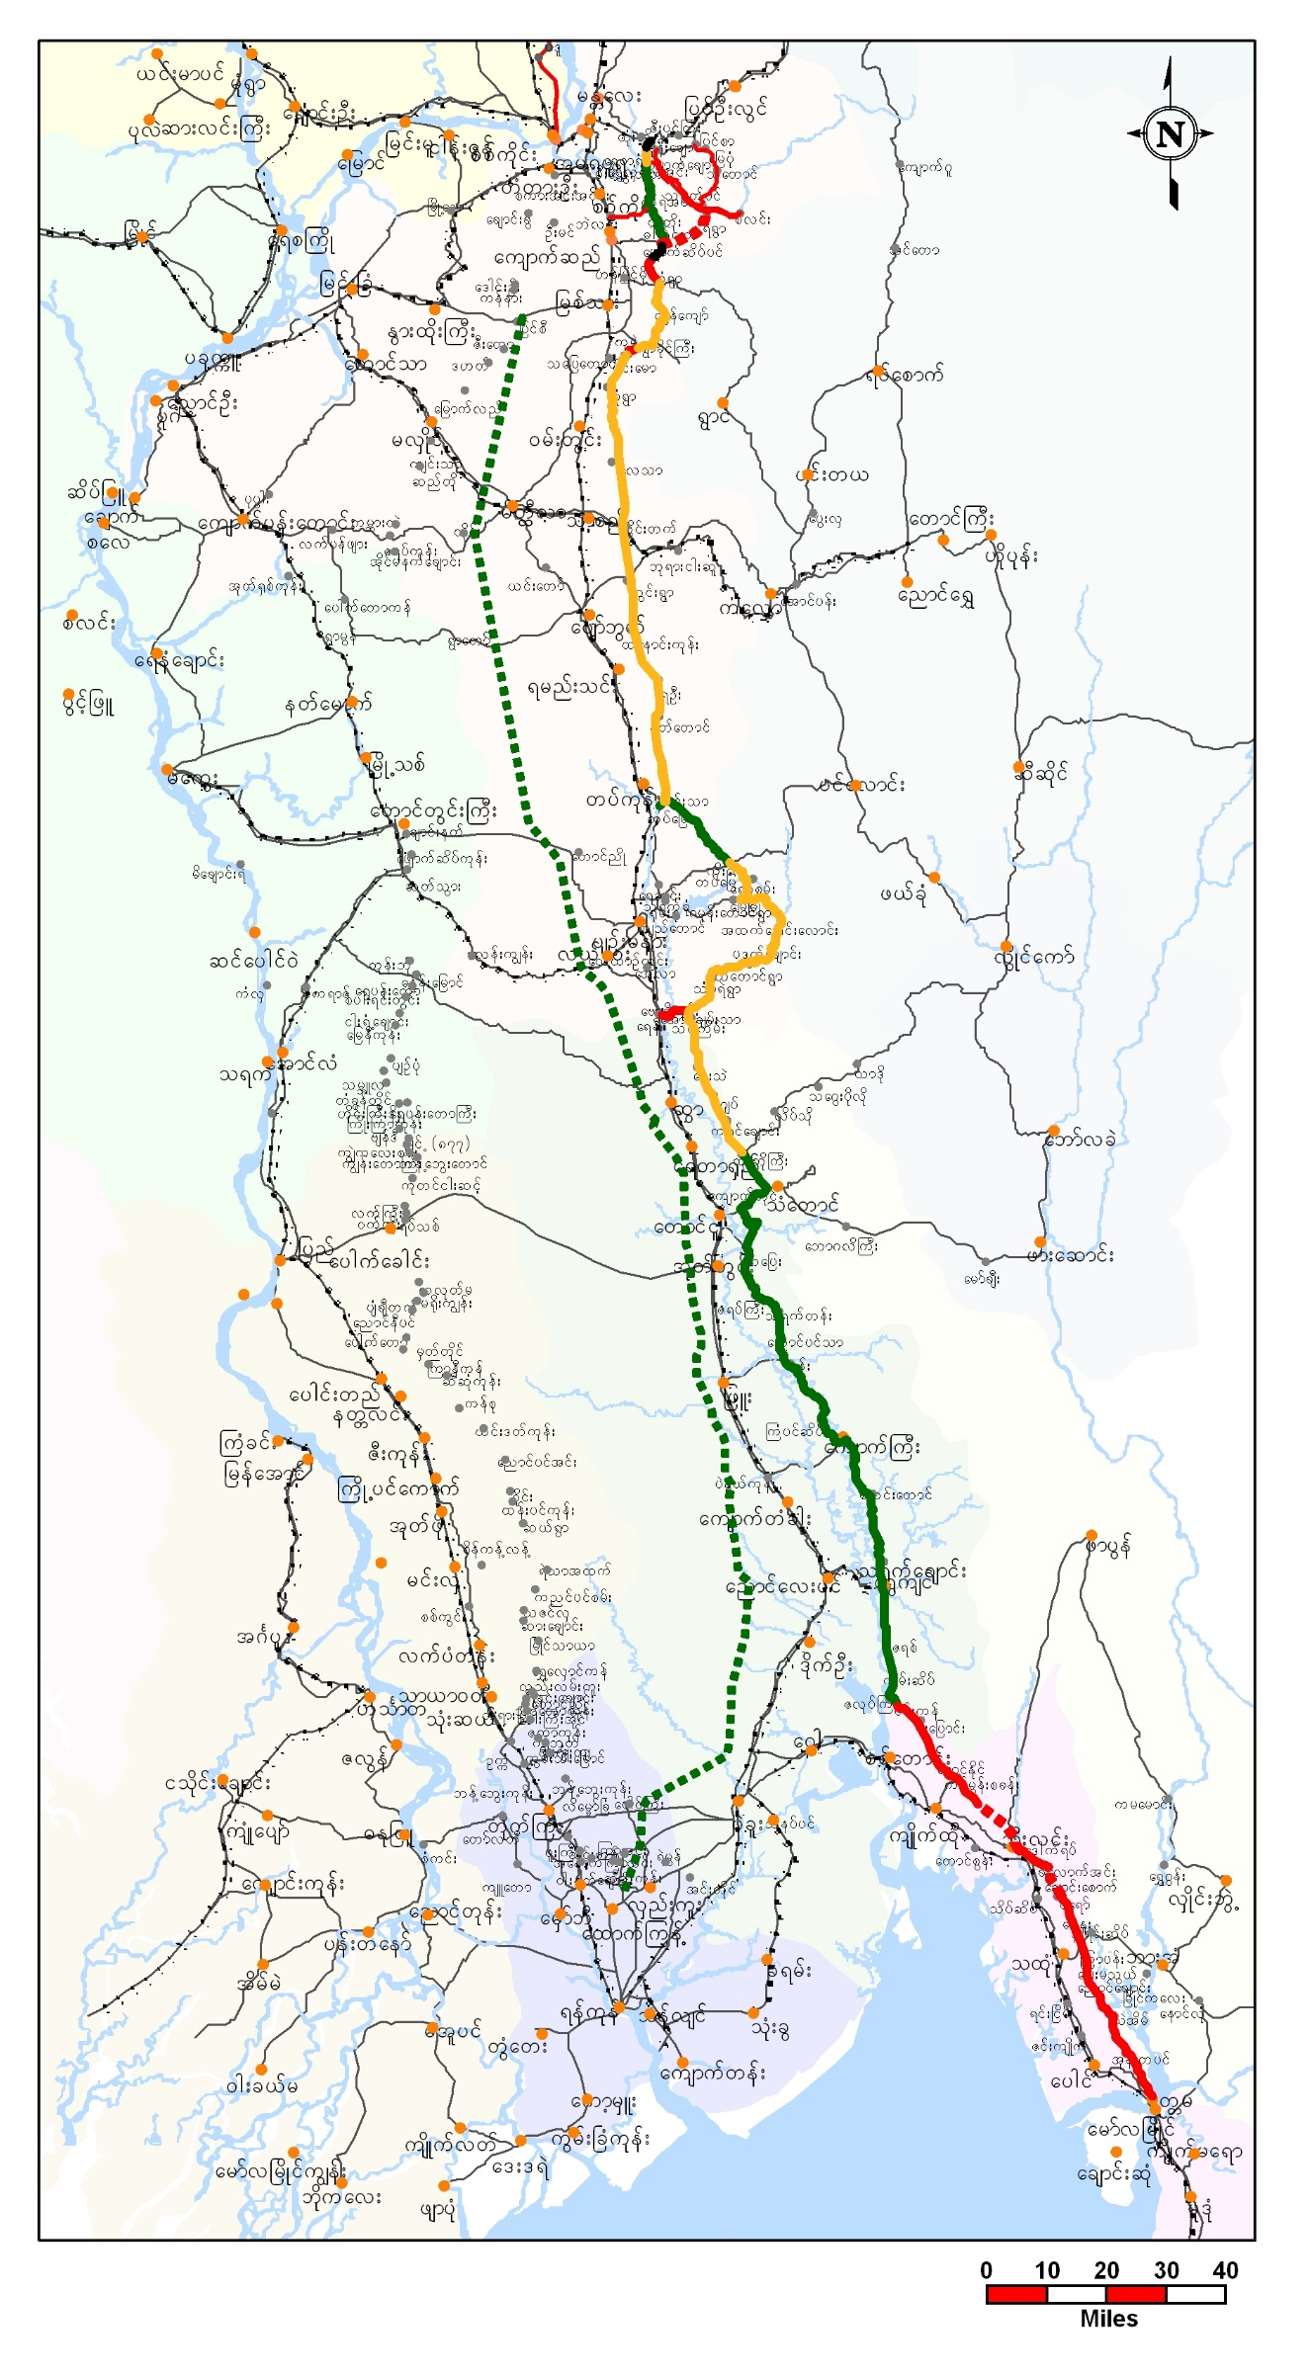
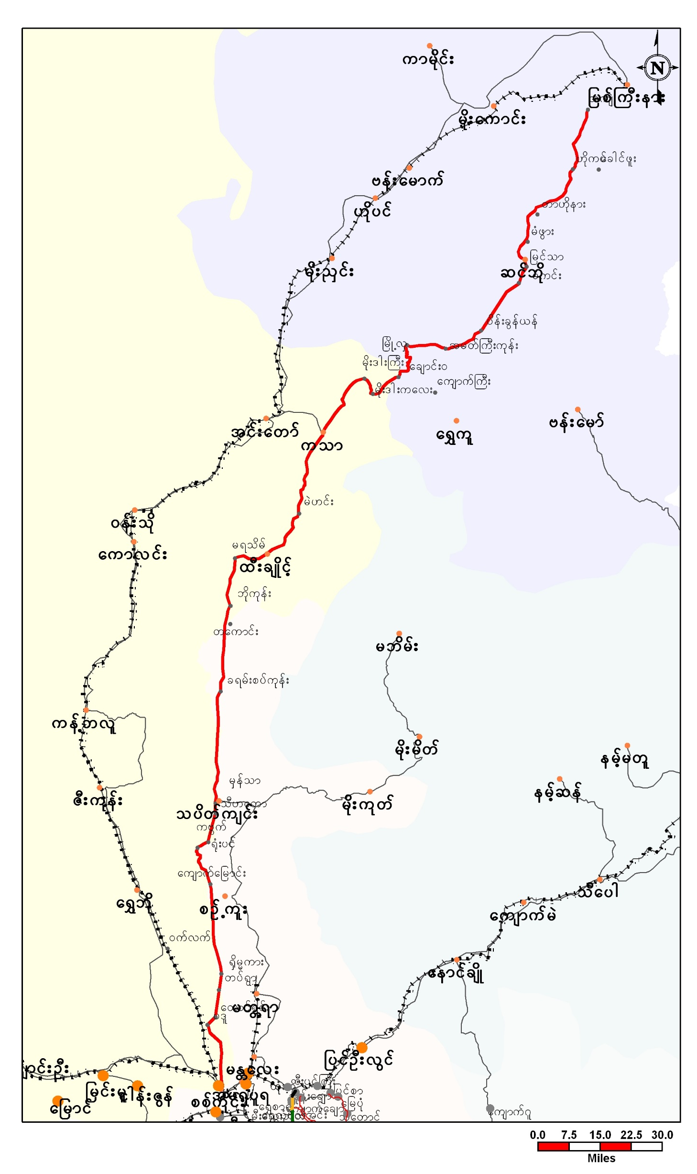
Inter-district Roads (1,2,3)

Slide 13
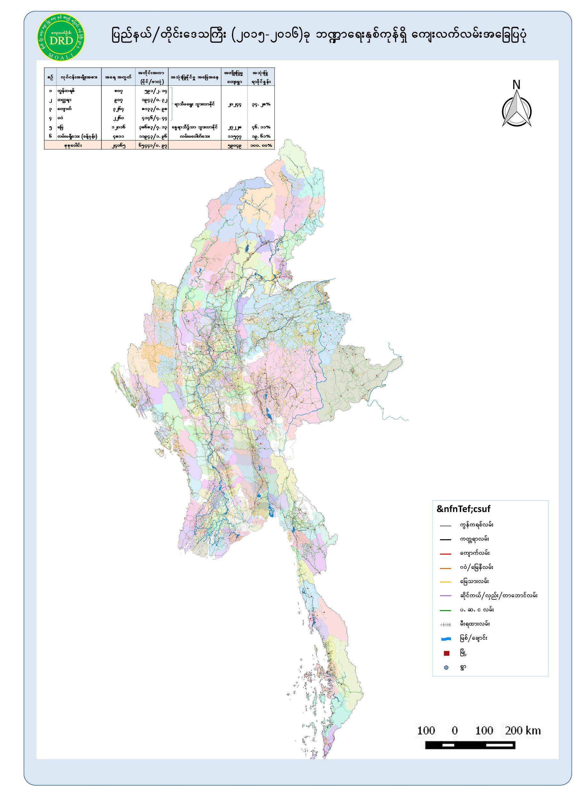
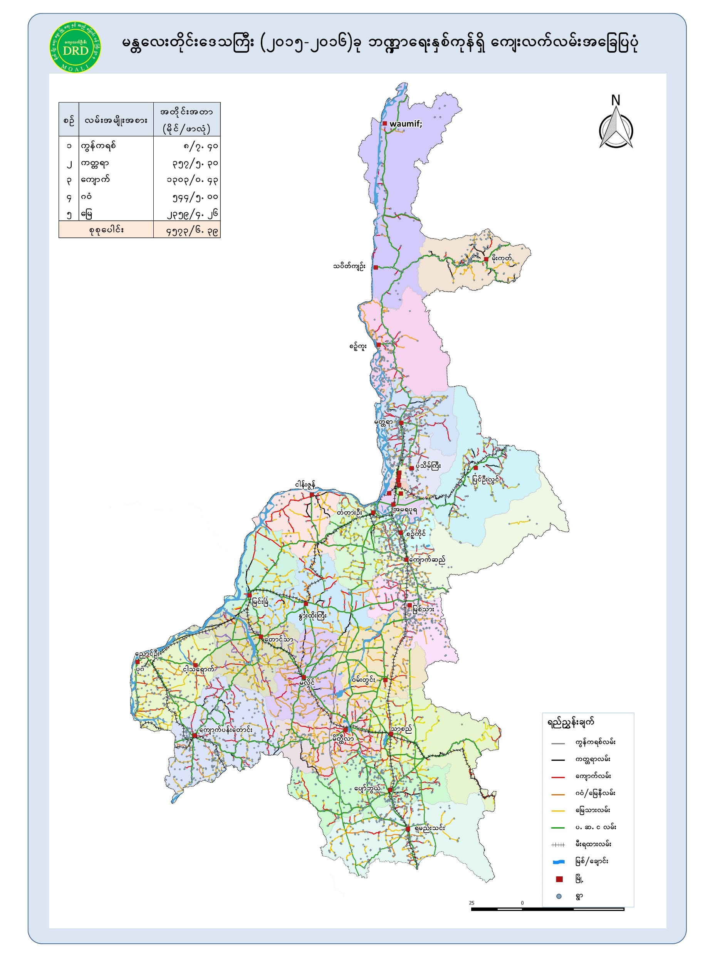
Rural Roads Village access levels (over 60000 miles)

Slide 14
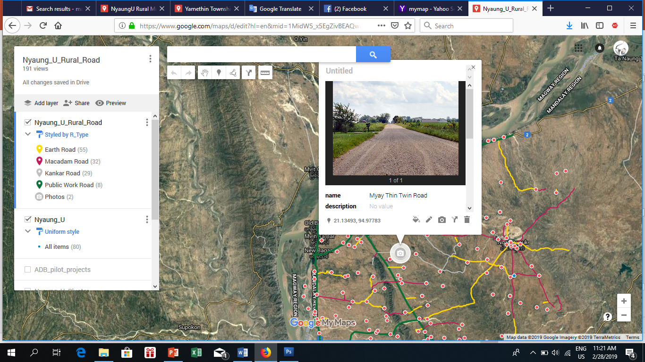
https://www.google.com/maps/d/edit?hl=en&mid=1MidW5_x5EgZivBEAQwA37jhMrSI&ll=21.320283503862953%2C94.83207999896081&z=10
Rural Road in NyaungU

Slide 15
DRD all open projects and programs using the GIS database

Slide 16
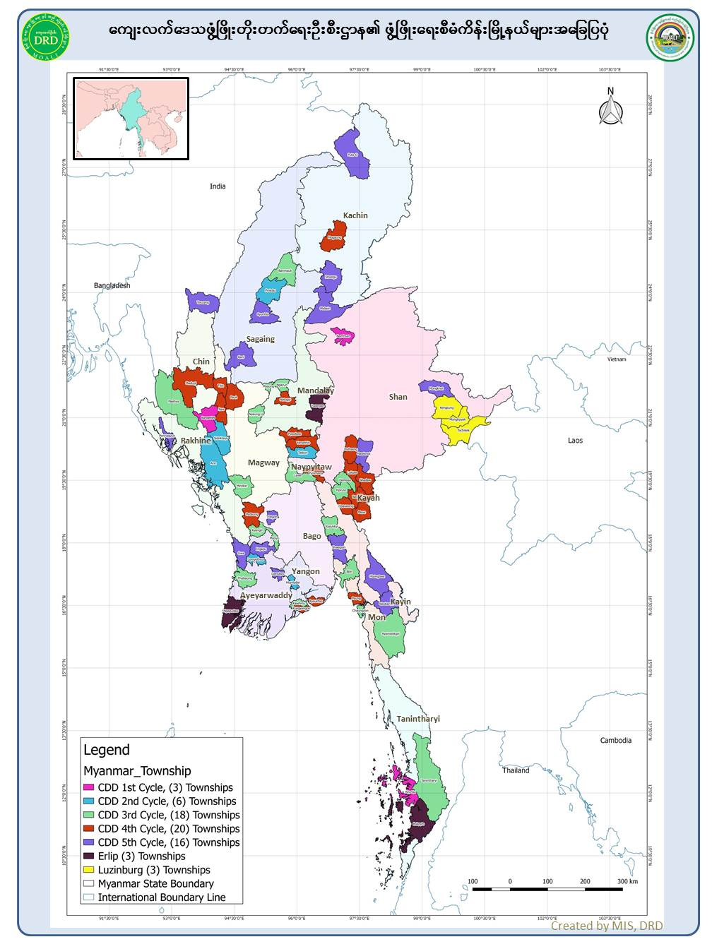
Development Projects Townships

Slide 17
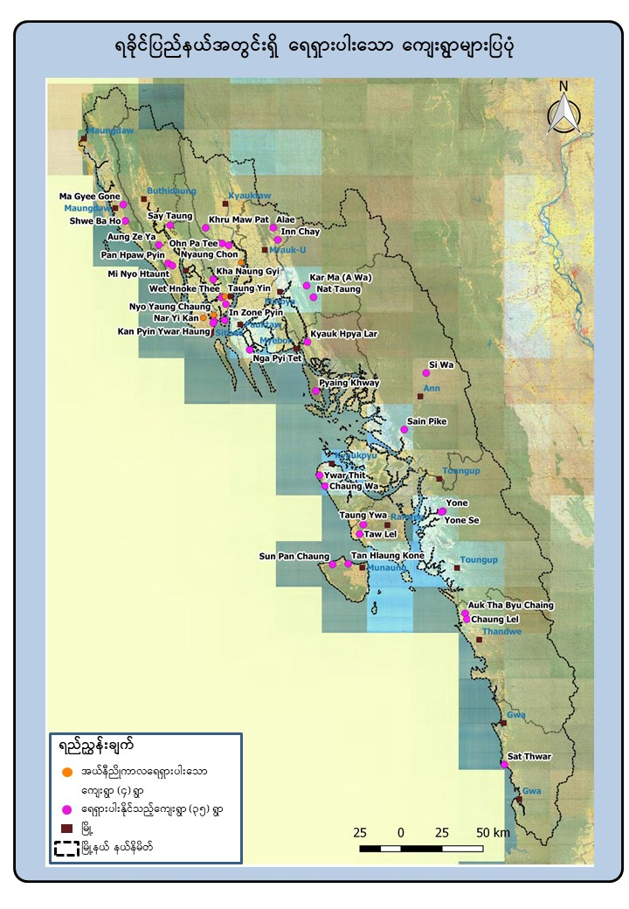
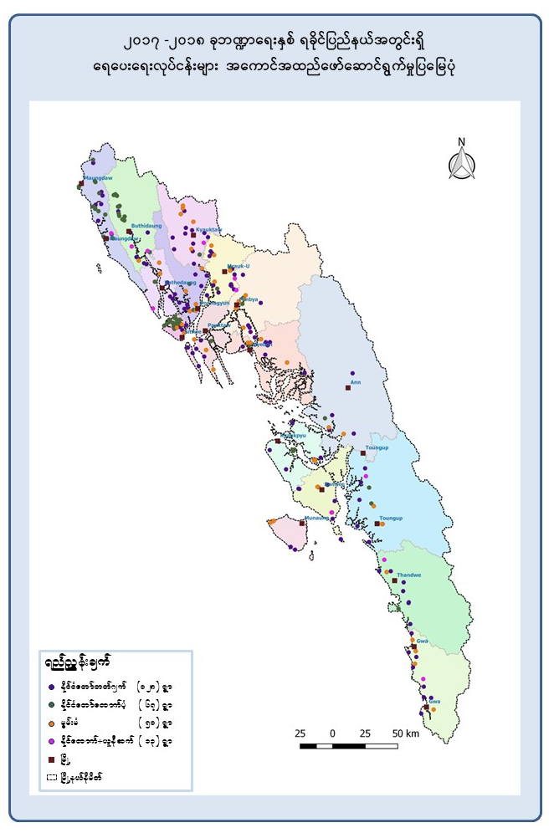
Water Supply Project

Slide 18
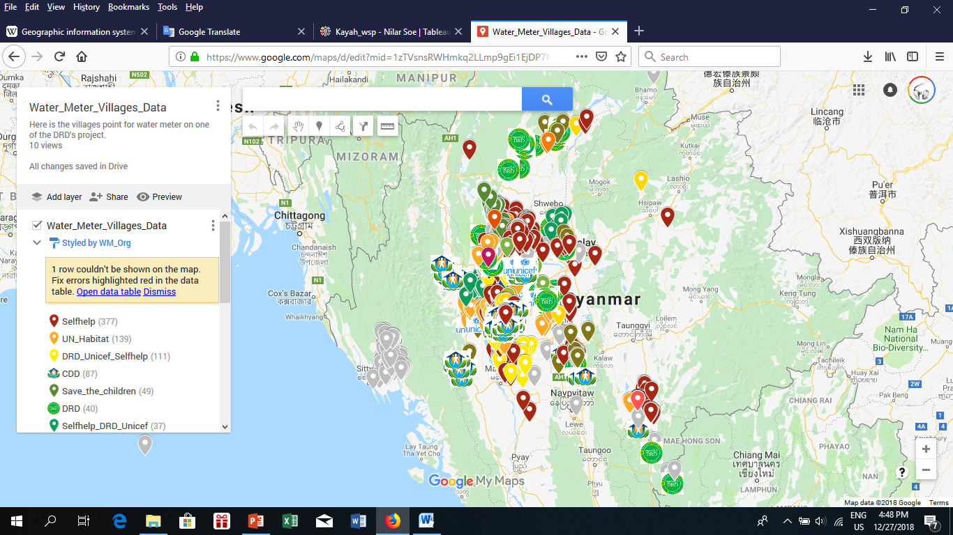
Water Meter
https://www.google.com/maps/d/edit?mid=1zTVsnsRWHmkq2LLmp9gEi1EjDP7NyeYI&ll=20.044312662520102%2C93.60697044999995&z=6er (Google My Map)

Slide 19
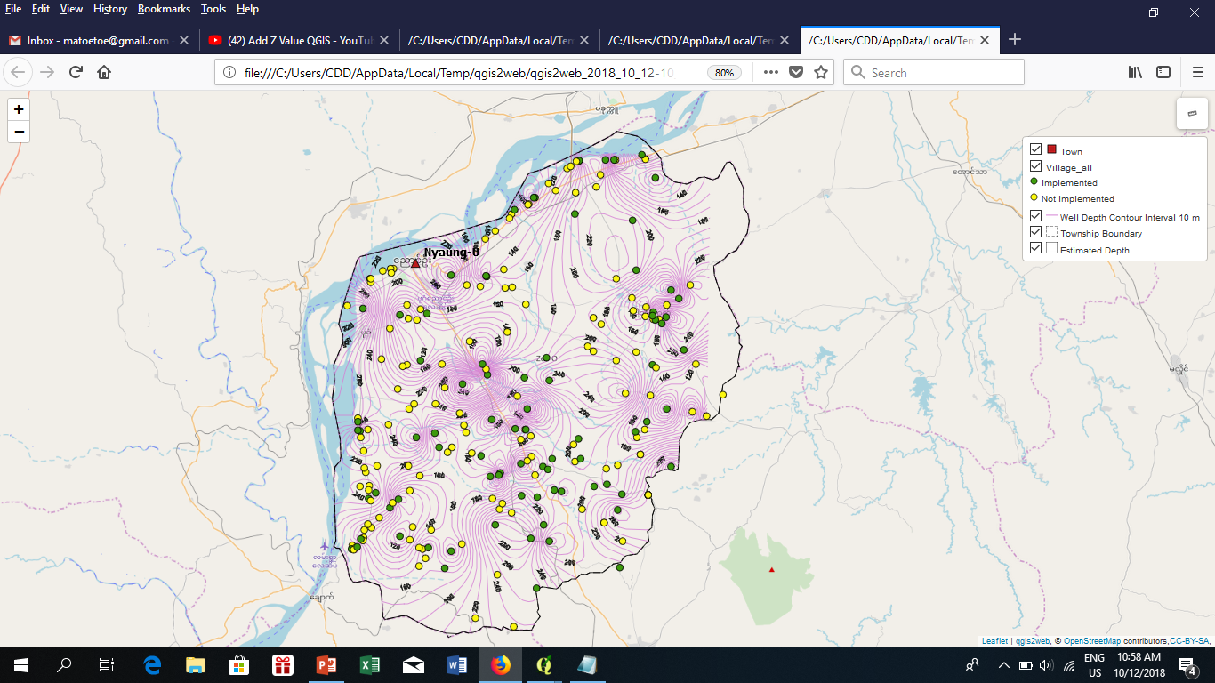
Ground Water Map
file:///C:/Users/CDD/AppData/Local/Temp/qgis2web/qgis2web_2019_03_03-13_19_55_024000/index.html#8/21.210/95.254

Slide 20
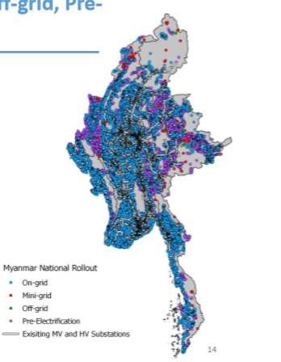
Rural Electrification Project
National Electrification Plan
Connected earlier
Connected later

Slide 21
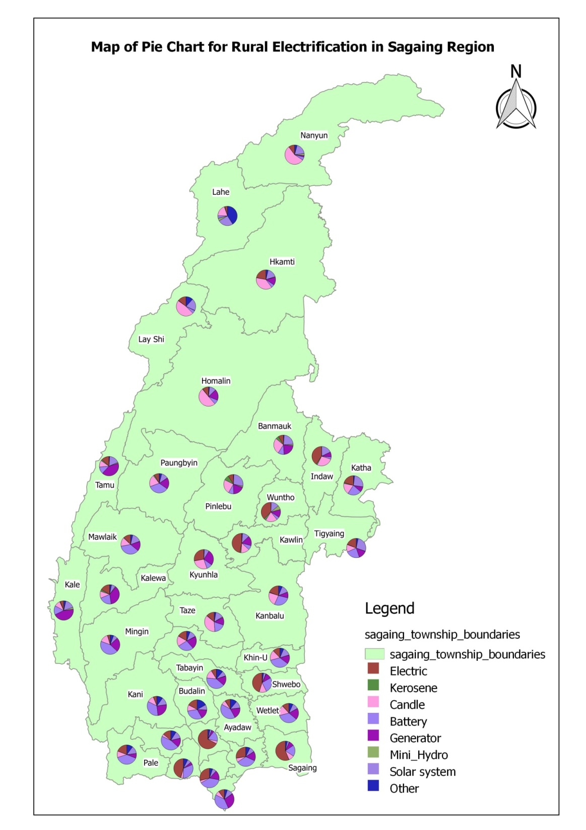
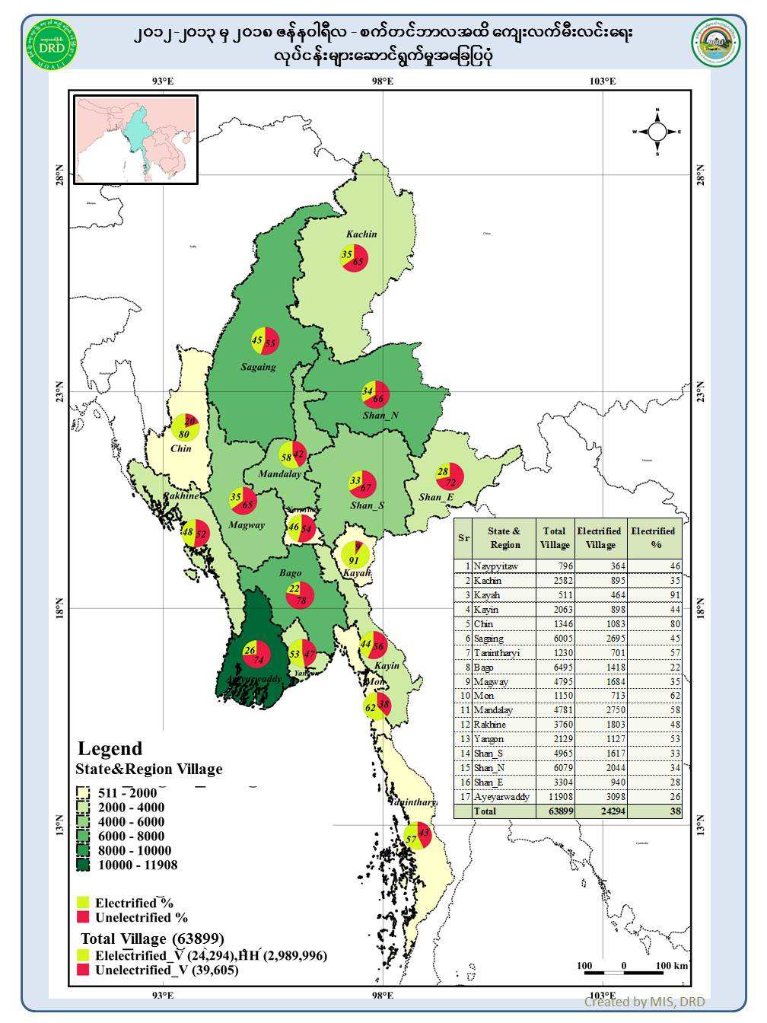
Rural Electrification Project

Slide 22
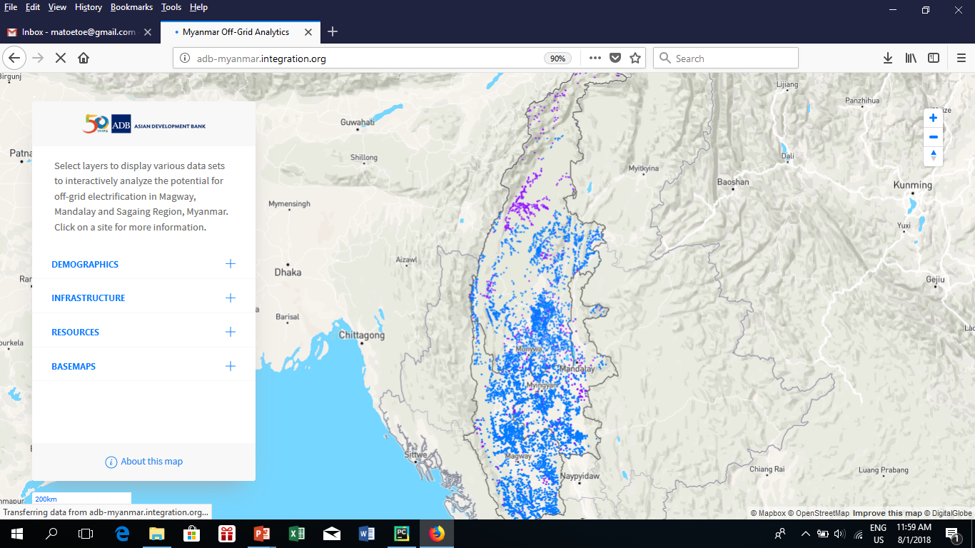
Rural Electrification Central Dry Zone (Solar)
http://adb-myanmar.integration.org/

Slide 23
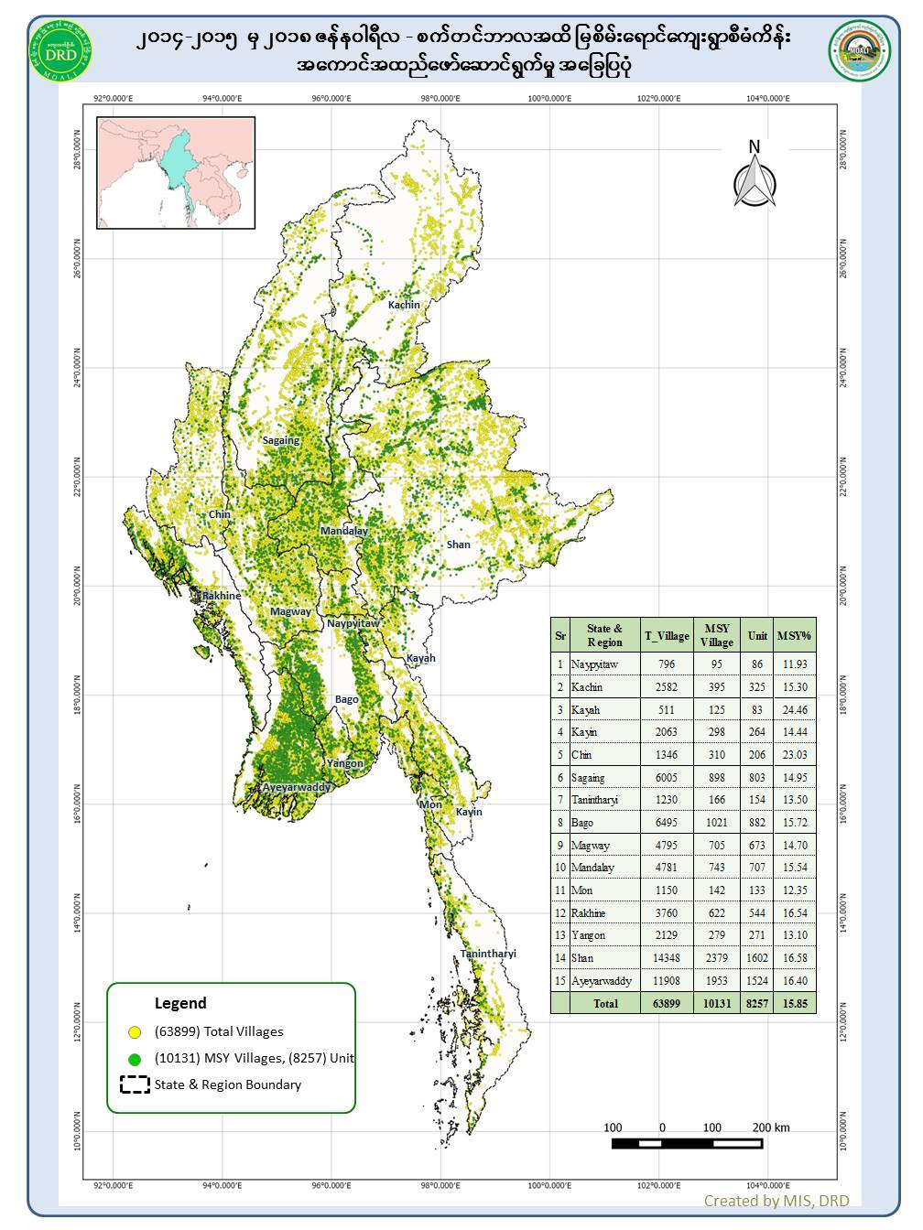
Ever Green Village Development Project

Slide 24
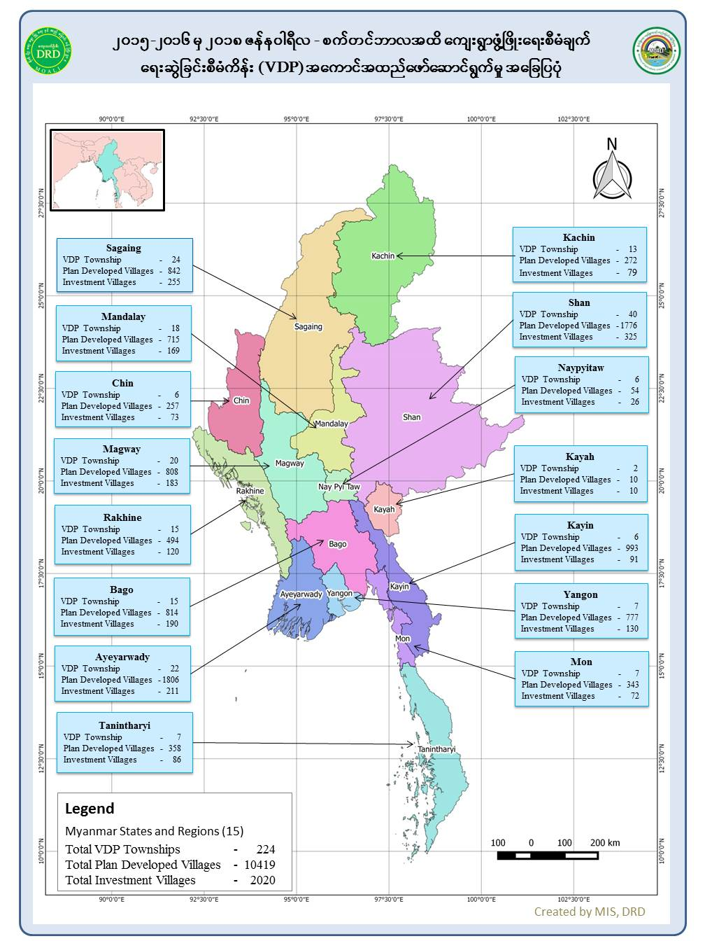
Village Development Plan Project

Slide 25
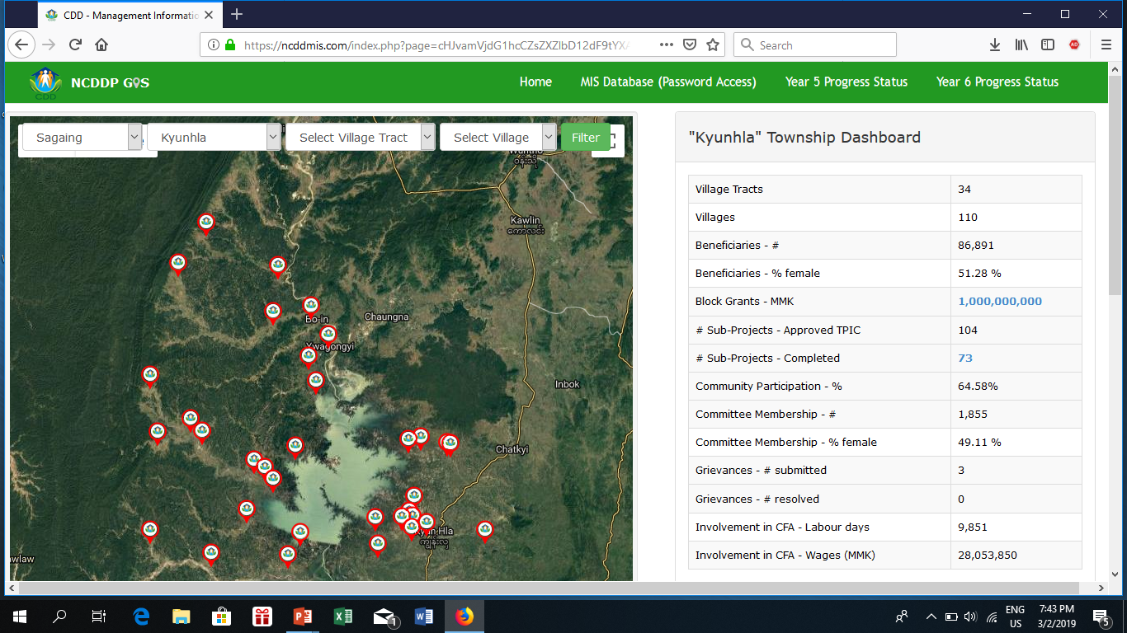
National Community Driven Development Project
https://ncddmis.com/

Slide 26
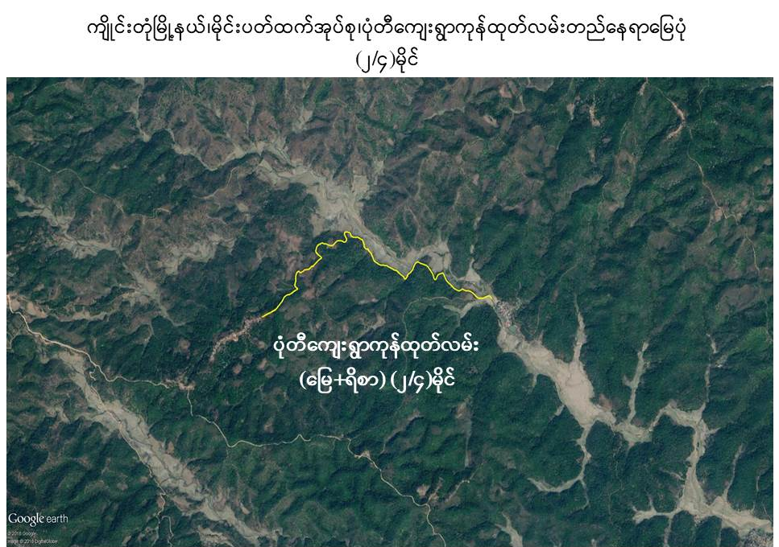
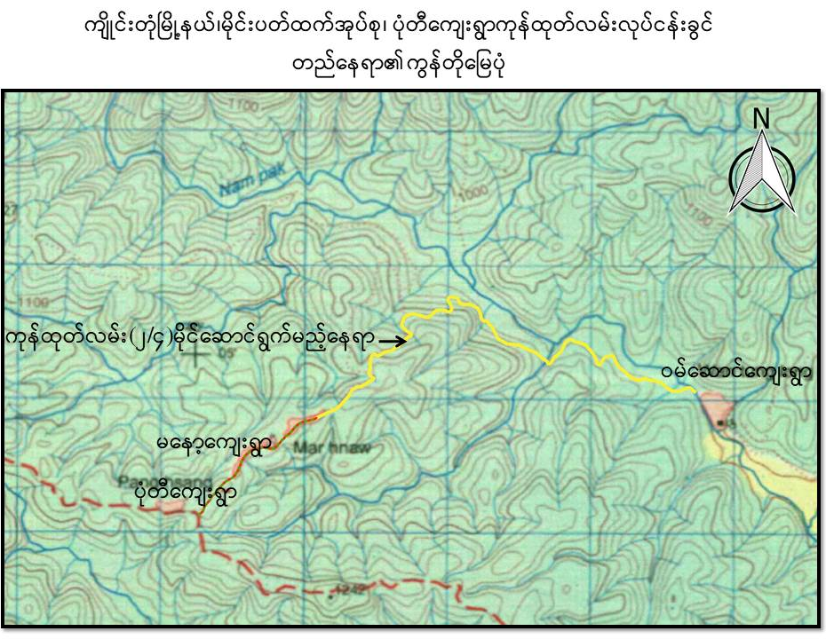
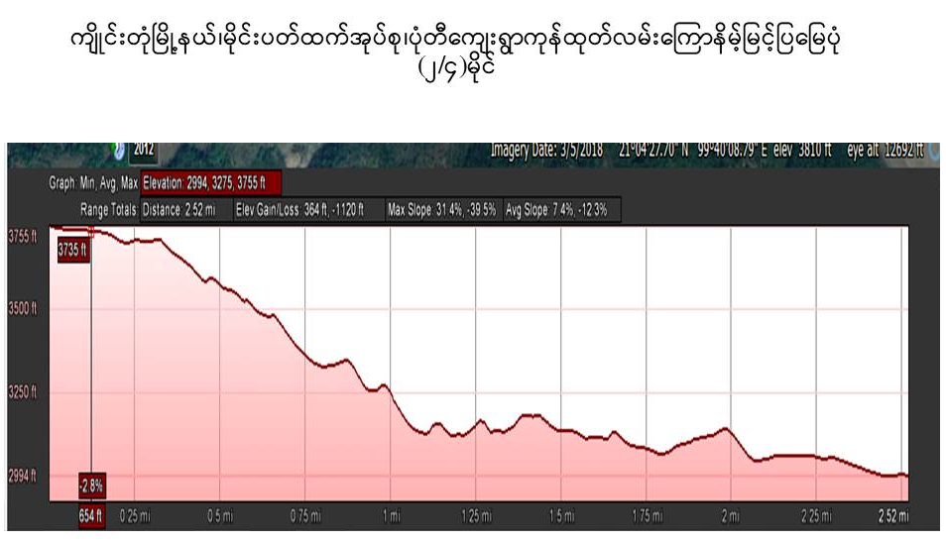
Farm Road

Slide 27
Monitoring and Evaluation
Data Processing System (MEPS)
Institutional Strengthening and Policy Dialogue Support
(2015-2018)
Supported by European Union

Slide 28



Overview Of DRD M&E Data Collection and Processing System
Upload
Download
ODK Application
Internet
Project
Form
Township
Form
Village
Form
Access
Data collection
Data collection
Data collection
Data analysis
Output
- Water Supply data Form (3)
- National Electrification Project data Form (3)
- Revolving Fund Form (4)
- Vocational Training data Form (3)
Report
Graph , Table, Map

Slide 29
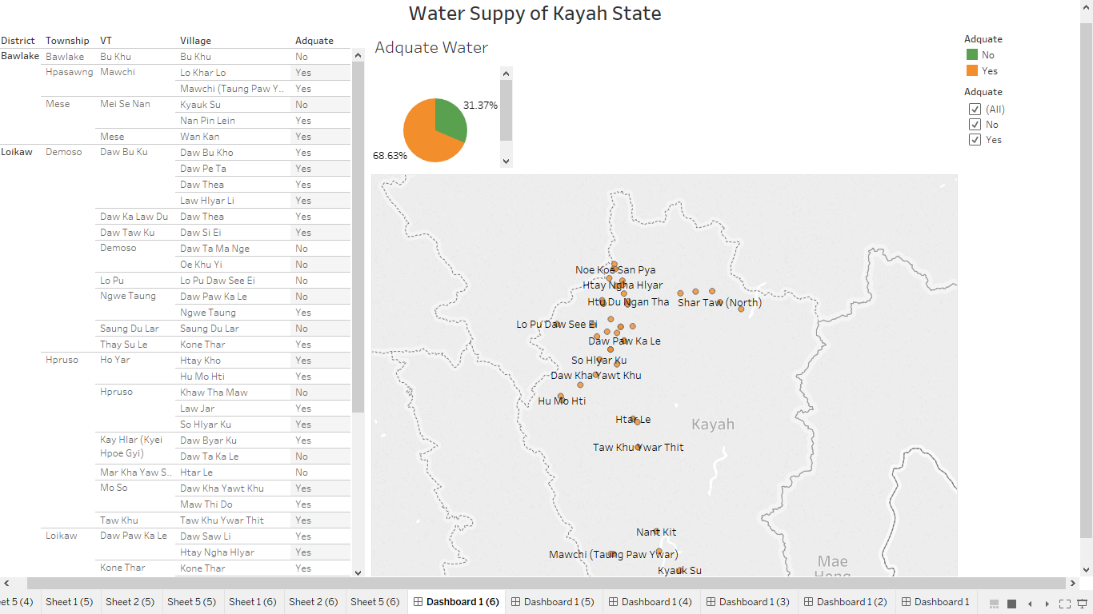
Pilot Test (Kayah State)
https://public.tableau.com/profile/nilar.soe#!/vizhome/Kayah_wsp/Dashboard16

Slide 30
Future Plan
Management Information System (MIS)
Interactive Mapping (One Map Myanmar)

Slide 31
Management Information System (MIS)
Upload
Website
Download
MIS
http://www.drdmyanmar.org
ODK Application
Internet
Project
Form
Township
Form
Village
Form
Data collection
Data collection
Data collection
- Water Supply data Form (3)
- National Electrification Project data Form (3)
- Revolving Fund Form (4)
- Vocational Training data Form (3)

Slide 32
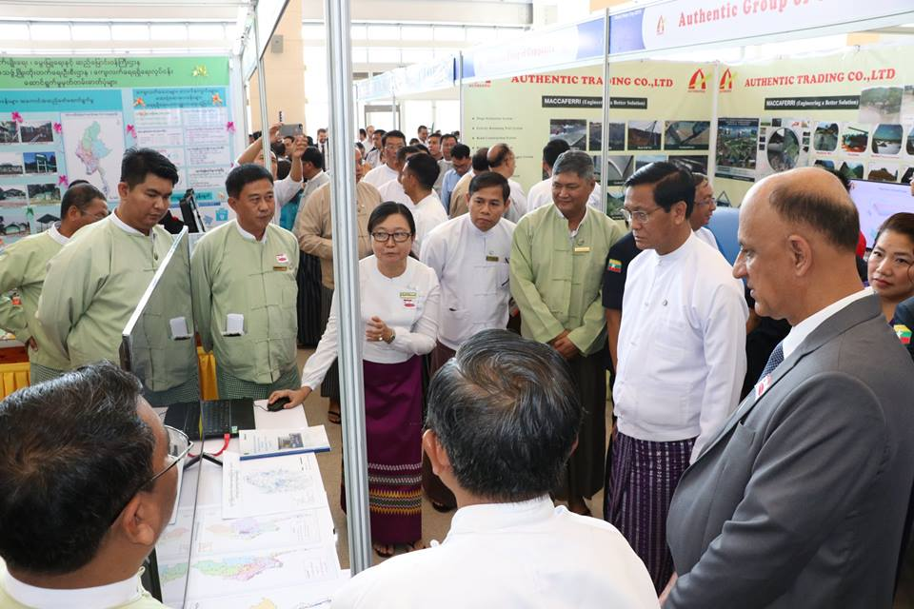
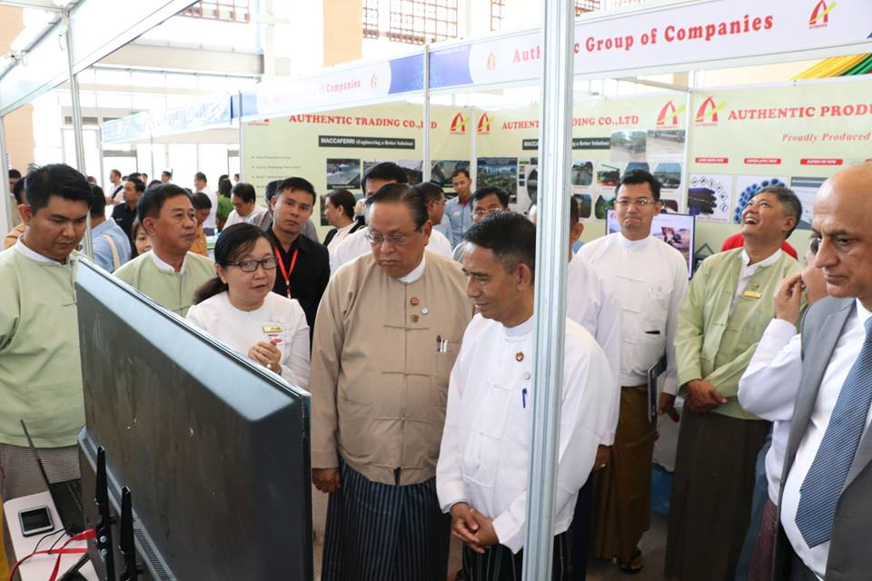
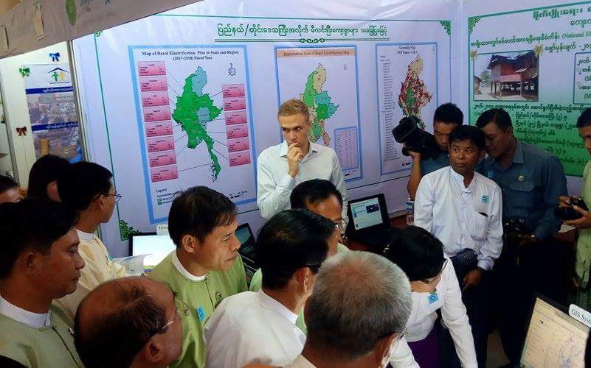
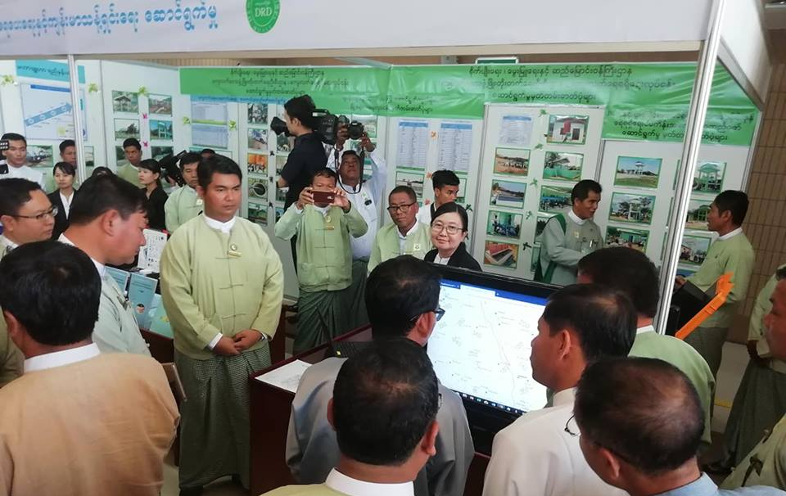
Photo records of NCDDP Union Multi Stakeholder Review and World Water Day

Slide 33
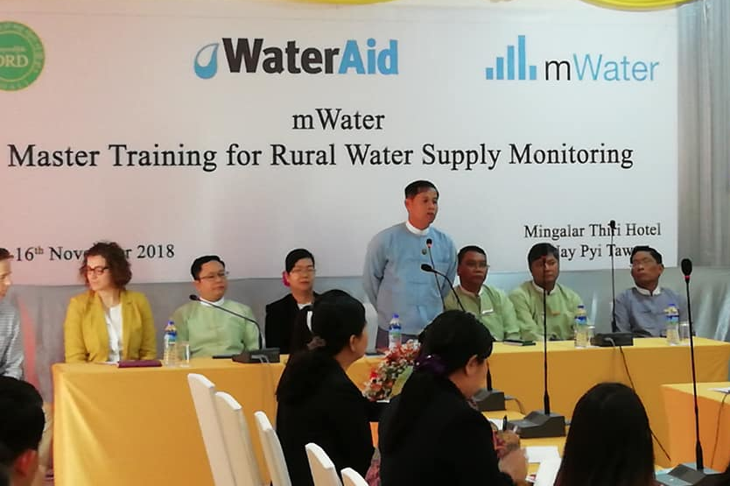
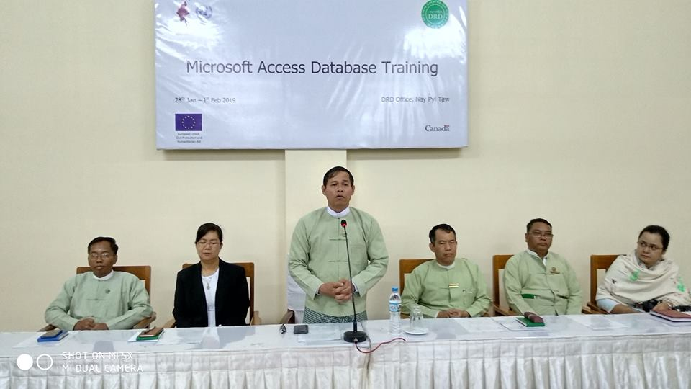
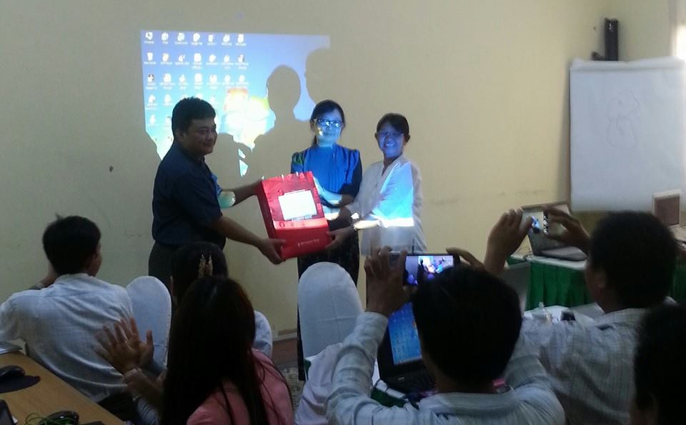
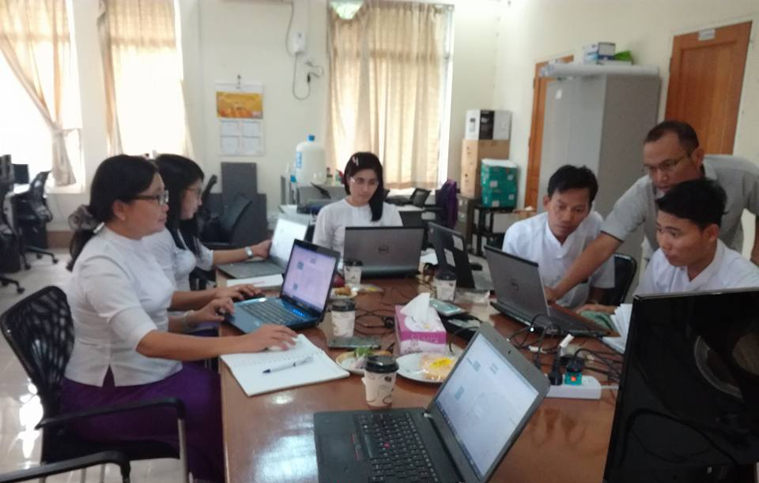
Photo records of Technical Training from MIMU, WFP, UNICEF, Water Aid and One Map Myanmar

Slide 34
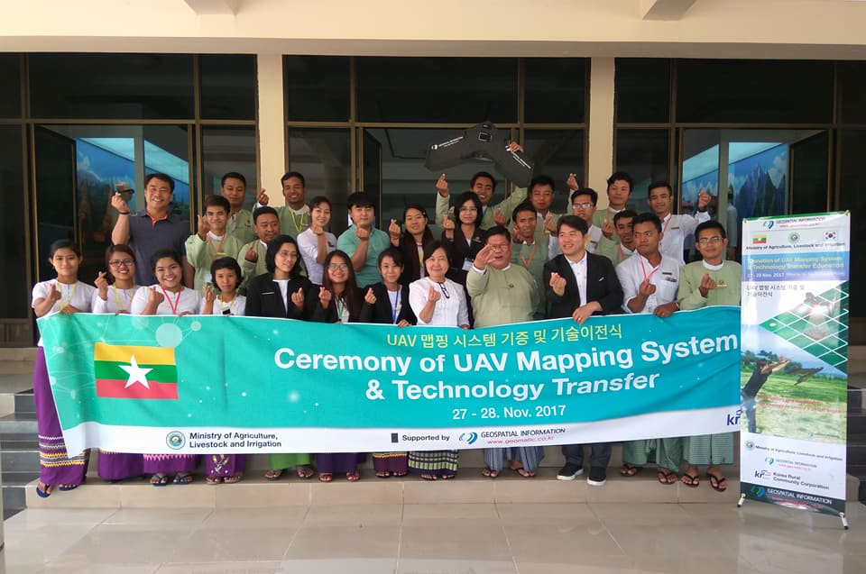
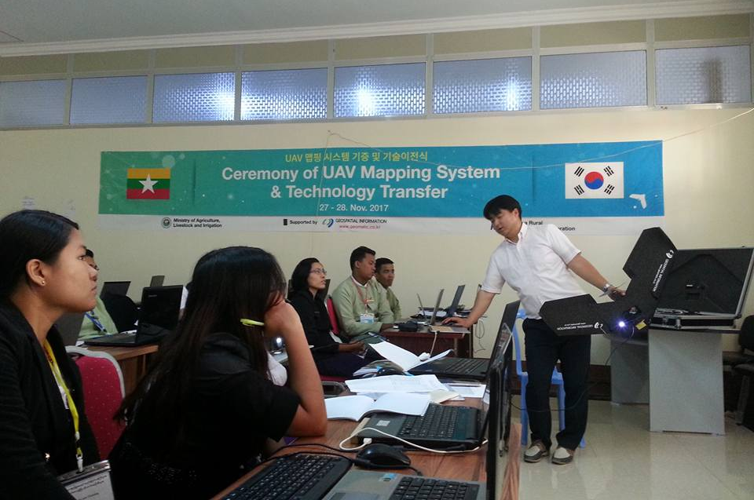
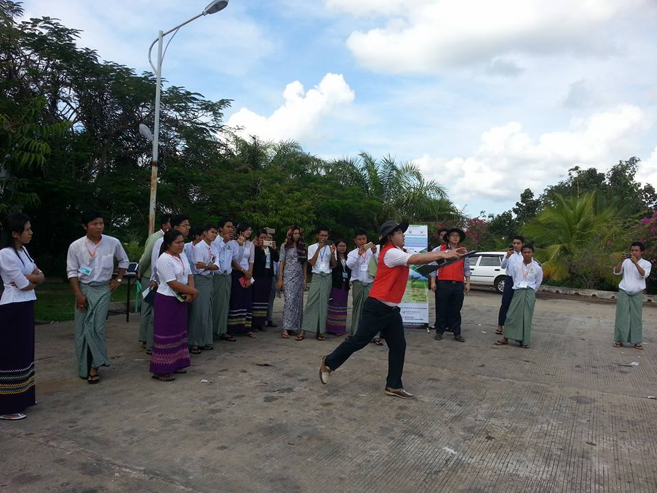
Photo records of Drone Mapping Training from Korea Geospatial.

Slide 35
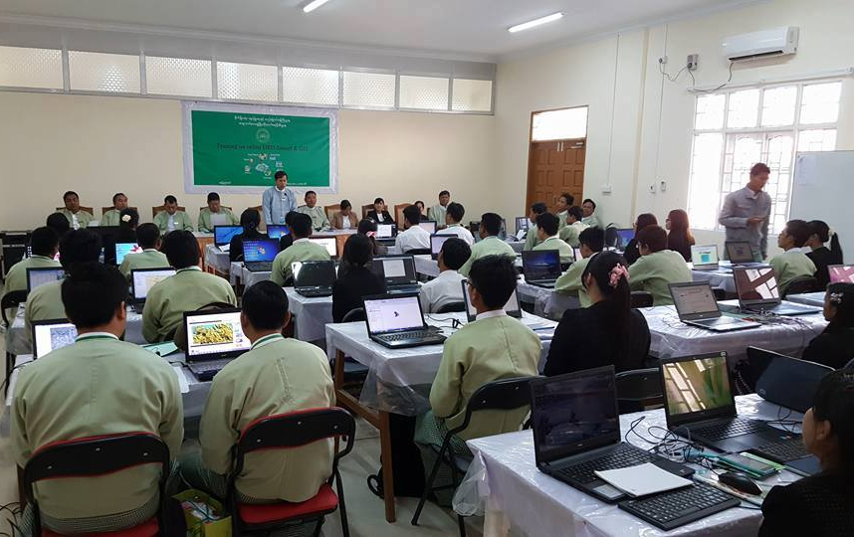
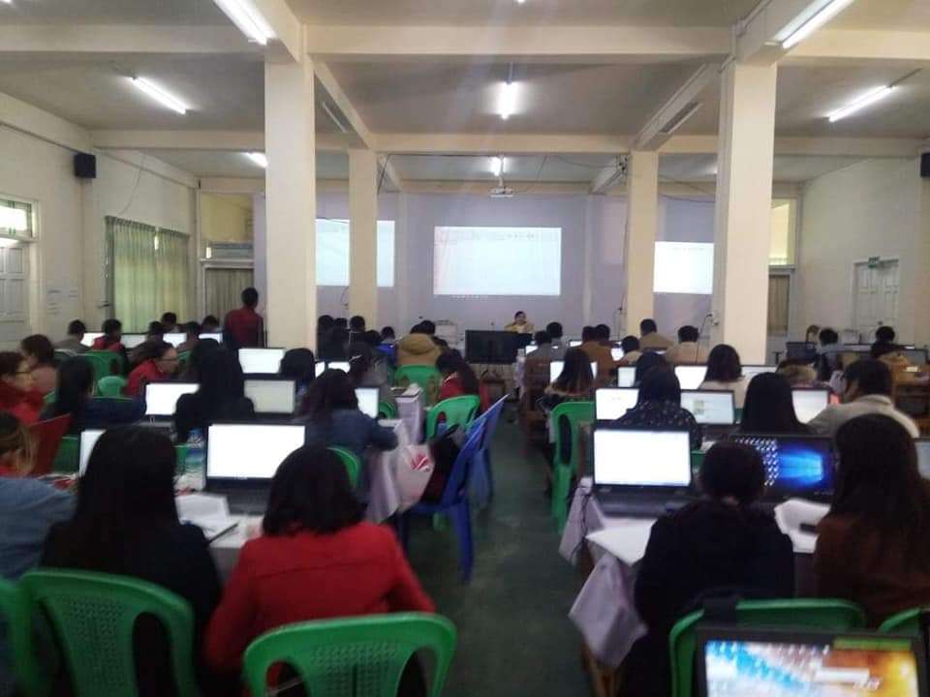
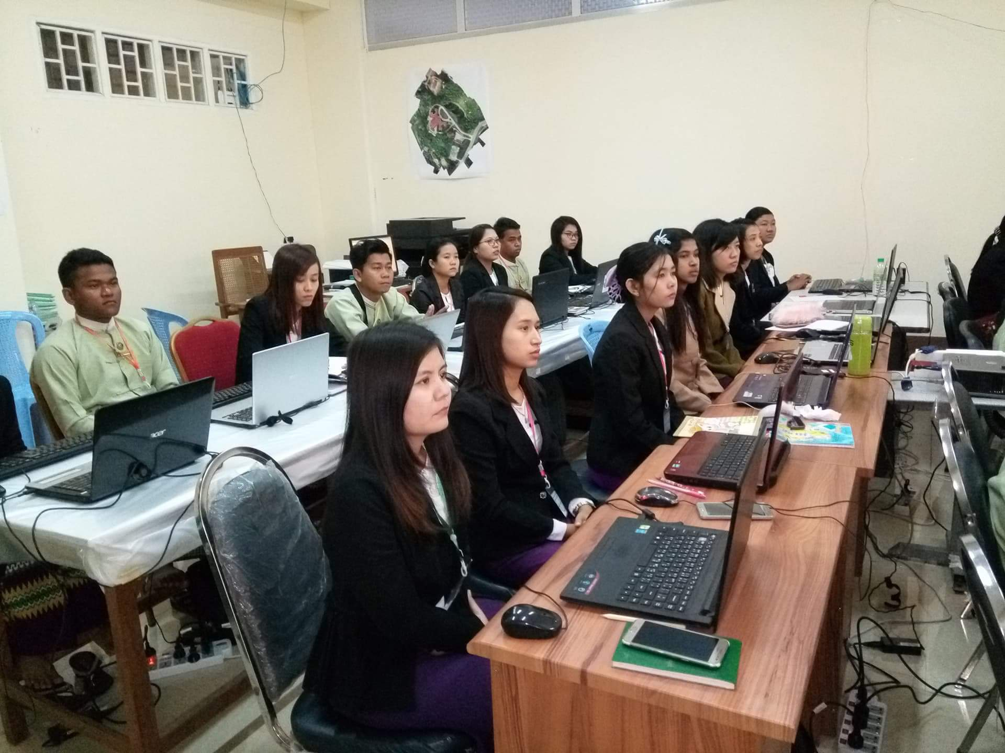
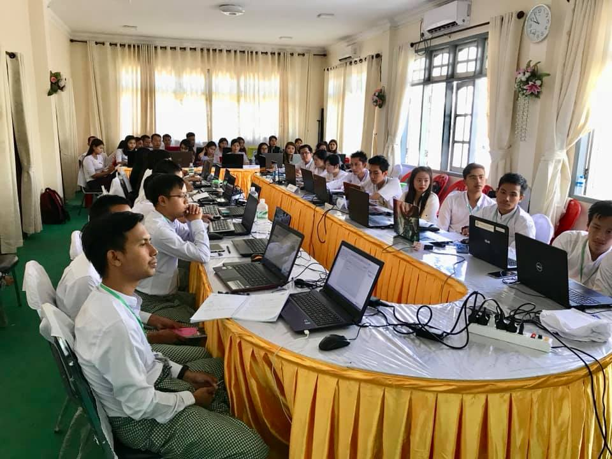
Photo records of GIS Training

Slide 36
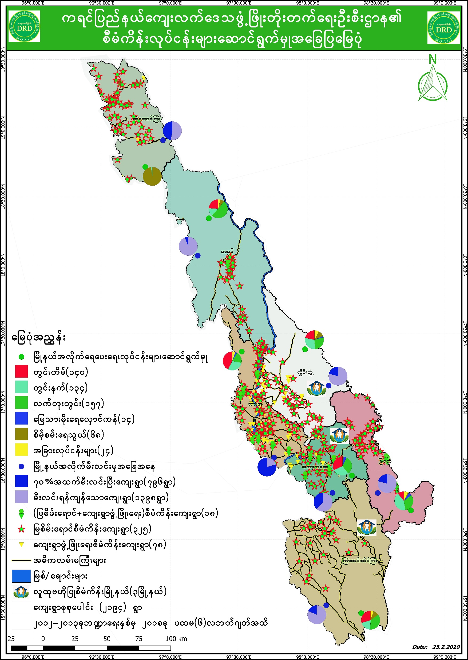
Township staffs able to use GIS Technology

Slide 37
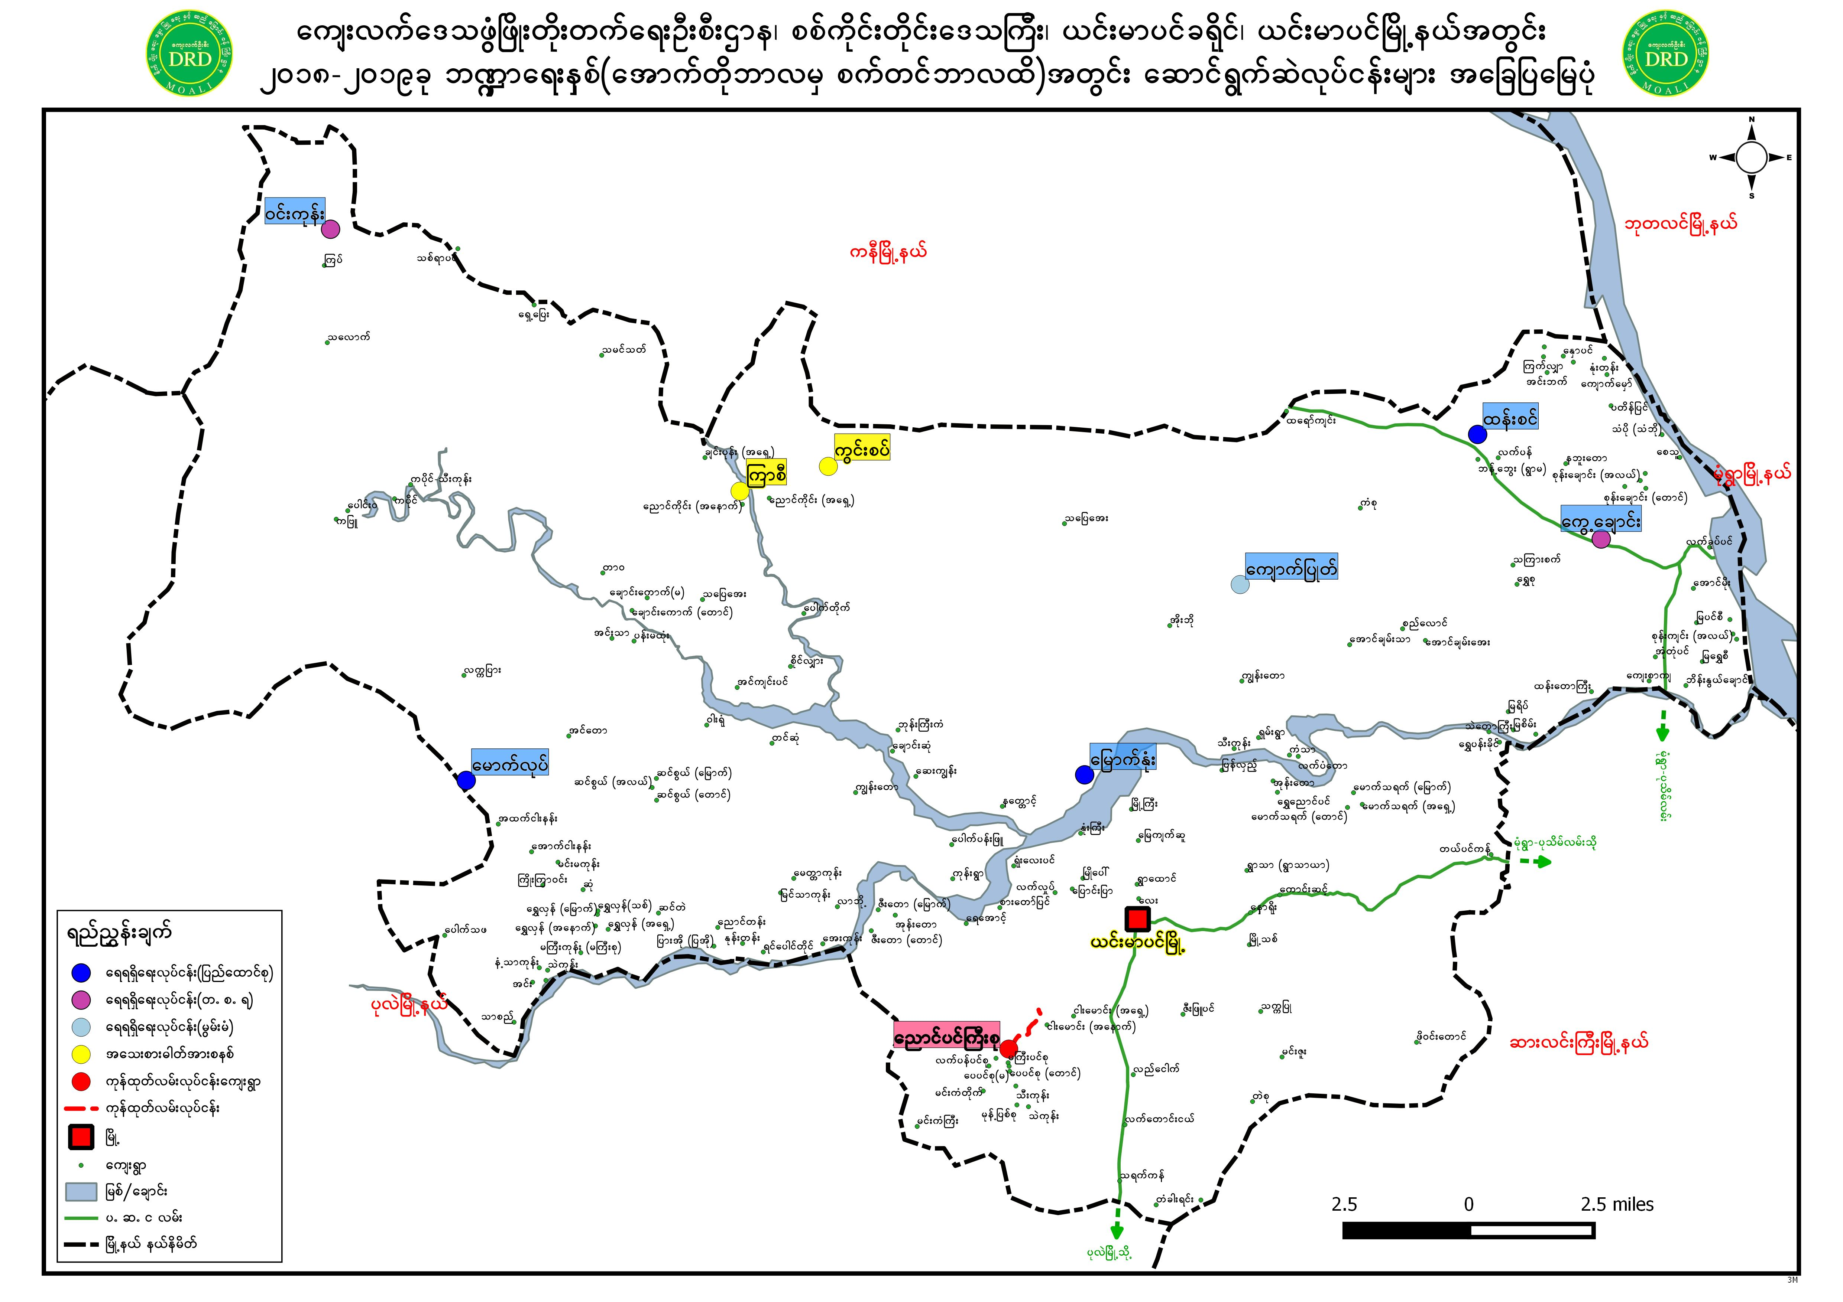
Township staffs able to use GIS Technology

Slide 38
Thank you for your kind attention!

