Slide 1
GIS Applications and Partnerships in Forestry Sector
Ministry of Natural Resources & Environmental Conservation
Forest Department
Thant Zin Maw
Staff Officer
Planning and Statistics Division
Forest Department
March 12th, 2019
Rose Garden, Yangon
Notes:
Good morning, ladies and gentlemen
Before giving the presentation, let me start by telling you a bit about myself.
My name is Thant Zin Maw working at the Remote Sensing and GIS Section, under Forest Department.
I’d like to talk to you today about the partnerships with Forestry Sector.

Slide 2
Contents
Background Information
Project Partners
Benefits
Challenges
Conclusion
Notes:
In this presentation, I will explain as I described in the contents.

Slide 3
Institutional Structure
Ministry of Natural Resources and
Environmental Conservation (MONREC)
Union Minister
Permanent secretariat (Environment)
Deputy Minister
Permanent secretariat (Mine)
Department of Mines
Forest Department
Department of
Geological Survey and
Mineral Explorer
Dry Zone Greening
Department
Myanmar Timber
Enterprise
No.1 Mining Enterprise
No.2 Mining Enterprise
Survey Department
No.3 Mining Enterprise
Environmental Conservation Department
Myanmar Gems Enterprise
Myanmar Salt and Marine Chemical Enterprise
University of Forest and Environmental Science, Yezin
Myanmar Pearl Enterprise
Notes:
At first, I am going to explain about Institutional Structure of our Ministry.
They make a lot of change and movement. They combined the two ministries, MONREC and Ministry of Mines.
Under the ministry office, two PS separatedly manage Mining and Environment field.
FD, DZGD, MTE, SD, ECD.
Let me move to the next slide

Slide 4
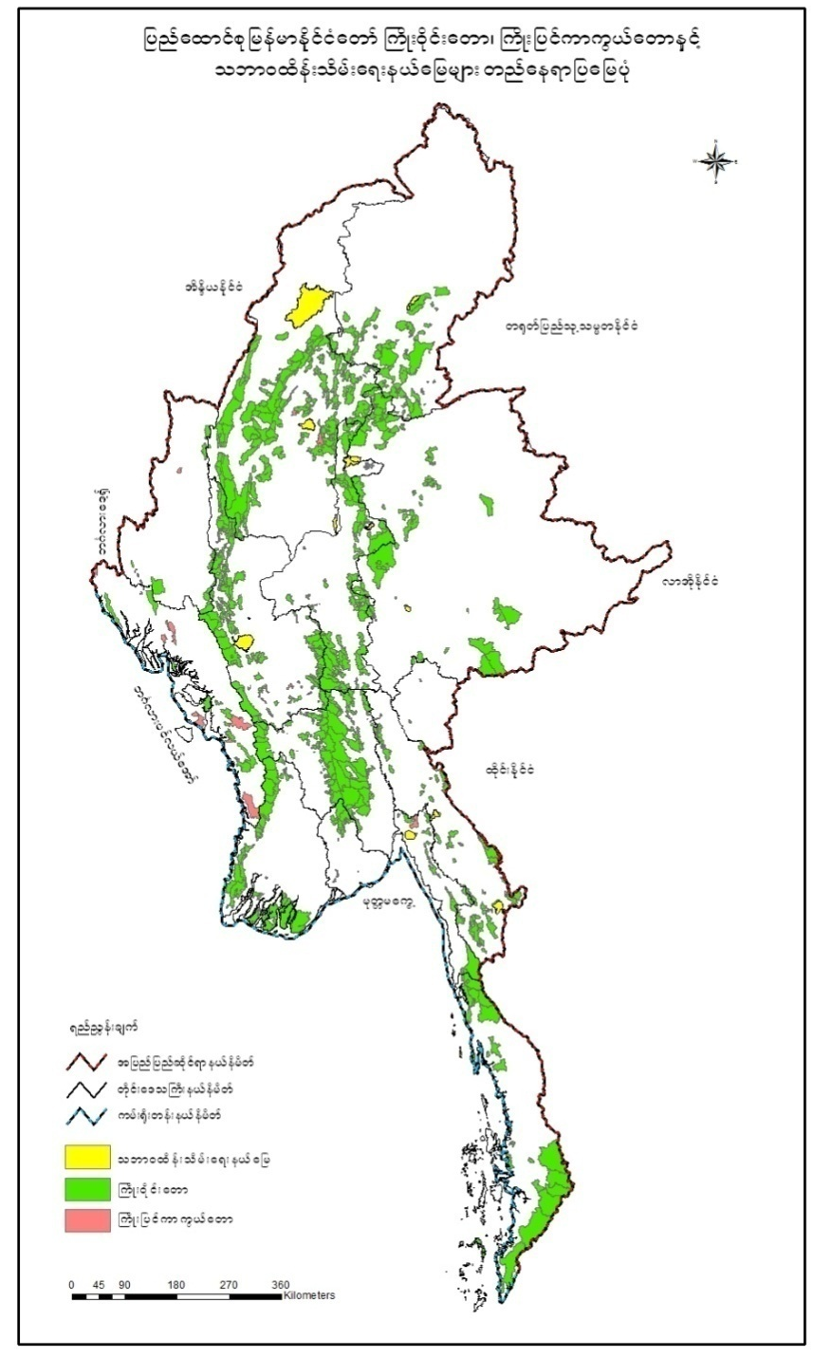
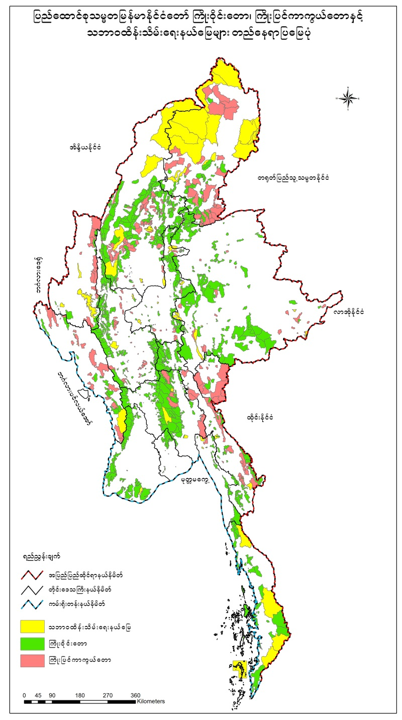
Permanent Forest Estate (PFE)
Extension of PFE Land
Current Status of PFE Land
Legal classification | Area (ha) | % of land area
RF | 12,010,682 | 17.75
PPF | 4,767,939 | 7.05
 | 16,778,621 | 24.80
PAS | 3,918,034 | 5.75
1990
2015
Target % in 2030(country's area)
RF+PPF – 30%
PAS – 10%
With the above target% , Myanmar has submitted INDC to UNFCCC in September, 2015.
Notes:
Type of Forest Lands
Permanent Forest Estate (PFE)
Forested Area under land at the disposal of the Government
PFE constitutes Reserved Forest (RF), Protected Public Forest (PPF) and Protected Areas System (PAS)
RF and PPF are almost equal legal status by Forest Law

Slide 5
Collaboration Type
Biodiversity conservation
Wetland management
Plant and seed conservation
Water resources management
Research Cooperation project
Forest law enforcement
Timber certification
Capacity building

Slide 6
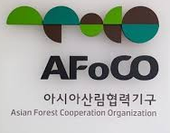

Slide 7
Scholarship program (Capacity building)
Japan (MEXT scholarship, JDS, JICA, ADB-JSP, etc...)
China (CAS, APFNet, ect....)
Korea (KFS, KOICA, SNU Government, ect....)
Austrilia Government
Norgian
Netherland
America (Fulbright scholarship)
Thailand

Slide 8
Projects Partnership in Forest Monitoring
Project | Partner | Cooperation type
REDD+, MRV(FRL/FREL) and NFMS | UNREDD, FAO | Financial support Technical support Capacity building
National Forest Inventory(NFI)/ Monitoring and Information System(NFMS) Capacity building of NFI(IC-MNFI) | Finland Government FAO Natural Resources Institute of Finland (LUKE) | Financial support Technical support Capacity building
Notes:
In this slide, I wanna talk to you Implementing Projects, especially in forest monitoring and information sector, on the behalf of Forest Deparment.
There are four main projects , The first one is REDD+ project,
In the GIS Section, we are concerned with two main portions; MRV and NFMS.
It was financially supported by UNREDD programme and technically by FAO.
Partners of Second project are Finland government, FAO and Natural Resources Institute located in Finland.
Their assistance is mainly interested in conducting National Forest Inventory and acquire the updated forest Information system, capacity building programme.
IC-MNFI project between Luke and Myanmar forestry organizations will run in parallel to support the capacity building necessary for establishment of NFI/NFMIS.
Let me go next slide, explaining about spatial dat

Slide 9
Projects Partnership in Forest Monitoring
Project | Partner | Cooperation Type
OneMap Myanmar (Spatial Data platform) | Swiz Development Agency for Development and Cooperation(SDC) CDE-Bern University in Switzerland, Servir-Mekong | Financial support Technical support Capacity building
Notes:
I wanna continue in talking about the Project Partnerships
Many of you may know about OneMap Myanmar Project.
This project is building the spatial data platform, OneMap does cross sectoral spatial data analysis
It was mainly assisted by the Swiss Agency for Development and Cooperation, CDE and Servir-Mekong

Slide 10
NFI/NFMIS Major Components
NFMIS National Forest Monitoring and Information System
NFMS National Forest Monitoring System
NFIS National Forest Information System
NFI National Forest Inventory
SLMS Satellite Land Monitoring System
LUKE IC-MNFI project
FAO UNREDD
Capacity Development
Other Projects
OneMap Myanmar
Servir Mekong
KFS, AAS, ITTO, JICA etc……
Notes:
Former MOECAF (Myanmar Ministry of Environmental Conservation and Forestry), now MONREC (Ministry of Natural Recourses and Environmental Conservation) and UN-REDD+ Programme developed REDD+ readiness Roadmap in 2013. Following to this Roadmap, an action plan for “Development of a National Forest Monitoring System for Myanmar” was prepared in 2015.
FAO and FD developed a project proposal for the governments of Finland. The project proposal supported the development of NFI/NFMIS.
Project I: Implementation on Myanmar National Forest Inventory/ National Forest Monitoring and Information System (NFI/NFMIS)
Project II: Improving the Capacity of Myanmar National Forest Inventory (IC-MNFI)
Forest Department will conduct the Project on NFI/NFMIS implementation with the finical support of Finnish Government and technical support of FAO.

Slide 11
Benefits from Projects
Contribution to consultations and advisory
Capacity building for establishment of NFI/NFMIS
Forestry GeoSpatial Database
Enhanced and Upgraded technical skills
Improve forestry governance using accurate and update data
Notes:
We have obtained a lot benefits from the international assistance
Capacity building necessary for establishment of NFI/NFMIS
Enhanced skills to use Remote Sensing tools
Upgraded skills and expertise in forest inventory and sampling design methodology
Developing methodologies for future forest inventory and monitoring efforts
Forestry geospatial database

Slide 12
Challenges
Capacity Building
Technical assistance
Budgets
Institutional Strengthening
Human Resources
Notes:
Although we are implementing many international projects, Forest Department still have many challenges.

Slide 13
Ongoing Projects
Project | Partner | Established Area
Land use land cover change analysis (R4d research) | OneMap Myanmar (SDC, CDE) | Tanintharyi, Mon
Land Use Assessment and Land Use Planning | EU, FAO | Bago, Mon, Shan, Chin, Ayeyarwaddy, Mandalay
Notes:
Besides the previous mentioned projects, FD is planning to implement
additional cooperation with Swiz Agency and EU govenment.
Land use land cover change analysis
Land Use Assessment and Land Use Planning
In the upcoming slide, I would like to conclude coming from our cooperative experience.

Slide 14
Conclusion
Strengthening the collaboration and cooperation for Earth Observation & Geospatial Applications
Technical and format issues in Geospatial Management
Substantial opportunities to learn the lessons
Necessary to accelerate the implementation of best practice in geospatial information management approaches
Notes:
We need to try for Strengthening the collaboration and cooperation for Earth Observation & Geospatial Applications
Currently, there are technical and format issues in Geospatial Management
FD have substantial opportunities to learn the lessons from the national and international communities.
It is necessary to accelerate the implementation of best practice in geospatial information management approaches.
That is all of my presentation.

Slide 15
Thank you very much
for your kind attention

