Slide 1

Accountability to Affected People and ​
Community Engagement: Overview​
Notes:
This course was developed using materials, from the CDAC network, with additional support from OCHA colleagues and the RCCE WG in Afghanistan.

Slide 2
TABLE OF CONTENT
01
02
03
04
Introduction to Accountability to Affected Populations
Information Provision
Enhancing Participation
Seeking Feedback and Complaints
05
06
07
Prevention of Sexual Exploitation and Abuse
RCCE and AAP
Conflict and AAP

Slide 3

1
INTRODUCTION
ACCOUNTABILITY TO AFFECTED PEOPLE

Slide 4

INTRODUCTION TO AAP
Humanitarian Aid and Accountability to Affected Populations
Notes:
What do you think of this video?​
​
What were the three main points you thought were useful?​
​
What challenges do you recognise from your own work?​

Slide 5
INTRODUCTION TO AAP
Accountability to Affected People (AAP)
An active commitment by humanitarian actors and organizations to use power responsibly by taking account of, giving account to and being held to account by the people they seek to assist [IASC].
Providing information to affected communities about humanitarian agencies’ activities.
Ensuring humanitarian agencies’ decisions are informed by the views of affected communities.
Enabling affected communities to assess and comment on agencies’ performance, including for sensitive complaints.
Notes:
Talking points​
​
First let us understand the definition of AAP​
​
To do this we use three main methods:​
​
Information provision​
Participation ​
Complaints and feedback, including for complaints related to PSEA​
​
PSEA MORE​
Health outbreak​
Conflict​
Disasters ​
​

Slide 6
INTRODUCTION TO AAP
Why is Community Engagement important?
Helps save lives – information, such as how to reconnect with family, which hospitals are functioning and how to make safe drinking can save lives, livelihoods and resources.
More effective programming and use of resources – also supports programme and response-wide adaptation.
Improves acceptance and trust – open and honest communication builds respect, helps address rumors, opens up humanitarian access and prevents reputational risk.
Empowers people and builds community resilience –People can make informed decisions, find answers to their problems and connect with others to organize their own recovery.
Notes:
Talking points​
​
AAP is a rights-based framework grounded in the rights, dignity, capacity and safety of people through the responsible use of power in humanitarian action informing effective and quality programming. ​
​
For this reason, ‘community engagement’ and ‘AAP’ are not interchangeable terms. The former, through coordinated activities that continuously feed into humanitarian decision-making, helps to achieve the latter. ​
​

Slide 7
INTRODUCTION TO AAP
IASC Commitments on AAP and PSEA
Leadership – Institutionalize into agencies and their programme cycle.
Participation and Partnership – Collective and coordinated approaches based on local capacities that enable active and meaningful community participation.
Information, feedback and action - Collective and coordinated approaches to informing community and gathering, analyzing and acting on their feedback. This especially includes issues on SEA.
Results – Measure results at the agency and collective level using agreed standards such as the Core Humanitarian Standard.
Notes:
Talking points​
​
​
The IASC has four key commitments to AAP – this is what we base our direction of our work on​
​
GB / CHS add in​

Slide 8

INTRODUCTION TO AAP
Communication with disaster affected populations
Beneficiary communication
Community Engagement
and accountability
Two-way communication
What is communication with disaster affected populations?
Information for affected populations, not about them.
Communication with not only to.
Closing the feedback loop.
Communicating with
communities
#commisaid
Accountability to affected populations
Community engagement
Risk Communication
Communication for humanitarian action
Humanitarian communication
CDAC
Notes:
Talking points:​
Recognise there are differing terminologies​
Ask percipients what they call it in their organisation? Do they recognise any of the terms?​
Recommendation: avoid lengthy discussion re: terminology and focus on concept​

Slide 9
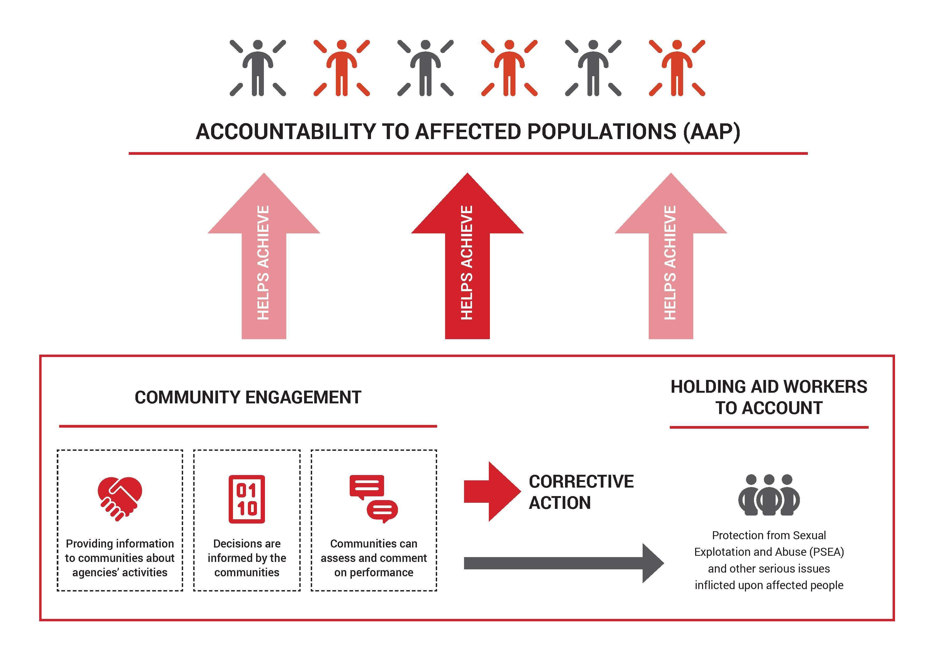
INTRODUCTION TO AAP
AAP and CE – How do they relate?
Notes:
What am we actually talking about here? ​
​
The increasingly important focus country level or response-wide ‘Accountability to Affected Populations’ – or AAP. This means inter-agency efforts supporting: ​
​
The coordination of the provision of information to affected communities;​
Ensuring the overall humanitarian response is regularly informed by the views of affected communities; and ​
Ensuring affected communities can assess and comment on agencies’ performance and the overall performance of the response (including on sensitive issues such as sexual exploitation and abuse).​
​
Now we’re speaking much more about community influence on and involvement in response performance management. ​

Slide 10
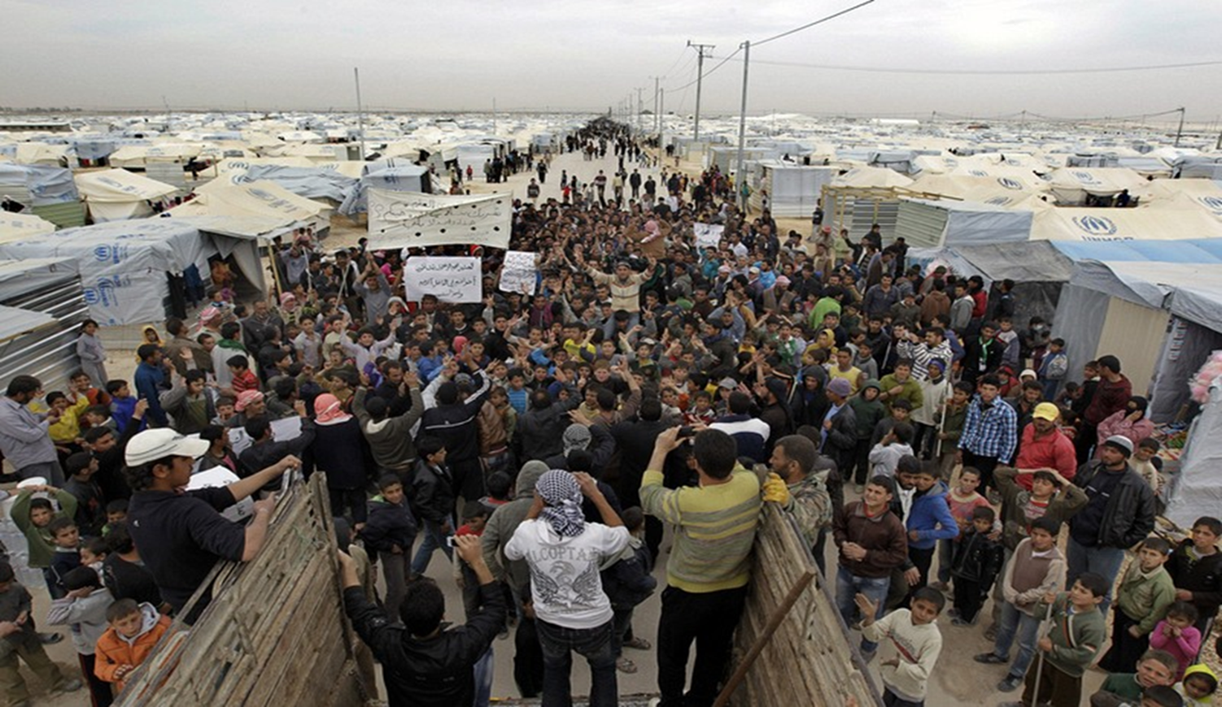
2
INFORMATION PROVISION
Notes:
Group discussion: Brainstorm in plenary in answer to the question, ‘How can communication help people in an emergency?’​
Possible answers:​
To share information about where to go for help ​
To share information on how to find missing family and friends​
To make people aware of dangers​
To share news​
To enable people to share their concerns ​
To share advice that may be needed​
It’s as crucial as food, water, shelter and medicine​
​
Follow on question: What happens if there is insufficient or conflicting information for people affected by disaster?​
It can cause confusion​
Worsen the feeling of isolation​
If people don’t know or trust the sources even the most vital messages can miss the mark​
​
Follow on question: What role does communication play between communities and aid providers?​
Engaging communities can help design and implement better quality and more relevant programmes, and allocate resources better​
Engaging communities can humanitarian actors meet their commitments on accountability to affected populations and promote a people-centred approach​
It can enable feedback and complaints to be voiced and acted on.​
​
​
Follow on question: Is communication aid?​
Yes, it can save lives​
It helps people make decisions and get back control of their lives​
It helps people reconnect and recover.​

Slide 11
INFORMATION PROVISION
Why communicate and engage with communities?
Rights-based
Right to information
Right to expression of opinions
Right to provide feedback about service delivery – strengthening accountability
Right to protection from sexual exploitation and abuse
Response effectiveness
Detects gaps in the response
Makes the response more needs-based
Allows aid to be distributed more effectively
The humanitarian imperative
Information saves lives
Provides psychological reassurance
Do no harm
Identifies misunderstandings
Manages expectations
Reduce community conflicts/tensions
Agency
Enables communities to help themselves
Engages them in response
Supports behaviour change
Notes:
Talking points:​
This slide summarises some of the reasons that were given in our earlier discussion, grouped by theme: humanitarian imperative / rights based / programme effectiveness / do no harm​
Agency is the capacity of an actor to act in a given environment. ​

Slide 12

INFORMATION PROVISION
Communication is aid
Notes:
Talking points:​
Ask participants to think about the following questions as they are watching the video:​
Is communication aid?​
How can communication help in an emergency?​
What were the three key take aways you understood from the video?​
​

Slide 13
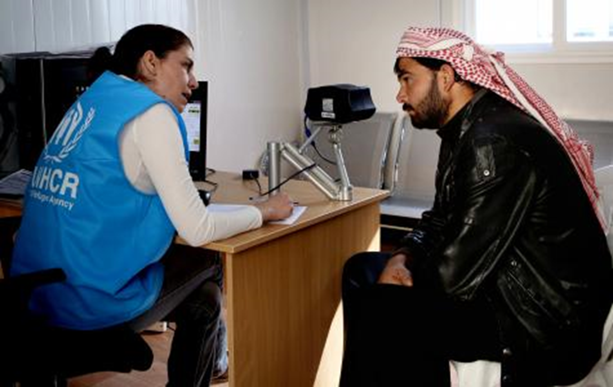
BRAINSTORM
  In pairs, discuss what qualities make communications with communities effective?
Notes:
Picture Source: http://www.knowledge.allianz.com​
​
Contextualisation: ​
Change photo (optional)​
​
Talking points:​
Ask people to work in pairs for 5 minutes to discuss: What qualities would make for effective communication with disaster affected people?​
In plenary take responses and capture these as outputs on a flipchart. ​
Share handout after the exercise.​
​

Slide 14
INFORMATION PROVISION
Effective communicate with communities is…
Needs-based
Inclusive
Accurate, on time and useful
Understandable
Useable
Two-way
Responsive
Accessible
Coordinated
Monitored
Recorded
Locally connected
Between communities
Trust
Notes:
Talking points:​
​
Communication with affected communities is more likely to be effective if it is:​
​
Needs-based: Communication should be based on an accurate and thorough assessment of the communities’ information and communication needs, and delivered through channels they trust.​
​
Inclusive: Communities are not homogenous. Any assessment should identify the different needs of men and women, the young and the old, and those with disabilities. Special attention should be paid to finding out how to communicate with marginalised groups who are harder to reach.​
​
Accurate, on time and useful: Information is accurate, on time, and as useful to the communities as possible. Information that is out of date or not appropriate could damage trust and perceptions about reliability. ​
​
Understandable: Information is communicated in a language communities can easily understand, and is communicated in a culturally and socially appropriate way. Channels of communication are chosen on the basis of literacy levels. ​
​
Useable: The only advice and information given to affected communities is information they have the means to act on. ​
​
Two-way: Communication must be two-way, with communities able to give their perceptions and preferences on the aid effort, ask for information, raise objections and concerns, and hold aid providers and those with power to account.​
​
Responsive: What communities have to say is listened to and acted on, or responded to where it cannot be acted on, so that there is effective dialogue between communities and humanitarian organisations, which builds trust.​
​
Accessible: Communication is better if an organisation’s office is located within the community, or agency staff are frequently seen and known by community members. Staff who speak the same language as community members are vital for effective dialogue. ​
​
Coordinated: Communities receive information which is consistent and accurate through proper coordination by agencies. , ​
​
Monitored: Agencies know their communications are reaching target audiences, being understood, and are meeting needs because of appropriate monitoring. ​
​
Recorded: The experiences of communicating with communities are recorded, so that lessons learned can be used to improve future practice​
​
Locally connected: Humanitarian communications build upon, support and fit in with local communication initiatives ​
​
Between communities: Where necessary, communication initiatives help affected communities to communicate between themselves.​
​
Trust: The qualities listed above are essential for effective communication and enable organisations to gain the trust of communities. ​

Slide 15





INFORMATION PROVISION
Community influencers
COMMUNITY INFLUENCERS
Community figures (e.g. elderly, women…)
Local & religious leaders (e.g. Wakili Gozars, mullahs)
Citizens’ representatives (e.g. GA/CDC reps)
School teachers
Health-care workers
Non-state armed groups
MOBILE / SOCIAL MEDIA
PRINT
Toll-free hotlines
SMS/text messages
Dedicated apps
Social media: Facebook, Instagram, Twitter…
Messaging apps (e.g. WhatsApp groups/Telegram channels…)
FACE-TO-FACE
BROADCAST MEDIA
Newspapers
Flyers
Fact sheets
Posters
Notice boards
Billboards
Wall murals
Community meetings
Door-to-door visits
Information desks
Community theatre/drama
Mobile cinema
Megaphones/loud speakers/sound trucks
TV and radio (e.g. pay for broadcast time; take part in interactive shows...)
Notes:
Talking points​
​
Here we can see different sort of information provision – all have strengths and weakness​
​
From your experience can you think about these channels and​
​
Selecting preferred channels is important, but is not necessarily enough to ensure your communication is effective. Also engaging trusted influencers contributes greatly to establishing effective two-way communication. ​
2. The main points to remember are to ensure your communication approach fits communities’ preferences – both in terms of where communication happens and the means of communicating – and to work with community influencers. ​
​
3. Keep in mind that community influencers can include non-state armed groups (NSAGs) – within the limits of what the law and humanitarian principles permit). NSAGs exert influence in a number of ways, including through social media (note: animation). ​
​
4. Last but not least, very importantly, we need to be aware of who (individuals and/or groups), may fall through the cracks of our multi-platform, multi-channel approach. We need to make sure we are reaching the whole community. We love talking about ‘digital disruption’ and how technologies are changing humanitarian action – that’s not happening yet for the big rural majority in Afghanistan and in fact, using high-tech and digital approaches may result in increasing the exclusion of vulnerable individuals and/or groups.​
​
​

Slide 16
INFORMATION PROVISION
Summary
Communicating with people affected by crises is one of the most important elements of humanitarian response.
Communication can help people in an emergency by sharing information, helping them reduce risks and take control over their own recovery
Insufficient or conflicting information can cause confusion and anger.
Engaging communities can help design and implement better quality and more relevant programmes. It also enhances people’s sense of well-being and can help them adapt to the challenges they face.
It is essential that the right people get the right information at the right time through the right channels.

Slide 17

INFORMATION PROVISION
Communications preferences
How do you communicate with your family?
Who uses WhatsApp to communicate with their older family members?
Who writes letters to their siblings?
Who emails their 2 year old son/daughter/nephew/niece?
Notes:
Everyone communicates with their families. ​
​
Give me some examples of how you do this? (capture on flipchart) ​
​
Go through the get the group to raise their hands in answer to each question. Those who say no – ask them why not. Start to draw out examples of communications preferences. ​
​
KEY POINTS: ​
Your family is like a community – made up of different people who prefer different ways of communicating. No family all uses the same channels of communications, nor does any community. They are diverse. ​
Men, women, boys and girls will all communicate differently. ​
Even within these groups there may be women from rural communities who will communicate differently from those in the city. ​
Not just how they communicate but also what they communicate about – so the information they would like to know. For example, when I talk to my Dad he wants to know about what work I’ve been doing and the weather. But when I talk to friends they want to know the places I have been and if I’ve seen a any good new bands. ​
These difference preferences between people and groups in the community needs to be assessed not assumed. ​
​
​

Slide 18
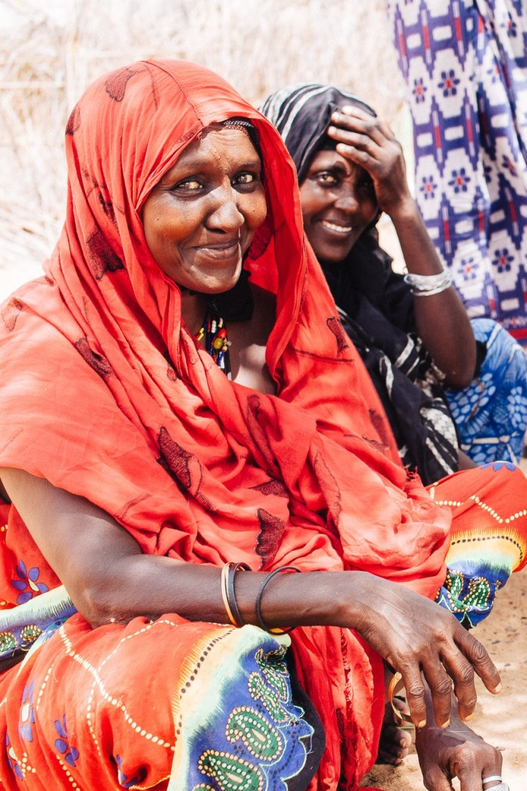
INFORMATION PROVISION
Rapid information and communications assessment tool NEEDS UPDATING
In 2014, CDAC and ACPAS developed a tool to assess the information and communication needs of communities affected by disasters.
Five key questions are suggested, including explanations of why these questions should be asked, and how agencies could act on this data to improve communication in humanitarian response.
Notes:
Hand out the print-outs of the ACAPS/CDAC assessment tool. Explain that participants will be given both tools in soft copy at the end of the training. ​
​
This tool can be either used as a standalone assessment, or the question can be integrated into existing inter-agency multi-sector assessments. ​
Integrating them into an existing assessments can help highlight the key role of knowing people communications needs and preferences for all sectors. It also help avoid assessment fatigue (when communities are constantly assessed and asked to take part in surveys and discussions).​
​
Talk through the questions:​
​
QUESTION ONE ​
It is important to know what they currently use, versus what they did before. People usually return to their channels they preferred before the crisis when these become available. In the meantime, it is important to know the best way to reach them now. ​
​
QUESTION TWO ​
This helps identify the barriers and also any groups who might be marginalised in accessing information. People who are unable to access information will be more vulnerable to risks. ​
​
QUESTION THREE ​
Trust is key especially when you look at trying to promote or change behaviours. You want people to believe the message. ​
NOTE – sometimes there is confusion between the source of information and the channel so it is worth clarifying this now. ​
​
The source is who the information has come from or is attributed to. ​
The channel is how it is delivered. ​
E.g. A radio programme (channel) that runs a programme on vaccinations from the Ministry of Health (source). ​
​
QUESTION FOUR ​
This is key to know exactly what the community wants to know about – very often what we assume the community want to know and what they actually want to know is different. The lesson here is simple ASSESS DON’T ASSUME - so this is really important question. ​
​
NOTE: this question can often get confused with general needs rather than information needs. So, this need to be explained very clearly when asking the question. ​
​
QUESTION FIVE ​
This question helps understand what kinds of feedback mechanism would be preferred by the community. ​
​
NOTE ON INTERPRETERS ​
Inevitably this will need to be translated and interpreted when sued – so be sure to take the time to sit with your interpreter and talk through the tool and what information you are expecting and to ask them to accurately interpret what is being said, not to paraphrase or prompt the community. ​
​
​

Slide 19

INFORMATION PROVISION
Communications channels
A communications channel is like a road which information can drive on
There are different roads that the same piece of information can drive on: Different Channels
Often, information can drive both ways on this road: Two-Way Information Sharing

Slide 20







INFORMATION PROVISION
Communications channels
Choosing the right communication channels, and the right language(s)
What channels does the community have access to?
What channels does the community prefer?
What channels do they trust?
How safe are those channels in the current context?
Who might be excluded in what channel? How to avoid it?
Need some help with community communication mapping?
Notes:
To recap, these are just a few questions you should always have in mind (facilitator refers to the slide). (Note: this slide has animation) Remind participants that understanding the local information/communication landscape can be complicated (if this came up in earlier discussions, refer back to that). There are a number of agencies who have the skills and the resources to help with community communication mapping. – acknowledge that the list shown on the slide is not exhaustive and apologise in advance in case we have left someone out. ​

Slide 21

INFORMATION PROVISION
Communications channels
One-way versus two-way
Radio
TV
Newspapers
Flyers
Posters
Banners
Magazines
SMS
Voice calls
Face-to-face
Facebook
Twitter
WhatsApp
Skype
Notes:
Talking points:​
Which channels are one-way and which are two-way? Could the one-way be two-way, and vice-versa?​
Why is two-way communication so important?​
How can you make a one-way channel two-way?​

Slide 22

BRAINSTORM
  Types of communication in this country
Notes:
Talking points: ​
Brainstorm: Ask participants to brainstorm for 2-3 minutes in groups of 5 about the most common channels of communication that are relevant in the country where you are.​
Ask for the most popular ones and assign a different one to each group. This should be written on their flipchart. Demonstrate the next group exercise which is to identify the advantages and disadvantages of the chosen channel. Talk through one example (radio).​
Think about gender and age and ability and how this would affect communication chalens?​

Slide 23
INFORMATION PROVISION
Summary
It’s never enough just to say something once: repeat things, and across different channels
It is always critically important to be consistent across different platforms
Information will need to be formatted for each channel
Remember that those you visit can and will talk and share their impressions
Remember that indirect ways to reach people can be very efficient too
Notes:
Talking points:​
In wrapping up, reinforce these points.​
Encourage people in the next break to browse the advantages and disadvantages shared on the different channels.​
Share handout.​
XYZ: review the things to remember and compare with guidance note – last 3 points are more relevant to msg dev.​
​

Slide 24
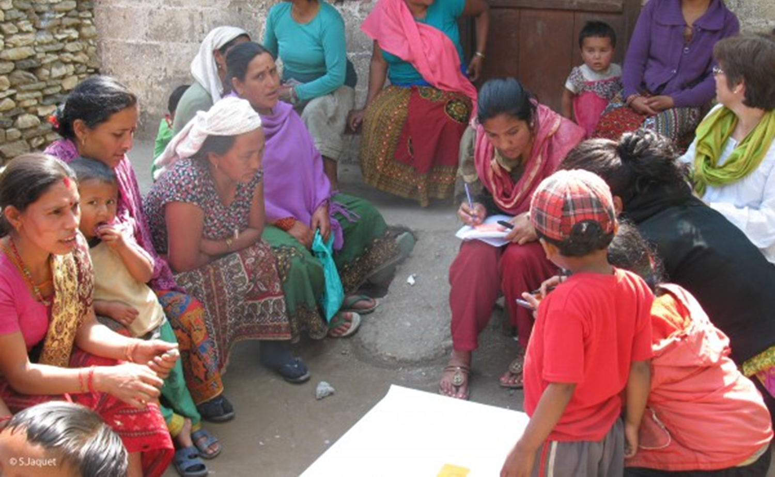
3
ENHANCING PARTICIPATION

Slide 25
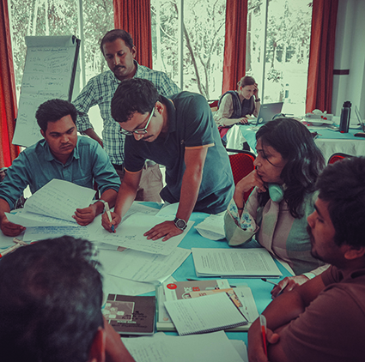
ENHANCING PARTICIPATION
Learning objectives
At the end of the session participants will be able to:
Explain participation and its importance in humanitarian work
Identify key components of steps to effective participation

Slide 26
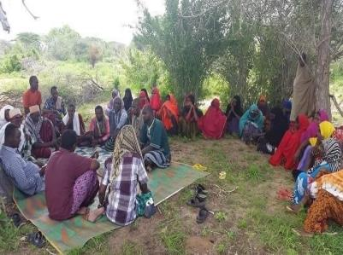
ENHANCING PARTICIPATION
What is participation?
Participation is empowering people to take part in decision-making that affects them.
Programmes and projects must have mechanisms that ensure partners and affected people are involved at all stages.

Slide 27

ENHANCING PARTICIPATION
The participation spectrum: how participatory is your work?
INFORM
Noticeboards
The community receives information to help them understand who you are, the problem and the solutions.
This is not real participation.
INVOLVE
Regular community meetings
The community works directly with your organisation, provides input to key decisions and receives feedback.
You write the plans & make final decisions.
EMPOWER
Community Action Plan
The community has final decision-making power and implements their plans.
Your organisation supports it with funding, materials, technical support.
CONSULT Assessment
The community is asked about their needs and priorities, provides feedback and is kept informed.
Lowest level of participation.
COLLABORATE
Project Committee
The community and your organisation enter into a partnership, planning and deciding things together.
You manage things together though final decisions still rest with you.
Source: Adapted from IFRC (2020), based on IAP2’s Public Participation Spectrum​
Notes:
INFORM (Noticeboards) The community receives information to help them understand who you are, the problem and the solutions. This is not real participation. ​
​
CONSULT (Assessment) The community is asked about their needs and priorities, provides feedback and is kept informed. They do not take part in planning or decisionmaking. Lowest level of participation. ​
​
INVOLVE (Regular community meetings) The community works directly with your organisation, provides input to key decisions and receives feedback. You write the plans & make final decisions. ​
​
COLLABORATE (Project Committee) The community and your organisation enter into a partnership, planning and deciding things together. You manage things together though final decisions still rest with you. ​
​
EMPOWER (Community Action Plan) The community has final decision-making power and implements their plans. Your organisation supports it with funding, materials, technical support. Ask participants a couple of questions and debate within the time you have: • What level of participation does your organisation aim for? • Does your organisation hope to increase community participation? • What is holding you back? • How do you currently involve communities in the response to COVID-19? Inform participants that both IAP2 spectrum of public participation and the participation journey are available as handouts.​

Slide 28
ENHANCING PARTICIPATION
Why are participatory assessments important?
Recognizes the communities as experts, and as partners and their right to be involved in information-gathering and decision-making on issues that affect them.
Helps identify root causes of risks, needs, capacities, vulnerabilities and existing coping strategies.
Helps to avoid interventions accidentally exacerbating problems or creating new ones.
Co-designs priorities and context-relevant solutions.
Helps to identify the resources needed to address priorities & solutions.
Minimizes risks of exclusion of less powerful groups and promotes participation of vulnerable groups, and their recognition as individuals with rights .
Recognizes the power relations among different groups.
Improves the relationship between ‘us’ and ‘them’.
Leads to more relevant/effective/successful programmes and projects.
Notes:
Refer to the slide (note: animation before every point). ​
Recognises the communities as experts, and as partners and their right to be involved in information-gathering and decision-making on issues that affect them. ​
Helps identify root causes of risks, needs, capacities, vulnerabilities and existing coping strategies. ​
Helps to avoid interventions accidentally exacerbating problems or creating new ones. ​
Co-designs priorities and context-relevant solutions. ​
Helps to identify the resources needed to address priorities & solutions. ​
Minimizes risks of exclusion of less powerful groups and promotes participation of vulnerable groups, and their recognition as individuals with rights . ​
Recognizes the power relations among different groups. ​
Improves the relationship between ‘us’ and ‘them’. ​
Leads to more relevant/effective/successful programmes and project​

Slide 29
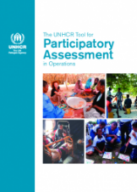
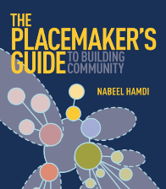
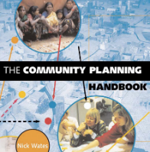



ENHANCING PARTICIPATION
Select participatory methods and tools
Focus groups discussions (FGD) with target group representatives.
Key Informant interviews (KII) with community leaders or others.
Observations and transect walks.
Social, resource and mobility maps.
Workshops.
… what else?
Notes:
It is interesting to note that development actors embraced the importance of participatory planning as long ago as the 1950s. The humanitarian community has come to share this understanding quite a bit later. While participatory approaches are now seen as essential in all humanitarian operations, humanitarians are still trying to catch up and get better – that’s why we are here today, right? ​
​
Ask participants what participatory methods and tools they are aware of or familiar with? Take a few comments… and show the slide​
• Focus groups discussions (FGD) with target group representatives. ​
• Key Informant interviews (KII) with community leaders or others. ​
• Observations and transect walks. • Social, resource and mobility maps. ​
• Workshops. ​
​
There are a number of tool showed here​

Slide 30
ENHANCING PARTICIPATION
Benefits of participation?
Why do we encourage participation in our programs?
Improve programme quality and appropriateness
Ownership of the programme
Deepen linkages with the affected community
Consultation can lead to empowerment
Increased skills and confidence
Notes:
success of programmes by allowing people to directly influence programmatic decisions that affect them. ​
​
Success but also an end in itself: consultation leads to empowerment and increased skills and confidence. ​
​
These skills can lead to improved results, even after the programme has finished. ​
For example the great inclusion of women may lead to great inclusion of women in decision-making structures after the project has finished. ​
Projects that do not make a special effort to increase the role of vulnerable groups and women in decision-making may further marginalise these groups. ​
​
While consultation is mostly with the affected community themselves, it can also describe a relationship with all stakeholders for example, Government, NGOs and community leaders. ​
​

Slide 31
ENHANCING PARTICIPATION
Quality participation
Identify the people we will assist
Enable men, women, boys and girls, including representation across diverse needs groups, and other stakeholders, to participate
Ensure that systems of community representation are fair and representative
Notes:
Identify the people we will assist and their representatives, with consideration of gender, age, diversity, and special needs;​
Enable men, women, boys and girls, including representation across diverse needs groups, and other stakeholders, to participate in and influence initial assessment, project design, deliverables, criteria for selecting target groups and the selection process, project implementation, and monitoring and evaluation;​
Ensure that systems of community representation are fair and representative, and that the most marginalised, vulnerable and affected have a voice.​
​

Slide 32
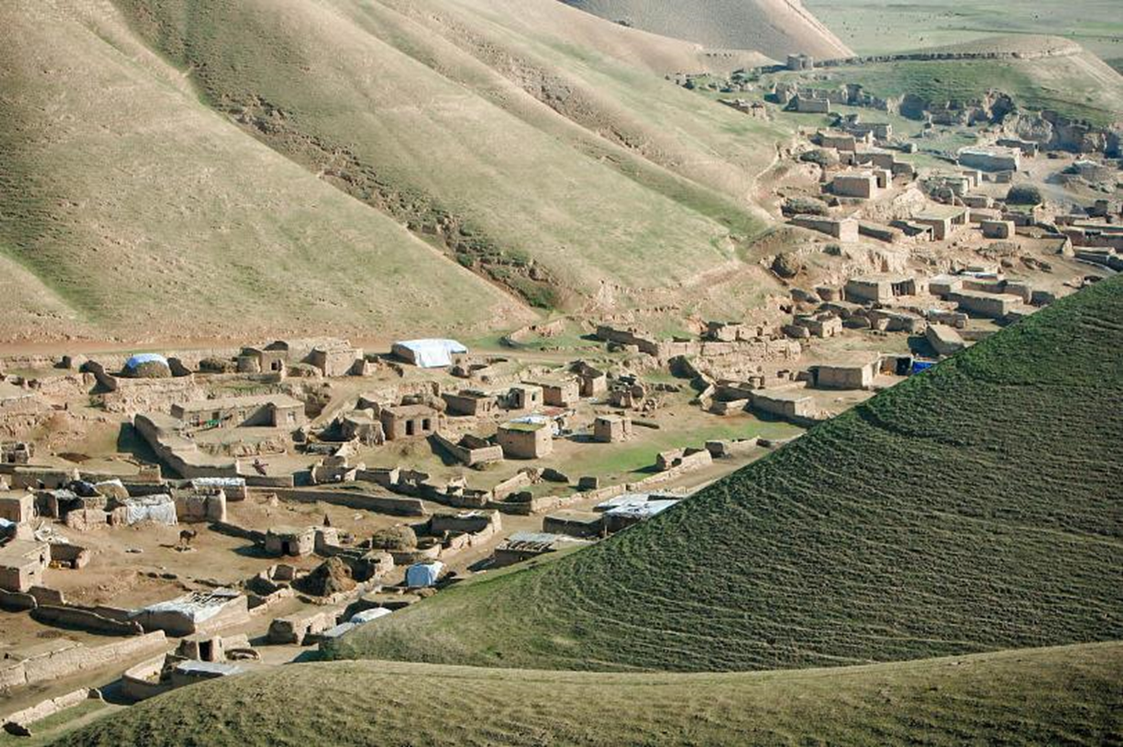
BRAINSTORM
  Before consultation, what do we need to consider?

Slide 33
ENHANCING PARTICIPATION
Things to think about before participation
Are the questions culturally appropriate?
Are they insulting, embarrassing, or demeaning?
Are there important issues missing that people are concerned about?
Who are the different segments in the community that should be consulted?
What time of day is best to ensure participation from all segments of the population?
Are the questions for community leaders different? Who should be asked?
Notes:
Before consultation takes place, communities should be informed about assessments and community representatives should be invited to participate in conducting them. ​
​
Organisations and their partners need to understand all contextual factors that may enhance or inhibit free and open speech among different segments of the community:​
Before starting the needs assessment, share the assessment questionnaire or checklist with community representatives (especially women) and explain the process that will be used.​
Ask them to give feedback and suggest improvements. For example:​
Are the questions culturally appropriate? ​
Are they insulting, embarrassing, or demeaning?​
Are there important issues missing that people are concerned about?​
Who are the different segments in the community that should be consulted (there may be ethnic and religious divisions, language groups, social status groups, people living in remote parts of the village that may not be present)?​
What time of day is best to ensure participation from all segments of the population?​
Are the questions for community leaders different? Who should be asked? ​
​

Slide 34
ENHANCING PARTICIPATION
Practical steps
Think about…
Gender
Age
Time of day
Time of the year
Child care
Security
Mobility
Cultural considerations
Language
Notes:
Meet with men and women to explain that their participation is important, and that their views do matter; build their confidence so they feel that they have the right to get involved in matters that affect their lives;​
Review the time and duration of the meeting, and how this fits with work and domestic responsibilities. Talk to men and women to find a time which is most suitable for them, e.g. avoiding mealtimes and harvest;​
Many women have child care responsibilities. Consider if it is possible to provide childcare; ​
Think about men and women’s mobility and security, and the accessibility of the venue. Consider providing transport and/or covering transport costs;​
In urban areas ensure that the meeting venue is suitable and safe for the participants to attend;​
Choose a venue that women will be comfortable with: somewhere they would normally congregate, or where women and men are used to coming together, not a venue that is traditionally male-dominated;​
Make sure women know about the meeting and are specifically invited to attend by an appropriate person, e.g. a village elder;​
Bear in mind any cultural considerations, such as restrictions on women and men mixing, and think about how to alleviate these, e.g. through seating arrangements;​
It is advisable that men and women are consulted separately, ideally female staff will run female consultation groups and vice versa;​
Consider whether the focus of the meeting is likely to influence who attends. For example, men may be more likely to attend meetings about construction and less likely to attend those about health issues, if they consider this to be women’s responsibility;​
Ensure that the consolation is held in a language that is understood by the participants;​
Find ways to give women and men the confidence to voice their opinions; for example, invite women to sit together or mutual support; actively invite people to speak, or work in small groups, which may be less threatening.​
​

Slide 35
ENHANCING PARTICIPATION
Summary
Participation:
empowers communities to be involved in decision-making and helps with psychological recovery
Improves programme quality and outcomes
is something that that every humanitarian organisations has committed to improve e.g. Participation Revolution, Accountability to Affected Populations, Core Humanitarian Standard.

Slide 36
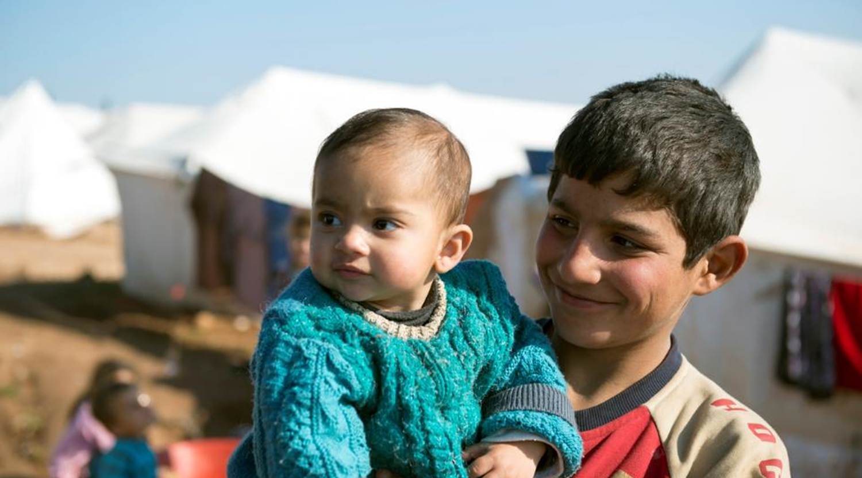
4
SEEKING FEEDBACK AND COMPLAINTS

Slide 37
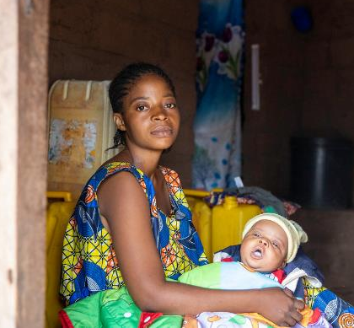
SEEKING FEEDBACK AND COMPLAINTS
Learning objectives
By the end of this session, participants will be able to:
Explain the difference between Complaints and Feedback.
Identify reasons why communities complain and mechanisms appropriate for collecting feedback and complaints.
Notes:
Plenary discussion –​
​
If no examples forthcoming, one of the facilitators should share an example. ​

Slide 38
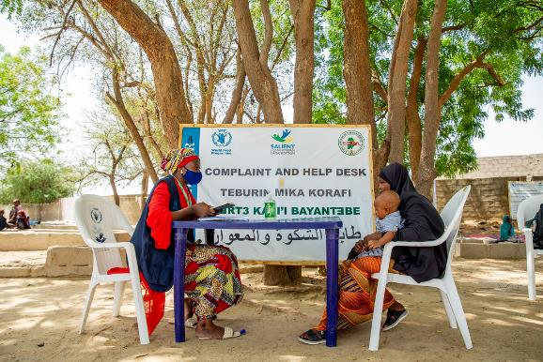
SEEKING FEEDBACK AND COMPLAINTS
Complaints
Have you ever made a complaint?
What did you complain about?
What would stop you making a complaint?
Did you get a response?
Do you think that complaint is a negative word?
Notes:
Plenary discussion –​
​
If no examples forthcoming, one of the facilitators should share an example. ​
​
Eg poor internet provision, ​
​
Do you think complaint is a negative ​
​
DIFF TERMINOLOGY FOR DIFF GROUPS​
​
FREE?​

Slide 39

BRAINSTORM
  Who has a feedback or complaints mechanism?
Notes:
Ask participants to share their examples. ​
​
Ask how many use complaint or suggestions box? Does it work well in that context? What other ways are used? ​

Slide 40

SEEKING FEEDBACK AND COMPLAINTS
Types of feedback
Questions
Suggestions
Concerns
Appreciation
Complaints about a programme/project
Complaints about staff behaviour (i.e. sensitive feedback)
Threats
Rumours
Notes:
People can give us feedback about anything. ​
​
Based on accumulated experience in the sector, we can classify feedback in at least 8 categories, depending on the nature of the information that the feedback provides: ​
Questions: Requests from people for information, or an explanation, or perhaps a justification. Questions require at least a response, perhaps a discussion and ideally a resolution. ​
Suggestions: Ideas or proposals from the community. Suggestions are often about how to tackle issues or what an agency could do better or differently. ​
Concerns: Matters that a person considers to be of interest or importance, and that may cause worry or anxiety. ​
Appreciation: Expressions of recognition and/or gratitude, for example of the importance or quality of something an organisation has done for someone, or for a community. ​
Complaints about a programme: This is feedback that expresses dissatisfaction about some aspect of a programme. It might be about the scope or quality, or perhaps the methodologies used. The failings expressed may be perceived or real. ​
Complaints about staff behaviour (i.e. ‘sensitive feedback’): Expressions of dissatisfaction - even accusations of misconduct - can also be directed towards staff, volunteers, suppliers or partners. The reported behaviour may include, to name a few possibilities: sexual exploitation and abuse (SEA), sexual and gender-based violence (SGBV); corruption; extortion; fraud; physical or verbal abuse; favoritism; nepotism, and any other issues of serious misconduct that may breach an organisation’s code of conduct​

Slide 41

SEEKING FEEDBACK AND COMPLAINTS
Community feedback
What is a community feedback mechanism?
A set of procedures and tools formally established with the community to enable people participating in a project, and others within the larger community, to provide information about their experience in the project.
Notes:
First ask participants what they think a feedback mechanism is. ​
​
Take a few contributions and then show the slide with the DEFINITION. ​
​
Please note the following: ​
Defining the purpose and function of a feedback mechanism is the first step in designing and implementing a successful feedback mechanism with and for the communities. What objectives do your feedback mechanism have? • ​
The definition in the slide is not an ‘official’ definition as such. it is derived from a number of definitions found in the literature and it revolves around a project. ​
Definition, as in the slide: A community feedback mechanism is a set of procedures and tools formally established with the community to enable people participating in a project, and others within the larger community, to provide information on their experience in the project.​

Slide 42

SEEKING FEEDBACK AND COMPLAINTS
Community feedback
A ‘closed feedback loop
Feedback acknowledged by organisation
Person’s
feedback given
Actions (not) taken on that feedback communicated back
Feedback analysed and shared with
relevant parties
Notes:
An effective feedback mechanism allows an organisation to, at minimum, collect, acknowledge, analyse and respond to the feedback received from the community, forming what it is known as a ‘closed feedback loop’. Where the feedback loop is left open, at any of these steps, the mechanism is not fully effective and your organisation may risk… Ask participants what can happen if you set up and announce a community feedback mechanism but can’t effectively close the feedback loop? Take a few answers​

Slide 43
SEEKING FEEDBACK AND COMPLAINTS
Community feedback
Benefits for affected people
Gives them a voice
Enables input to decision-making
Supports their rights and ability to report on violations
Promotes community empowerment and participation
Notes:
Ask the group what they think the benefits are for the affected community to be able to provide feedback or complaints. ​
Discuss in the group and then reveal the answers. ​
​
Benefits for communities​
​
It gives affected people a voice and it allows them to contribute to decisions about the assistance they receive​
It helps to promote community empowerment and participation​
It helps to safeguard entitlements as people have the ability to report on wrongdoings, e.g. food diversion, exploitation, misappropriation etc.​
It enables affected people to directly approach organisations making them more active participants in programmes​
It supports a rights-based approach to programming​
​

Slide 44
SEEKING FEEDBACK AND COMPLAINTS
Community feedback
Communities are demanding it
People expect to have a voice and to be able to give feedback, organisations need to be sure they are able to respond and react to it.
In an increasingly connected world communities have the platforms and voice to give feedback, whether organisations seek it or not.

Slide 45
SEEKING FEEDBACK AND COMPLAINTS
Community feedback
Benefits for humanitarian organisations
Continual learning
Illustrates community perceptions
Early warning of issue relating to quality
Flags sensitive issues e.g. exploitation or abuse
Complements monitoring and evaluation activities
Notes:
Ask the group what they think the benefits are for organisations to be able to receive feedback or complaints. ​
Discuss in the group and then reveal the answers. ​
​
All humanitarian agencies UN and INGOs have made commitment to improve accountability and a cornerstone of this is better engagement with the community and ensuring that they have the chance to give feedback and complaints and that these are acted on by the organisations and change the services provided ot the community. ​
​
Benefits for organisations ​
It builds knowledge and understanding ​
It enables access to community perceptions programmes and service quality​
At an early stage, problems - such as targeting, quality of items, issues of transfer modality can be detected​
It can alert organisations to sensitive and severe cases of misconduct, fraud, corruption, protection-related issues, and sexual exploitation and abuse (SEA)​
It can complement and improve monitoring and evaluation activities by including affected people’s views and perspectives into monitoring, assessment and reporting practices.​
​

Slide 46
SEEKING FEEDBACK AND COMPLAINTS
Community feedback
Donors demand it
‘The regular collection and feedback obtained directly from beneficiaries of humanitarian programs funded’ and ‘feedback will be used to change programming decisions where appropriate’ (USAID)
‘Ensure appropriate robust mechanisms are in place for obtaining regular, accurate feedback from beneficiaries…demonstrate how such feedback is collected, considered, and acted upon’ (DfID)
Notes:
It is this two phase approach – collecting feedback and acting on it – that donors are demanding from organsitaions​
These are only two examples but show you some of the language used. ​
​
​

Slide 47
SEEKING FEEDBACK AND COMPLAINTS
Community feedback
Channels to receive feedback
Face-to-face: through interactions with staff and partners
Community committees
Office walk-in
Information desks during/after distributions and/or at set times/days
Focus Group discussions (FGD) and Key informant interviews (KII)
Call-in radio/TV show
Hotlines
SMS
Messaging apps (e.g. WhatsApp groups, Telegram channels…)
Social media (e.g. monitoring FB, Twitter, IG)
Suggestion boxes
Inter-agency feedback mechanisms (e.g. Awaaz)
Third-party (e.g. Ground Truth Solutions)
Any other options?
Notes:
it is crucial to know what communication channels people use and trust and to design your mechanism so that it corresponds with these preferences as much as possible (both in terms of physical locations for providing feedback and the use – or not – of phone lines, apps or other technology). This includes asking people how they would prefer to make complaints or give feedback and to ensure you have sought the views of different groups within the community, to find out the variances in preferences among them (e.g. women and men might choose different channels to complain; children – whose views should also actively be sought – might not have the same access to phones as adults…). ​
​
Knowing people’s preferred communication channels is going to help us to decide with the community what are the most appropriate channels for receiving feedback from different parts of a community. We should take into consideration gender, age and disability and any other factors that might present obstacles to accessing the mechanism. Consulting the community is essential to identifying what barriers may prevent different people/groups from using the feedback mechanism.​
​

Slide 48

BRAINSTORM
  What would you list as minimum requirements to establish a feedback and complaints mechanism?
Notes:
Ask the group what they think some of the minimum requirement would be. Capture on a flipchart. ​
​
Probe for more information and examples from participants. ​

Slide 49
SEEKING FEEDBACK AND COMPLAINTS
Feedback and complaint mechanism
Minimum Requirements
Senior management support
Participation of the affected-community
Defined purpose of the feedback mechanism
People understand and agree to how their complaint and/or feedback will be processed
The sustainability of the mechanism
That there is a response, which is communicated back to the community member
Notes:
Ensure senior management support: Senior management must support the idea of a feedback and complaints mechanims. If there is no management commitment, staff will not be able to follow up on the feedback and complaints received. Failure to do so will negatively affect relationship with them community and may jeopardize implementation of the programme. ​
​
Involve affected people in the design of the CFM: Affected people (across age, gender, and other diversity characteristics) should be consulted on the design of the feedback mechanim and their feedback should be reflected in the implementation of the mechanism. It is important that the mechanism is based on community preferences and cultural norms to ensure that it is safe to access and use. ​
​
Define the purpose of the CFM: Prior to the design of a CFM, identify the objectives of the mechanism, clarify what type of complaints the mechanism can and should handle, and determine who the mechanism is for e.g. beneficiaries and non-beneficiaries. Be aware that this may need to be adapted upon feedback from the community. ​
​
Ensure sustainability of the mechanism: CFMs have costs attached to them. Prior to the implementation of a CFM, estimate the running costs, such as staff, training, communication material, phones, and computers, and ensure a budget is dedicated to the CFM. This is crucial to ensure the feedback mechanism is sustainable and does not raise expectations that cannot be meet. A feedback mechanism could run just for the duration of a specific project as long as this is clearly communicated to the affected population. ​
​
Ensure that people understand and agree to how their complaint and/or feedback will be processed: People making a complaint should be informed of: a) who will review their complaint, b) when feedback will be provided, c) who they can contact if they have a concern with regards to their complaint and d) what will happen if it is not possible to follow up on the complaint within a given time frame. People making a complaint should be asked if these points are well understood and acceptable to them. A feedback mechanim is only effective and reliable if it can ‘close the loop’ by responding to the complaint received. ​
​
Ensure that the feedback mechanim is accessible: The feedback mechanim has to be accessible for all or the majority of the people it aims to serve. It therefore needs to be designed in a way that takes the context in which it will be implemented into consideration. Understanding possible obstacles that affected people might have in accessing different types of CFMs, including economic, social, cultural and physical, can help prevent or mitigate these obstacles.​
​
Raise awareness of the CFM: Affected people need to be informed about the CFM: how to use it, when they can use it, what they can use it for, and what kind of response they can expect. This can be done for example through community meetings, consultations with affected people, loudspeakers, radio and through publication material such as posters and leaflets that are issued in a language that is understood by affected people. ​
​
Ensure confidentiality and professionalism: All complaints and feedback received need to be treated with confidentiality to safeguard personal data and respect people’s right to privacy. All the data (electronic and paper) need to be stored in a safe way (e.g. in locked drawers or rooms, and multiple levels of password protection). All staff (including WFP and partner staff) that have any kind of involvement in the feedback mechanim should be trained on how to handle, follow-up and process complaints and feedback in a confidential manner, and be aware of what their respective roles and responsibilities are. ​
​
Establish referral systems for protection related complaints: Before implementing a CFM, map the known and trusted protection actors in the areas where the feedback mechanim will be implemented as well as their services to address protection issues (e.g. clinical, legal, psychosocial, and security). If they exist, a referral system between WFP’s feedback mechanim and these services should be agreed with the relevant actors.​
​
Design procedures to adequately handle high priority cases such as fraud, corruption and complaints related to sexual exploitation and abuse (SEA): Complaints should be graded according to severity and therefore priority. High priority cases need to be handled with specific procedures: any misconduct issues must be flagged to the Country Director, and SEA cases involving WFP staff should be reported to WFP’s Office of Inspections and Investigations (OIGI). Every country office is required to have a SEA focal point, and an alternate, responsible for handling these types of complaints (outlined in the ED’s Bulletin on protection against sexual exploitation and abuse). A referral system between the feedback mechanim and the SEA focal point needs to be in place for cases where a SEA complaint is raised through the CFM. ​
http://docustore.wfp.org/stellent/groups/public/documents/cd/wfp270695.pdf​

Slide 50
SEEKING FEEDBACK AND COMPLAINTS
Feedback and complaint mechanism
Minimum Requirements
Ensure that the feedback mechanism is accessible
Raise awareness of the feedback mechanism
Ensure confidentiality and professionalism
Establish referral systems for protection related complaints
Design procedures to adequately (safely and confidentially) handle high priority cases such as fraud, corruption and complaints related to sexual exploitation and abuse (SEA); ensure this is linked to SEA referral pathways, internal reporting procedures and accountability
Notes:
Ensure senior management support: Senior management must support the idea of a feedback and complaints mechanims. If there is no management commitment, staff will not be able to follow up on the feedback and complaints received. Failure to do so will negatively affect relationship with them community and may jeopardize implementation of the programme. ​
​
Involve affected people in the design of the CFM: Affected people (across age, gender, and other diversity characteristics) should be consulted on the design of the feedback mechanim and their feedback should be reflected in the implementation of the mechanism. It is important that the mechanism is based on community preferences and cultural norms to ensure that it is safe to access and use. ​
​
Define the purpose of the CFM: Prior to the design of a CFM, identify the objectives of the mechanism, clarify what type of complaints the mechanism can and should handle, and determine who the mechanism is for e.g. beneficiaries and non-beneficiaries. Be aware that this may need to be adapted upon feedback from the community. ​
​
Ensure sustainability of the mechanism: CFMs have costs attached to them. Prior to the implementation of a CFM, estimate the running costs, such as staff, training, communication material, phones, and computers, and ensure a budget is dedicated to the CFM. This is crucial to ensure the feedback mechanim is sustainable and does not raise expectations that WFP cannot meet. A feedback mechanim could run just for the duration of a specific project as long as this is clearly communicated to the affected population. ​
​
Ensure that people understand and agree to how their complaint and/or feedback will be processed: People making a complaint should be informed of: a) who will review their complaint, b) when feedback will be provided, c) who they can contact if they have a concern with regards to their complaint and d) what will happen if it is not possible to follow up on the complaint within a given time frame. People making a complaint should be asked if these points are well understood and acceptable to them. A feedback mechanim is only effective and reliable if it can ‘close the loop’ by responding to the complaint received. ​
​
Ensure that the feedback mechanim is accessible: The feedback mechanim has to be accessible for all or the majority of the people it aims to serve. It therefore needs to be designed in a way that takes the context in which it will be implemented into consideration. Understanding possible obstacles that affected people might have in accessing different types of CFMs, including economic, social, cultural and physical, can help prevent or mitigate these obstacles.​
​
Raise awareness of the CFM: Affected people need to be informed about the CFM: how to use it, when they can use it, what they can use it for, and what kind of response they can expect. This can be done for example through community meetings, consultations with affected people, loudspeakers, radio and through publication material such as posters and leaflets that are issued in a language that is understood by affected people. ​
​
Ensure confidentiality and professionalism: All complaints and feedback received need to be treated with confidentiality to safeguard personal data and respect people’s right to privacy. All the data (electronic and paper) need to be stored in a safe way (e.g. in locked drawers or rooms, and multiple levels of password protection). All staff (including WFP and partner staff) that have any kind of involvement in the feedback mechanim should be trained on how to handle, follow-up and process complaints and feedback in a confidential manner, and be aware of what their respective roles and responsibilities are. ​
​
Establish referral systems for protection related complaints: Before implementing a CFM, map the known and trusted protection actors in the areas where the feedback mechanim will be implemented as well as their services to address protection issues (e.g. clinical, legal, psychosocial, and security). If they exist, a referral system between WFP’s feedback mechanim and these services should be agreed with the relevant actors.​
​
Design procedures to adequately handle high priority cases such as fraud, corruption and complaints related to sexual exploitation and abuse (SEA): Complaints should be graded according to severity and therefore priority. High priority cases need to be handled with specific procedures: any misconduct issues must be flagged to the Country Director, and SEA cases involving WFP staff should be reported to WFP’s Office of Inspections and Investigations (OIGI). Every country office is required to have a SEA focal point, and an alternate, responsible for handling these types of complaints (outlined in the ED’s Bulletin on protection against sexual exploitation and abuse). A referral system between the feedback mechanim and the SEA focal point needs to be in place for cases where a SEA complaint is raised through the CFM. ​
http://docustore.wfp.org/stellent/groups/public/documents/cd/wfp270695.pdf​

Slide 51
SEEKING FEEDBACK AND COMPLAINTS
Feedback and complaint mechanism
Summary
All programmes should actively seek and welcome feedback and complaints from the affected communities. All organisations have committed to doing this better.
Involve the community in the design and running of the feedback mechanism to help build trust and encourage use.
It is the reaction to the feedback or complaint that is as important as collecting it. This should be communicated back to the community.
Using more than one channel will help the system be accessible to different groups and people.

Slide 52
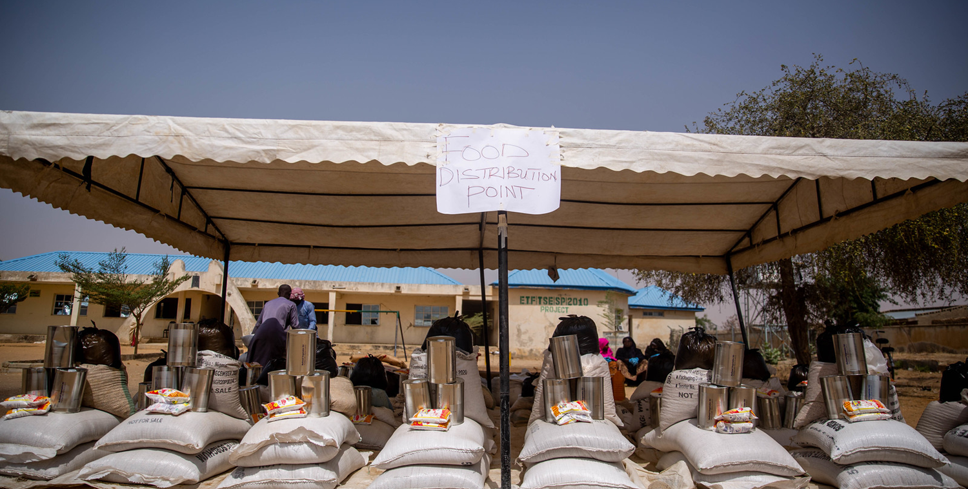
PREVENTION OF SEXUAL EXPLOITATION AND ABUSE (PSEA)
5

Slide 53


PREVENTION OF SEXUAL EXPLOITATION AND ABUSE
Current situation
OUR ANALYSIS:
MOST ORGANISATIONS HAVE FEEDBACK/COMPLAINTS MECHANISMS IN PLACE
MOST ORGANISATIONS HAVE PSEA POLICIES AND PROCEDURES IN PLACE
BUT…….
Notes:
Evidence shows that most organisations have some kind of AAP mechanism in place and PSEA policies and procedures. We are basing this presentation on the assumption that WVI is one of them; so will not go into details on particular activities and systems….
However, happy to provide support here if there are identified gaps..
-

Slide 54
PREVENTION OF SEXUAL EXPLOITATION AND ABUSE
Challenges and Gaps
Notes:
Evidence shows that most organisations have some kind of AAP mechanism in place and PSEA procedures but we consistently hear the following:
- Communities do not know about and do not use feedback and complaints mechanisms
- Communities do not always differentiate between who the perpetrators are
- Mechanisms on the ground are unable to deal with complaints of SEA
- Mechanisms on the ground do not know what to do with complaints about other organisations

Slide 55
PREVENTION OF SEXUAL EXPLOITATION AND ABUSE
Solutions/Actions
Collective systems
Why?
Communities can complain about anything and anyone and it will be dealt with in an appropriate and safe manner
Organisations will know how to refer complaints against alleged perpetrators in other organisations
More likely that serious complaints will be acted upon and organisations supported (with investigatory capacity etc, if required)
Notes:
From our perspective there are some ways in which we can work together to change this. Will focus on 2 areas: the need to contribute to collective systems and the need to better link AAP and PSEA activities.
This is not to say that other areas (e.g. boosting investigatory capacity etc) are not important; but for the purposes of this presentation; this will be the focus in terms of potential solutions.

Slide 56
PREVENTION OF SEXUAL EXPLOITATION AND ABUSE
Solutions/Actions
Collective systems
What?
Common / inter-agency or coordinated feedback and complaints mechanisms
In-country PSEA networks with SOPs for referrals to other agencies
How?
Have a PSEA focal point in every country
Join in-country PSEA Networks
Contribute to collective AAP/CBCM mechanisms
Be familiar with OCHA SOPs on PSEA/SHA (2021)
Notes:
From our perspective there are some ways in which we can work together to change this. Will focus on 2 areas: the need to contribute to collective systems and the need to better link AAP and PSEA activities.
This is not to say that other areas (e.g. boosting investigatory capacity etc) are not important; but for the purposes of this presentation; this will be the focus in terms of potential solutions.

Slide 57



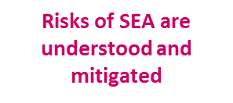

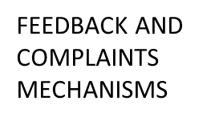

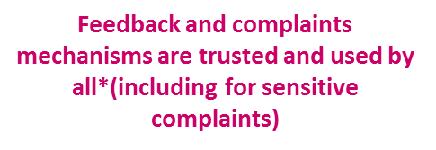
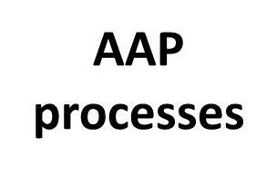
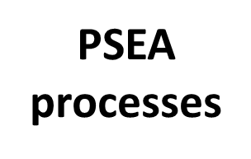



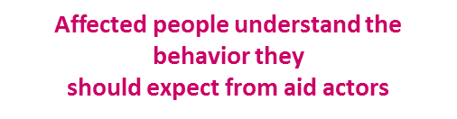

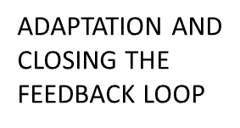
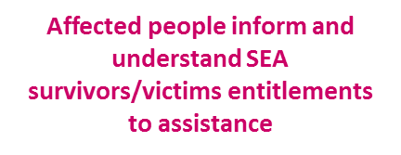




PREVENTION OF SEXUAL EXPLOITATION AND ABUSE
Solutions/Actions
Linking AAP and PSEA
Notes:
Underlying everything we have talked about is the critical need to link AAP and PSEA.
Talk about AAP processes; then PSEA processes and then show the results of collaboration between the 2.
Main point: PSEA – very internally facing processes; AAP – very community based.
Who are we trying to safeguard? Our organisations or the communities? Need to link the PSEA to the AAP to make sure affected people are at the heart…

Slide 58
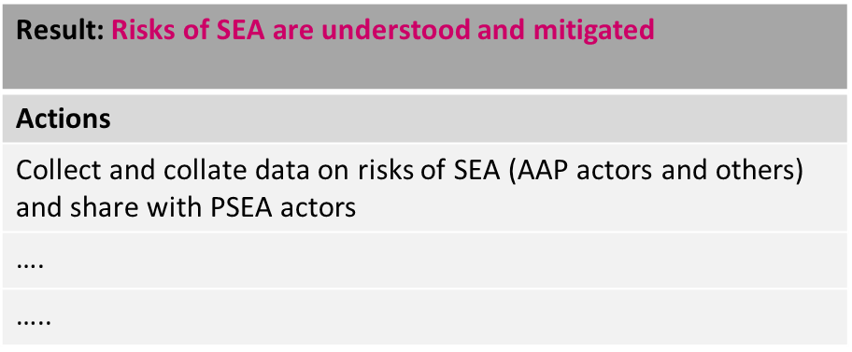
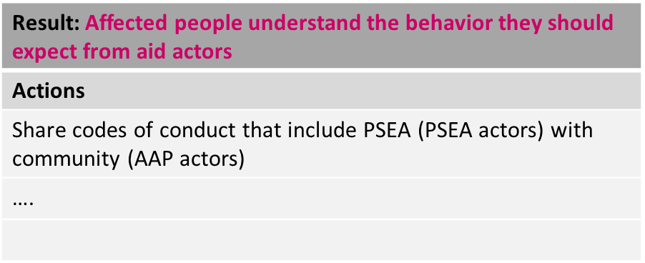
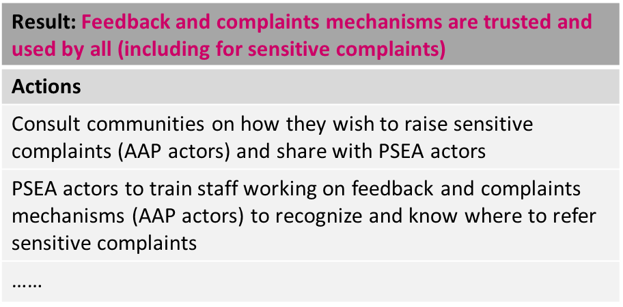
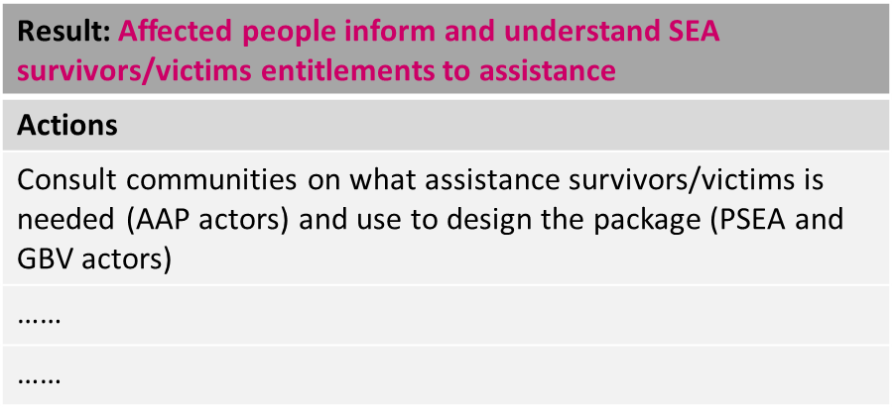
PREVENTION OF SEXUAL EXPLOITATION AND ABUSE
Solutions/Actions
Examples of Collaborative AAP and PSEA Actions:
Notes:
But for now some examples on how collaboration between AAP and PSEA could function
Ask participants to share experiences from their counrties

Slide 59
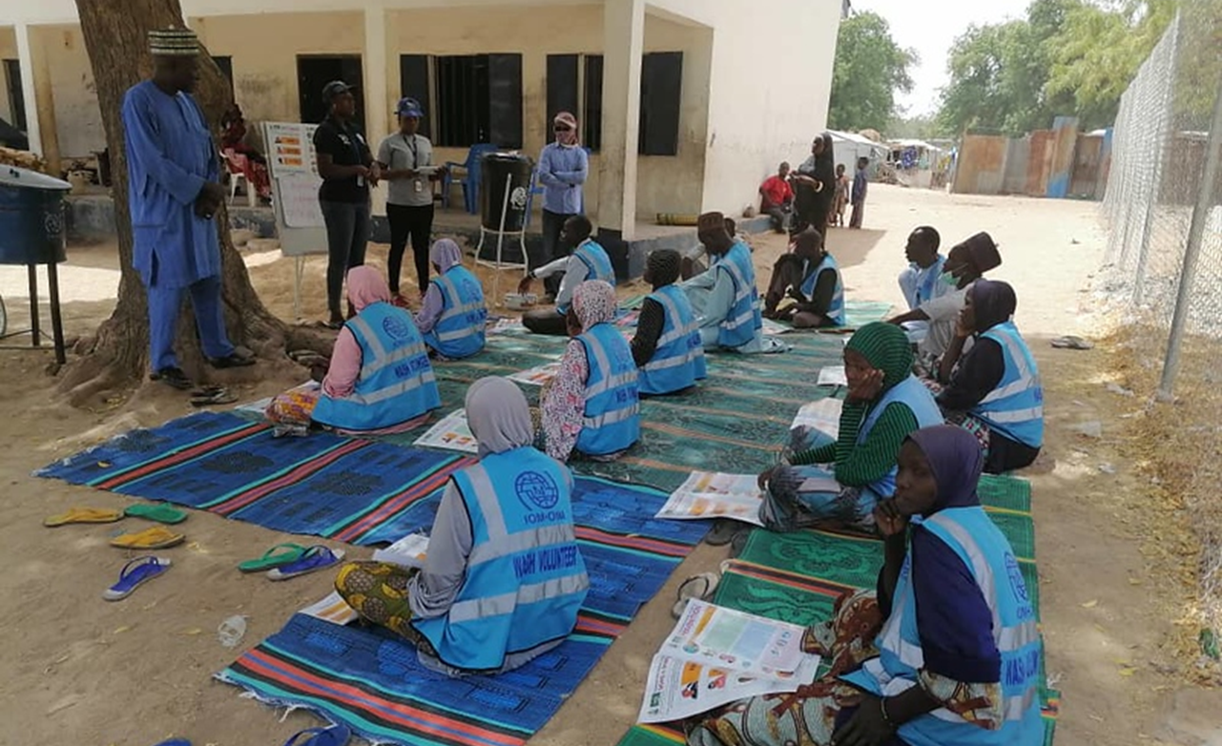
6
RCCE and AAP

Slide 60
RCCE AND AAP
Intersections/Complementarity
What is the relationship with COVID-19 and RCCE?
Risk Communication and Community Engagement (RCCE) is the agreed inter-agency terminology for the COVID-19 response.
RCCE and AAP/CE/CCEA are built on the same values and principles – both are community-centred approaches that enable and empower people to be active in overcoming the risks that they face.
Risk communication refers to real time exchange of information, opinion and advice between frontline responders and people who are faced with the threat of a disease to their survival, health, economic or social wellbeing.
People in the community will not distinguish between an RCCE actor and an AAP/CE actor, so the two groups should work together seamlessly. In some cases, it will be the same partner capacity tasked to do both AAP/CE/CCEA and RCCE, so the collaboration is even more important.
Notes:
RCCE and AAP/CE/CCEA are built on the same values and principles – both are community-centred approaches that enable and empower people to be active in overcoming the risks that they face. Community engagement is a broad term that encompasses multiple approaches aimed at working collaboratively with communities to effect positive change. Various community engagement approaches can be placed along a broad scale of participation, meaning some approaches involve communities more passively whilst others involve them more actively. Similarly, some participatory approaches are more empowering than others. RCCE is an essential part of any public health emergency response. Risk communication refers to real time exchange of information, opinion and advice between frontline responders and people who are faced with the threat of a disease to their survival, health, economic or social wellbeing.
People in the community will not distinguish between an RCCE actor and an AAP/CE actor, so the two groups must work together seamlessly. The specifics of the collaboration between the two approaches will vary depending on the context. Ideally, if there is an existing Communication, Community Engagement and Accountability group active withing the humanitarian architecture, the AAP and RCCE would be the specific sub-groups within the community engagement group, where one exists. However, where this level of integration is not possible, the two groups should work extremely closely, collaborating on areas such as shared learning on approaches and community feedback, joint planning and integrated engagement strategies.
Engaging the community is most effective when done by people the community trusts, regardless of their technical specialty. In some cases, it will be the same partner capacity tasked to do both AAP/CE/CCEA and RCCE, so the collaboration is even more important.

Slide 61
RCCE AND AAP
Benefits of strengthening coordination between RCCE and AAP/CE approaches
Risk Communication
and Community Engagement
Assesses information needs/landscape, risk
perceptions, believe systems, power
dynamics of different community groups
Plans engagement and behaviour change
strategies based on the assessment
Initiates and maintains positive
behaviors to reduce risks
Enables communities to lead
response efforts and promote
participatory planning
Promote and support the use of socio-behavioural information for effective decision-making
Collect and amplifies community feedback to
influence decision-making and inform community engagement and behaviour change approaches
People can speak to any actor
(AAP or RCCE) and trust that their needs,
concerns and feedback will be dealt with regardless
Strengthen participatory planning with communities
People trust that sensitive complaints, regardless of who they
report them to, will be handled and referred to the appropriate
entities for follow-up
The changing protection risks that COVID exposes are understood and PSEA/GBV/AAP/RCCE interventions are adjusted accordingly
Changing patterns of exclusion are understood and engagement practices are adjusted accordingly to reach marginalised groups
Avoid duplication/gaps in engagement; clarity on who does what in response to community feedback
Actors with established community trust can engage communities with technical content on COVID-19 as well as other humanitarian needs
Efficiency – community insights and feedback mechanisms can be
used to inform public health and humanitarian approaches
Shared learning to inform programme
adaptations by AAP WG and clusters,
as well as RCCE
Accountability to Affected Populations/Community Engagement
Assesses information & communications preferences and needs within the community
Manage feedback mechanisms, analysing trends and referring to relevant actors
Closing the feedback loop by reporting back to the community
Collaborate with clusters to manage people-centred engagement campaigns
Ensure all diversities can benefit from AAP strategies and that marginalized voices are heard
Ensure feedback mechanisms can manage
complaints of a sensitive nature and
that PSEA programmes are
informed by community voices
Notes:
Working out the best way to integrate, based on your context, is the starting point to unlock the potential benefits of this close collaboration – a summary of which are shown in the diagram.

Slide 62
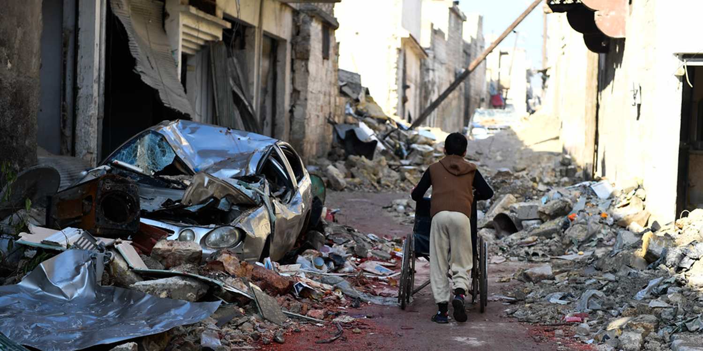
7
Conflict and AAP

Slide 63
CONFLICT AND AAP
Community engagment in complex settings
What are the issues?
Engagement with people in conflict crises remains an area that has seen the least progress in recent years.
Biases and power imbalances exist within and between communities affected by conflict; rumors, misinformation and propaganda are common. There is constant change and disruption; unique sets of expectations from those affected by the violence and those party to it; and an erosion of trust and proximity to communities themselves.
These issues need to be taken into consideration in all of our efforts to engage with communities.
Notes:
Engagement with, and accountability to, people affected by crises remains one of the areas in the humanitarian system that has seen the least progress in recent years.
Even where more detailed dialogue does occur, not enough consideration is given to the possible replication, through existing or newly created decision-making bodies supported by humanitarian organizations, of pre-existing power structures that may prolong and/ or create new forms of discrimination within the community.
This means that, as willing as they may be, affected people remain unable to systematically, and meaningfully, hold humanitarians to account for aid provided or aid not received. This is further exacerbated in armed conflicts and other situations of violence, which are intrinsically characterized by highly politicized, sensitive, insecure and contested environments, both physically and digitally. Biases and power imbalances exist within and between communities affected by conflict; rumours, misinformation and propaganda are rife. There is constant change and disruption; unique sets of expectations from those affected by the violence and those party to it; and an erosion of trust and proximity.

Slide 64
CONFLICT AND AAP
What can we do?
AAP and conflict-sensitivity require us to pay attention to not just ‘needs’ and ‘rights’ but also to the quality of relationships.
We need to understand that AAP and conflict sensitivity can support each other: using information from effective CFMs can help our programming
Our power and privilege as aid workers can also lead to behaviours of indifference, impatience, and superiority, which further confirm to those in distress their loss of autonomy and worthiness.
A conflict-sensitive way of working goes beyond the local level, where AAP is centered, and includes strategic choices such as who you take funding from, and on what terms.
Notes:
AAP and conflict-sensitivity require us to pay attention to not just ‘needs’ and ‘rights’ but also to the quality of relationships. While a conflict-sensitivity lens looks at a wider set of relationships, e.g. within IDP and host populations and between them, it does include the quality of relationship between the affected populations and us, which is central to AAP.
AAP and conflict sensitivity can support each other: If we have an effective feedback and complaints mechanism, it may help us pick up unintended negative consequences of our intervention. A concern not to cause unintentional harm, will reinforce our care that the AAP feedback and complaints mechanism is indeed ‘safe’ for people to use, and doesn’t expose them to any form of retaliation. It also keeps our eye on the ‘implicit messages’ we may be sending through our behaviours: reducing people to statistics, to categories of ‘displaced’ and ‘host’, to their ‘needs’, whether we like it or not, is taking away much of their dignity, of their diversity, and of their confidence in their ability to make their own choices. Our power and privilege as aid workers can also lead to behaviours of indifference, impatience, and superiority, which further confirm to those in distress their loss of autonomy and worthiness. Fierce rivalry among aid agencies sends a clear message that competition, not collaboration, is the norm.
A conflict-sensitive way of working goes beyond the local level, where AAP is centered, and includes strategic choices such as who you take funding from, and on what terms. But if we act with great conflict-sensitivity, and prevent or mitigate negative consequences from our intervention, then this is something positive we can account for to the affected populations.

Slide 65
THANK YOU!

