Slide 1
Cholera Multisector response
With the collaboration of

Slide 2
Outline
Cholera Basics
What is cholera?
How do you get cholera?
What are the symptoms?
How is cholera transmitted?
What is the course of the disease?
Is cholera always symptomatic?
How is cholera treated?
Response Strategy
Pillars of the Global Strategy
Core elements of a Cholera Response
Sectors involvement
Community interventions
Community Based Surveillance
Community Case Management
WASH and Targeted interventions
Community engagement
Discussion

Slide 3
Cholera Multisector response: Cholera Basics

Slide 4
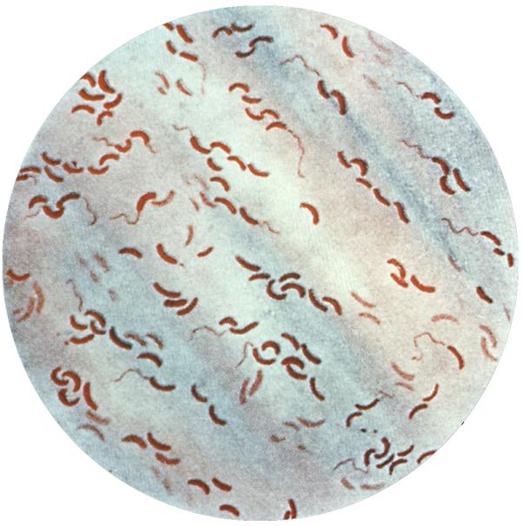
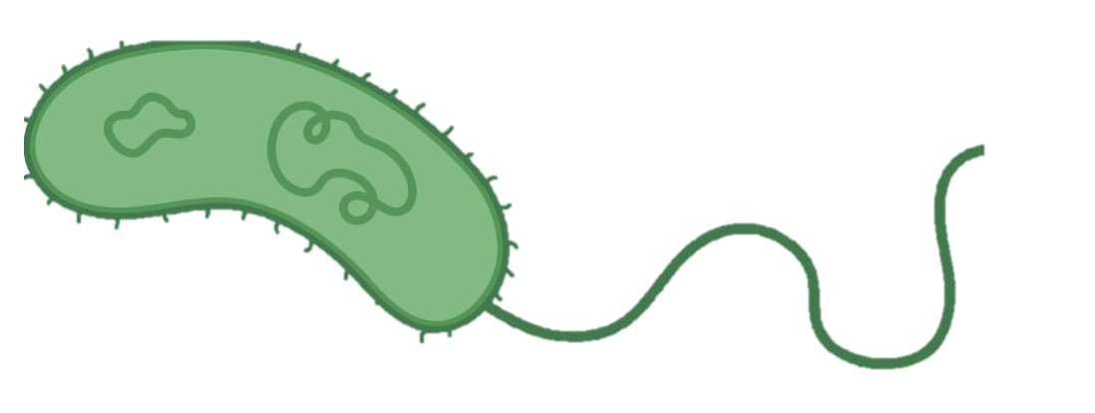
1. What is cholera?
Description
Cholera is caused by a bacteria called Vibrio cholerae
V. cholerae is naturally present in the environment and is found in riverine, coastal, and estuarine ecosystems
Serogroups O1 and O139 can produce the cholera toxin and large-scale outbreaks
Vibrio cholerae adheres to the small intestine epithelial cells
Image: https://phil.cdc.gov/details.aspx?pid=5324

Slide 5
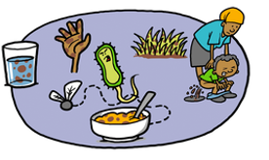
2. How do you get cholera?
Infection
Infection will happen through ingestion of the bacteria through contaminated water and/or food
Most probably incubation period is from 2 to 5 days (range from 0.5 to 10 days)
Vibrio cholerae can be present in the individuals feces during 10 days after the infection
Cholera toxin disrupts the normal function of intestinal cells, leading to excessive water loss
Drawnalism, UNICEF 2024
Notes:
Incubation period: The incubation period of cholera: a systematic review - PubMed (nih.gov). “We estimate the median incubation period of toxigenic cholera to be 1.4 days (95% CI, 1.3-1.6). Five percent of cholera cases will develop symptoms by 0.5 days (95% CI 0.4-0.5), and 95% by 4.4 days (95% CI 3.9-5.0) after infection.”

Slide 6
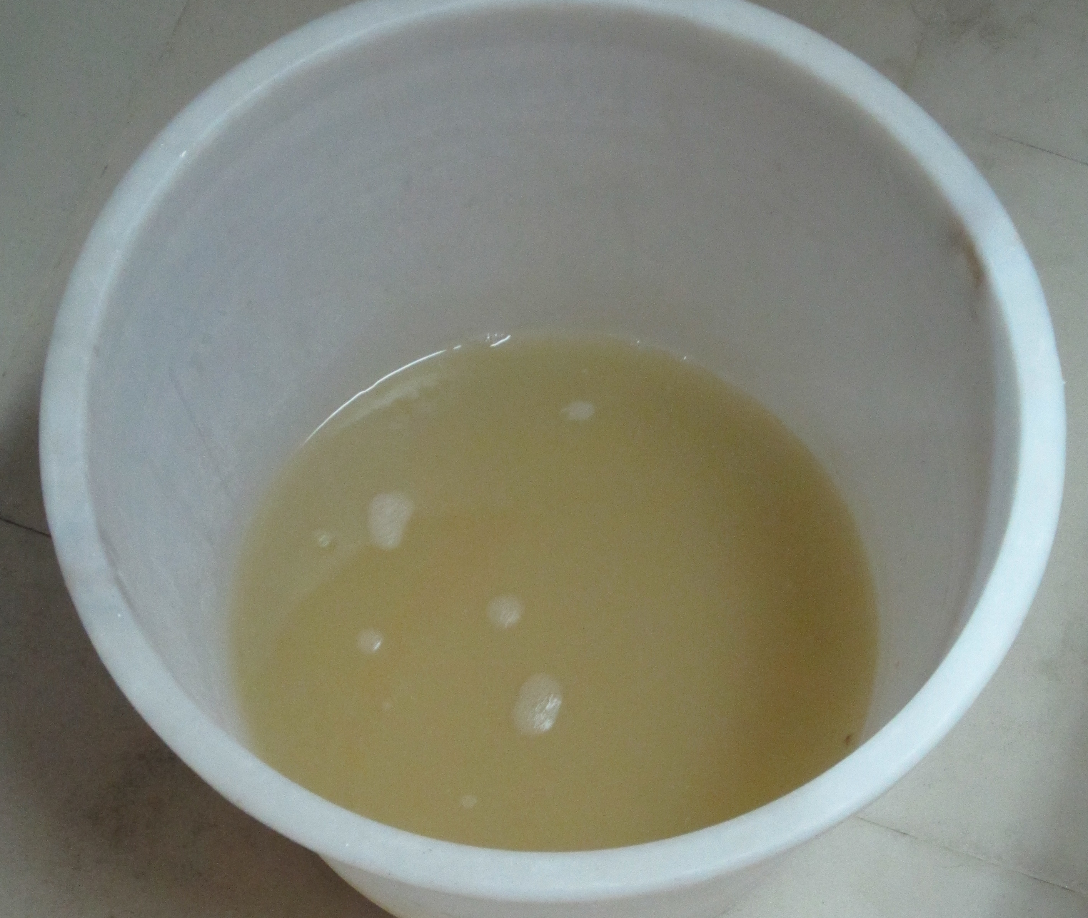
3. What are the symptoms of cholera?
Watery diarrhoea “rice water”
Symptoms
Acute watery diarrhoea
With or without vomit
NOT bloody diarrhoea
Severe dehydration is the cause of death
If dehydration is not treated, the disease can lead to death in a matter of hours

Slide 7
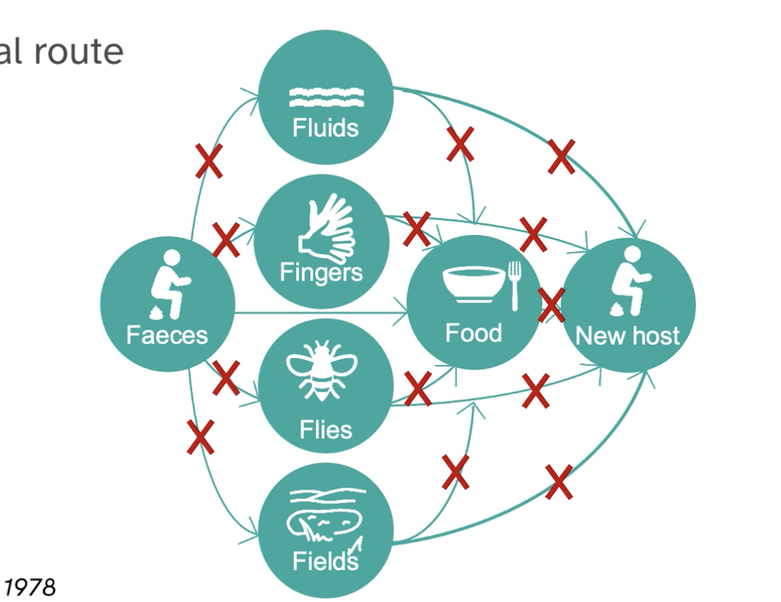
4. How is cholera transmitted?
F-diagram
Primary Barriers
Fecal-oral route
Secondary Barriers
Notes:
V. cholerae is spread from person to person via the fecal-oral route or indirectly through contaminated food and water
Primary Barriers: These barriers act directly on the source of contamination, which is feces. The main goal is to prevent the microorganisms present in feces from spreading into the environment.
Adequate Sanitation:
Construction and use of latrines or toilets that prevent direct contact between feces and the ground or water.
Safe disposal of excreta through sewerage systems or sanitary latrines.
Hygienic Waste Management:
Proper disposal of diapers and other contaminated materials.
Regular cleaning and disinfection of areas where excreta are handled.
Secondary Barriers: These barriers act on the transmission routes, preventing microorganisms from reaching a new person.
Personal Hygiene:
Frequent handwashing with soap and water, especially after using the toilet and before preparing food.
Use of antibacterial soaps in case of outbreaks.
Food Hygiene:
Proper cooking of food, especially raw or undercooked foods.
Washing fruits and vegetables before consumption.
Protecting food from contamination by flies or other insects.
Water Treatment:
Chlorination or filtration of water to remove microorganisms.
Avoiding consumption of water from unsafe sources.
Vector Control:
Control of flies and other insects that can transmit diseases.

Slide 8
5.What is the course of the disease?
Susceptible person
Infection, in a village...
Infected person
Recovered person
Notes:
SIR model and the immunity
Natural course of the disease is to recovery, but we can modify the natural course with vaccination without going through the infection.

Slide 9
6. Is cholera always symptomatic?
Among the infected, If 100 people get cholera...
80% have the disease, they don’t show symptoms but they spread it
80%
20% show symptoms, from those, 70 - 80% will be mild cases, and 20-30% severe cases and may die without treatment
20%
Notes:
It can affect both, adults and children and that it can kill even healthy adults within hours if not treated.
People at higher risk are:
Pregnant women
Children under the age of 5, especially malnourished children
Malnourished people in general
People that have not a good immune system such as people with HIV/AIDS or other chronic condition

Slide 10
7. How is cholera treated?
Treatment
Treatment involves administering oral rehydration solutions, intravenous fluids, and/or antibiotics, depending on the severity
ORS
Can be taken at home if received indication on preparation and quantities, but always better if it’s in a community structure (like Oral Rehydration Points) where they can be monitored
No dehydration
Mild dehydration
Severe dehydration
ORS
Treatment at a healthcare structure
Under 5, pregnant women or comorbidities - REFER
Notes:
Antibiotic prophylaxis can theoretically prevent both human-to-human and environment-to-human cholera transmissions. Also, some field trials have suggested that chemoprophylaxis has a protective effect among household contacts of people with cholera. However, due to the risk of resistance selection, antibiotic prophylaxis for close contacts, as well as for travelers arriving in or departing from cholera-affected areas, is not usually recommended

Slide 11
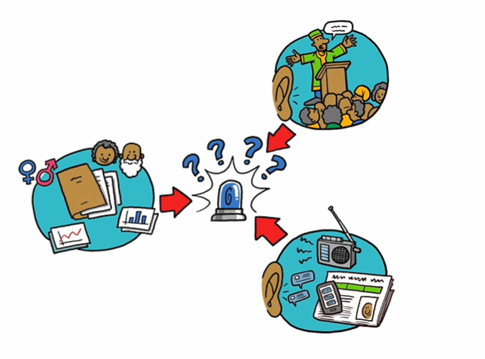
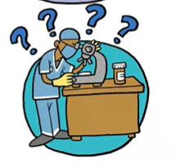
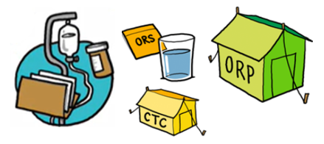
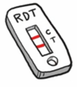
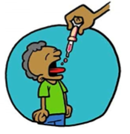
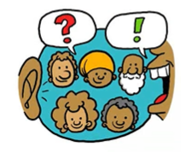
Cholera Multisector response: Response strategy
Drawnalism, UNICEF 2024

Slide 12
1. Pillars of the Global Strategy
WHO - Pillars of the Global cholera strategic preparedness, readiness and response plan
Pillar 1: Leadership, coordination, planning and monitoring
Pillar 2: Risk communication and community engagement (RCCE)
Pillar 3: Surveillance and outbreak investigation
Pillar 4: Water, sanitation and hygiene (WASH)
Pillar 5: Laboratory diagnostics and testing
Pillar 6: Infection prevention and control (IPC)
Pillar 7: Case management
Pillar 8: Operational support and logistics
Pillar 9: Continuity of essential health and social services
Pillar 10: Vaccination
https://www.who.int/publications/m/item/global-strategic-preparedness--readiness-and-response-plan-for-cholera
Notes:
https://www.who.int/publications/m/item/global-strategic-preparedness--readiness-and-response-plan-for-cholera

Slide 13
2. Core elements of a cholera response
PREPAREDNESS
Coordination mechanisms with authorities: mobilization of supplies, actors, activation mechanisms, monitoring, etc.
Surveillance mechanism in place or reinforcement, preparedness of community-based surveillance
Identify potential areas at risk
Map actors, identify their capacity, knowledge, supplies, funds, etc.
Revision of previous epidemiology, materials created, latest guidelines and protocols for the different sectors
Provide training to main actors and to the population
Preposition supplies in the areas of risk and in healthcare structures

Slide 14
2. Core elements of a cholera response
RESPONSE
Epidemiological intelligence
Setting up an epidemiological intelligence system is the first step of a well-informed response.
Surveillance at government level
Community based surveillance
Laboratory testing and confirmation
Alert and response
Coordinated monitoring
WHERE is happening?
WHO is affected?
WHY/HOW infection happened?
WHEN has happened/is happening?
WHAT should we do?
Notes:
Setting up an epidemiological intelligence system is the first step of a well-informed response.
It should help answer the following questions
WHERE is it happening. Where should we do something ?
But ALSO WHEN - because affected communities this week might differ from affected communities the following week.
WHO is affected ? The old ? The young ? The women ? The fishermen ? etc
WHY – what are the reasons, practices, beliefs, at risk behaviors, that are leading to contamination and death
WHAT should we do ?
ARE WE DOING ENOUGH, ARE WE DOING THE RIGHT THINGS ? IS OUR RESPONSE WORKING ?
It is about making sure all the data that we need to make informed decisions are collected and analysed.
It allows us to understand what is happening (to whom, and where) and to guide the response based on the situation on the ground (which will differ from place to place).
Without a proper Epidemiological Intelligence system, the response is blind and ineffective, almost never targeting the right activities directed at the right persons and at the right place and time.
An effective Epidemiological Intelligence system will favour a well designed, agile and targeted response, and increase its chance of being effective in saving lives and interrupting transmission.

Slide 15
2. Core elements of a cholera response
RESPONSE
Epidemiological intelligence
Setting up an epidemiological intelligence system is the first step of a well-informed response.
Surveillance at government level
Community based surveillance
Alert and response
Laboratory testing and confirmation
Coordinated monitoring
ARE WE DOING ENOUGH, ARE WE DOING THE RIGHT THINGS ? IS OUR RESPONSE WORKING ?
Where-When-Who-Why-What
Drawnalism, UNICEF 2024
Notes:
Setting up an epidemiological intelligence system is the first step of a well-informed response.
It should help answer the following questions
WHERE is it happening. Where should we do something ?
But ALSO WHEN - because affected communities this week might differ from affected communities the following week.
WHO is affected ? The old ? The young ? The women ? The fishermen ? etc
WHY – what are the reasons, practices, beliefs, at risk behaviors, that are leading to contamination and death
WHAT should we do ?
ARE WE DOING ENOUGH, ARE WE DOING THE RIGHT THINGS ? IS OUR RESPONSE WORKING ?
It is about making sure all the data that we need to make informed decisions are collected and analysed.
It allows us to understand what is happening (to whom, and where) and to guide the response based on the situation on the ground (which will differ from place to place).
Without a proper Epidemiological Intelligence system, the response is blind and ineffective, almost never targeting the right activities directed at the right persons and at the right place and time.
An effective Epidemiological Intelligence system will favour a well designed, agile and targeted response, and increase its chance of being effective in saving lives and interrupting transmission.

Slide 16
Cholera response
Core elements of a Cholera response
Epidemiological intelligence
Saving lives in communities
COLLECTION OF ALL THE DATA NEEDED TO MAKE INFORMED DECISIONS AND GUIDE THE RESPONSE ON TIME AT THE RIGHT PLACE
Interrupting transmission
Increase awareness and risk perception
An effective Epidemiological Intelligence system will favour a well-designed, agile and targeted response, and increase its chance of being effective in saving lives and interrupting transmission.
WHERE is happening?
WHO is affected?
WHY/HOW infection happened?
Tailored response measures
OCV campaigns
WHEN has happened/is happening?
WHAT should we do?

Slide 17
2. Core elements of a cholera response
Save lives in communities
STOP PEOPLE FROM DYING IS THE FIRST PRIORITY DURING AN OUTBREAK
STRENGTHEN THE SYSTEM OF CARE AT ALL LEVELS AND FOR EVERYONE
Hospital
Clinic
ORP
CHW
Notes:
Care structures need to be accessible for the population. Hospitals should be kept for the severe cases and introduce structures that are closer to the population to provide assistance to the mild and moderate cases and can refer the severe cases to the hospitals or Cholera treatment centers.

Slide 18
2. Core elements of a cholera response
Interrupting transmission
Quick interventions AROUND potential source of infection can help limit the scale of the outbreak and slow down transmission.
Water safety and access
Access to clean, safe and dignified toilets
Clean environment
Access to hygiene products and safe hygiene practices
Vector control
Infection, prevention and control in healthcare structures

Slide 19
2. Core elements of a cholera response
Increase awareness and risk perception
Increasing awareness and risk perception may lead to the adoption of protective behaviors
Awareness
BEHAVIOR
Risk Perception
Behavioral Intention
Norms / Social Factors
Perceived benefits
Means
Notes:
Increasing awareness and risk perception may lead to the adoption of protective behaviors
However, behavior change is complex, and other elements are to be considered that are beyond the behavioral intention.
How the new protective behavior will be perceived by others
Are benefits superior to costs in money or time / efforts spent
Do I have the capacity to practive and sustain this new behavior
Etc.
The adoption of a new protective behavior is complex – even though the person understands that washing hands might be beneficial, it might not do it for a number of (often valid) reasons.

Slide 20
2. Core elements of a cholera response
Tailored response measures
Case households and nearby neighbors
Public institutions and places
Environmental contamination
Population gatherings
AWD/hospital treatment facilities
Burials and funerals of AWD cases
Drawnalism, UNICEF 2024
Notes:
Case households and nearby neighbors
Public institutions and places
Population gatherings
Environmental contamination
Burials and funerals of AWD cases
AWD/hospital treatment facilities
Understanding at what occasion, in which context transmission occurs is key to be effective in limiting the spread of diseases.
Epidemiological Investigation is the basis for asking the right questions around possible transmission contexts
Cholera transmission could originate from a number of occasions / places :
Contaminated water source
At the occasion of a ceremony (wedding) or a public gathering
Inside the household – with other family members or neighbours
When going to visit a patient (friend or relative) in a health center
While participating to a funeral ritual or meal
Outside, while eating in restaurants or markets
Related to a speciric profession
AWD control measures must be tailored according to the local disease transmission context(s) as well as the at-risk populations and practices, which may evolve over the course of an epidemic. The transmission context is defined as the circumstances in which a person will likely contract the disease ¹⁵. In areas where water supply, access to sanitation, and/or food safety and hygiene are lacking, six major AWD transmission contexts include:
within case households and between nearby neighbors
public institutions and places (e.g., railway or bus stations, markets, harbors, public places, and schools)
population gatherings (e.g., large-scale population movements, refugee camps, IDP camps, military bases, ceremonies, mass gatherings)
AWD treatment centers
funeral and burial ceremonies of AWD cases (including preparation, washing and touching of AWD corpses as well as shared funeral feasts)
environmental contamination (e.g., release of AWD patient feces into (1) local lakes or rivers used as a drinking water source or (2) unprotected drinking sources due to flooding)
Based on the identified transmission context(s), the appropriate service delivery mechanisms and WASH packages may be selected

Slide 21
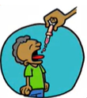
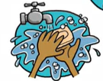
2. Core elements of a cholera response
OCV campaigns
OCV will buy us time, we can’t forget WASH
Drawnalism, UNICEF 2024
Support the access of the population to vaccination (increase vaccine coverage)
Work on barriers
Encourage people to vaccinate
Understand acceptance
OCV is just preventing Cholera, push for preventive measures to continue
Opportunity for multisector interaction
Notes:
OCV is a great intervention with the power to alleviate the consequences of cholera outbreaks.
However it is a complicated process to decide which country gets to receive vaccines – and when
BUT If happens – then we need to ensure that most of the population can have access to the vaccine (increase vaccine coverage).

Slide 22
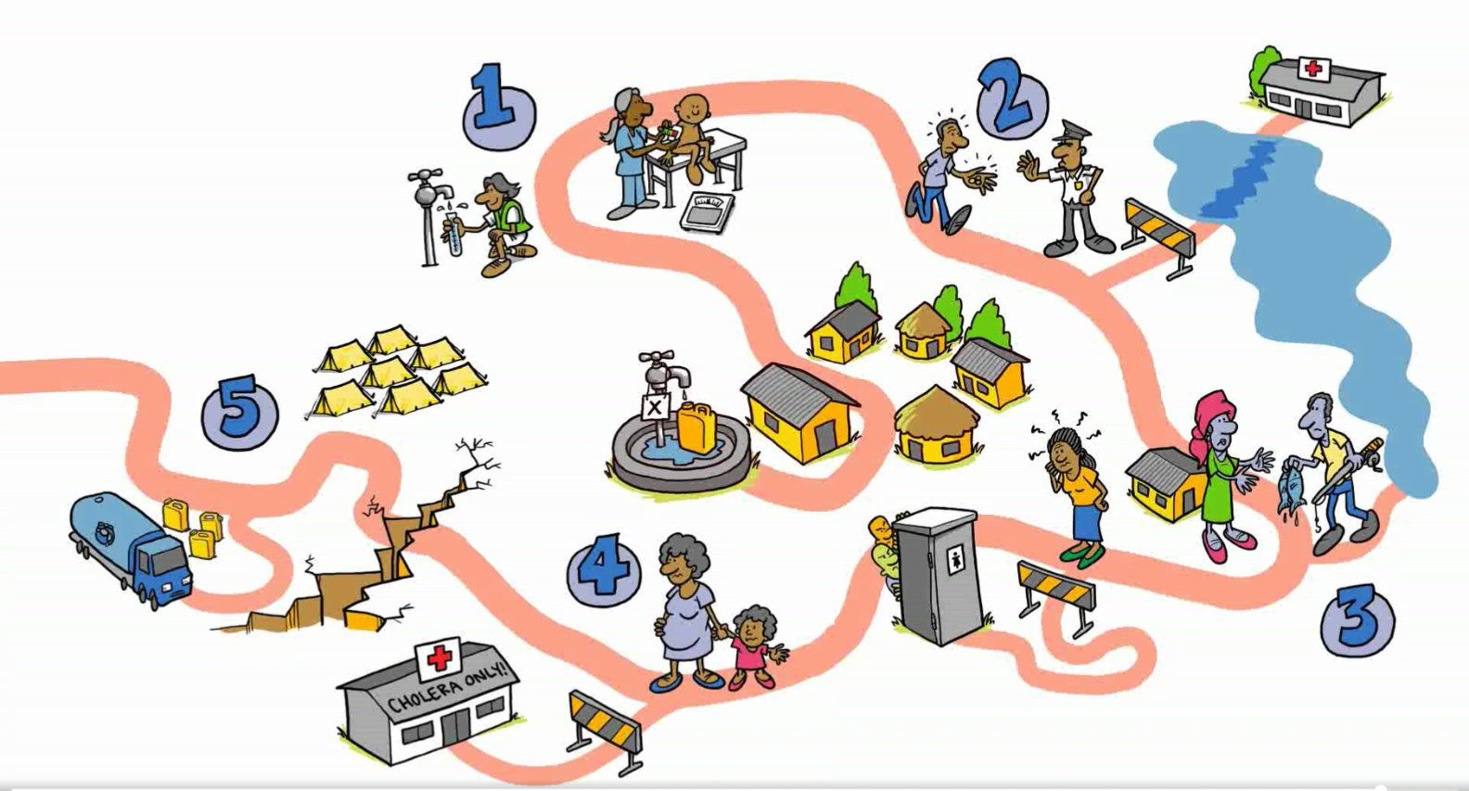
3. Sectors involvement
Opportunistic: Using already existing structures to integrate the cholera response components
Security
Nutrition
MHPSS
CCCM
PGI
Education
Notes:
During the response we will find opportunities in other sectors to collaborate. OCV campaigns are a good option to provide other services in addition, like nutrition screening, or they can be conducted in schools and improve the WASH services. Key messages of Cholera prevention can be tailored to each sector. Activity matrix

Slide 23
Cholera Multisector response: Community interventions

Slide 24
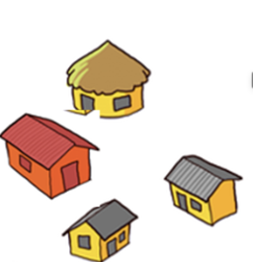
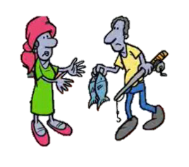
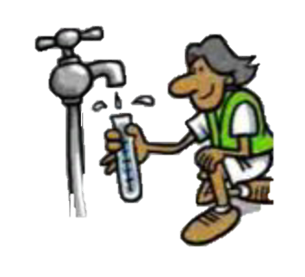
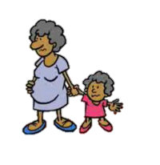
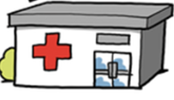
Overview of community interventions
Drawnalism, UNICEF 2024
Notes:
Cases are detected in the ORPs or by Community volunteers doing surveillance. Those cases are informed to the Rapid Response Teams, that will conduct investigation and WASH interventions in the affected HH and around it.
Community based surveillance
Community Case Management
Targeted WASH interventions
Community engagement

Slide 25
1. Community Based Surveillance
Existing surveillance systems may be weak or only collect information when people are present in a health facility
Often, during an outbreak, groups of sick people or sudden death occur at the community level, but the information may not be captured in the existing traditional surveillance system.
Often, the community is aware of the health problem, but information don’t arrive early enough to stop the spread of the disease.
CBS aims to bridge the gap through early detection of people getting sick
Preparedness
Outbreak
Stabilization
Time
The system is discussed and integrated in the current surveillance system
Active case finding
Stable structure inside the community by community members

Slide 26
2. Community Case Management
In the preparedness phase, we should identify existing community health programs where cholera response can be integrated
Oral Rehydration Points – Stabilization centres
Outbreak
Tertiary
health care
Oral Rehydration Points
Secondary
health care
Mobile Oral Rehydration Points
Primary health care
Stabilization
Oral Rehydration Therapy Volunteers
Clinical preventive services
Community health programs
Population-based health care services

Slide 27
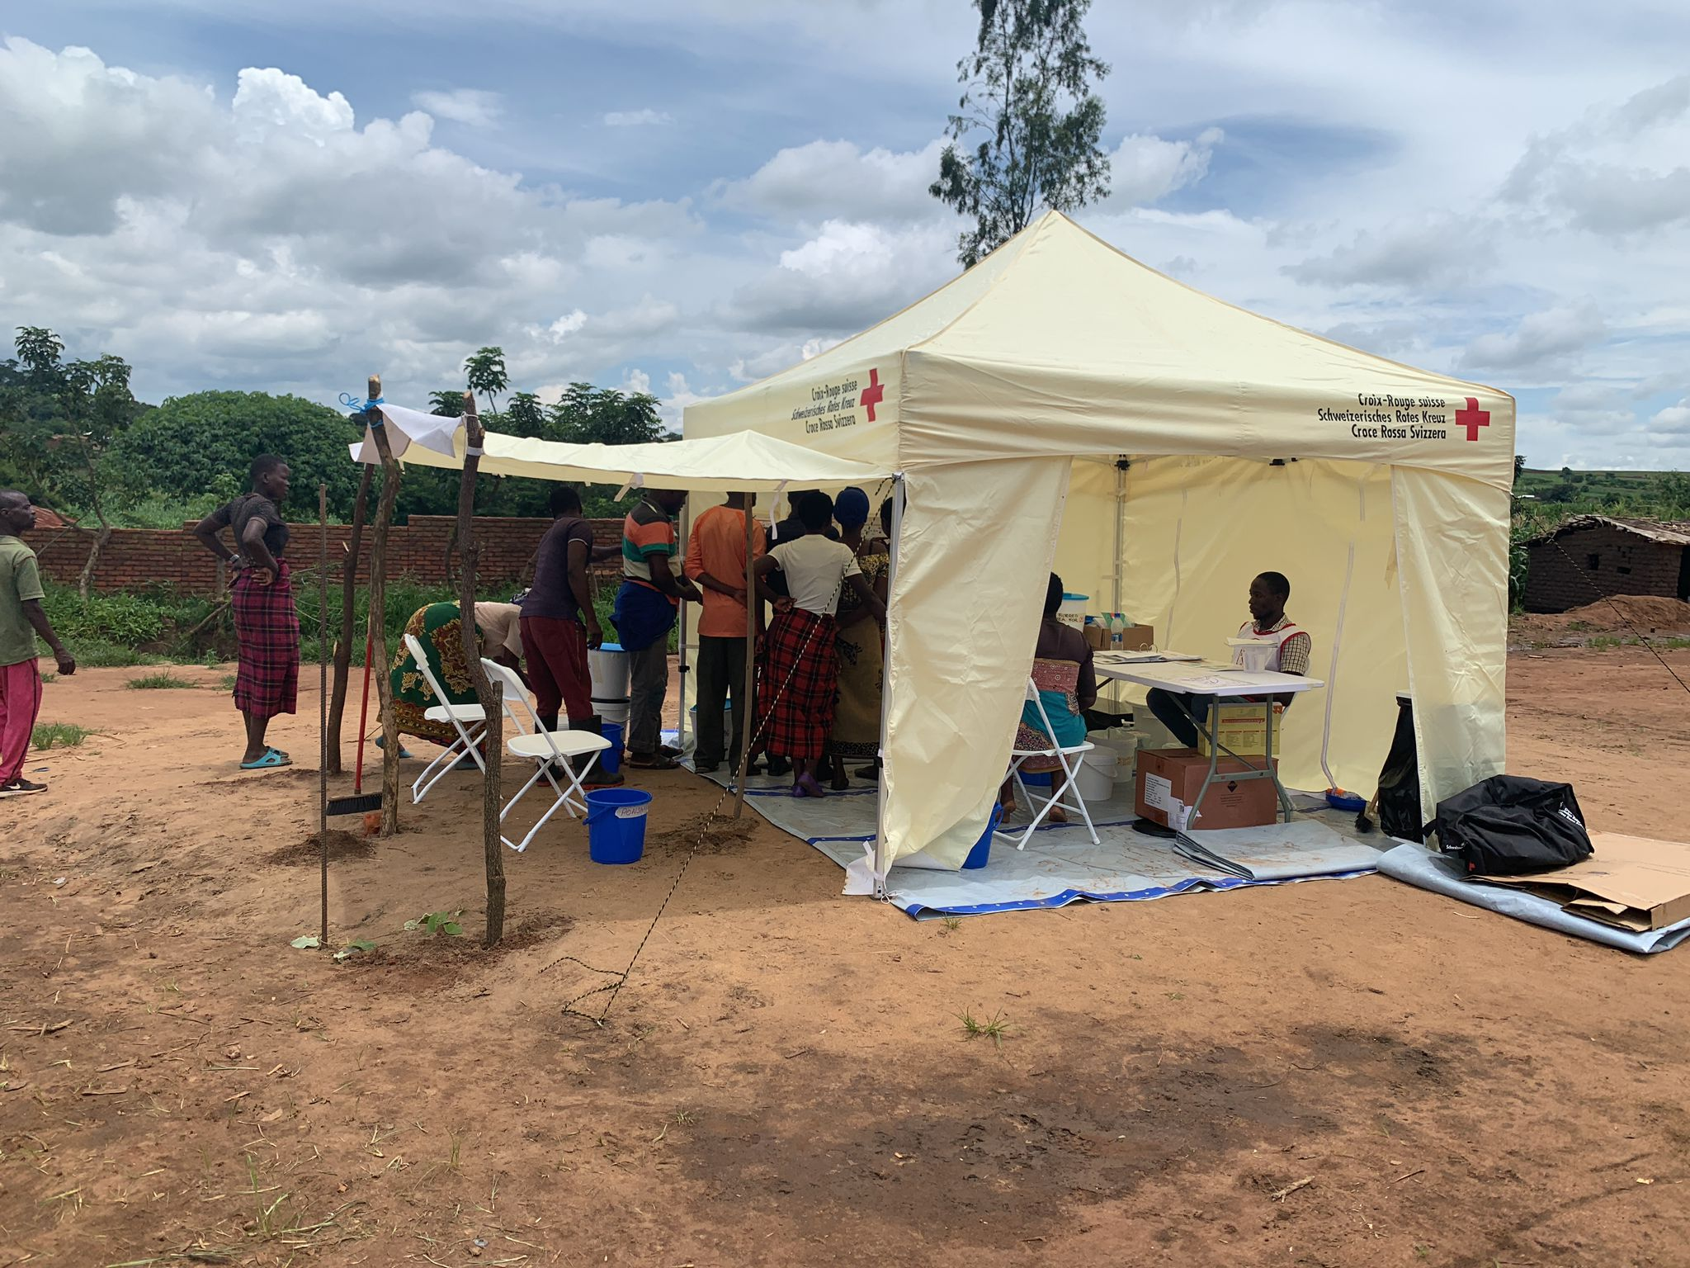
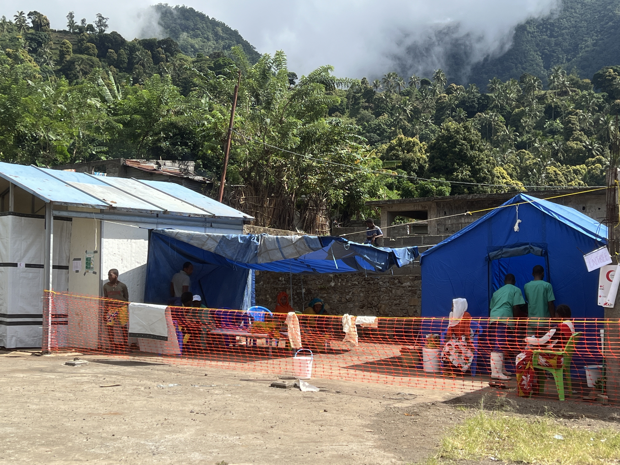
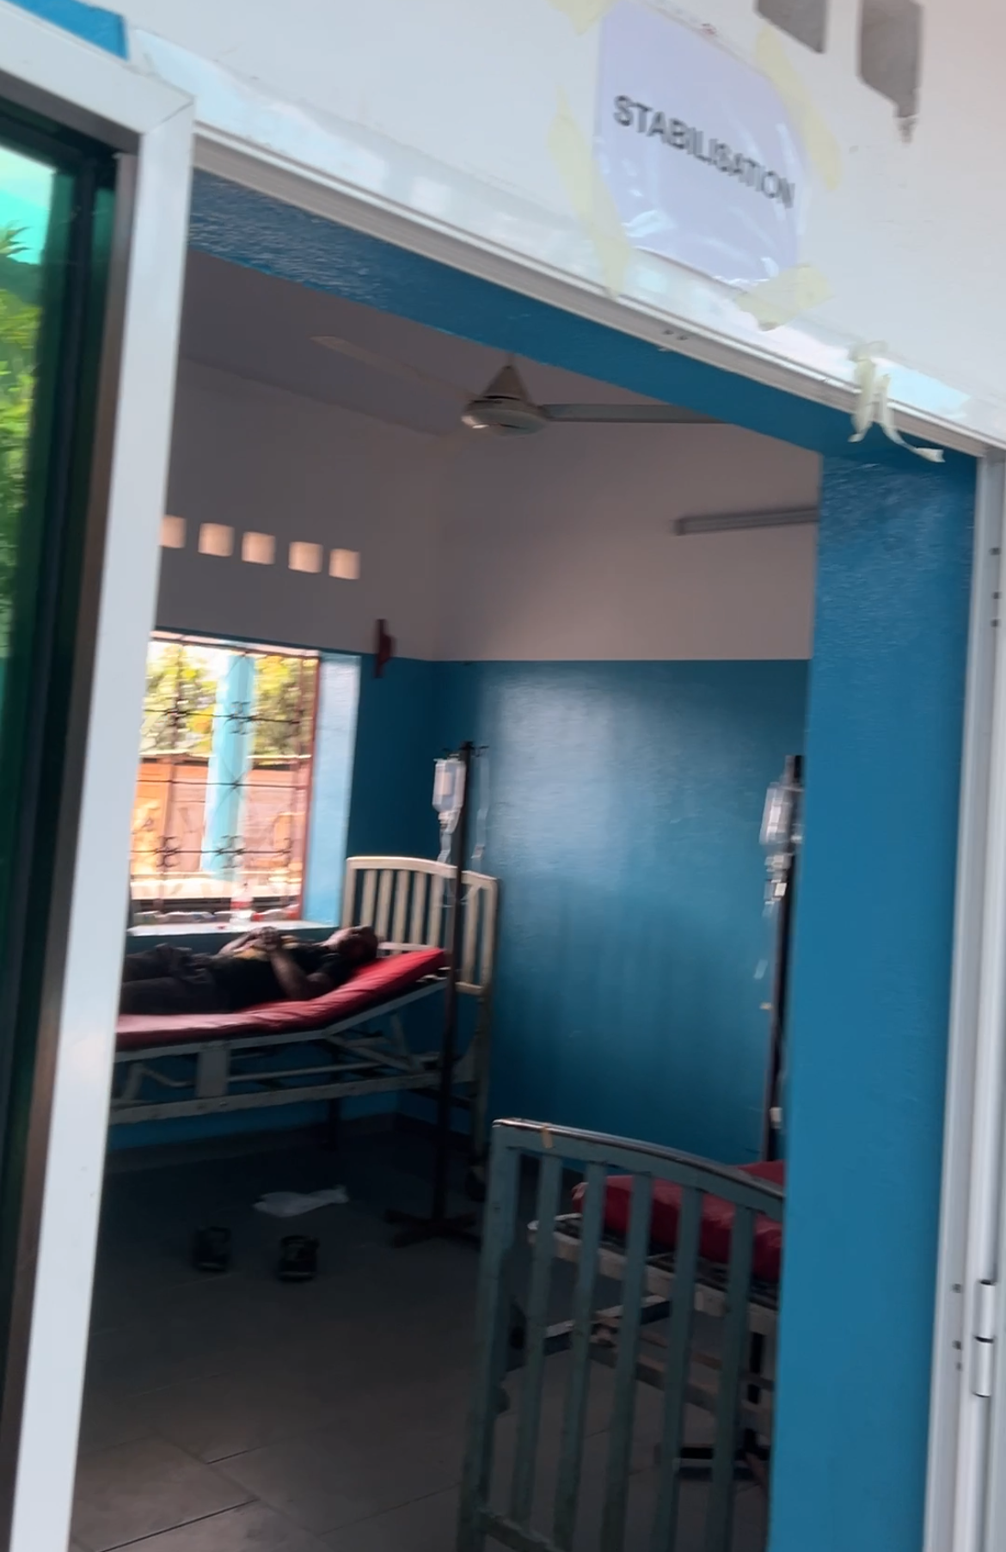
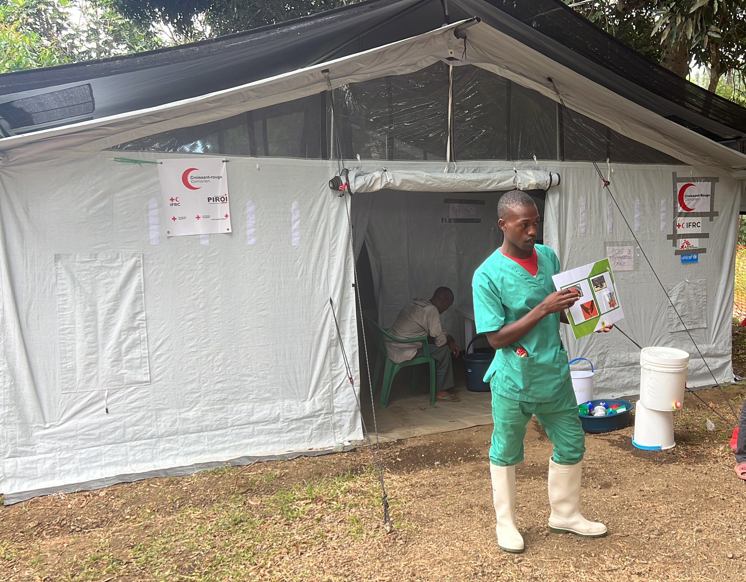
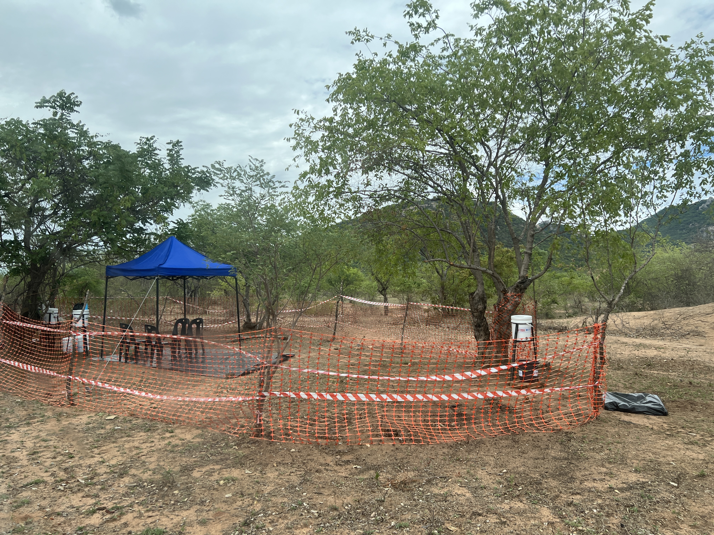
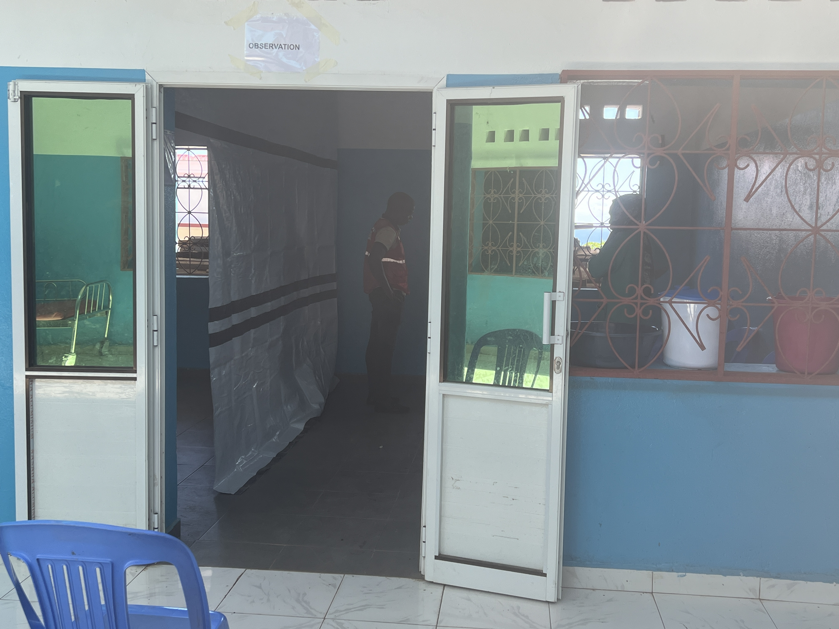
2. Community Case Management
ORPs
Mobile
Stabilization centre

Slide 28
2. Community Case Management
At all levels, Infection, Prevention and Control measures should be implemented to minimize the transmission inside the healthcare structures.
That is an activity shared with WASH and Health, and it’s different from the WASH activities in HCF
Tertiary
health care
Secondary
health care
Primary health care
Clinical preventive services
Population-based health care services

Slide 29
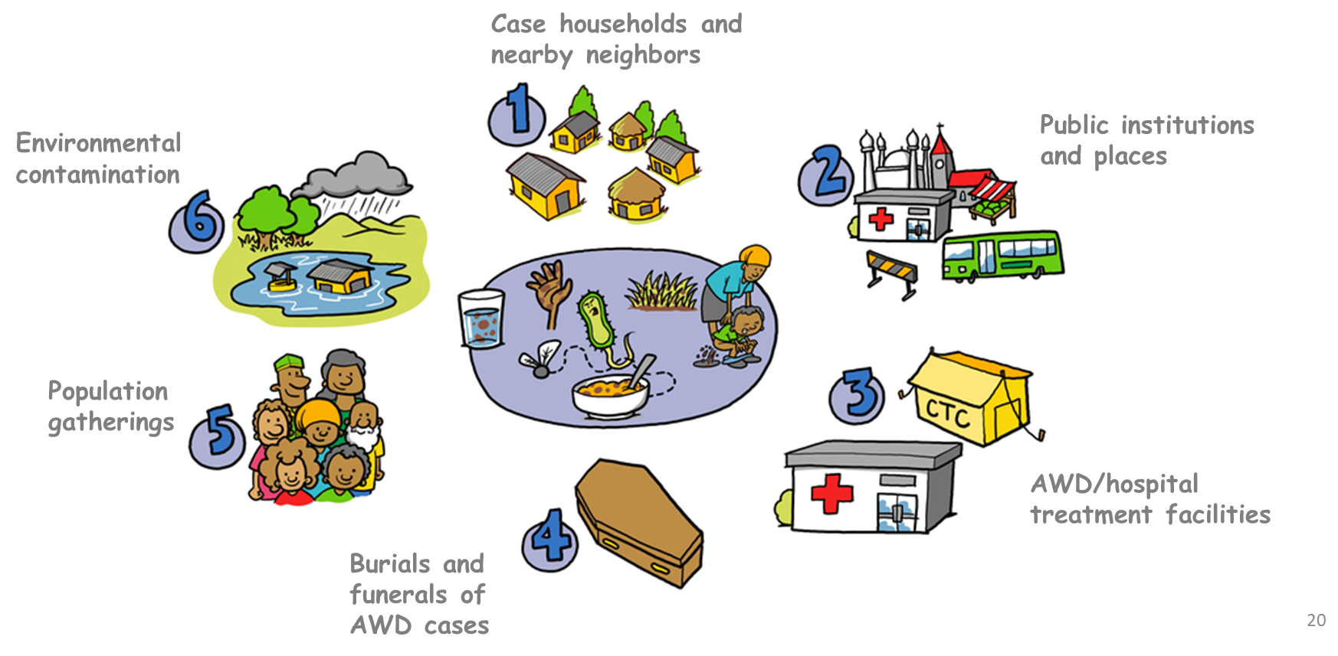
3. WASH and Targeted interventions
We can intervene with WASH protective activities in all those contexts to interrupt transmission
Drawnalism, UNICEF 2024
But, at the affected households and neighbourhoods, we can conduct targeted interventions.
Notes:
WASH protective activities can be always conducted as WASH measures is how we can stop cholera. But targeted interventions have shown to be more effective. Explain what we mean by WASH protective activities.

Slide 30
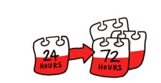
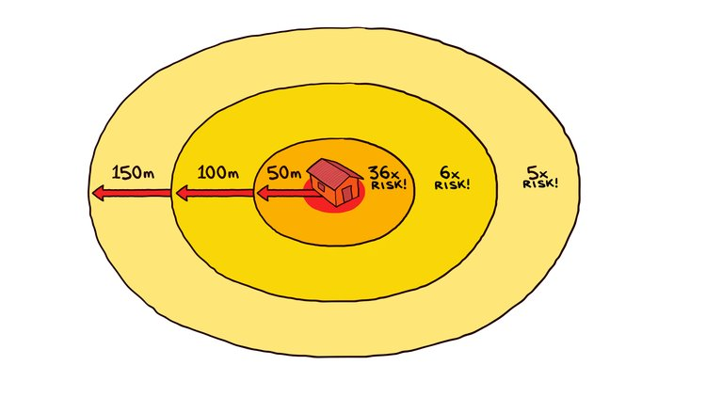
3. WASH and Targeted interventions
Targeted interventions are not just responsibility of WASH, an efficient rapid response team should be multisectoral including health and community engagement.
Teams should intervene before 72h after the identification of the case
Drawnalism, UNICEF 2024
Notes:
Cholera infection risk is higher for household members of cholera patients and close neighbors, especially during the first week and up to three weeks after the cholera patient had shown symptoms and or sought treatment.​
​
Research and practice have shown that the relative risk is 36 times greater within a 50-metre radius of a confirmed case, 6 times higher within a 51-100 metre radius and 5 times higher within a 101-150 metre radius.​ ​
Contexts of vibrio cholerae transmission and the relative risk therefore support the rationale for rapid and targeted multi-sector interventions to stay ahead of the epi curve and control the outbreak.

Slide 31
3. WASH and Targeted interventions
There are 4 mechanisms to deliver the intervention
Drawnalism, UNICEF 2024
Case-area targeted interventions (CATI) ​
Case-cluster targeted interventions (CLUSTI) ​
For CATI/CLUSTI there are minimum requirements to conduct it: understand the transmission context; quality and timely epidemiological data; Security and access; Supplies and resources
Notes:
Explain the activities that you would conduct at the HH and community level:
Case-area targeted interventions are specific tailored WASH activities carried out by mobile teams at case residences and neighboring households in a defined perimeter (50- to 150-meter radius) around localized AWD cases. Once cases are identified, a team carries out a rapid case investigation, active case search, and WASH interventions at the case resident to limit transmission: home disinfection, hygiene promotion, household water treatment, water quality monitoring and delivery of a household AWD kit. Meanwhile, preventive WASH activities are conducted at the residences of nearby neighbors (e.g., rapid investigations, active case search, hygiene awareness, household water treatment, water quality monitoring and distribution of neighbor household AWD kits). To effectively interrupt transmission, interventions should be conducted during “windows of opportunity”: during the early and late phases of an outbreak.
Targeting case clusters, interventions carried out in the community may include water quality monitoring and source-based water treatment (e.g., water network chlorination), temporary safe water supply systems, “quick fixes” for water and/or sanitation systems, restriction of access to contaminated or high-risk water points, mass media hygiene promotion, mass media food safety and hygiene, enforcement of public health regulations, and social mobilization.

Slide 32
3. WASH and Targeted interventions
There are 4 mechanisms to deliver the intervention
Drawnalism, UNICEF 2024
Health-care facility based interventions
Blanket neighbourhood interventions ​

Slide 33
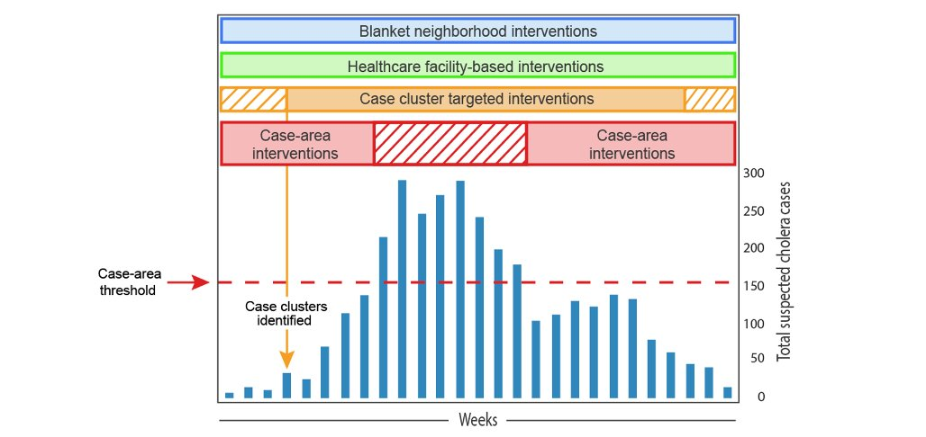
3. WASH and Targeted interventions
How to select the appropriate mechanism
Windows of opportunity: multiple service delivery mechanisms may be implemented simultaneously or consecutively during an outbreak, depending on the outbreak phase, magnitude and context.

Slide 34
4. Community engagement
Risk communication
Understand local behaviours, communicate transparently even in uncertainty, create and maintain trust
Clarifying Rumours and Community Concerns
Drawnalism, UNICEF 2024
Trusted information should reach people and rumours should be addressed by maintaining a very open flow of information from the beginning of the outbreak; rumours spread easily when information is incomplete or delayed
Key messages
Key messages to the public should help people to recognize symptoms of cholera and how it is transmitted and provide information about what to do for prevention and treatment, encouraging early treatment-seeking behaviour
SBC Team UNICEF
Notes:
Outcomes of effective community engagement are foremost about community ownership of the response and include increasing trust, confidence and cooperation with response teams, community feedback and uptake of preventive practices.

Slide 35
4. Community engagement
Community has ownership of the response
Community feedback mechanisms
Community cooperates with the response teams
Community integrates preventive practices
Community participates in the response*
Contribute to making communities more self-sufficient and empowered in taking care of their own health
Drawnalism, UNICEF 2024
*Community deaths tend to happen at onset of the outbreak, communities start to mobilize always before organizations arrive
Notes:
Best practices for community engagement include:
identifying and using trusted, community-appointed people as entry points for response teams to work with the at-risk community;
facilitating a local risk assessment and using locally generated data to develop an implementation plan for the community to remain cholera free or to rapidly interrupt transmission;
forming a small local task team comprising trusted leaders, respected members of the community, religious representatives and youth and women’s group members who are responsible for engaging with the response teams and monitoring implementation of the local plan;
facilitating routine feedback and engagement between the community and the cholera response team to be able to change the strategy if needed;
supporting and building on the mass mobilization efforts of local churches, networks, teachers and vendors to improve the community’s confidence;
linking up and using mass media to promote community engagement activities and using local structures to discuss public health advice promoted in the media; and
using local communication channels (such as information boards, meetings, social media) to communicate which parts of the response are working, which are not working and how to improve the response.

Slide 36
Discussion
Does this look realistic?

Slide 37
Discussion
Thank you
Does this look realistic?
With the collaboration of

