Slide 1
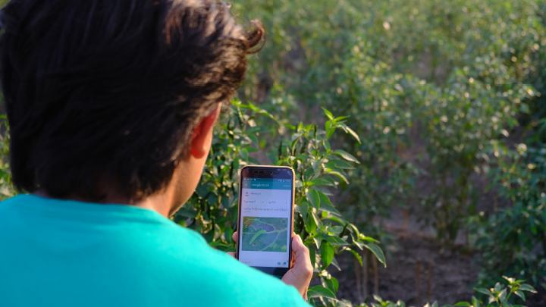
GIS and Agriculture
Green Way Agri-livestock app

Slide 2
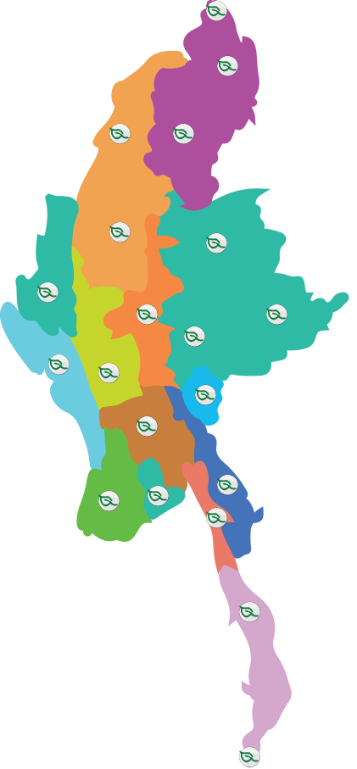
Covering over 95% of the total townships
Over 1,000
Over 100,000
Over 900
Over 3,900
Over 1,400
￼

Slide 3
Easy Registration
Village- Nampan (Pcode - 200457)

Slide 4
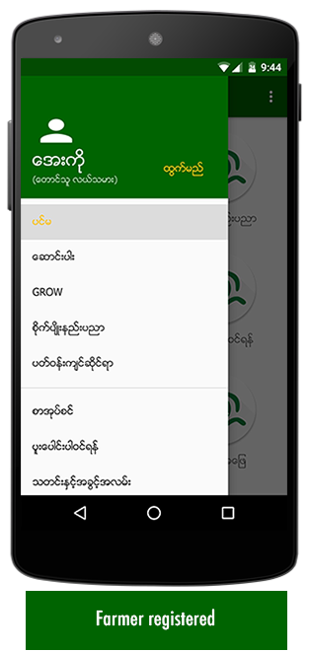
Different user group has different access based on the location

Slide 5
Connecting the question with right experts
Question 1
Question 2

Slide 6
Cropping guidelines by location
Paddy Farmer
Different variety
Different growing method
Paddy Farmer
Different variety
Different growing method

Slide 7
Survey by region and user types

Slide 8
Useful Address by locations
Check Useful address
Call number
Know location
Know info of institutions

Slide 9
Farming Record (released last week)
Farmers can record their plots and enter various expenses
Future, enable farm location and entry location for better traceability

Slide 10
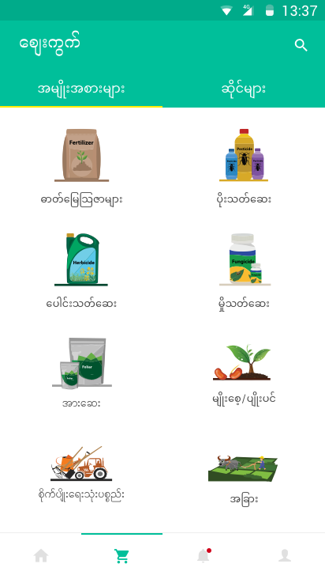
Market Place (near future)
Connect with buyers in their nearby townships
Shops location and farmers location used
Payment gateways integrated (supported by FHI360)

Slide 11
What should we focused!
Be visionary but with practical steps easy for farmers to understand
Critically important for training farmers in digital literacy
Later employ AI for image detection and big data

