Slide 1
Wash Cluster / Kachin and North Shan states Clashes

Slide 2
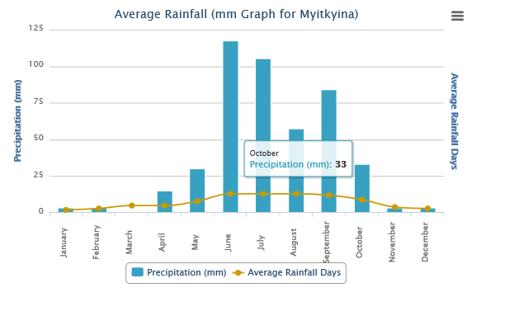
Wash Cluster / Kachin and North Shan states Water Shortage

Slide 3
Wash Cluster / Kachin and North Shan states Cross line missions
Mai Ja Yang | 31st March – 5th April 15 | WASH report | HK distribution in Dum Bung
Lana Zup Ja and Bum Tsit Pa | 25 to 29 April 2015 | OCHA
Chipwi & Pan War | 22 -26 April 2015 |  | HK distribution
Border Post 8 and Post 6 Camps | 27th -30th April 15 | OCHA report | HK distribution

Slide 4
Wash Cluster / Kachin and North Shan states WASH actors coverage
155 IDPs camps
55 camps not currently targeted by WASH Focal agencies (35%)
18090 IDPs not targeted out of a total of 74001 (24%)
End of may : 73 IDP camps
End of June: 119 IDP camps

Slide 5
Wash Cluster / Kachin and North Shan states WASH actors coverage

Slide 6
Wash Cluster / Kachin and North Shan states Planning Monitoring framework Capacity Building
Impact
Outcome
Outputs
Activities
Contribute to enhancing the capacity of the affected community to be able to manage and sustain the WASH services in IDP camps, host communities, schools, and health centers
Increased technical capacity of Local NGOs and gov’t authorities to be able to respond to emergency WASH needs in accordance with Sphere standards and WASH cluster strategy
WASH partners’ Technical knowledge and skill on Emergency WASH response and preparedness enhanced monitoring
Best practice and lessons learning documentation improved
WASH standards and technical guidelines developed and shared with WASH cluster
Improved quality of WASH data in IDP camps
Technical trainings related to water, sanitation and hygiene; Proposal development; Project planning, monitoring, and reporting; Provide Tools/templates for project planning, monitoring, and reporting;
Provide template for best practice documentation. Review the best practices and provide technical feedback; organizing workshops for sharing best practices
Establish TWGs, Develop ToR with the TWGs; Provide technical guidance during TWG meetings, review products of TWGs and provide feedbacks
Develop tools for WASH Data collection and analysis; and provide technical guidance and, training to WASH monitors,

Slide 7
Wash Cluster / Kachin and North Shan states Monitoring
 | Activity | Product | WASH actor in charge | Frequency | Exit strategy
I | Mapping of geographical WASH needs coverage | 4W | WASH focal agencies & WASH cluster team | Monthly | RRD
II | WASH camp profiling | Camp profiling including WSP | WASH cluster team and one Local NGO for the NGCA | Complete round every 6 months | Hand over to RRD and DRD
III | Water quality monitoring | Water quality monitoring report | WASH sector with data consolidation by WASH cluster team | Monthly | Hand over to DoH
IV | WASH response evaluation /Assessment | IDP camp evaluation | WASH cluster team accompanies by WASH focal agencies and local authorities | On a need basis with a minimum of 1 evaluation per month | Archived on MIMU website
Desludging
WASH NFI
TWG

Slide 8
Wash Cluster / Kachin and North Shan states AOB
Desludging
WASH NFI
TWG

