Slide 1
Using MIMU Map Maker
2022

Slide 2
Contents
Basic Concepts
Map Maker in MIMU Home Page
MIMU terms and conditions
Map Maker Layout
Tools
Layers
Legend
Add Data
Basemap Gallery
Draw on Map
Add Customized Text on Map
Measurement
Coordinates Conversion
Printing Map
Sharing Map
About
Sources
2

Slide 3
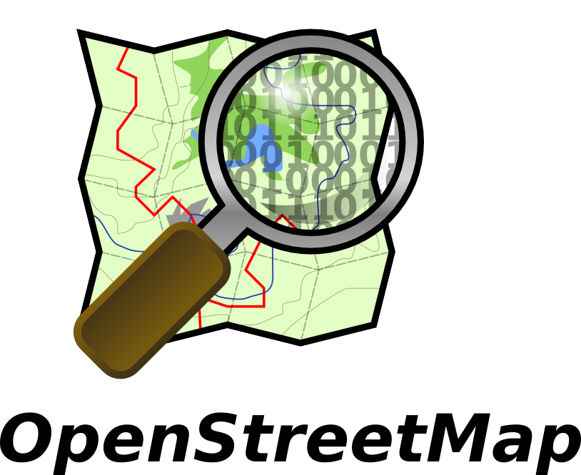
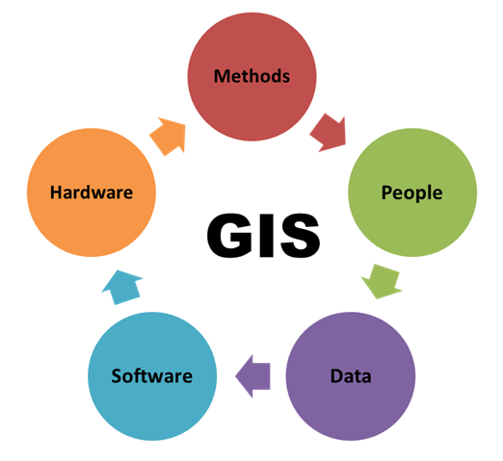
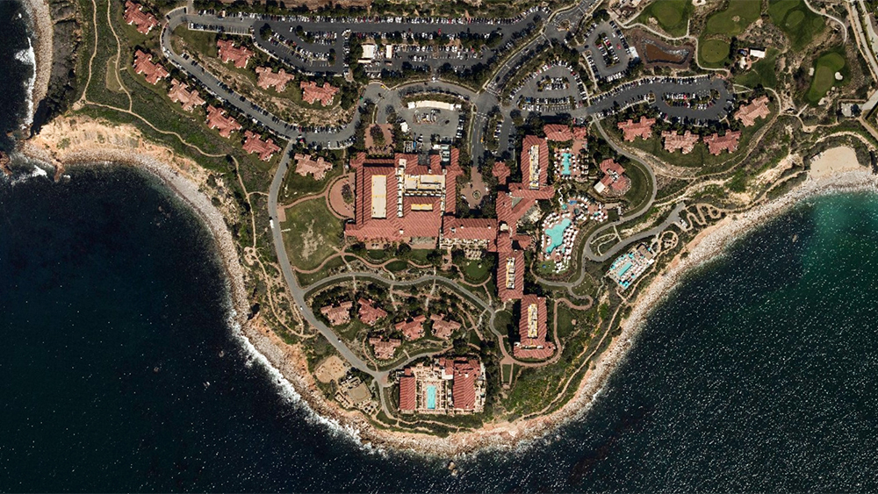
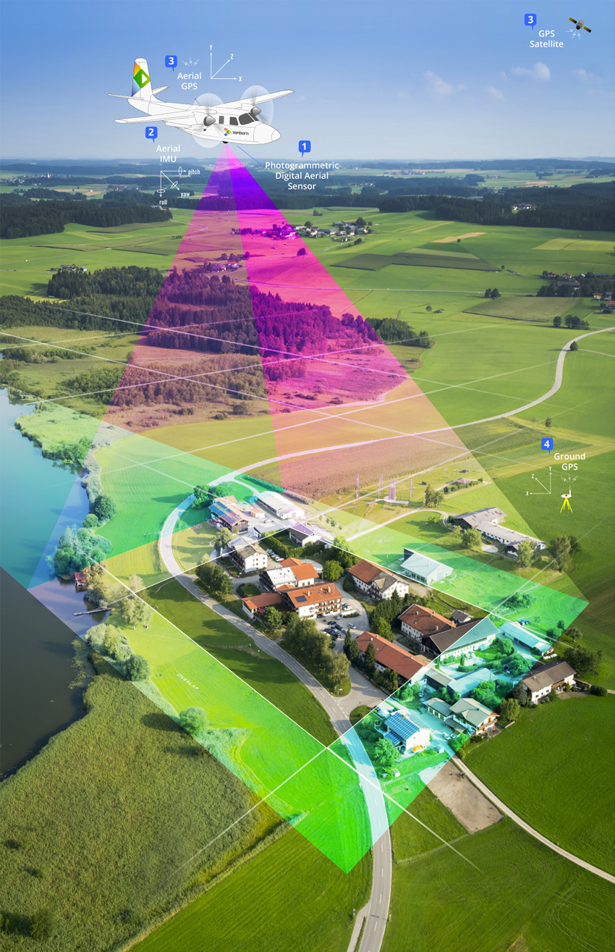
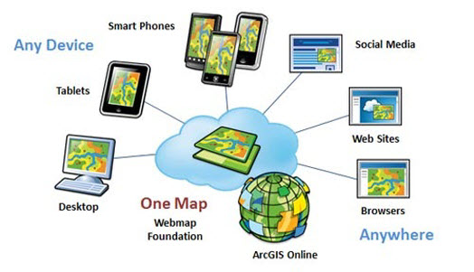
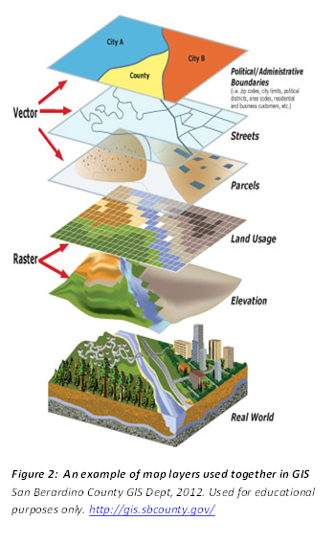
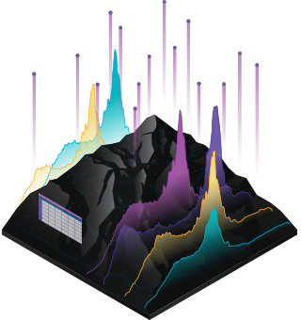
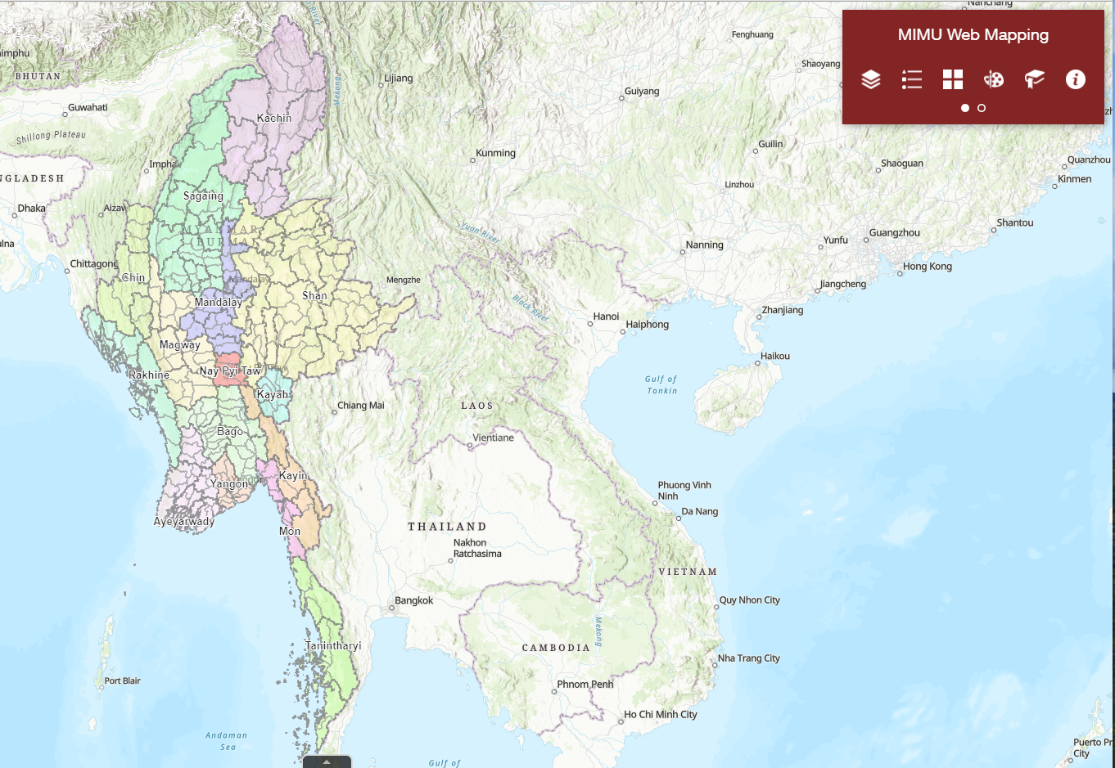
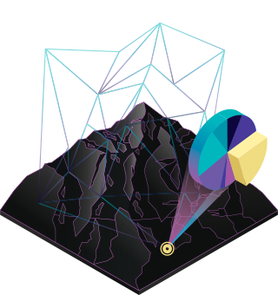
Basic Concepts – Web Mapping
A Web mapping or an online mapping, is the process of using the maps delivered by Geographic Information Systems (GIS) on the Internet.
GIS
Web Maps/Apps
Popular Platforms
3

Slide 4
Basic Concepts – MIMU ArcGIS Online
What is ArcGIS Online?
Open data platform for maps and geographic information
Collaborative, Cloud-based Platform
Integral Part of the ArcGIS system
Includes WebApps, WebMaps and Geospatial Layers
Use within an organization or share with larger communities and/or public
MIMU Map Maker is an intuitive WebApp based on the ArcGis online catalog and creates immersive experiences that take maps from a static view to an opportunity for users to explore. Enhanced details and new perspectives spring from the map as you zoom in, search, and interact with the data
How can we access ArcGIS Online?
Can access through web browsers & mobile devices (Chrome, Mozilla Firefox, Safari 3 and later, Microsoft Edge, Chrome for Android, iOS Safari)
Can create Public Account for everyone
What can we do with ArcGIS Online?
Build interactive maps
Share your maps with specific groups or everyone
Create web apps with your maps for a focused, interactive experience
Work effectively across your organization to build and use maps
Understand your data in the context of location by using intuitive analysis tools
Print the Map Layout

Slide 5
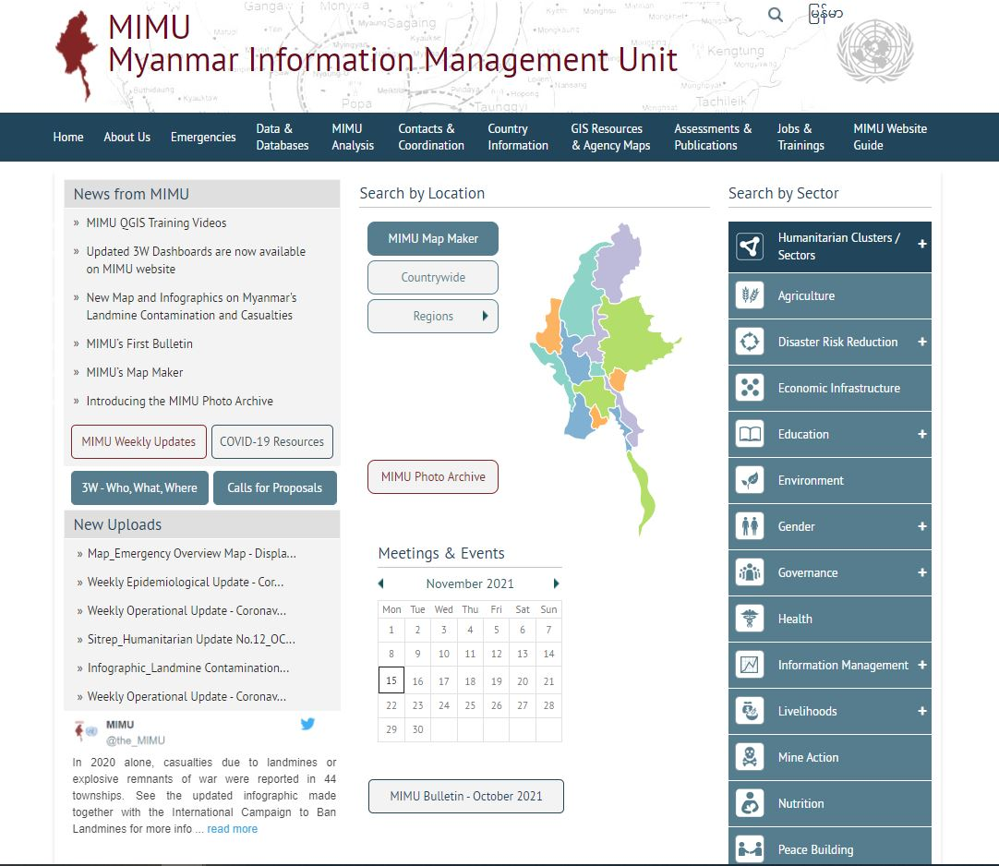
Map Maker in MIMU Home Page
Go to MIMU Home Page
https://www.themimu.info/
Click on MIMU Map Maker

Slide 6
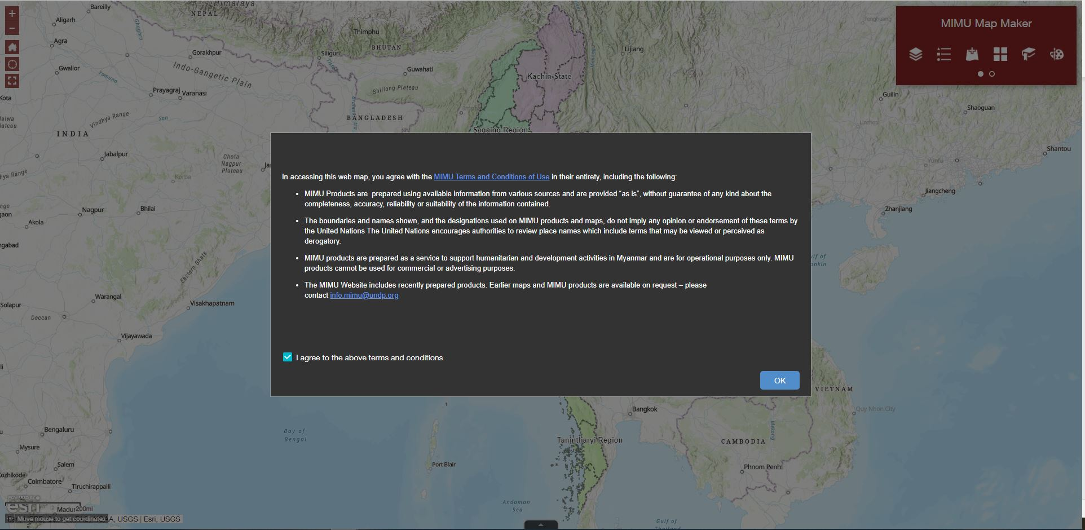
Agree to the MIMU terms and conditions
Please read and agree the terms and conditions, click “I agree to the terms and conditions” and click “OK” to continue

Slide 7
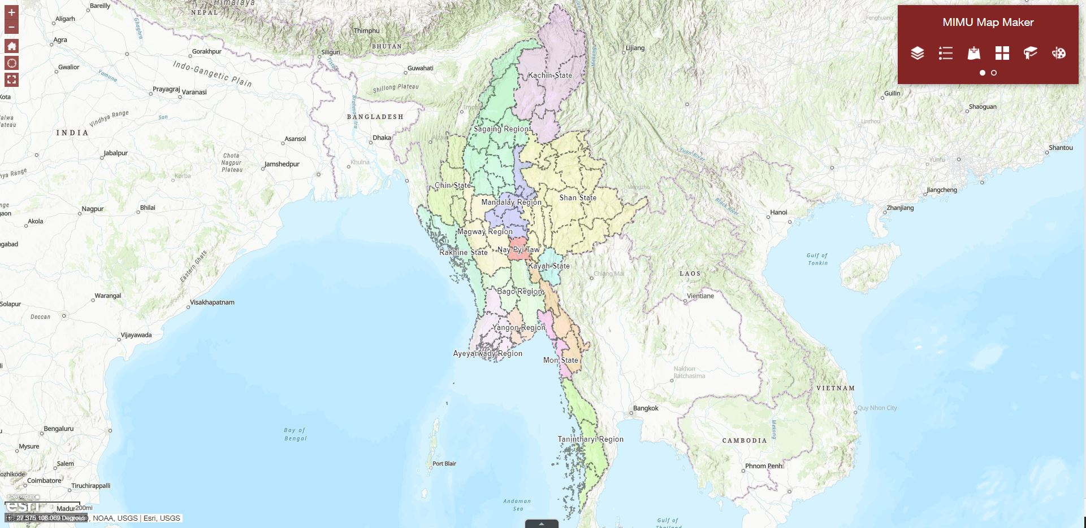
Map Maker Layout
Navigation Buttons
Tools window (a.k.a. Widgets)
Divided in 2 groups:
1st Group:
Layers
Legend
Add Data
Basemap Gallery
Bookmark
Draw
2nd Group:
Measurement
Coordinate Conversion
Print
Share
About
Scale and Coordinates
Attributes Table

Slide 8
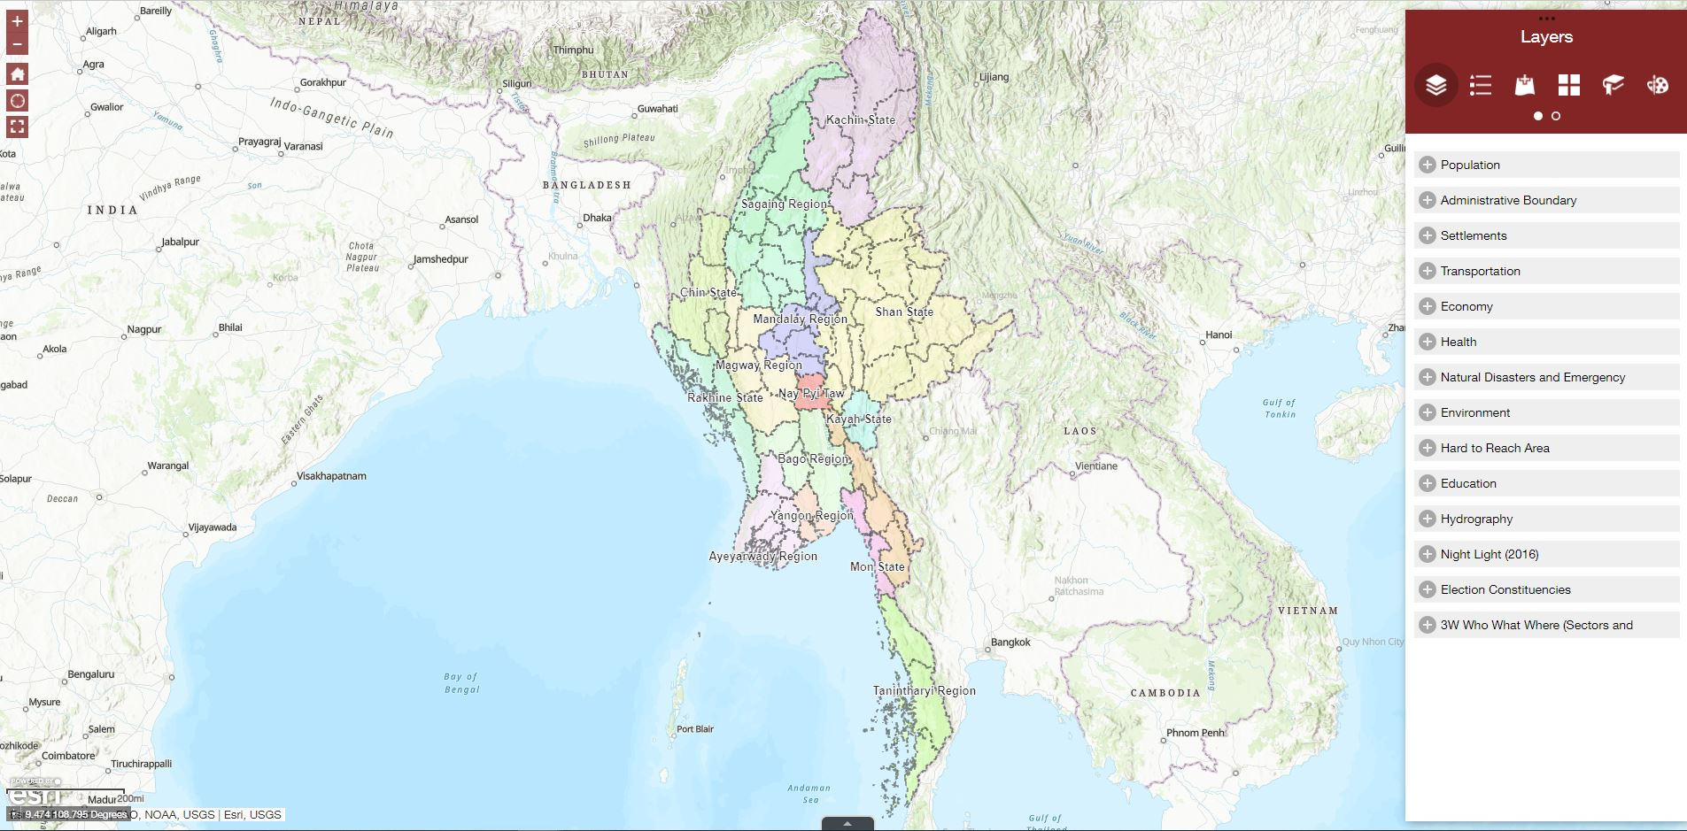
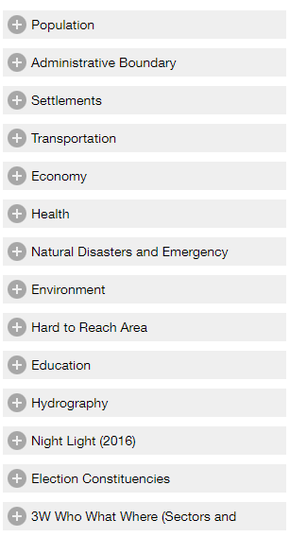
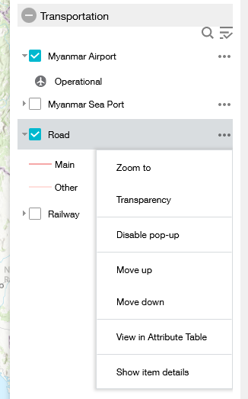
Layers
Layers Button
You can see the list of operational layers, their symbols and allows to turn individual layers on and off. Each layer in the list has a check box that allows you to control its visibility. Some layers contain sublayers or subtypes.
Thematics Available
Layers list
Click the three dots on the right side of a layer to display the layer menu with the following options:
Zoom To—Sets the map extent to the extent of the layer.
Transparency—Sets the transparency for the layer.
Enable /Remove Pop-up—Enables or disables the pop-up when click layer on the map.
Move up/down —Moves the layer one level up/down.
View attribute table—Opens the attribute table for the feature layer.
Show Item Details—Opens the metadata and description or the layer if available.

Slide 9
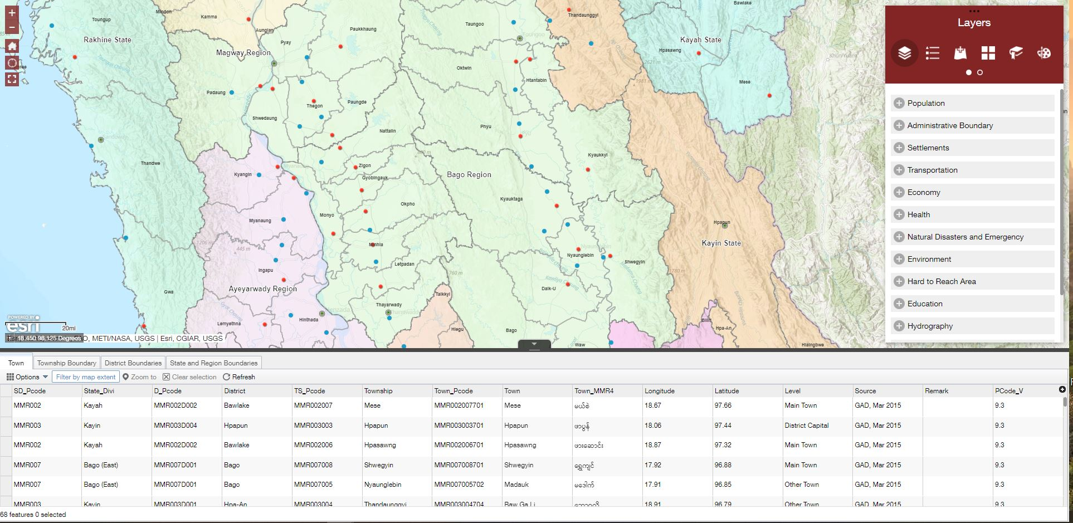
Layers
Click here to show (or) hide the Layer Attributes Table

Slide 10
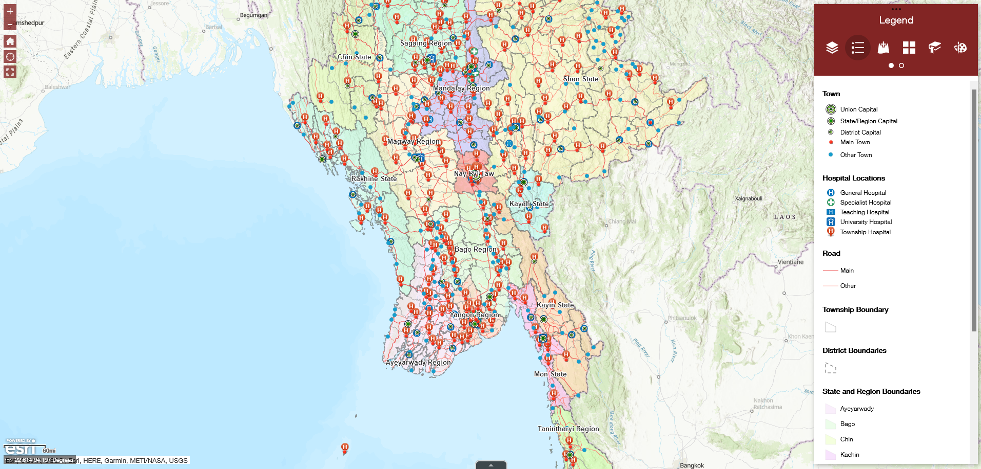
Legend
Legend Button
Clicking the button, displays the Legend window showing labels and symbols for layers in the map. It supports dynamic, tiled, image, feature, and KML (Google Earth) layer types as well as WMS (Web Map Service) layers with an associated legend URL.
Legend window

Slide 11
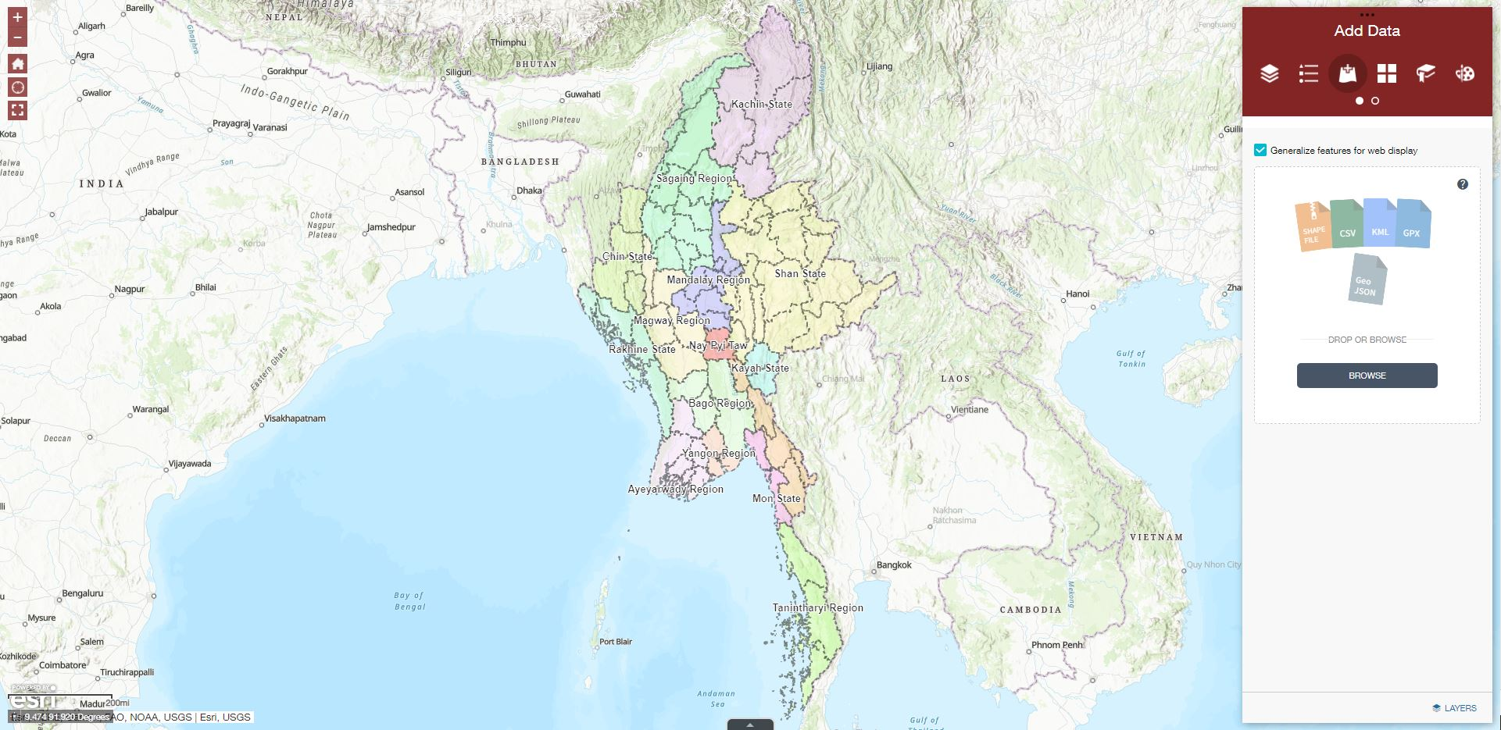
Adding Data
Add Data Button
Allows you to add data to the map by uploading local files, entering URLs or searching for layers in ArcGIS content. You can temporarily add layers to and remove layers from the map. However, you can't save the layers to the map; when close or refresh your browser, those will be deleted.
Add Data window
Click to browse your own data (shapefile (zip), CSV, KML, GPX, Geo JSON) or Drag and Drop the layers.
NOTE: If you add a layer that has a spatial reference different from that of your basemap, the added layer might not be visible.
Click on this to see data layer that you browsed

Slide 12
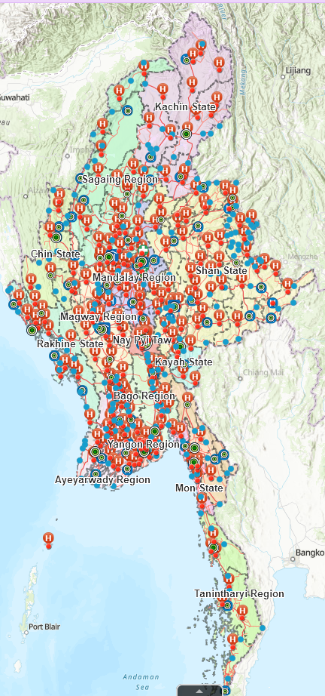
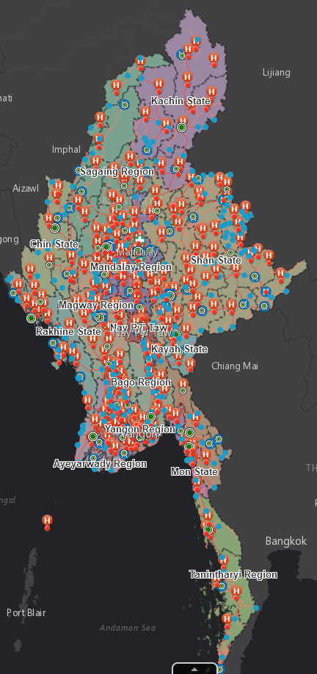
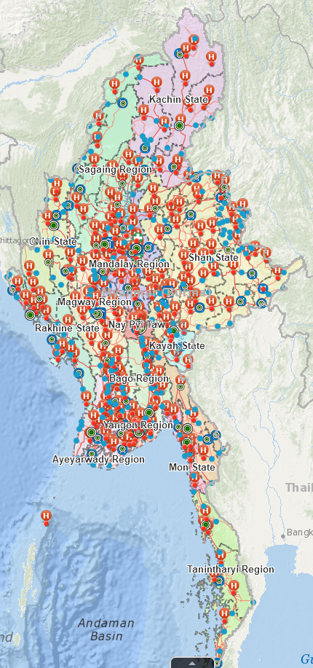
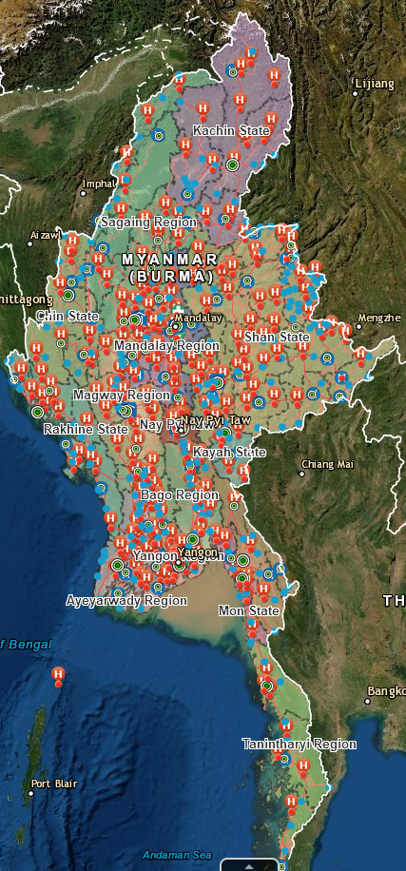
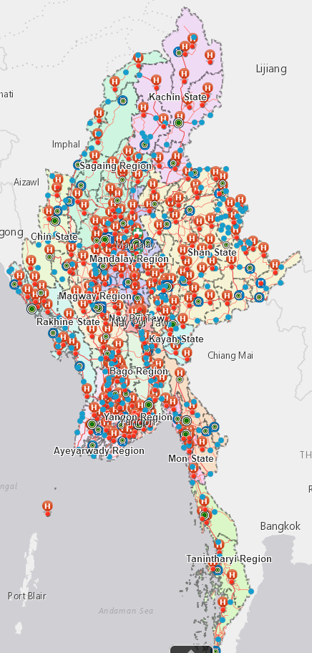
Basemap Gallery
Basemap Gallery Button
Presents a gallery of basemaps and allows you to select one.
Basemap Gallery list
Clicking a basemap thumbnail, sets it as the active basemap.

Slide 13
Bookmark
Bookmark Button
Stores a collection of map view extents
Myanmar State and Regions are listed to be chosen
Click on this button to add customized bookmarks or shortcuts to your places.
NOTE: The newly added bookmarks are saved in your web browser's cache. They will be removed after you clear your browser cache.
Bookmark list
You can click the state or region you want to see and will be displayed on the map.
Click here to rename your customized bookmark

Slide 14
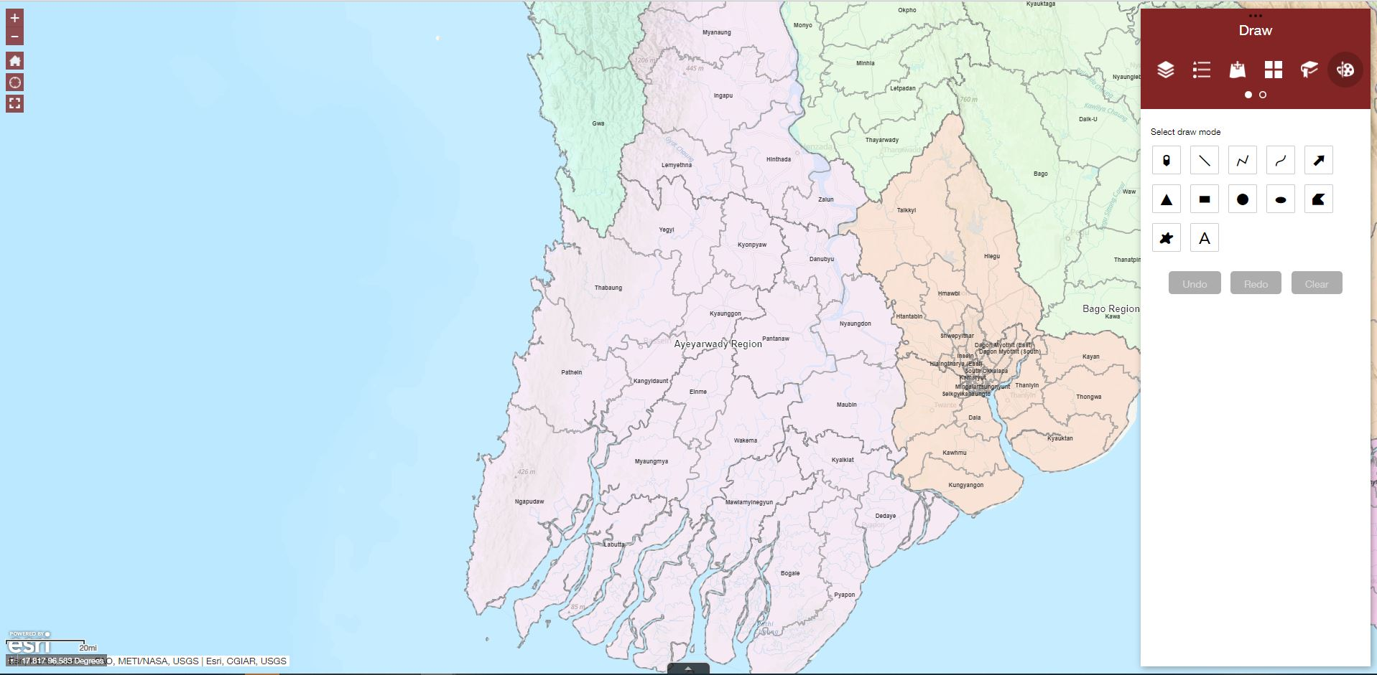
Draw on Map
Draw Button
Allows you to draw simple graphics and text on the map. You can also use it to add line distance or polygon area to the feature as text
Draw window
Contains the following drawing tools:
Point
Line
Polyline
Freehand polyline
Arrow
Triangle
Rectangle
Circle
Ellipse
Polygon
Freehand polygon
Text
Click Undo or Redo to cancel or repeat your drawings or click Clear to remove them all from the map.

Slide 15
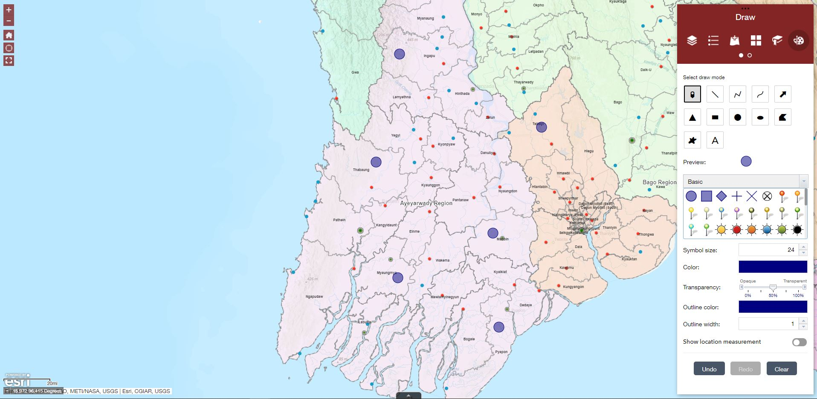
Draw Points on Map
Click to select the drawing mode Point
Select the marker category (different symbols are available in each category) to set the symbol size, color, transparency, outline color, outline width.
Draw the desired features on the map.
Click Undo or Redo to cancel or repeat your drawings or click Clear to remove them all from the map.

Slide 16
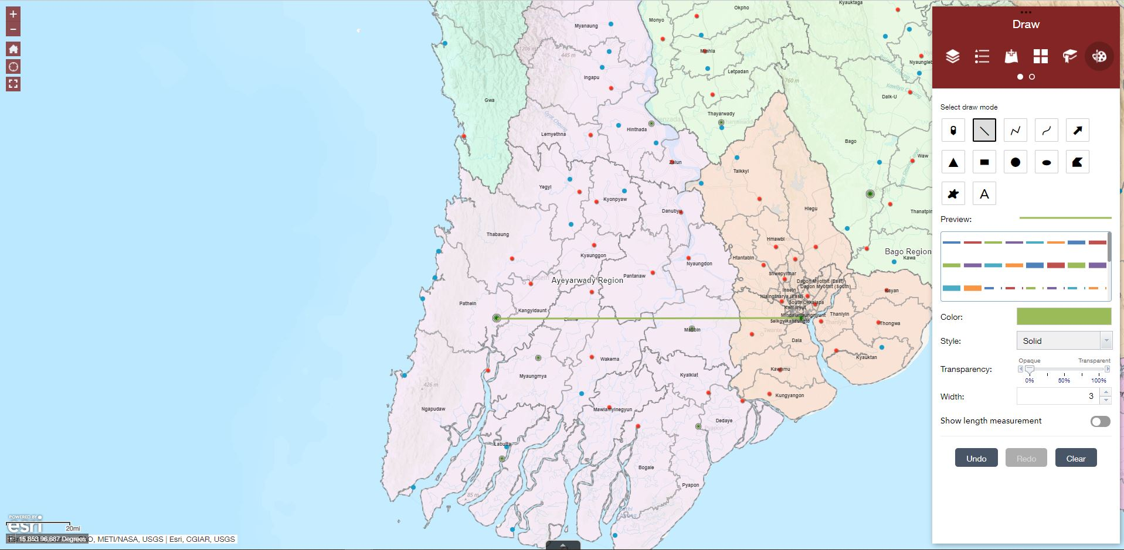
Draw Lines, Polylines and Freehand Lines on Map
Click to select the drawing mode:
Lines or
Polylines or
Freehand polyline
Length: 33 Miles
Select a predefined type of line to set the color, style, transparency, width; whether show the length measurement, unit and font style.
Draw the desired features on the map.
Click Undo or Redo to cancel or repeat your drawings or click Clear to remove them all from the map.
Length: 199.8 Kilometers

Slide 17
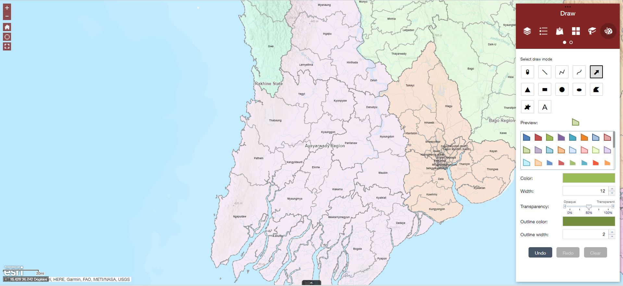
Draw Arrows on Map
Click to select the drawing mode Arrow
Select a predefined type of line to set the color, width, transparency, outline color and outline width.
Draw the desired features on the map.
Click Undo or Redo to cancel or repeat your drawings or click Clear to remove them all from the map.

Slide 18
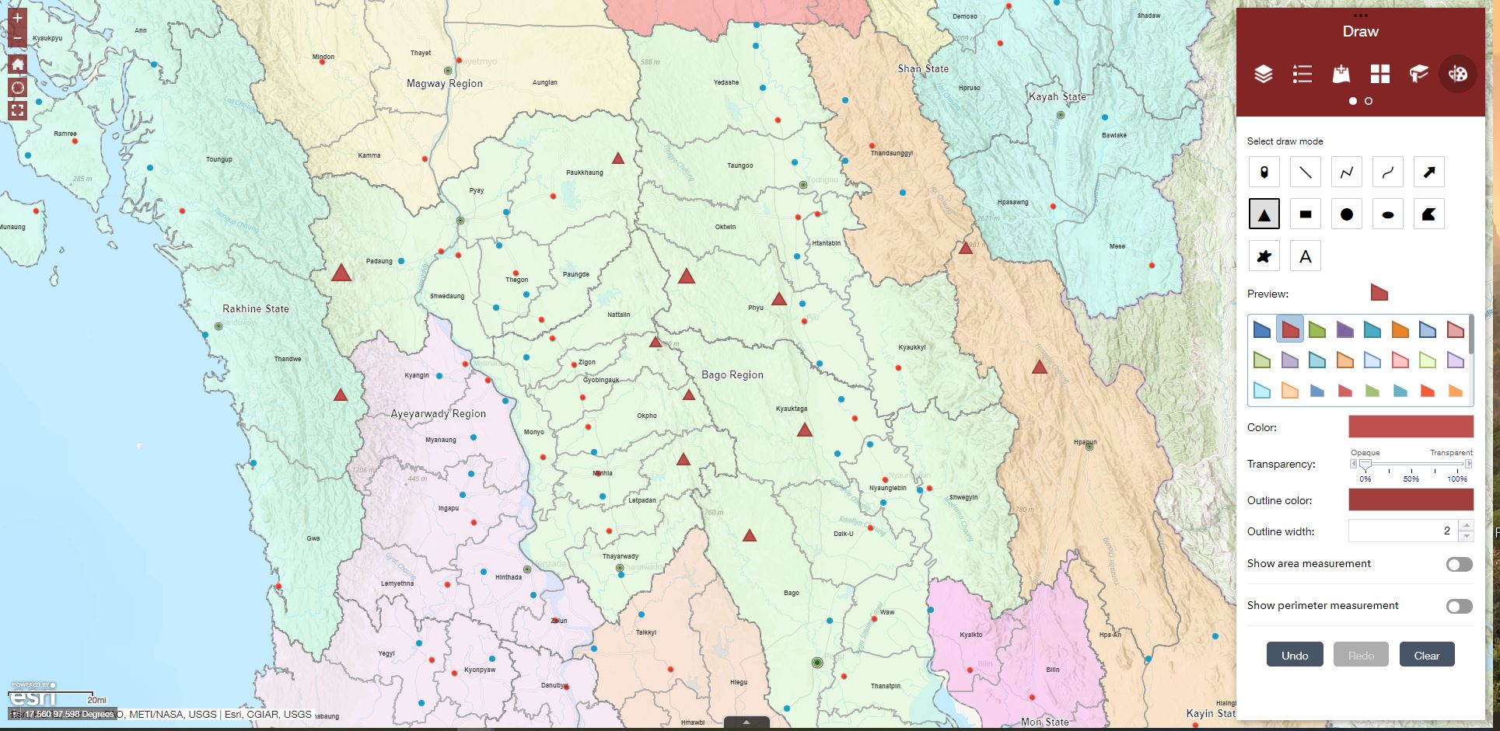
Draw Triangle, Rectangle, Circle, Ellipse, Polygon, Freehand polygon on Map
Click to select the drawing mode
Triangle
Rectangle (Extent)
Circle
Ellipse
Polygon
Freehand polygon
Select a predefined type of line to set the color, width, transparency, outline color and outline width.
Draw the desired features on the map.
Click Undo or Redo to cancel or repeat your drawings or click Clear to remove them all from the map.

Slide 19
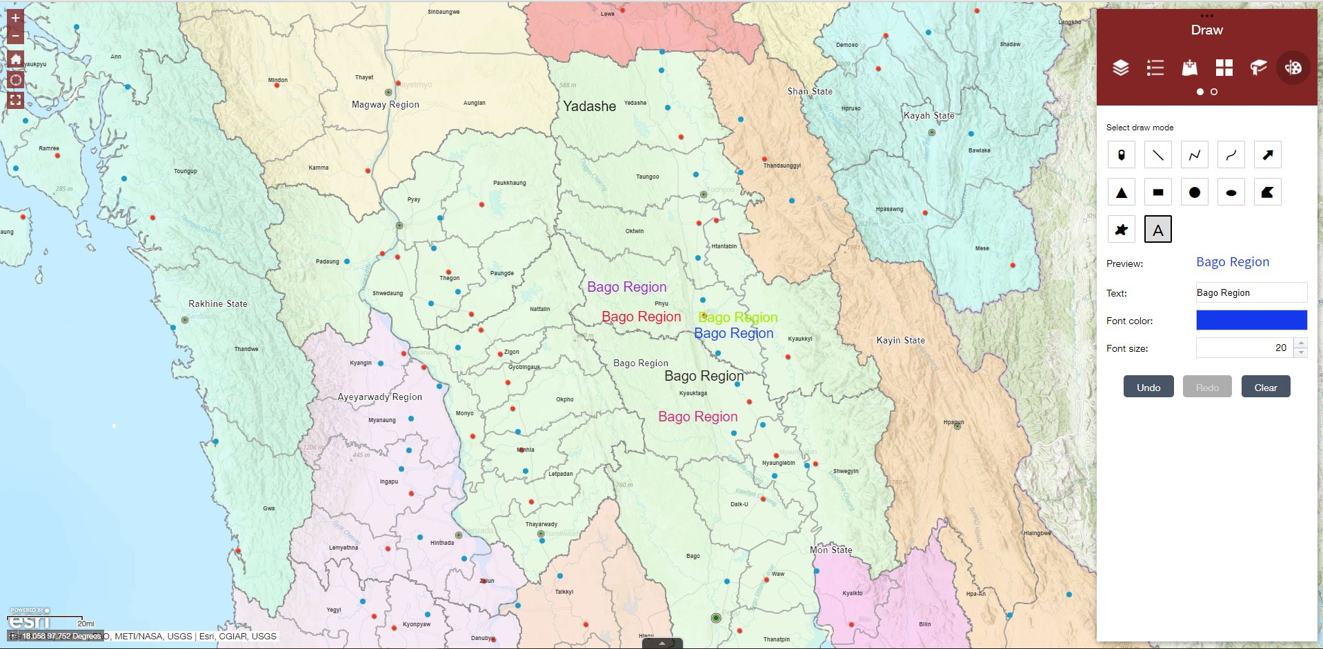
Add Customized Text on Map
Click to select the drawing mode Text.
Type the text and select the font color and size.
Project Area
Bago Region
Impact communities
Click to add the text on the map.
3W Report
Click Undo or Redo to cancel or repeat your text or click Clear to remove them all from the map.

Slide 20
Click the page navigation button to go to second tools group.
Tools window (Widgets)
2nd Group:
Measurement
Coordinate Conversion
Print
Share
About

Slide 21
Measurement
Measurement Button
Allows you to measure the area of a polygon, length of a line or find the coordinates of a point.
Measurement window
Area
Distance
Location
To delete the measurement graphics, open the measurement tool and select Clear.

Slide 22
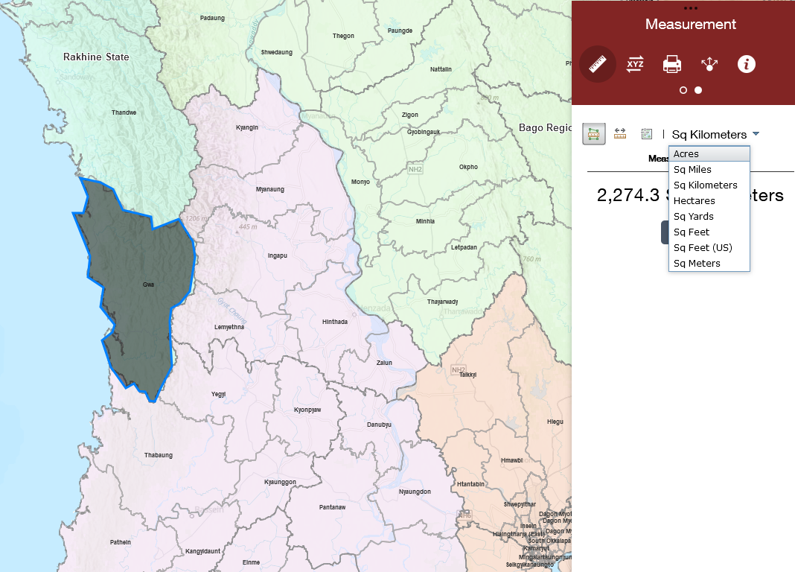
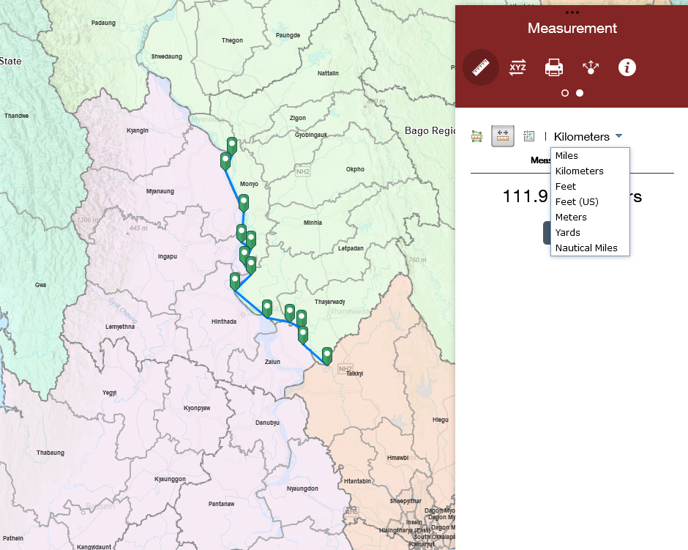
Measure the Area or Distance on Map
AREA
DISTANCE
Click the Area button.
Draw a polygon on the map by clicking three or more points.
Double-click to finish drawing the polygon.
Click the Distance button.
Draw a polyline on the map by clicking two or more points.
Double-click to finish drawing the polyline.
To change the area unit, select the applicable unit of measure.
To change the length unit, select the applicable unit of measure.

Slide 23
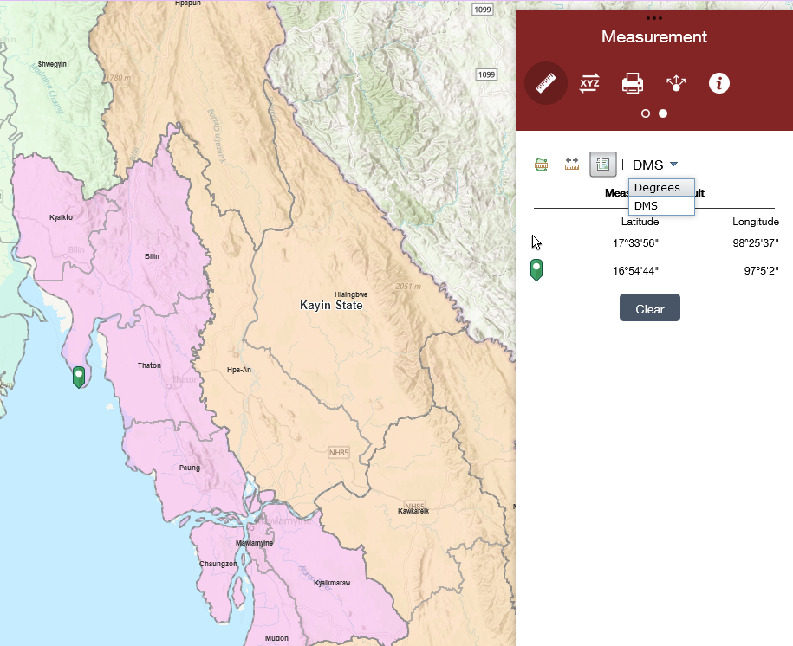
Measure the Location on Map
Click the Location button.
Click a location on the map.
To change the coordinate display format unit, select between Degrees or DMS (Degrees/Minutes/Seconds).

Slide 24
Coordinate Conversion
Coordinate Conversion Button
Allows you to input coordinates using one coordinate system and output to different coordinate systems using multiple notation formats:
DD - Decimal Degrees
DDM – Degrees Decimal Minute
DMS - Degrees Minutes Seconds
Military Grid Reference System (MGRS)
Universal Transverse Mercator (UTM)
Global Area Reference System (GARS)
Output Coordinates window
You can see, copy and edit your results

Slide 25
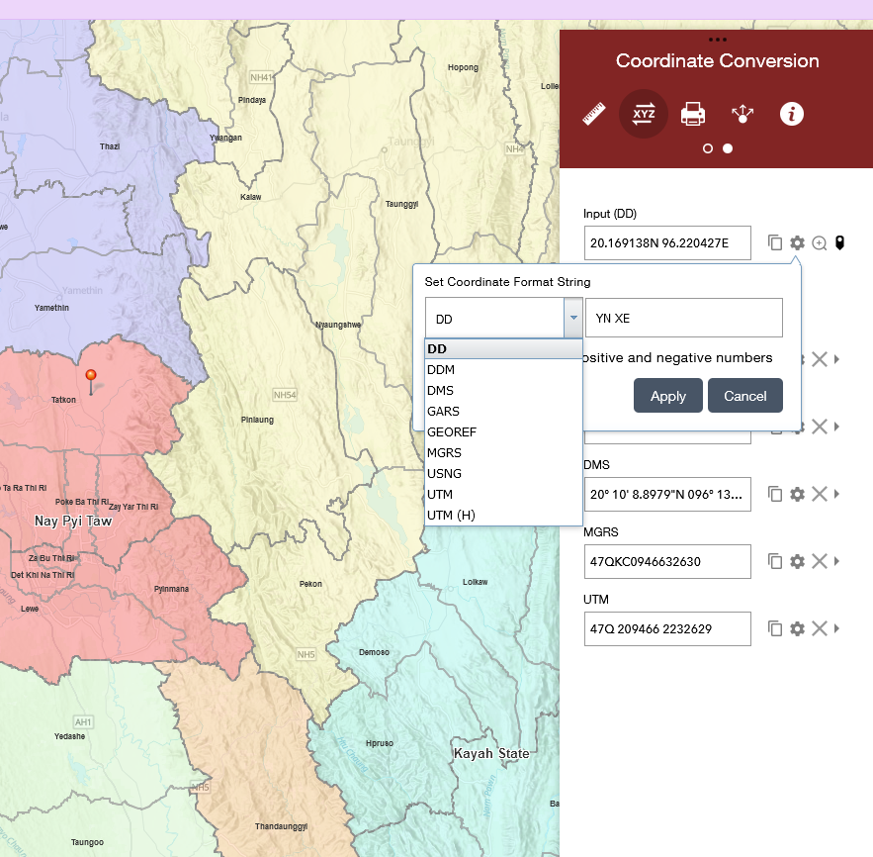
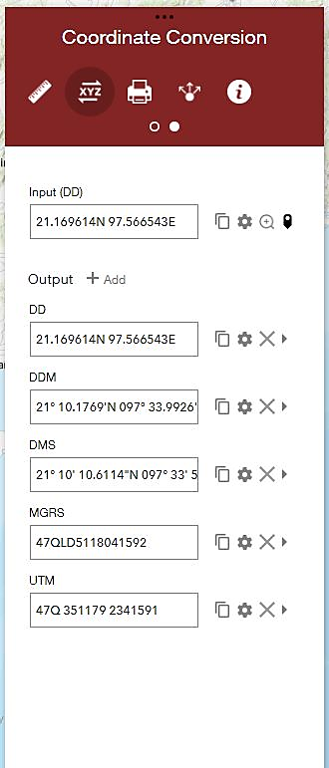
Coordinate Conversion
Before input coordinates:
Set the input coordinate format you want from the drop-down list.
Edit the text box to change the notation of the input coordinate format.
Check the check box if want use a +/- for coordinates in the Northern / Southern or Eastern / Western hemispheres.
To input coordinates:
Type or paste coordinates and press Enter.
or
Click a location on the map.
Click the Zoom button to zoom to the input coordinates.
You can copy input coordinates.
1
2
Output coordinates:
Conversion is automatic.
Click if want copy output coordinates.
You can set the output coordinate format you want from the drop-down list.
Click if want remove additional formats. X

Slide 26
Printing the Map
Print Button
Allows to print the current map.
Print window
Type a title for the map in the Map title text box.
Select the applicable Layout and Format for the exported map.
Note: MAP_ONLY format prints only the map, omitting any marginal information from the output.
Select the applicable Layout and Format for the exported map:
PDF (georeferenced), PNG32, PNG8, JPG, GIF, EPS, SVG, SVGZ

Slide 27
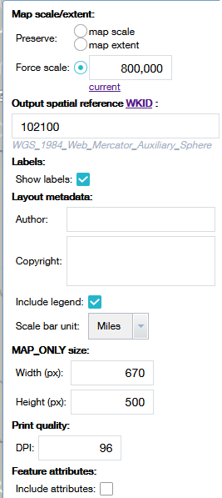
Printing the Map
Click Advanced to open a menu with advanced print options:
Map scale/extent . Choose Preserve map scale, Preserve map extent or Force scale. Click current to populate the value with the present scale of the map.
Output spatial reference WKID. Allows to define the output spatial references of the print by specifying a valid well-known ID (WKID).
Check the Show labels check box if want to display the labels on the printed map.
Layout metadata. Allows to type the Author name and not allowed for the Copyright.
Check the Include legend check box if want to display the legend on the printed map. Users can choose the Scale bar unit in the drop-down list.
If the MAP_ONLY size: format is selected, you can provide dimensions for the Width and Height properties in pixels. Otherwise, these values are ignored.
Print quality. Allows you to update the resolution of the printed map. Provides an updated value for the DPI (dots per inch) in the text box
Feature attributes. Allows to display a table of features and their attributes.

Slide 28
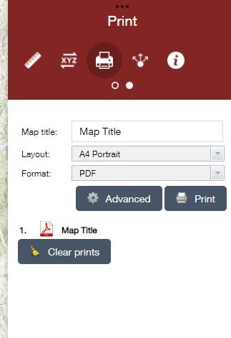
Printing the Map
Click Print. After all options have been set.
A progress bar displays next to the executing task.
Click the task to open the file in a new window.
Click Clear prints to clear the print history.

Slide 29
Sharing the Map
Sharing Button
Allows you to share the map by posting it to your social media account, sending an email with a link, or embedding it in a website or blog.
Sharing window
Copy the short link under Share a link to this app and paste it into your email, instant message, and so on. You can also use the provided buttons to post your app to your Facebook, Twitter, or Google accounts, or in an email.
In the Link options, users can select URL parameters included in the link.
You can copy the HTML code from Embed this app in a website and paste it into your website. If you want, click Embed Options to choose the size of the app to be embedded.
Note: Drawings and uploaded layers will not be shared.

Slide 30
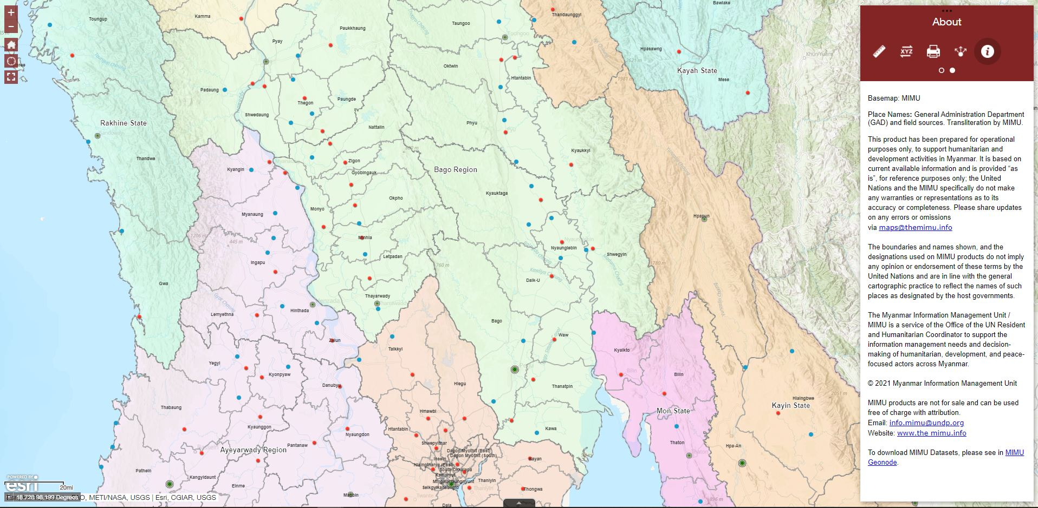
About
About
Clicking here you can see the MIMU info, contact, links and disclaimers related to the Map Maker.
About window
Basemap: MIMU
Place Names: General Administration Department (GAD) and field sources. Transliteration by MIMU.
This product has been prepared for operational purposes only, to support humanitarian and development activities in Myanmar. It is based on current available information and is provided “as is”, for reference purposes only; the United Nations and the MIMU specifically do not make any warranties or representations as to its accuracy or completeness. Please share updates on any errors or omissions via maps@themimu.info
The boundaries and names shown, and the designations used on MIMU products do not imply any opinion or endorsement of these terms by the United Nations and are in line with the general cartographic practice to reflect the names of such places as designated by the host governments.
The Myanmar Information Management Unit / MIMU is a service of the Office of the UN Resident and Humanitarian Coordinator to support the information management needs and decision-making of humanitarian, development, and peace-focused actors across Myanmar.
© 2022 Myanmar Information Management Unit
MIMU products are not for sale and can be used free of charge with attribution.
Email: info.mimu@undp.org
Website: www.themimu.info
To download MIMU Datasets, please see in MIMU Geonode.

Slide 31
Sources
MIMU Map Maker
https://app.themimu.info/mimu_mimumapmaker/
ArcGIS Online site
https://www.esri.com/en-us/arcgis/products/arcgis-online/overview
ArcGis WebApp site
https://doc.arcgis.com/en/web-appbuilder/create-apps/widget-about.htm
MIMU Website
https://www.themimu.info/
Myanmar Information Management Unit (MIMU)
Office of the United Nations Resident and Humanitarian Coordinator
No. 5, Kanbawza Street, Bahan Tsp, Yangon, Myanmar
http://themimu.info/

